Slide 1
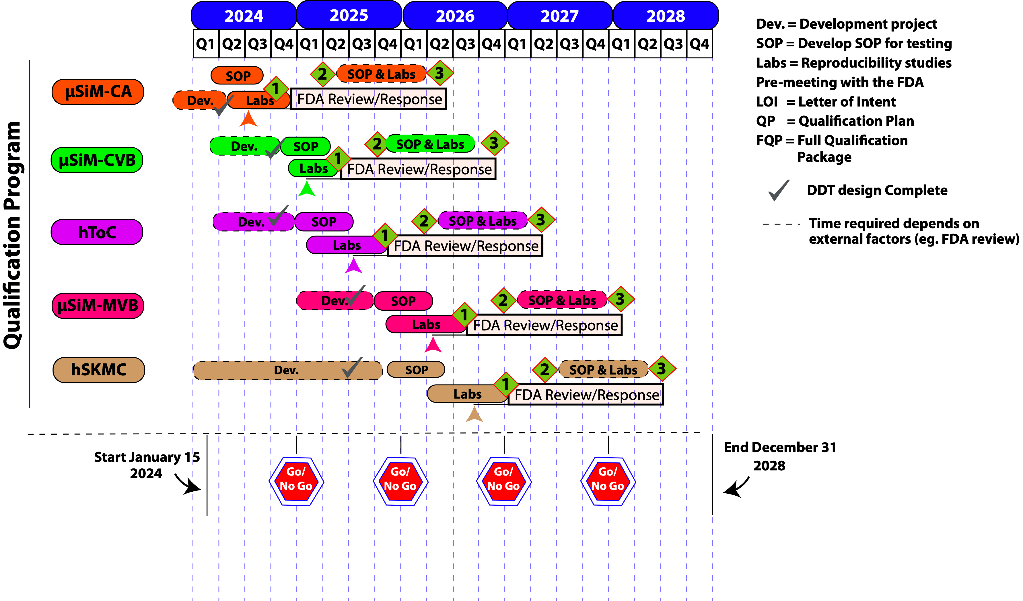

TraCe-bMPS Letters of Intent

Slide 2


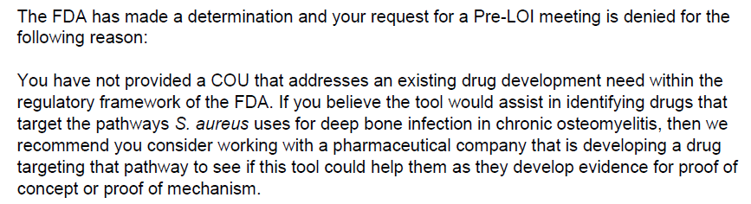

TraCe-bMPS Letters of Intent
Sent to FDA
µSiM - hMoC
Reply from FDA
Sent to C-Path
µSiM-CRS-ICANS
µSiM-CRS-ICANS
Patient Strat. COU

Slide 3

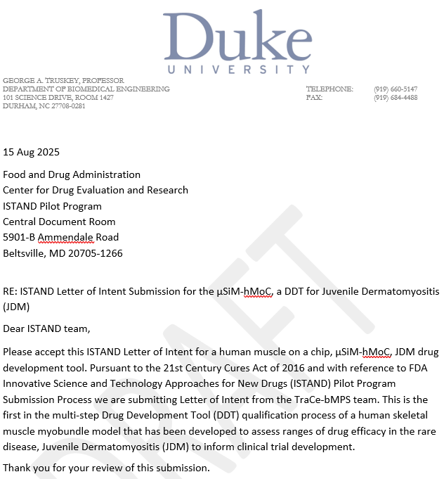
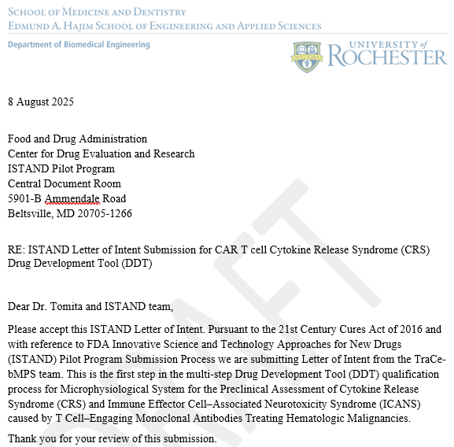
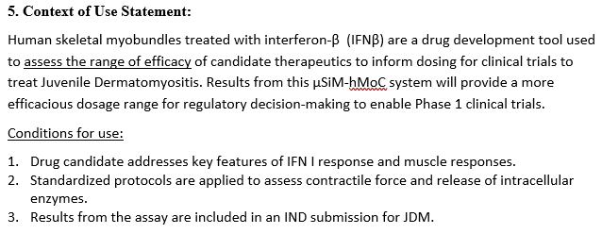
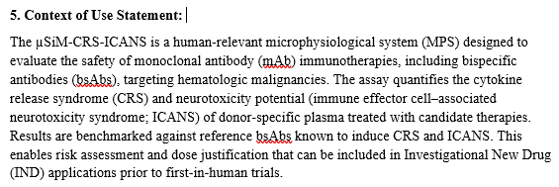
TraCe-bMPS Letters of Intent – Under review at C-Path

Slide 4
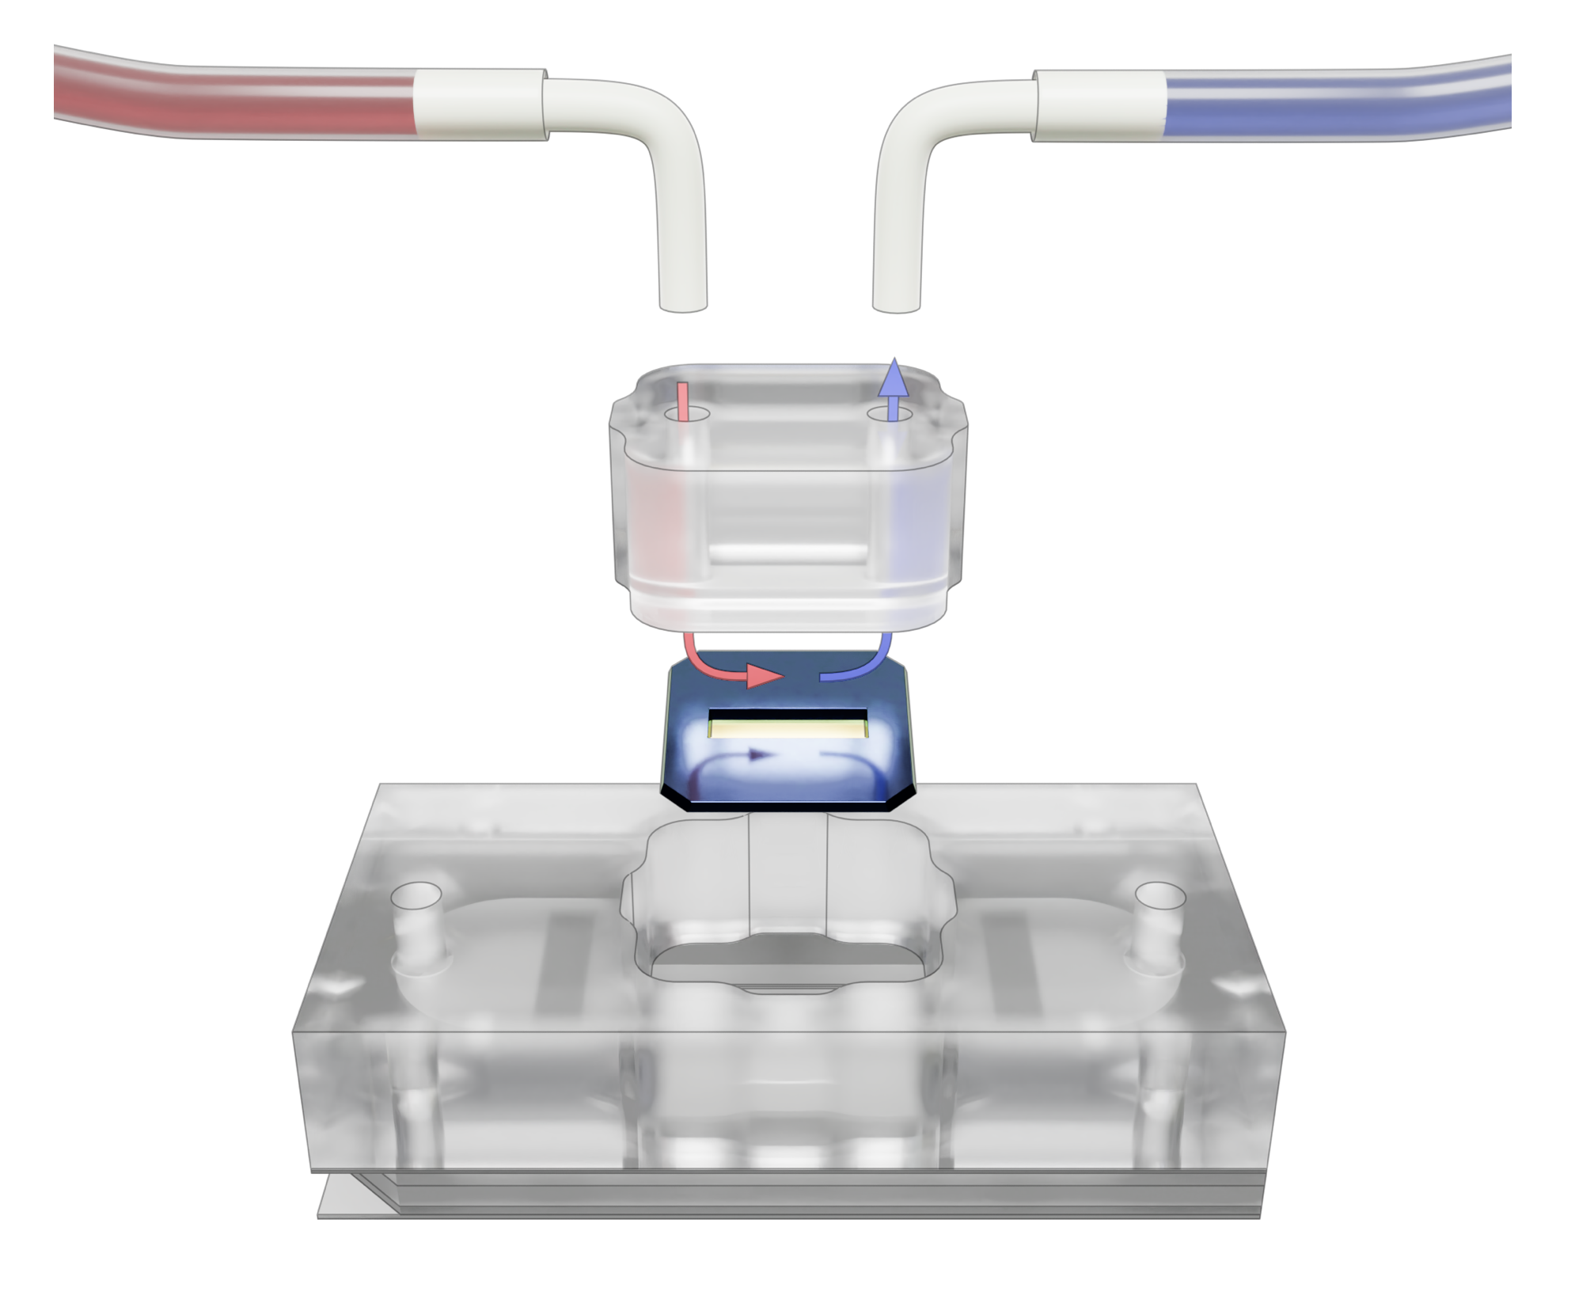
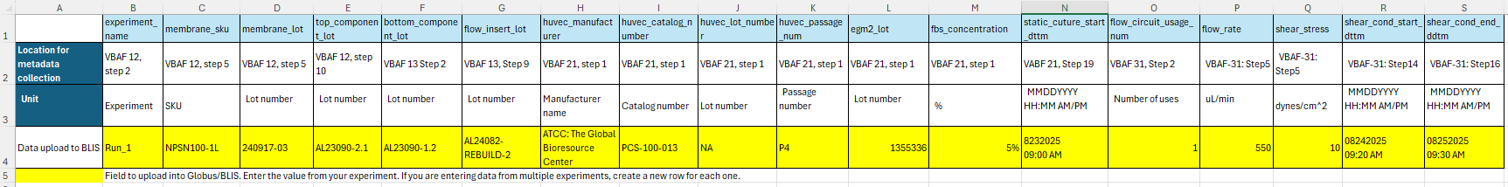
Vascular Barrier with Apical Flow (VBAF) Quality System – Metadata Collection Forms

Slide 5
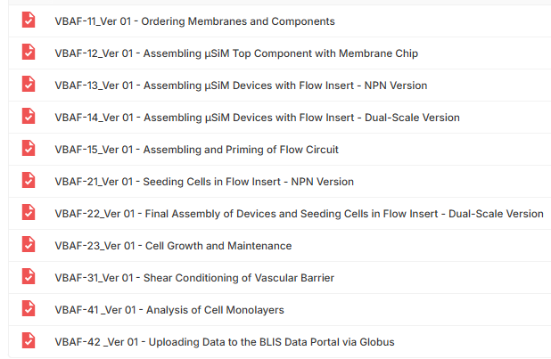
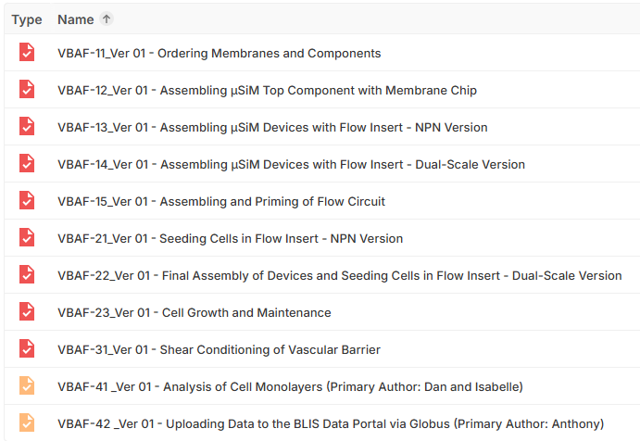
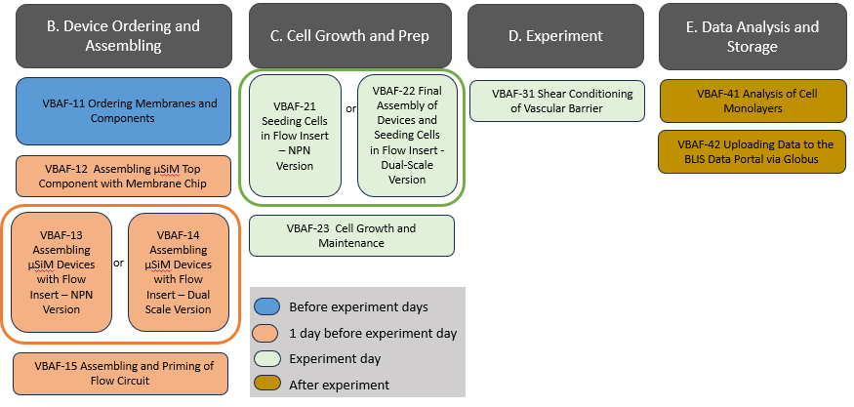
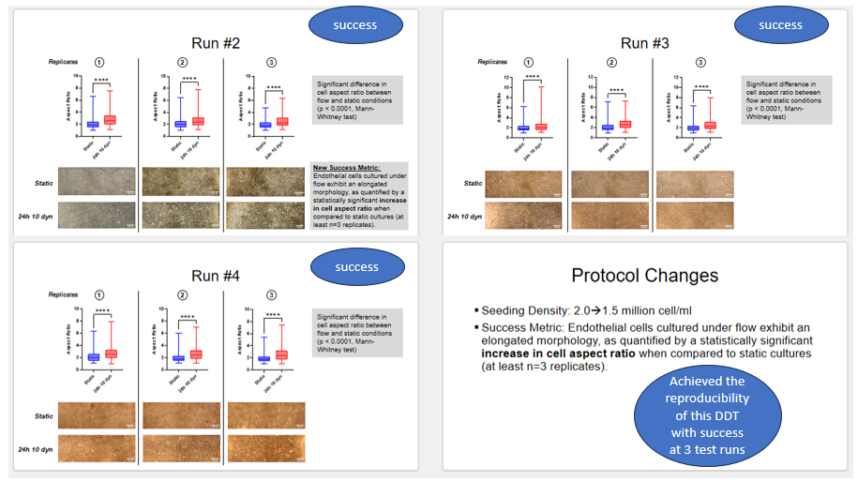
Vascular Barrier with Apical Flow (VBAF) Quality System
Reproducibility Testing
  Internal
    External @ RIT

Slide 6


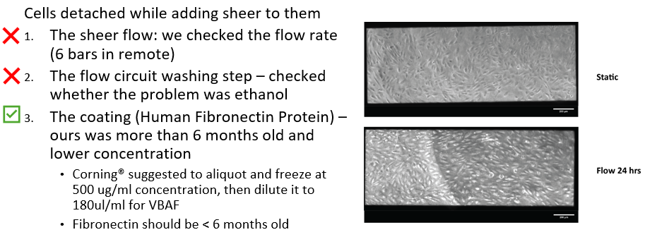
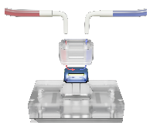
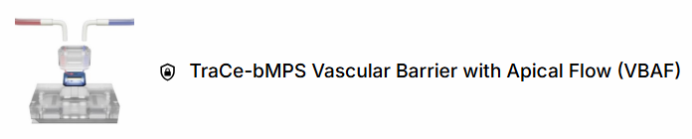

Vascular Barrier with Apical Flow (VBAF) Quality System
8 SOPs
9 SOPs
General Management and Training
Material Quality Control and Inventory process
11 SOPs
B. Device Ordering and Assembling
C. Cell Growth and Prep
D. Experiment
E. Data Analysis and Storage
Reproducibility Testing
  Internal
  External @ RIT
Training Management System for TraCe µSiM-VBAF project PID 30726
Trainee survey
Logging SOP training survey

Slide 7

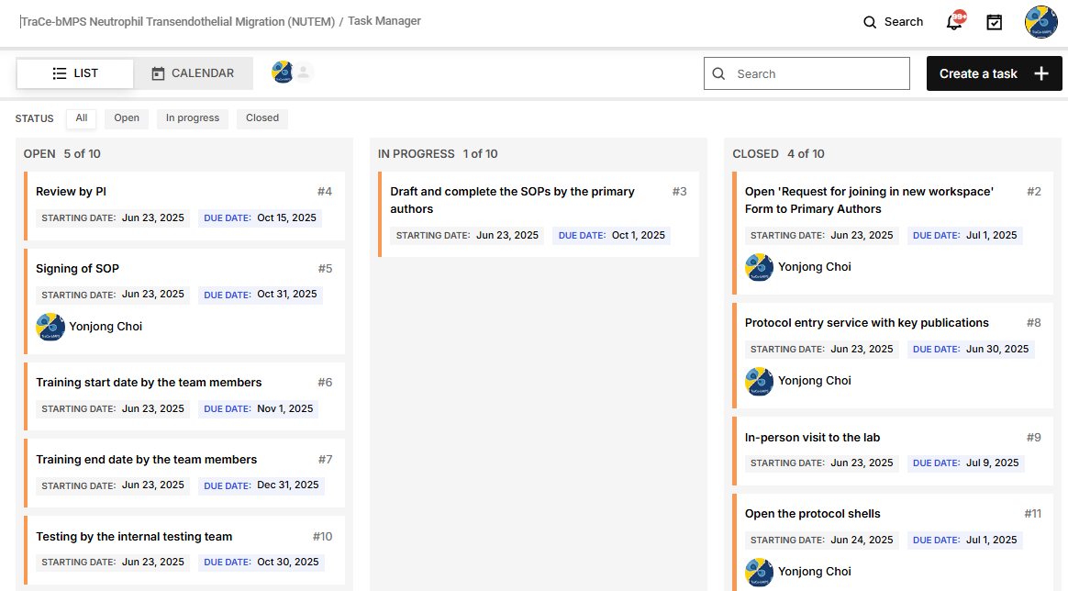
Two sample protocols were created based on previous research articles.
  Protocol entry service with Frontiers article
  Protocol entry service with Advanced Healthcare Materials article
11 protocols created from Frontiers articles. Dan and Arthur working at Main Folder of NUTEM workspace.
Development team | Testing team
Rochester: Danial Ahmad*, Emily Reitz, Arthur Masiukiewicz*, Ahmet Gurcan | Terrando (Duke) Gaborski (RIT)

