Slide 1

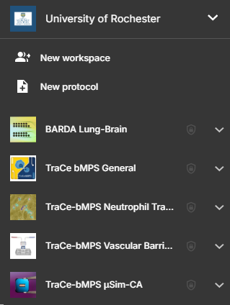


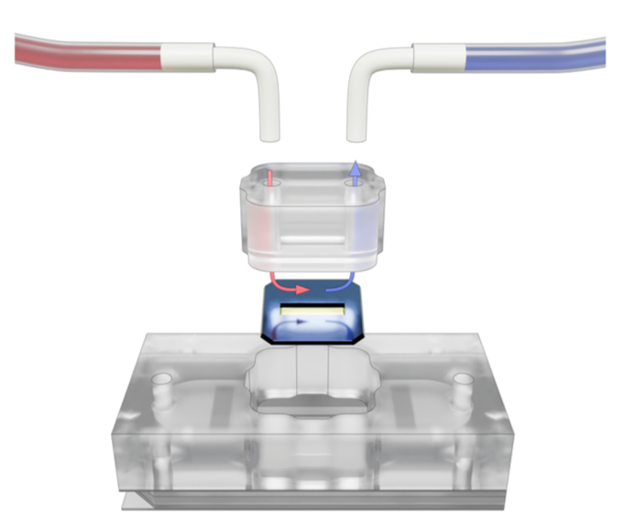
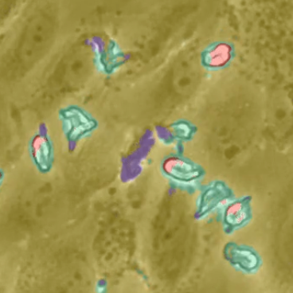
Quality Systems Update
27 June 2025 - TraCe Progress Meeting
Microfluidic silicon membrane canalicular array (µSiM-CA)
17 project-specific SOPS – completed and approved, ready to share
General Project Management (TraCe-bMPS)
9 Materials QC and Inventory SOPs – pending finalization
8 General SOPs – comments cleared, pending approval
Vascular Barrier with Apical Flow (VBAF)
11 project-specific SOPS – pending finalization
Neutrophil Transendothelial Migration (NUTEM)
Manuscript submitted to protocols.io for protocol entry service

