Slide 1
12 Month Progress
AFM on cells grown under flow

Slide 2
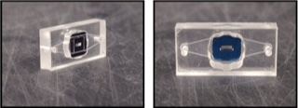
Standard A-line Configuration
Access port to lower channel
Access port to lower channel
Cells growing on membrane
𝜇SIM
Open well
Adhesive gasket layer
Gasket forming lower channel
Thin plastic base
Membrane chip
Lower channel

Slide 3
Inverted A-line Adapted for Flow in Lower Channel
Cells growing on membrane
Plastic base
Gasket forming ”lower” channel
Flow
𝜇SIM
Adhesive gasket layer
Flow
Flow
PDMS block
Supports tubing attachments
Upstream
Reservoir
Downstream
Reservoir
Pressure control port

Slide 4
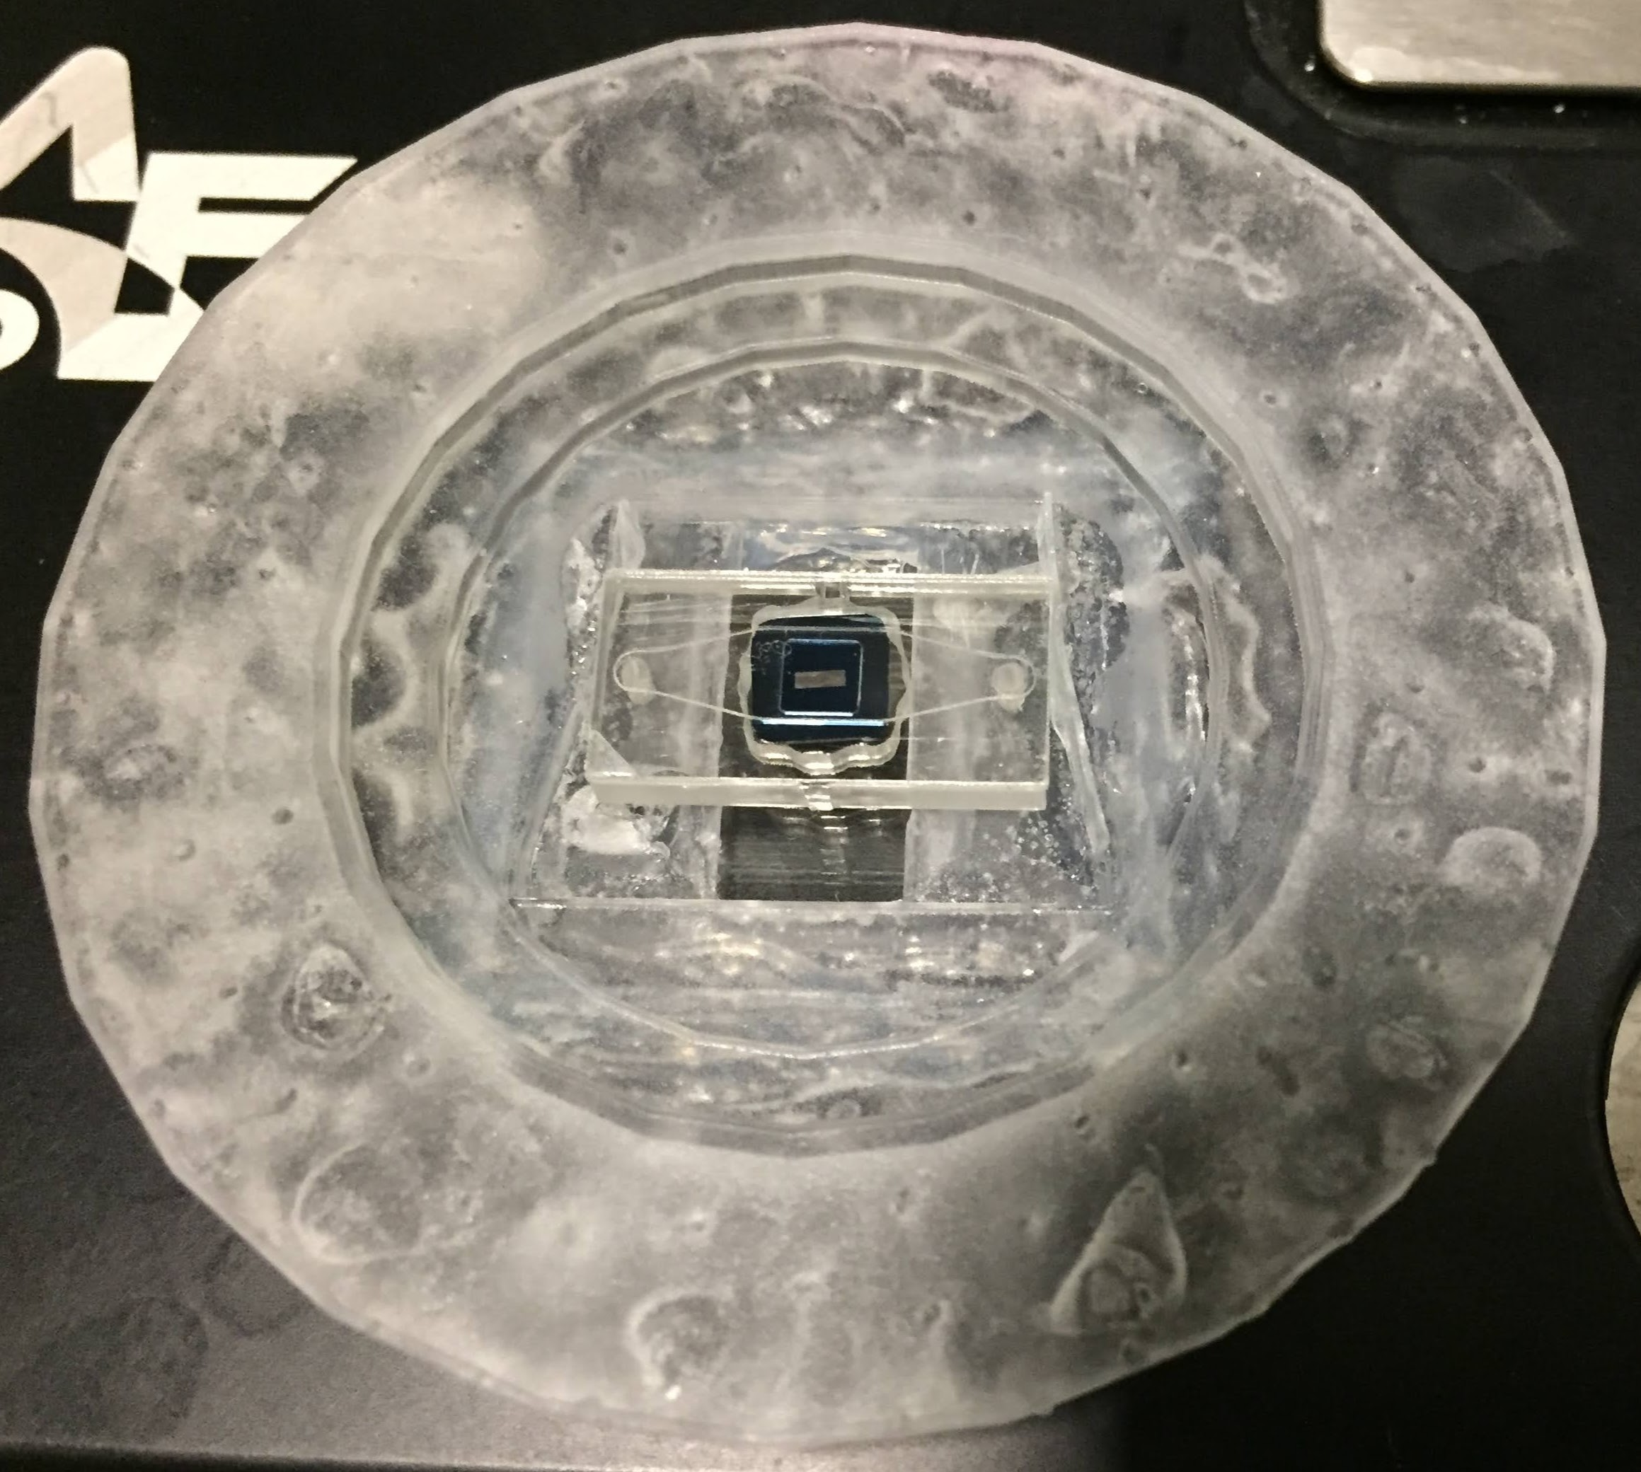

Slide 5
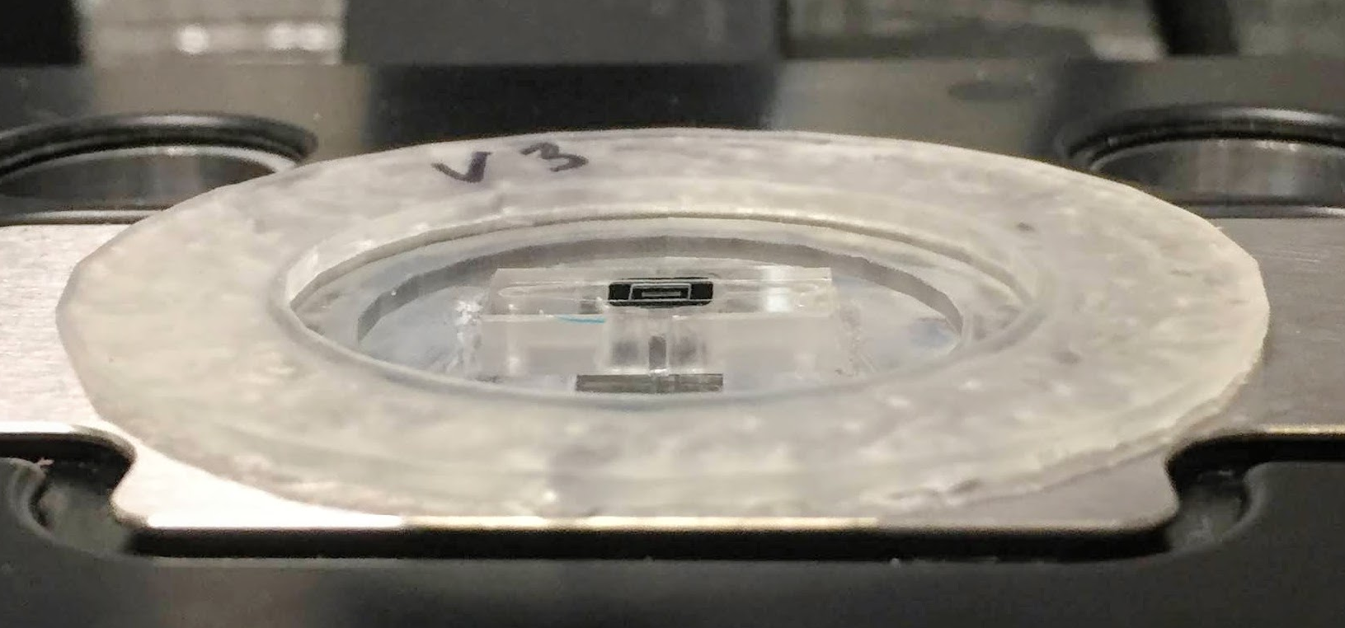
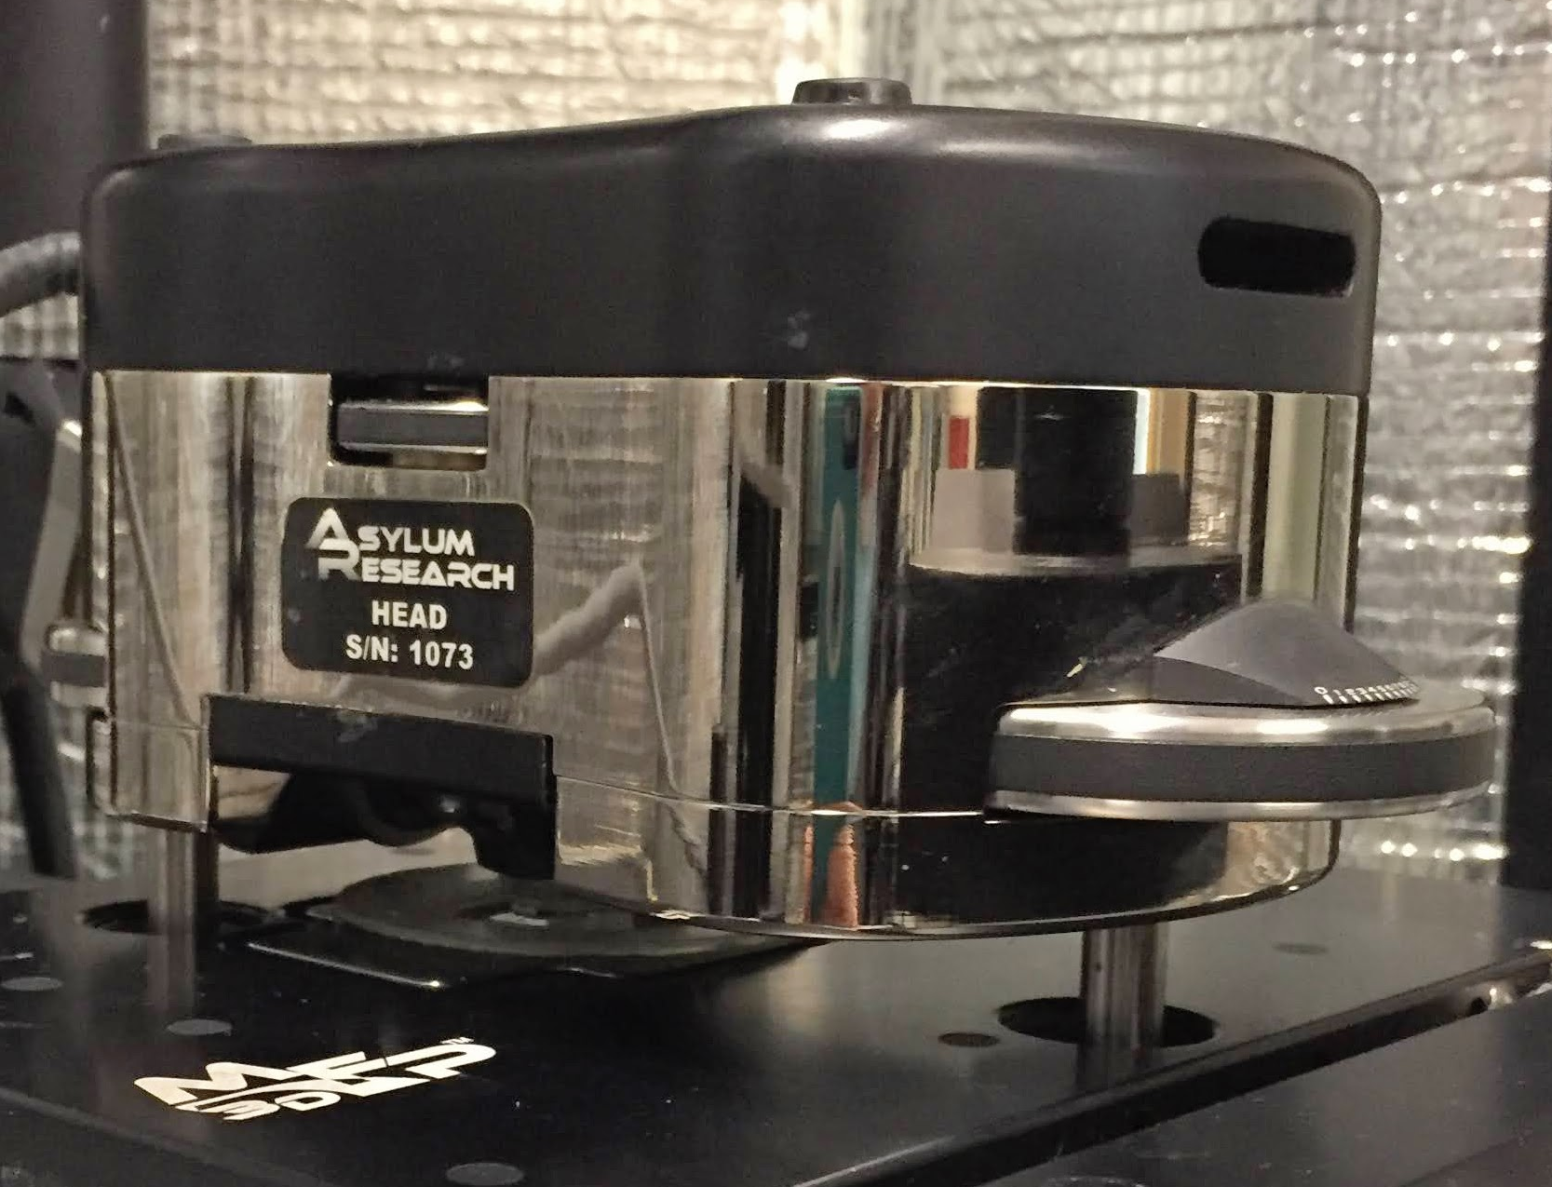
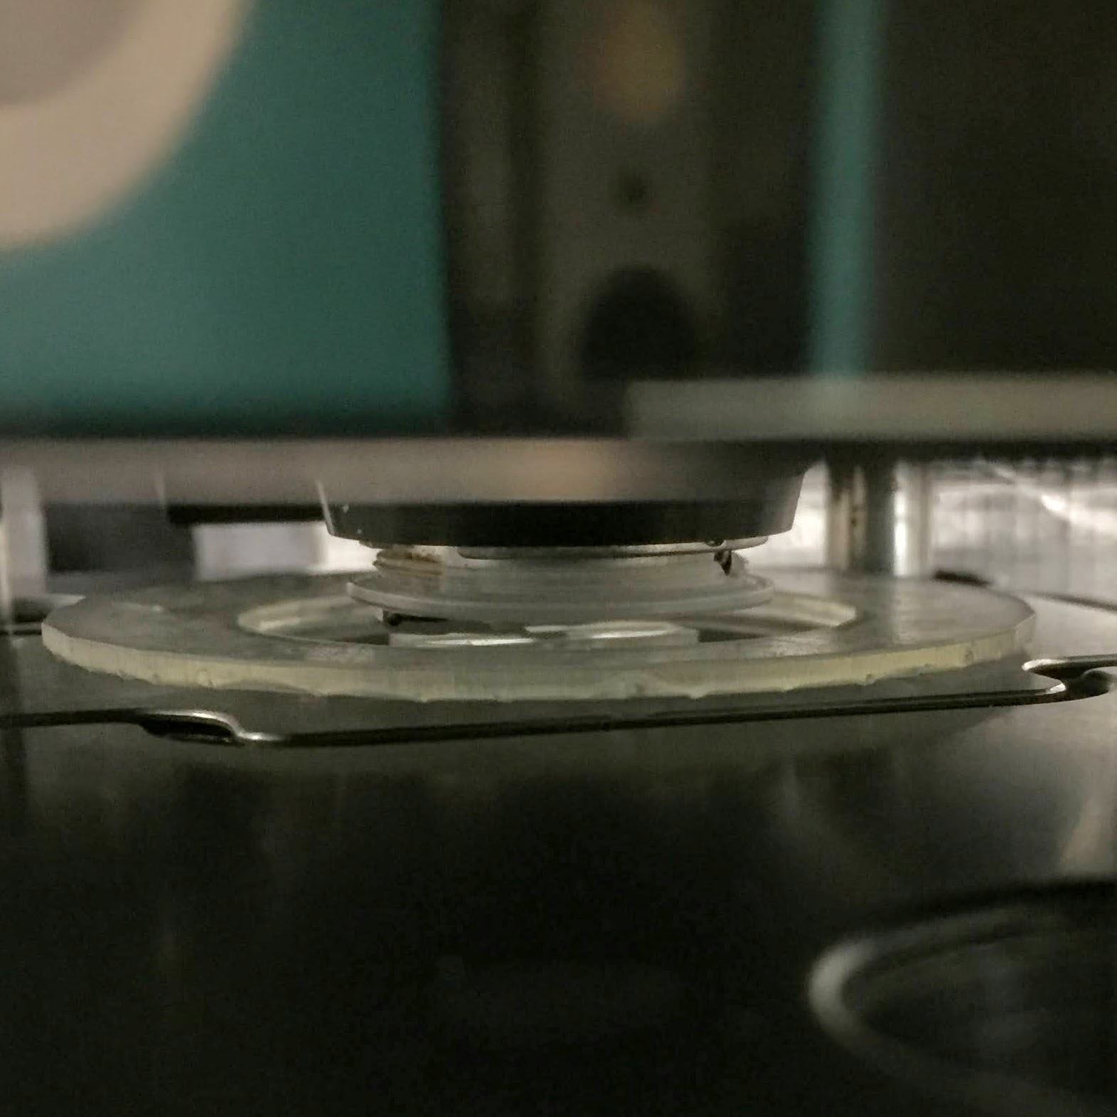
Fitting the A-line onto the AFM

Slide 6
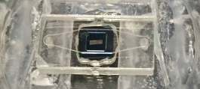
Inverted A-line Adapted for AFM Measurements
AFM Cantilever
Plastic base removed
Gasket forming ”lower” channel
Adhesive layer
𝜇SIM
PLUG
Inserted into
Aline well
𝜇SIM Holder

Slide 7
Inverted A-line Adapted for AFM Measurements
AFM Cantilever
Plastic base removed
Gasket forming ”lower” channel
Adhesive layer
𝜇SIM
𝜇SIM Holder

Slide 8
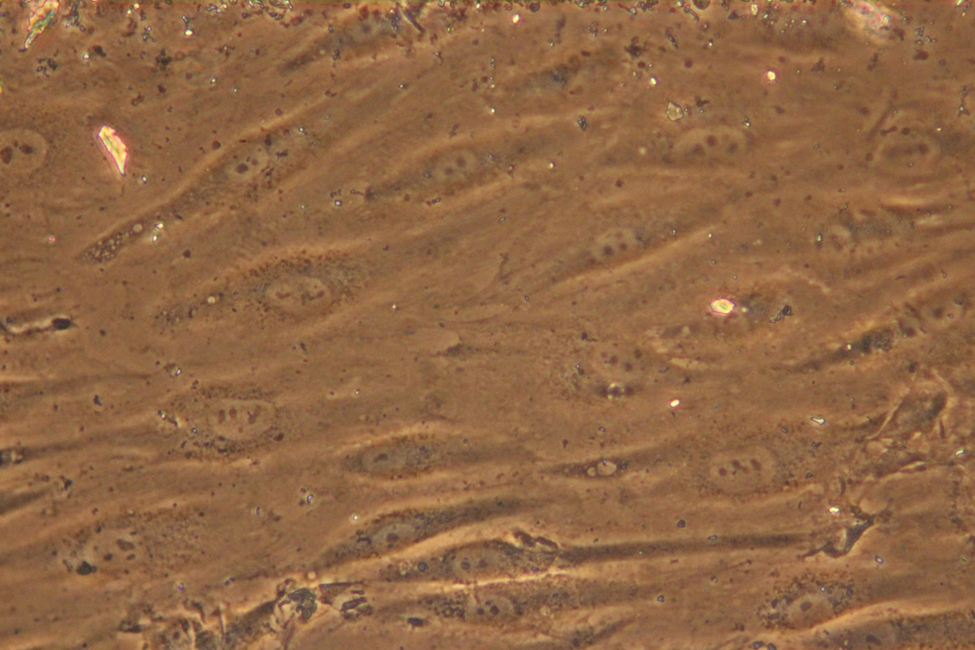
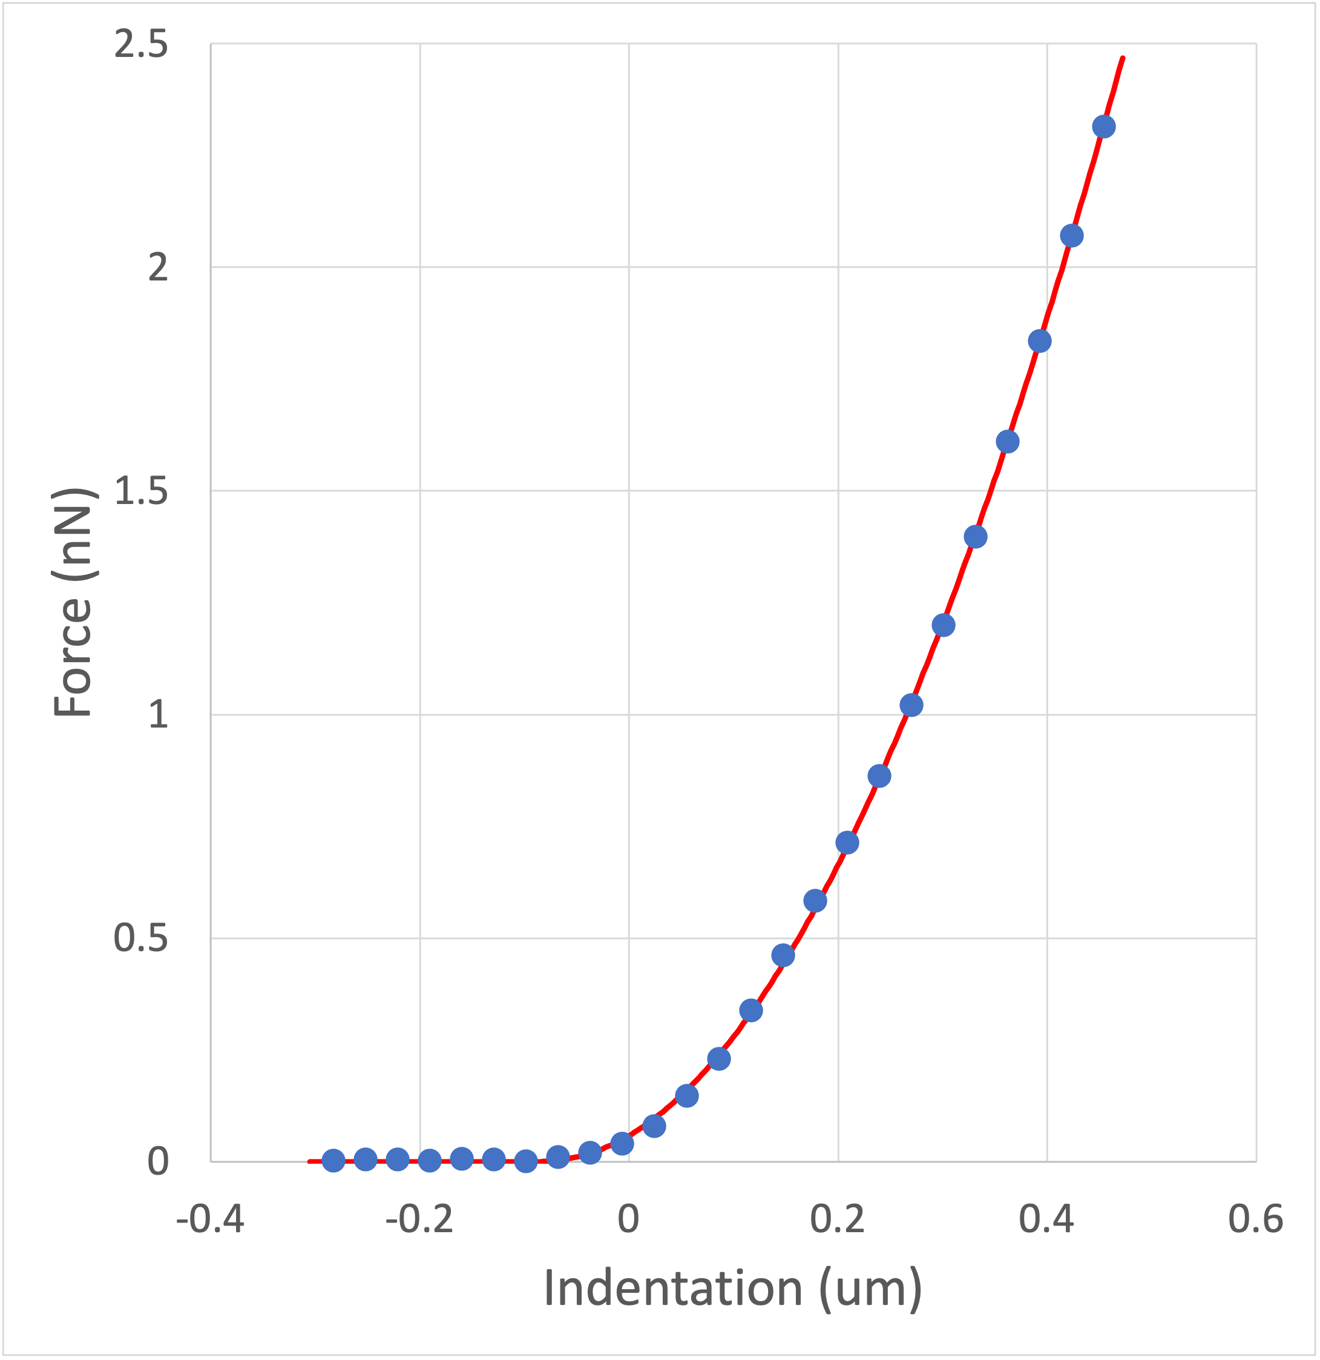
Cells growing well (HUVEC)
5 um

Slide 9
Data summary, Thickness
Static, plug Static Flow

Slide 10
Cell modulus
Static, plug Static Flow

Slide 11
EGL modulus
Static, plug Static Flow

Slide 12
Recent stability issues

