Slide 1
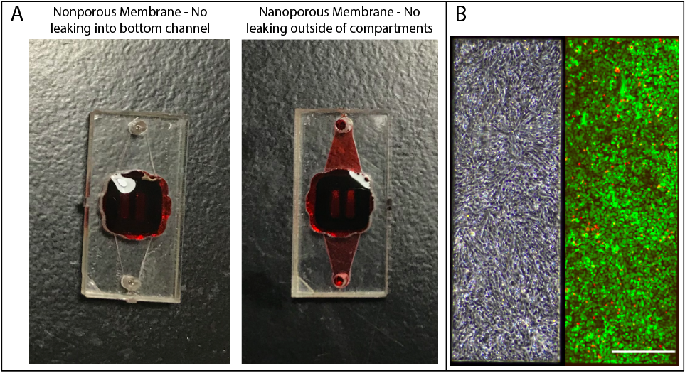
Notes:
Supp Fig. 1. m-µSiM assembly and cell culturing validation. (A) Representative images of assembled core “Transwell”-style m-μSiM devices used for a leak test. Devices assembled with nonporous membranes (left) retained dye in the top well, whereas devices assembled with nanoporous membranes (right) showed diffusion into the channel after 2 hours. There was no leaking within the device. N = 4-5 devices each group. (B) Representative images of hCMEC/D3 growth in m-μSiM. Cells were cultured for 5 days. A brightfield image was taken of the monolayer (left) and a LIVE/DEAD stain was performed (right), with 98.2±1.2% cell viability. Green indicates live cells, red indicates dead cells. N=4. Scalebar = 300 µm.

Slide 2
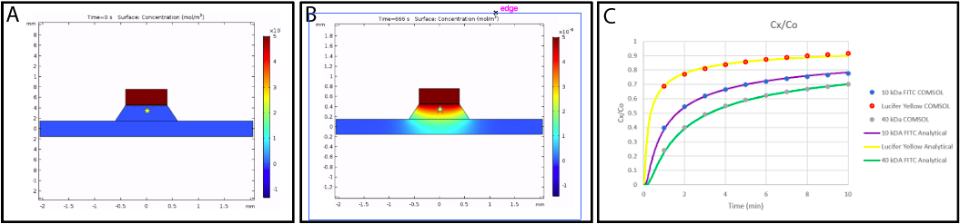
Notes:
Supp Fig. 2. Comparison between 1D analytical model of diffusion and 2D finite element model. (A-B) COMSOL geometry representing membrane chip with trench, bottom chamber, and a ‘well’ of dye above the membrane at times zero (A) and 666 seconds (B). (C) Concentrations over time in the center of the trench at a position of 100 µm below the membrane. Agreement between the analytical and computational models for free diffusion (Equation 2 in main text) for all molecular tracers indicates that a 1D analytical solution can be used with the µSiM without error.

Slide 3
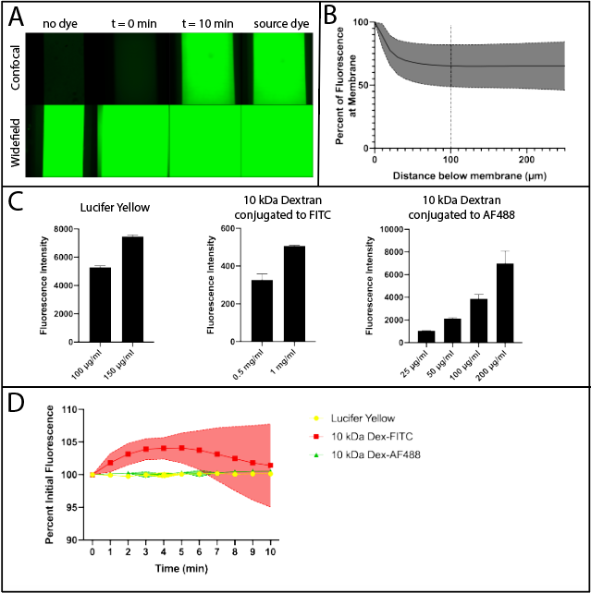
Notes:
Supp. Fig. 3. in situ permeability assay optimization. (A) Demonstration that confocal microscopy is necessary for in situ permeability assay. Images are acquired on the same scope in widefield and confocal modalities. Background fluorescence in widefield overwhelms the field of view, whereas in confocal, background is minimal and can be subtracted. (B) Optimization of depth of measurement. Dye is added into the top well of a nonporous device and fluorescence intensity is measured at the membrane down. Distance below membrane refers to distance the objective moves. At approximately 100 µm below the membrane, which is a change of 133 µm in the focal plane of measurement, background fluorescence from dye in the well is minimized. N = 5 devices. (C) Optimization of dye concentration for three dyes of interest. The concentration selected for each is within the linear range of fluorescence intensities. (D) Photo bleach test for three dyes of interest. 10-25% of the source dye concentration is added into the channel of a nonporous device. Fluorescence intensity is measured once every minute for ten minutes. Fluorescence intensity does not diminish over the course of the experiment.

Slide 4
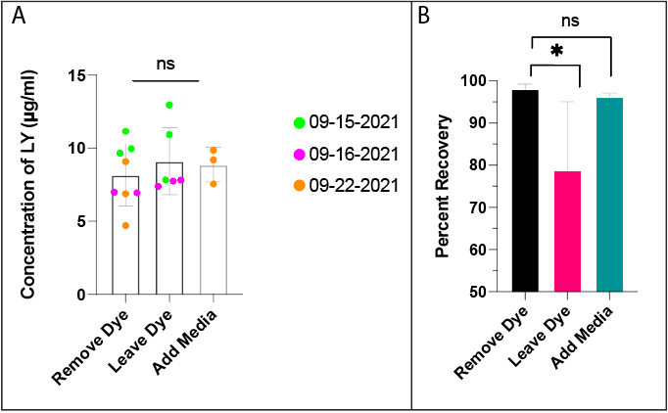
Notes:
Supp. Fig. 4. Sampling permeability method validation. (A) Dye was added into the top well of uncoated NPSN devices and allowed to diffuse for one hour. After one hour, dye was removed from the channel using a 50 µl reservoir. A fluorescent plate reader was used to measure fluorescence intensity and concentration was calculated from a reference ladder. For the sampling process, dye in the well was either removed, left in the well, or removed and replaced with media. Experimentation was done on separate days for different tests of methodology. N = 3-8 per group. One-way ANOVA, p < 0.05. (B) Percent recovery was of dye within the channel was tested by two 50 µl samples N = 3-8 per group. One-way ANOVA, p < 0.05.

Slide 5
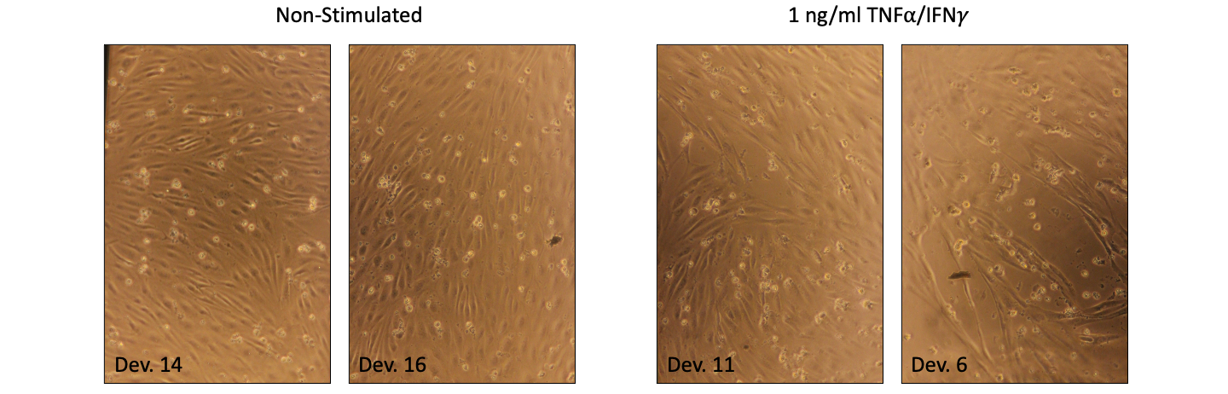
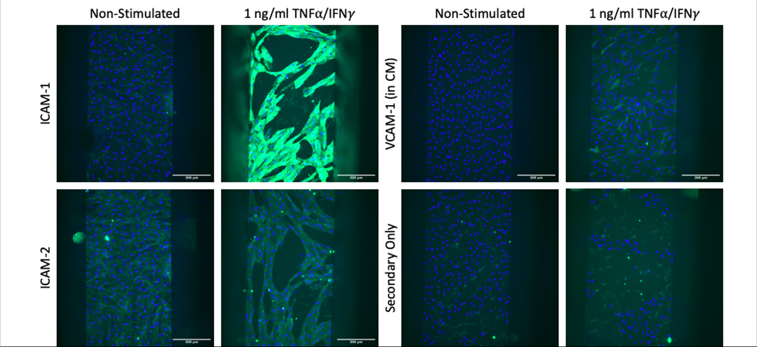
A
B
Notes:
Supp. Fig. 5. I need to make this in Illustrator still. I may include 40X cell adhesion staining too. The point would be to demonstrate that 1 ng/ml cytokine stimulation is too high in devices.

Slide 6
Supplement for Transwell Stimulation in SMLC-CM?

Slide 7
Supplement Table for Antibodies?

Slide 8
Supplement Table for Objectives/Working Distances
Objectives
Working distances for each chip orientation
Example images

Slide 9
Supplemental Videos
Assembly video
COMSOL diffusion video (Natalie’s work)
COMSOL diffusion videos (Howard’s work)

