Slide 1
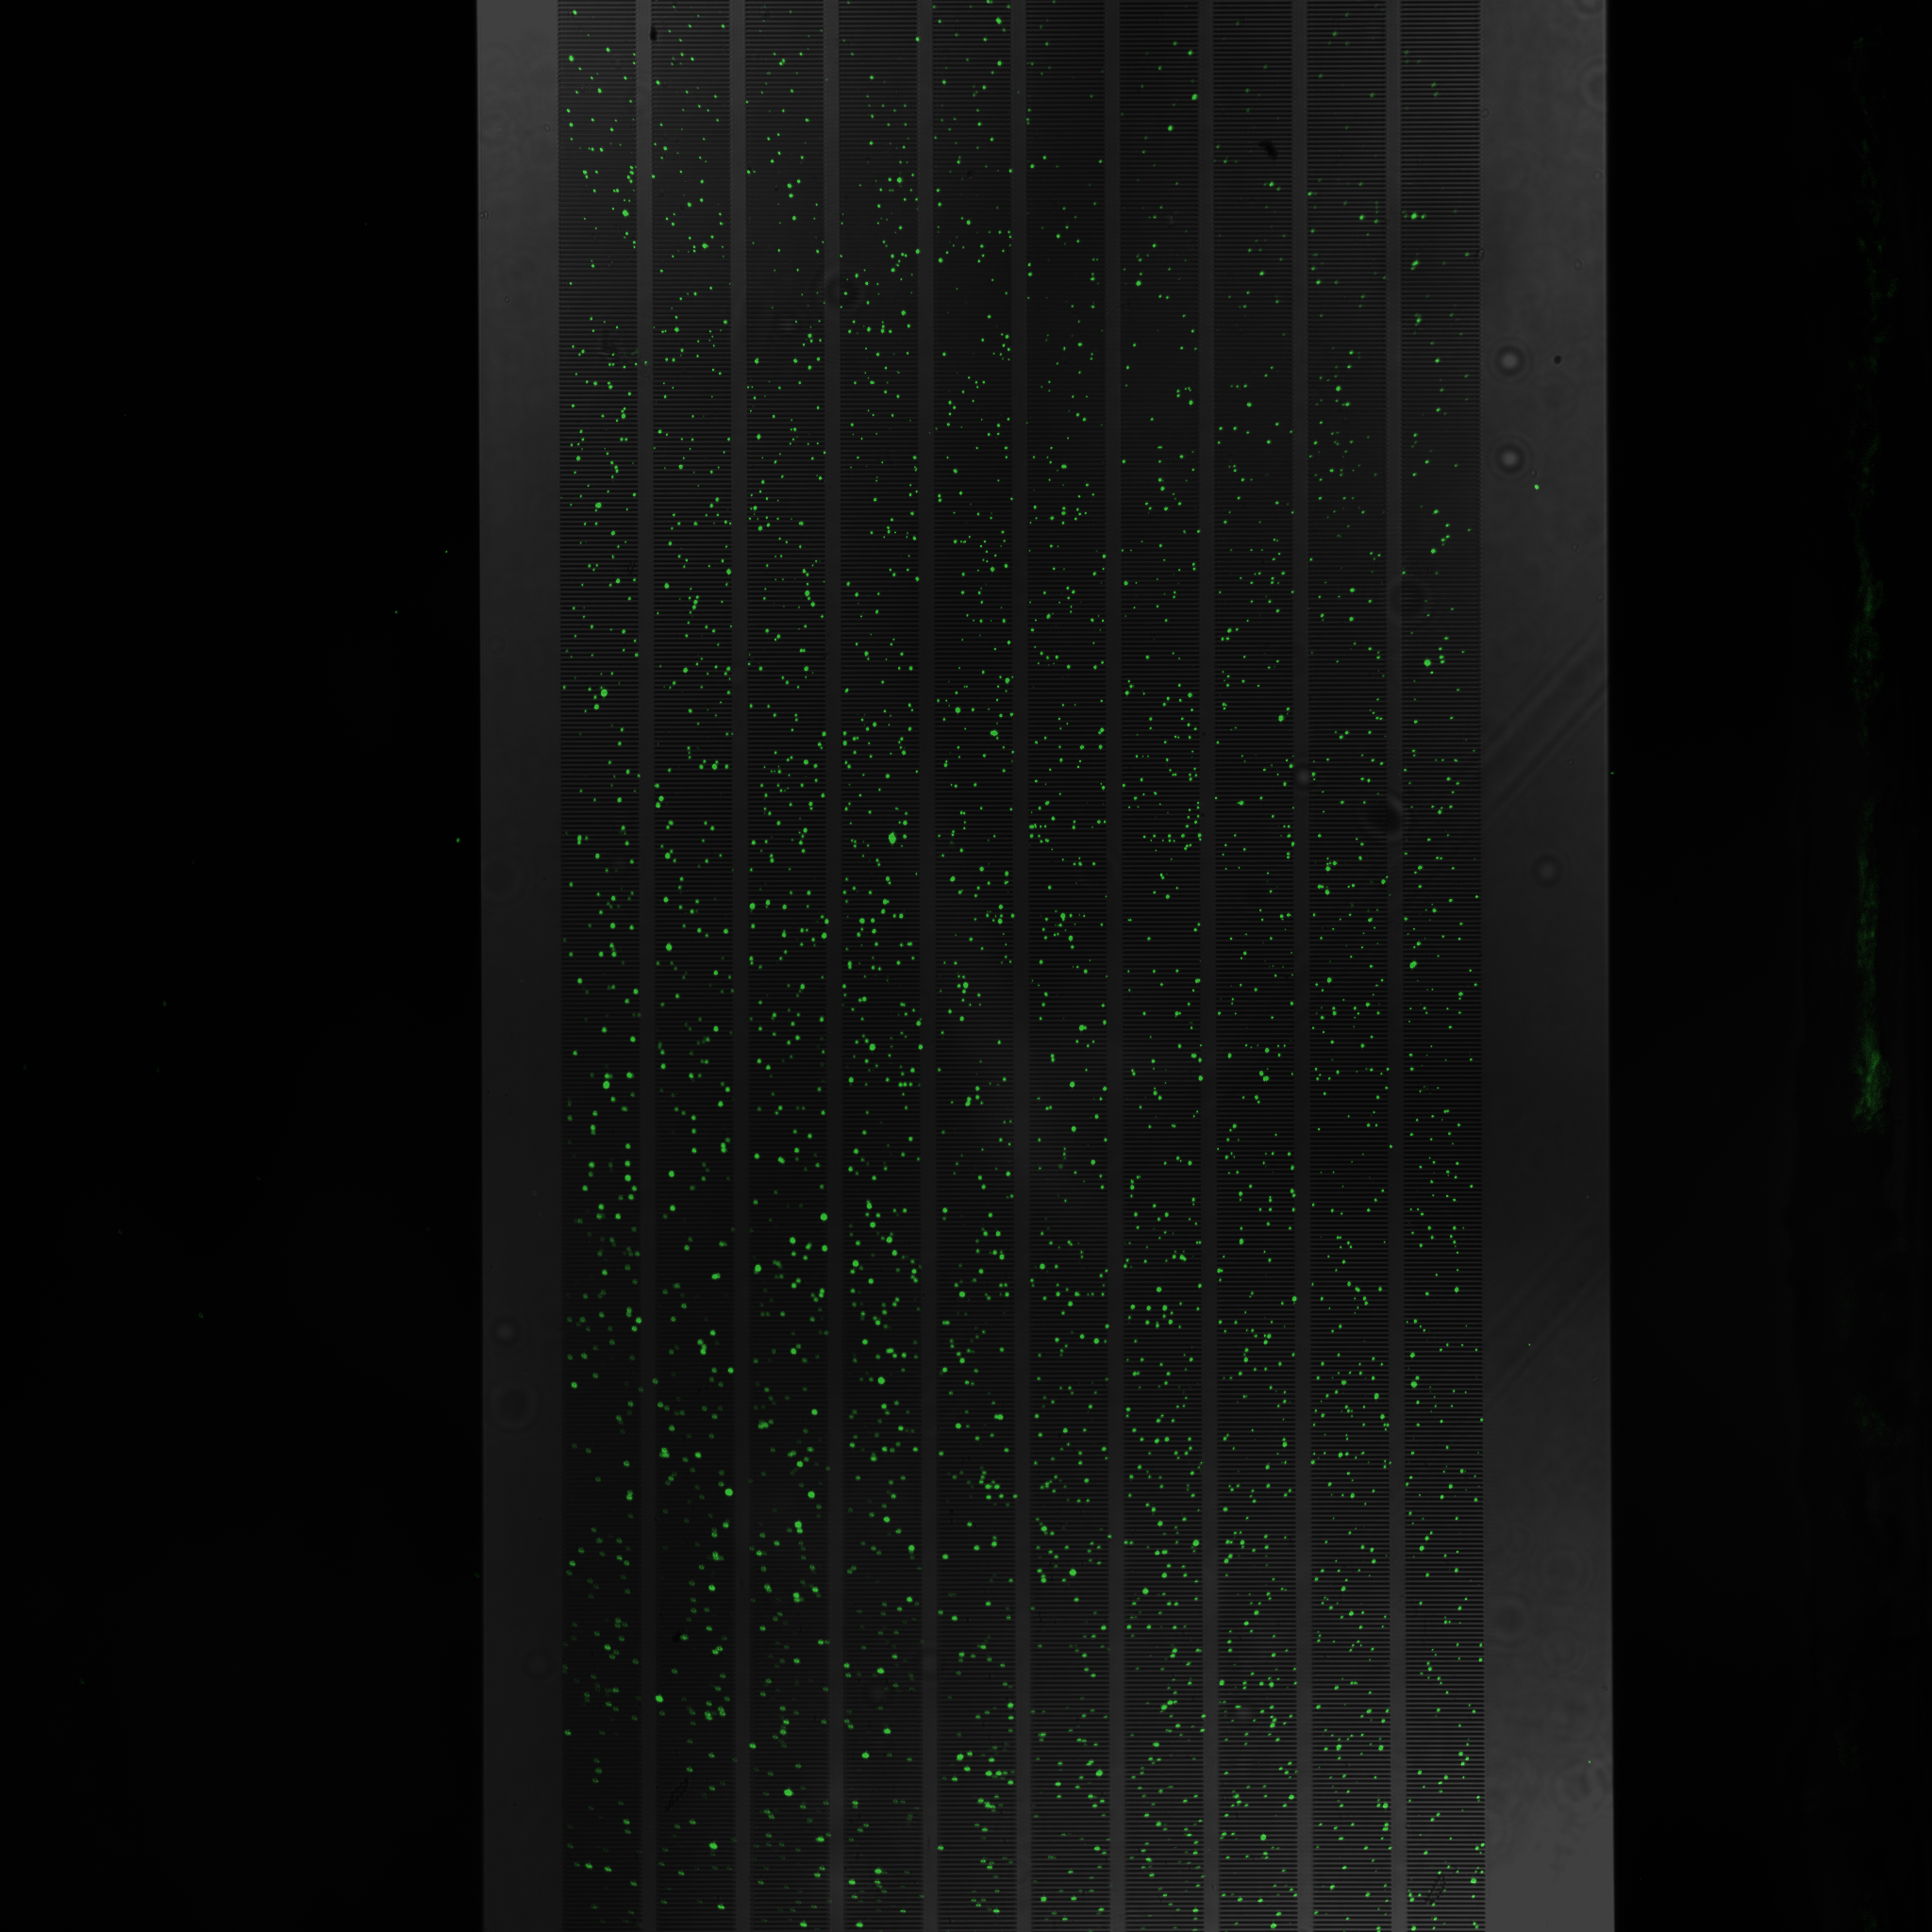
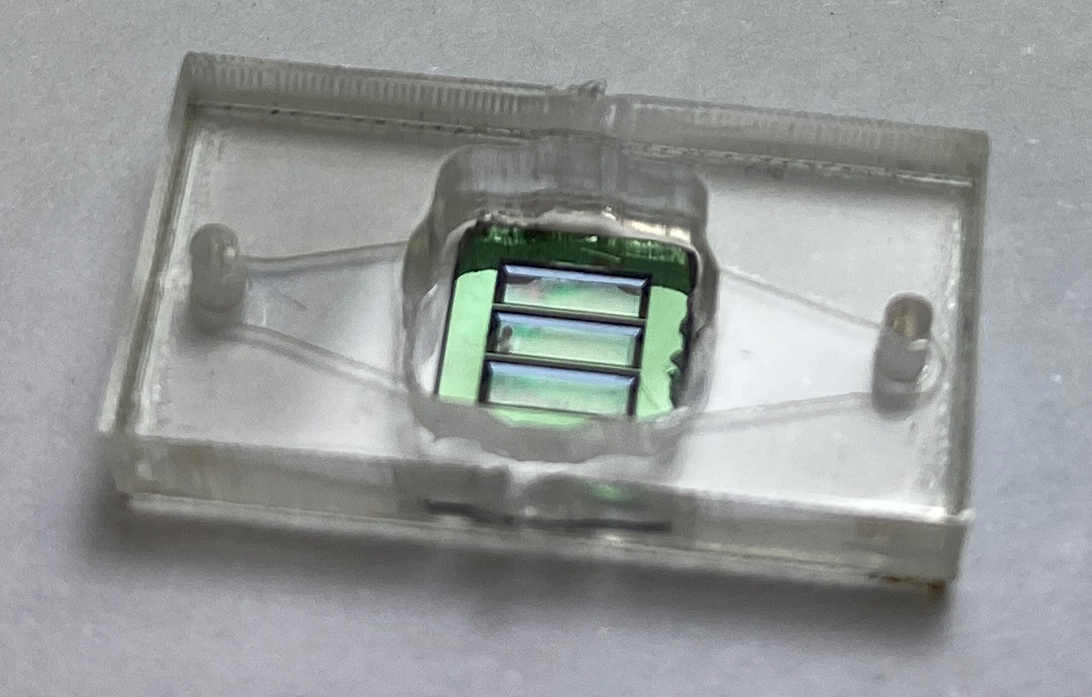
Rapid detection of intact SARS-CoV-2 viral particles using silicon nanomembranes
Michael Klaczko
University of Rochester
McGrath Lab

Slide 2
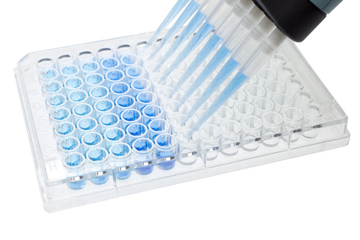
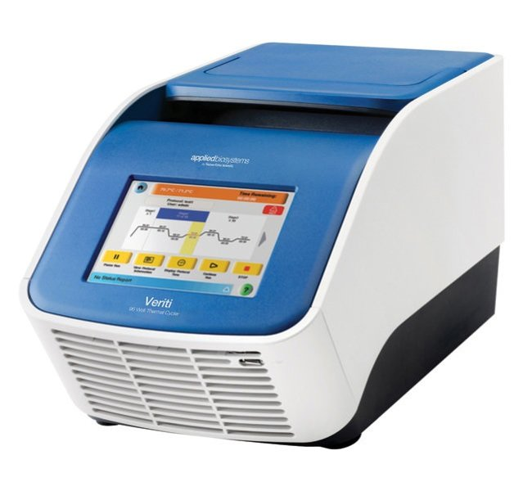
Current Testing Capabilities
Serological Testing
Diagnostic Testing
https://adipogen.com/covid-19/
https://www.fishersci.be/shop/products/veriti-thermal-cycler-extended-warranty-package-384-well-3/12353653

Slide 3
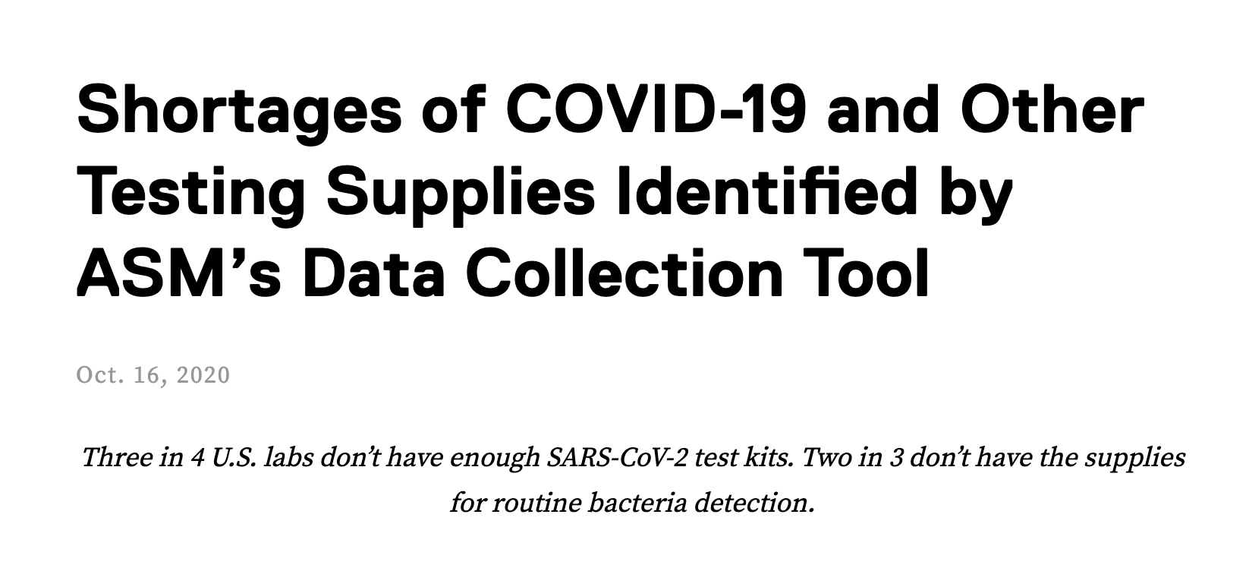

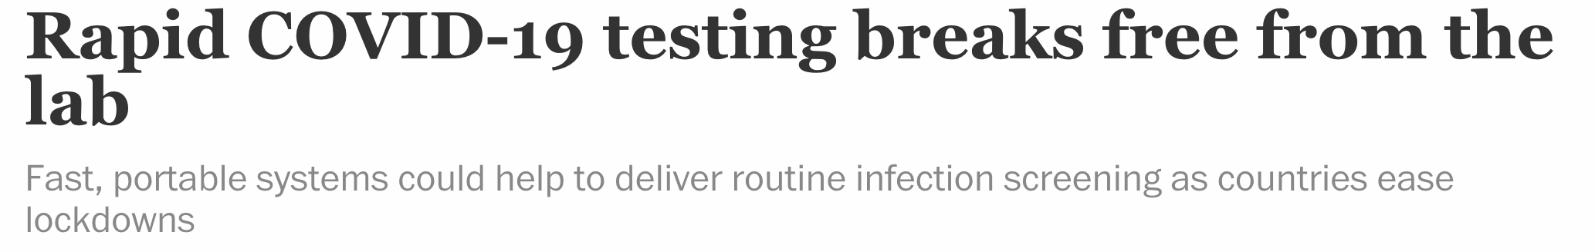

Need for Rapid Testing
https://www.mckinsey.com/industries/pharmaceuticals-and-medical-products/our-insights/covid-19-overcoming-supply-shortages-for-diagnostic-testing#
https://asm.org/Press-Releases/2020/October/Shortages-of-COVID-19-and-Other-Testing-Supplies-I
https://cen.acs.org/analytical-chemistry/diagnostics/Rapid-COVID-19-testing-breaks/98/web/2020/08
https://www.nbcnews.com/news/us-news/covid-testing-only-getting-harder-come-s-serious-problem-n1249956

Slide 4
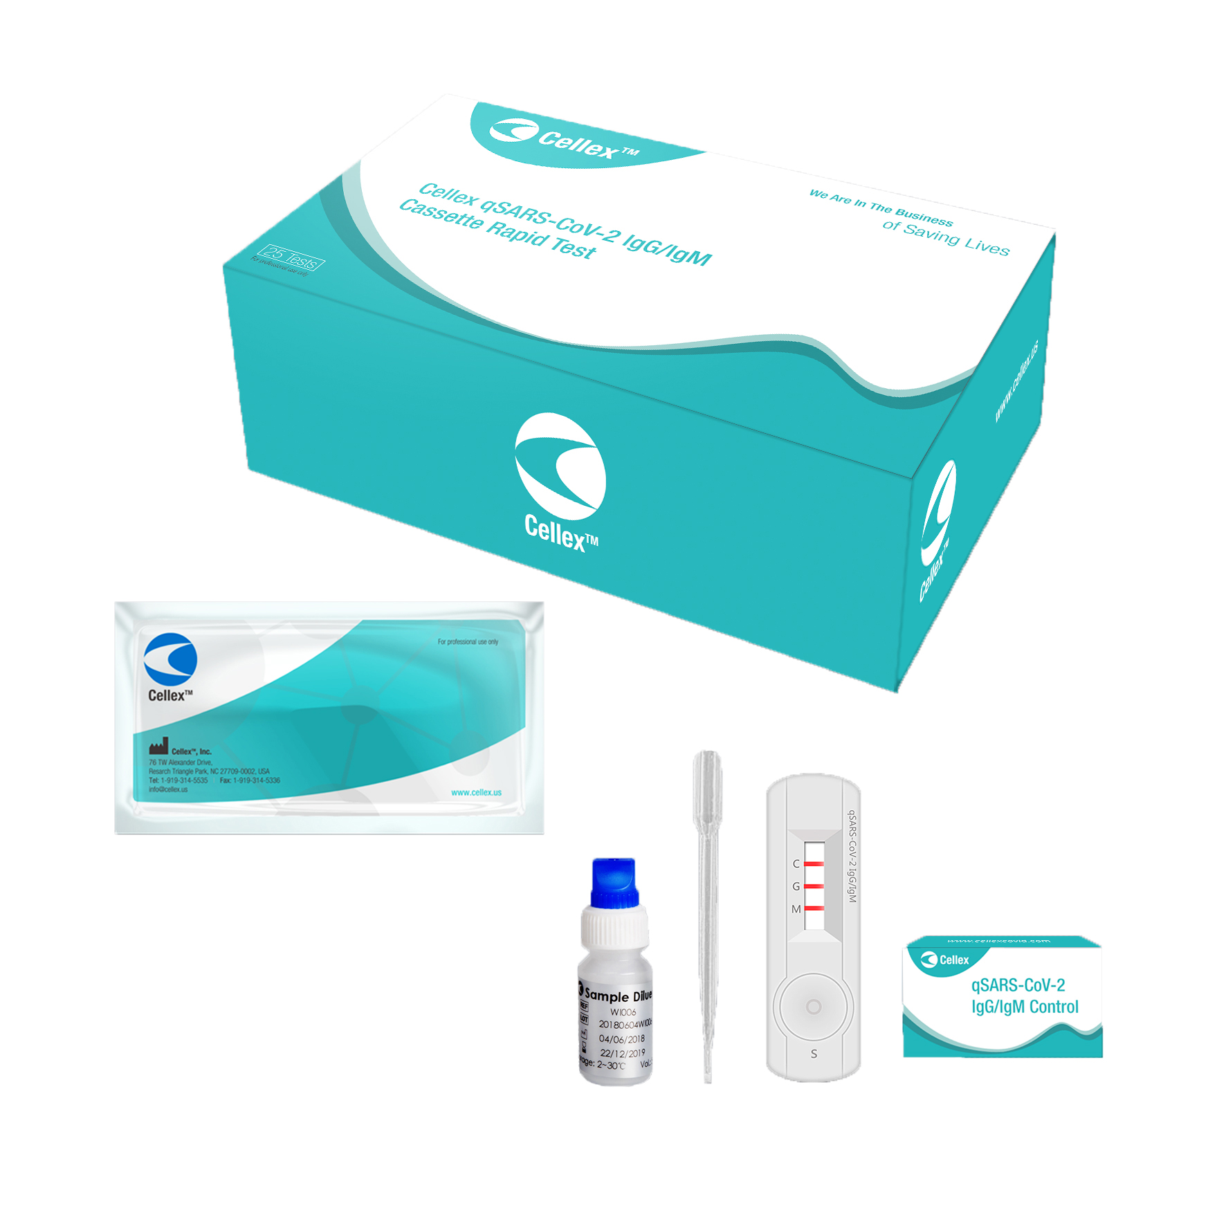
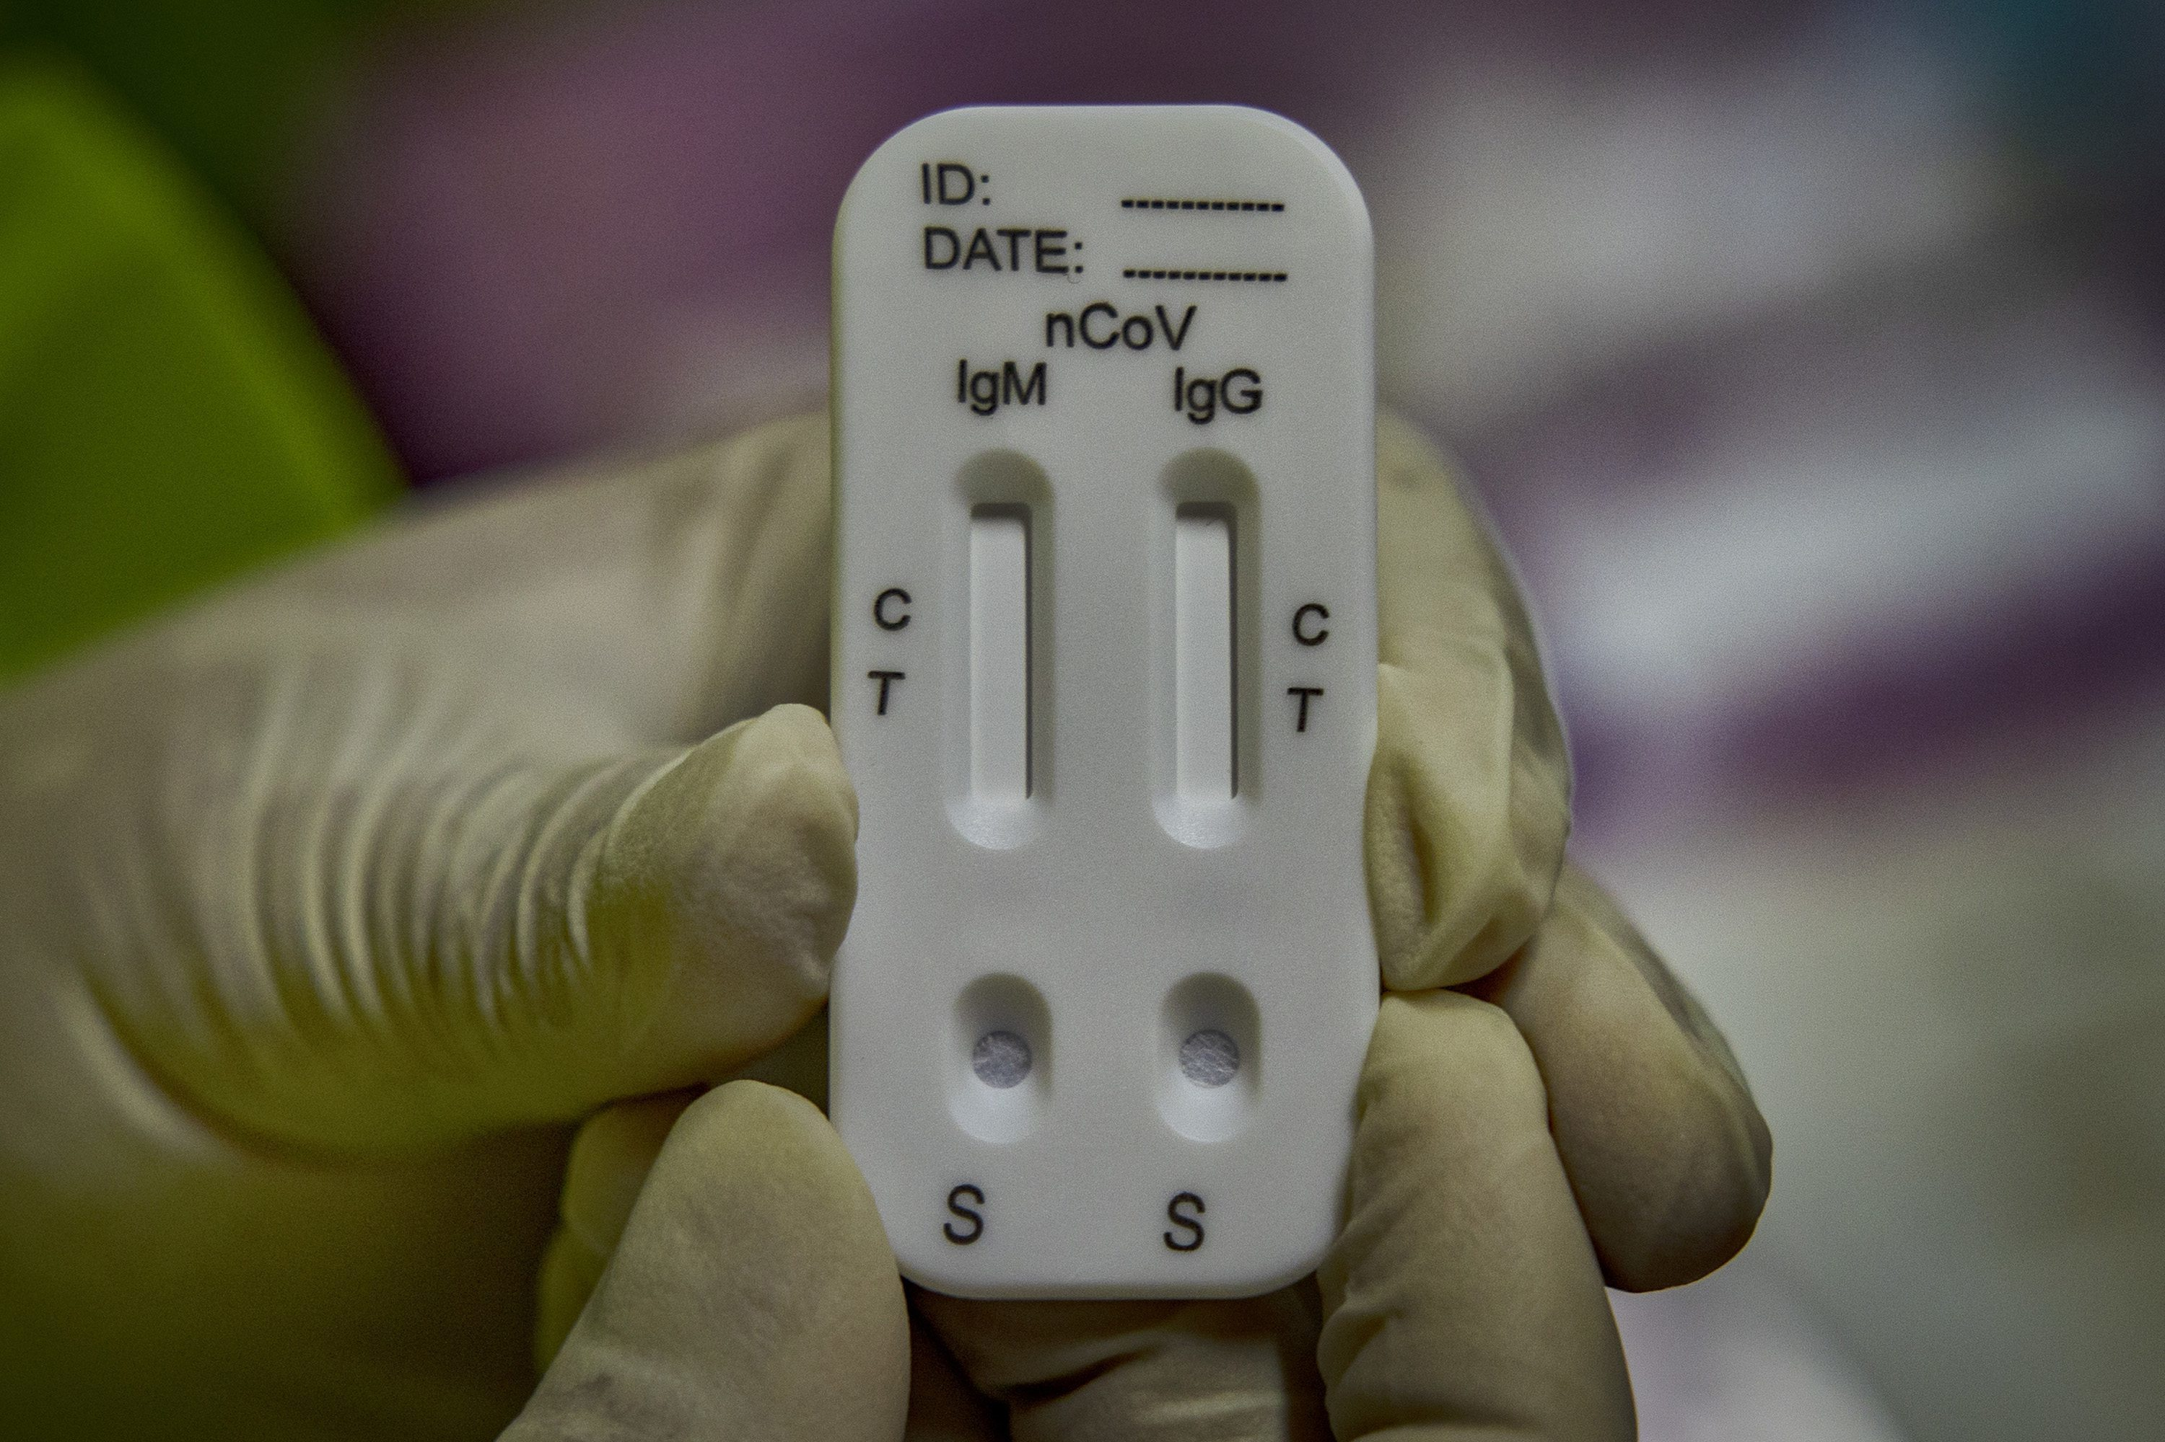
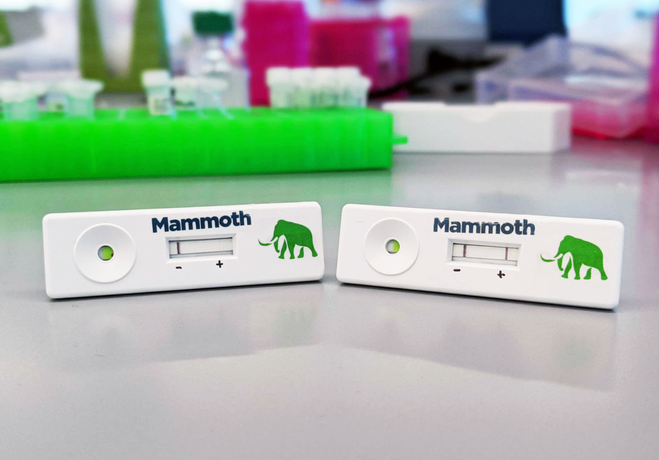
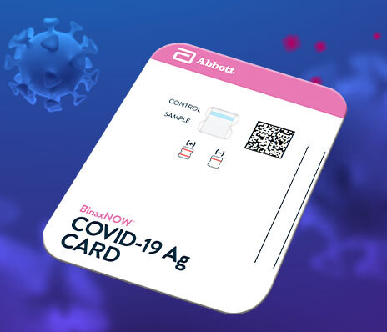
Current POC Testing Capabilities
Serological Testing
Diagnostic Testing
https://www.cardinalhealth.com/en/cmp/ext/med/med-lab/cellex-covid-19-igm-igg-rapid-test.html
https://fusion.inquirer.com/news/coronavirus-antibody-testing-expanding-with-questions-roche-abbott-20200509.html
https://www.abbott.com/corpnewsroom/diagnostics-testing/upping-the-ante-on-COVID-19-antigen-testing.html
https://www.the-scientist.com/news-opinion/toward-covid-19-testing-any-time-anywhere-67906

Slide 5
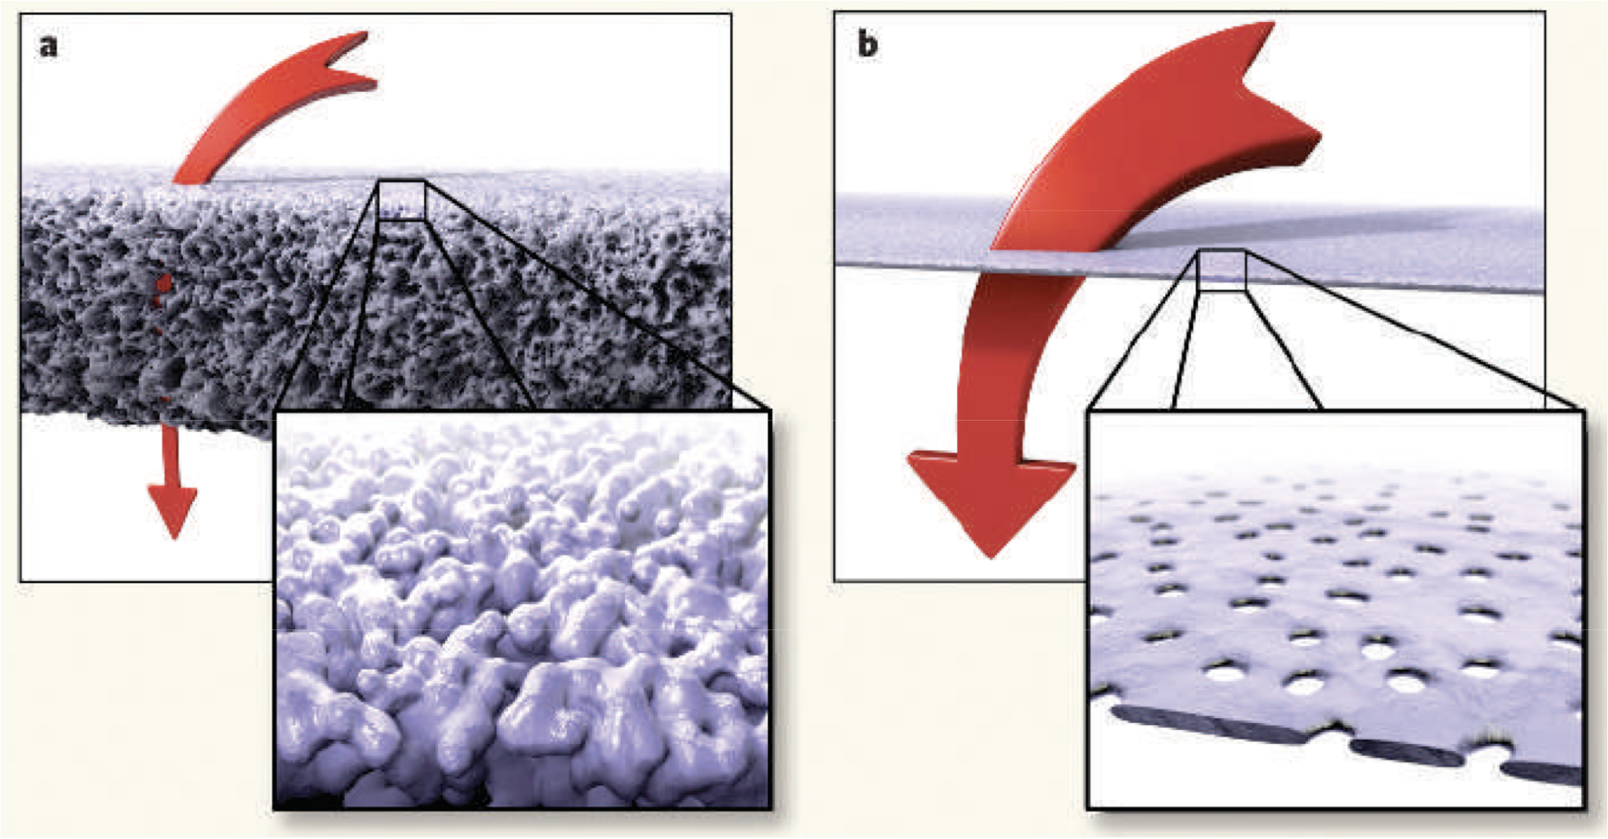
Silicon Nanomembranes
Free Standing w/ thickness between 50 nm and 400 nm
Pores between 15 nm and 10 µm
Striemer et al. (2007) Nature 445:749-753
*Art is from A. van den Berg and M. Wessling, Nature 445, p. 726
Nanomembrane Research Group (NRG) est. 2007. Now > 50 publications.
Pore size
High hydraulic and diffusive permeability.
Sharp separations.
Biocompatible.
Scalable membrane and device manufacturing.
Optically and electronically transparent.
≥ 1
Thickness

Slide 6
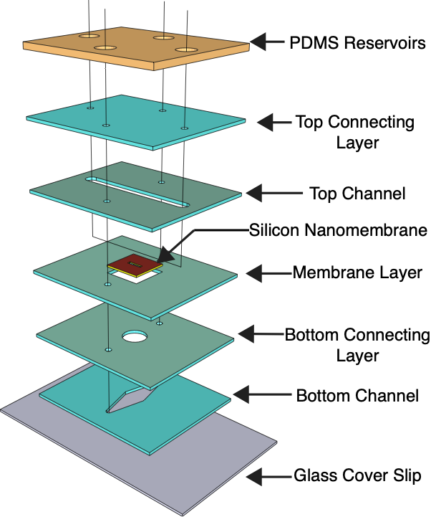

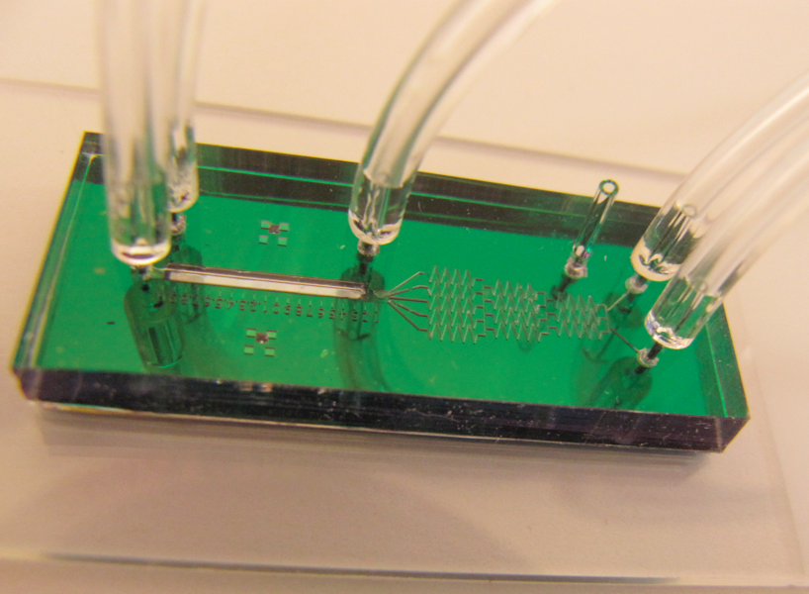
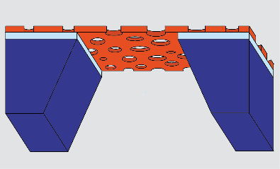
Nanomembranes Devices
5.4 mm
5.4 mm
Transwell™ mimetic
Silicon
frame
700 um x 3 mm
membrane
‘windows’
trench
flat side
nanomembrane
‘chips’
layer-by-layer
assembly
microfluidics

Slide 7
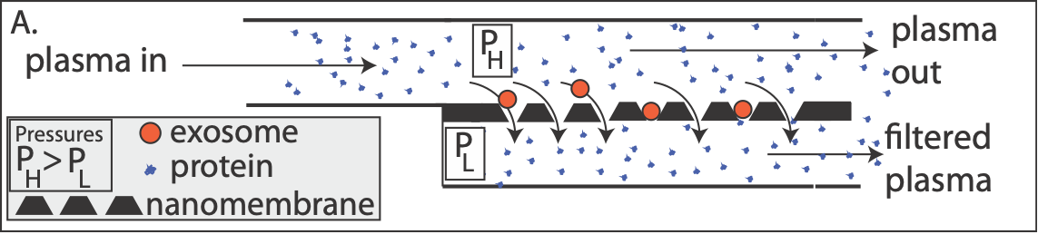
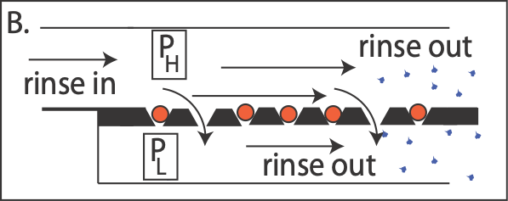
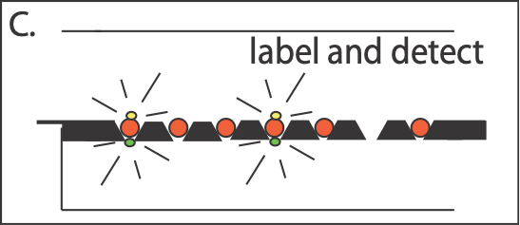
In Situ Diagnostics?
Capture
Clean
Detect

Slide 8
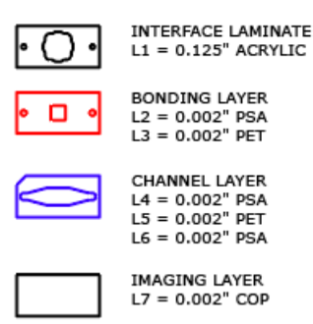
ALine Microfluidic Devices

Slide 9
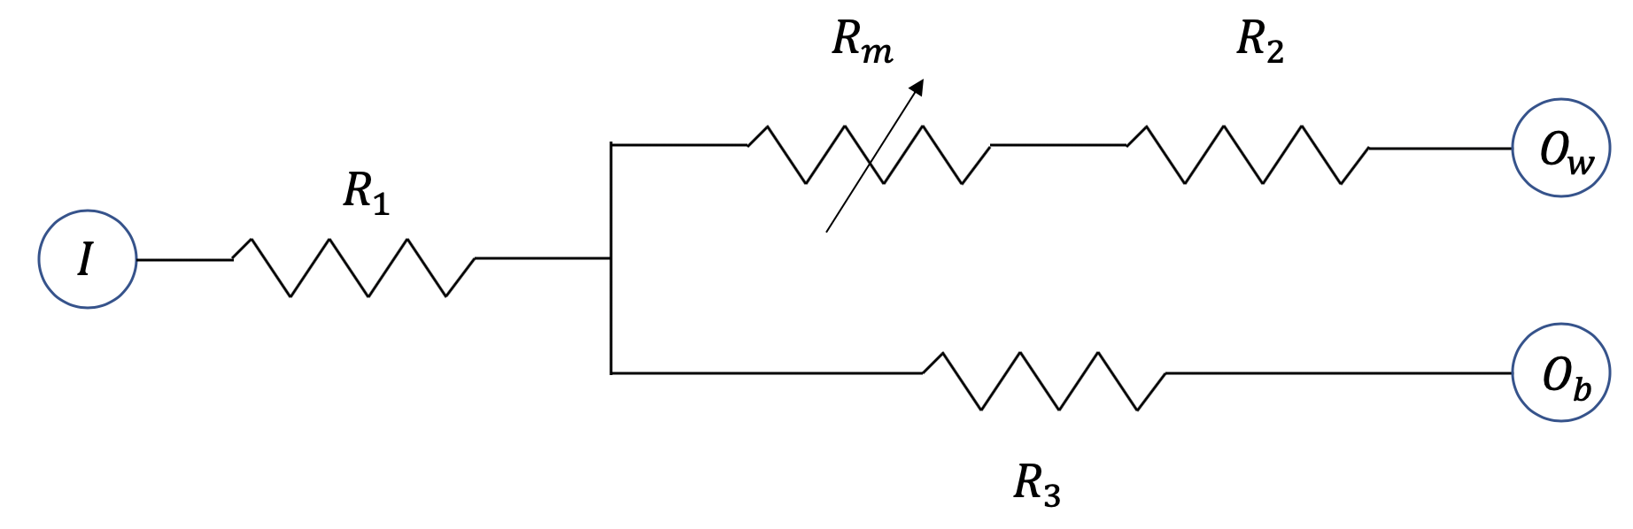
μSIM-DX Design
0

Slide 10


μSIM-DX Sensor Function – The Resistance Switch
Sample Injection
Negative
$$R_{m+Well}<R_{Bottom Channel}$$
Positive
$$R_{m+Well}>R_{Bottom Channel}$$

Slide 11
Sample Pre-mixing
Pre-mix with Streptavidin Conjugated Antibody
Surface Coat with KodeTM Biotin
+ Antibody
Kode Biotin
Membrane

Slide 12
Surface Modification using KODE™
R
R
R
R
http://www.kodebiotech.com/
One step dip coating
Optimization can lead to precise control over thickness
Stabile wet and dry, can withstand flow

Slide 13
Pre-labelled Target Capture
Pre-Mixture
Large component
Surface coating
Small component a
Streptavidin conjugated antibody bound small component b

Slide 14
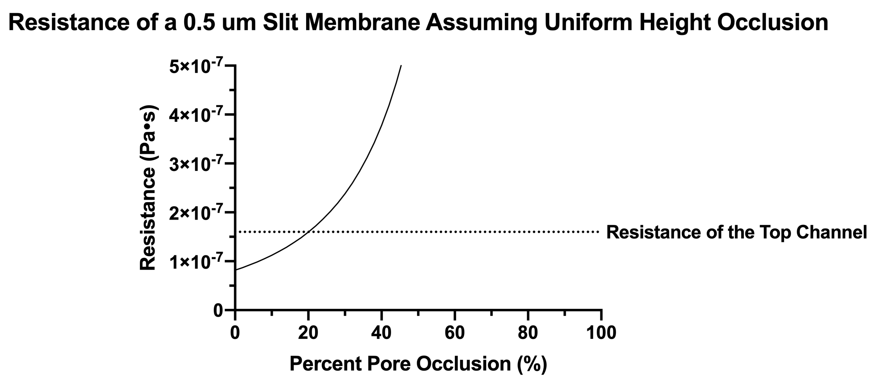
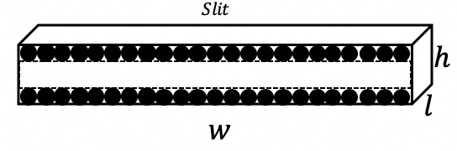
Slit Pore Occlusion Analysis

Slide 15
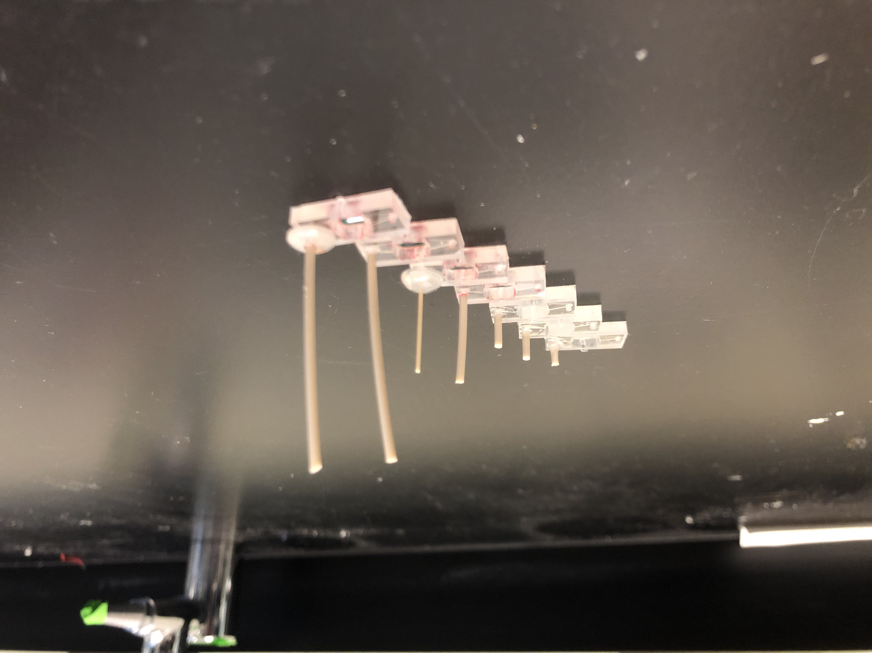
Control of the Resistance Switch
Increasing height = Increasing resistance

Slide 16
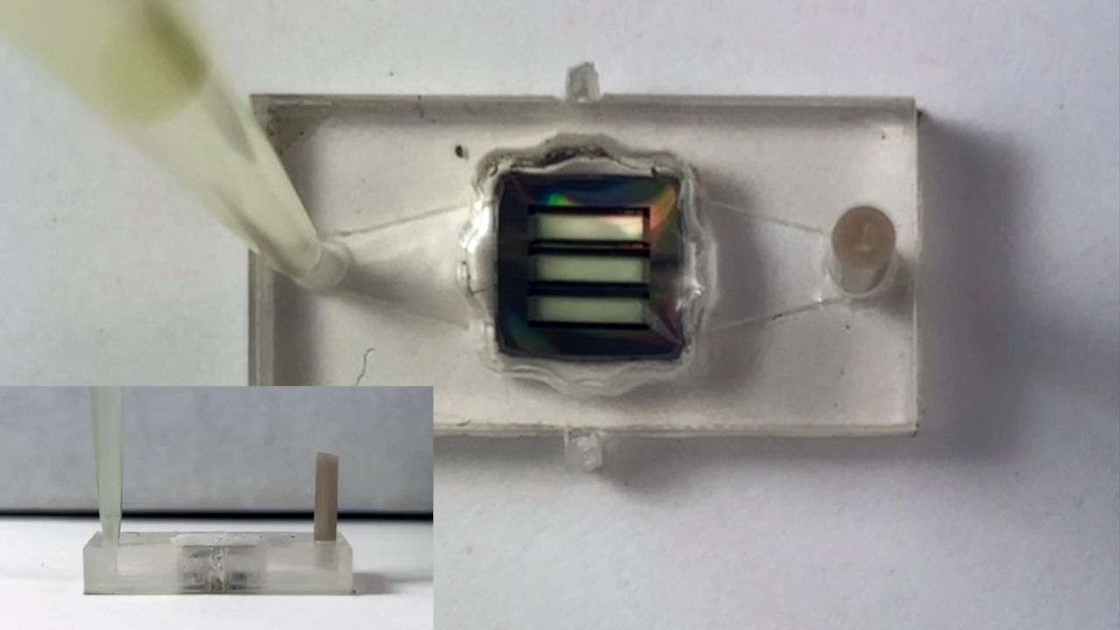
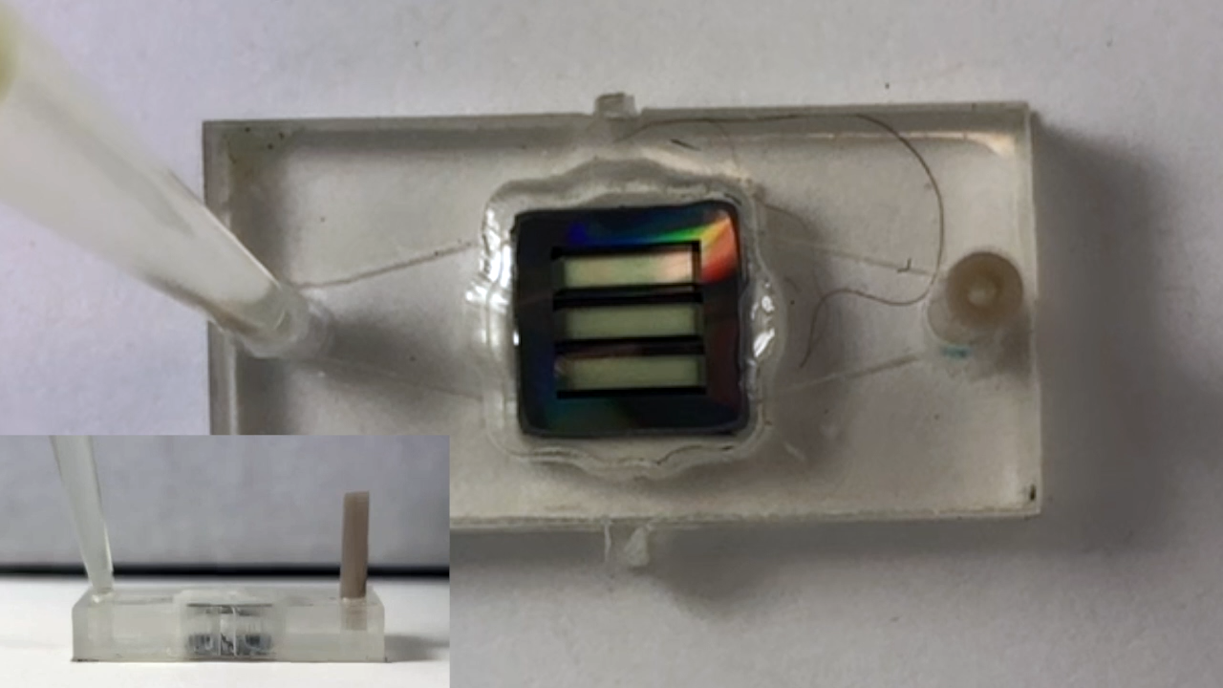
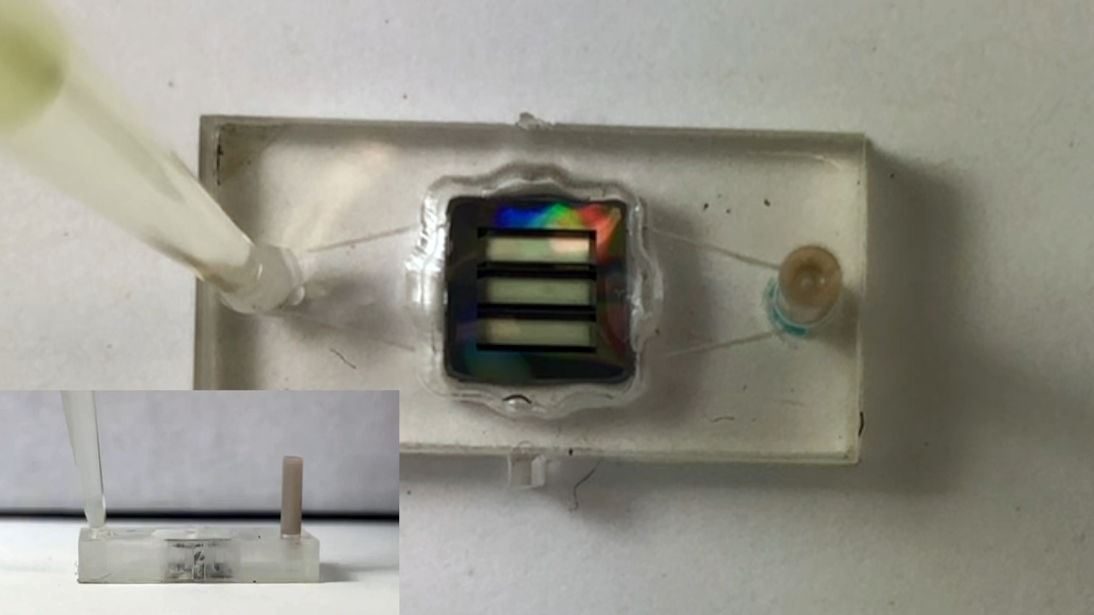
Sensor Function Controls
PBS
500 nm Beads
200 nm Beads
Negative switch
Positive Switch
Positive Switch
All tests with beads use 10^5 beads/mL

Slide 17
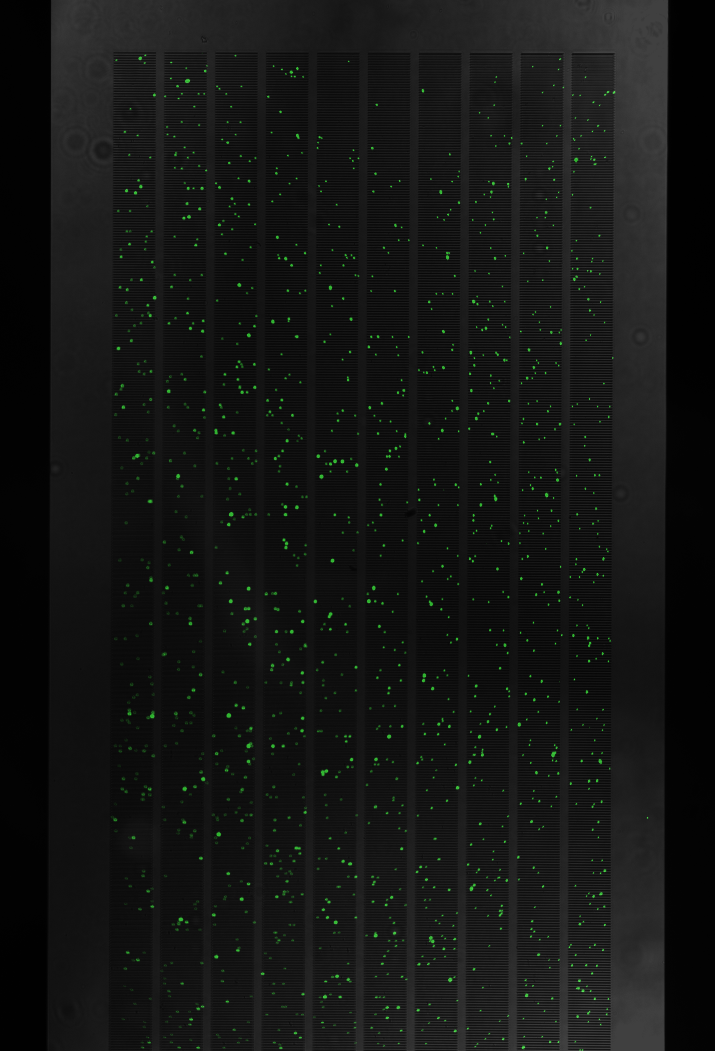
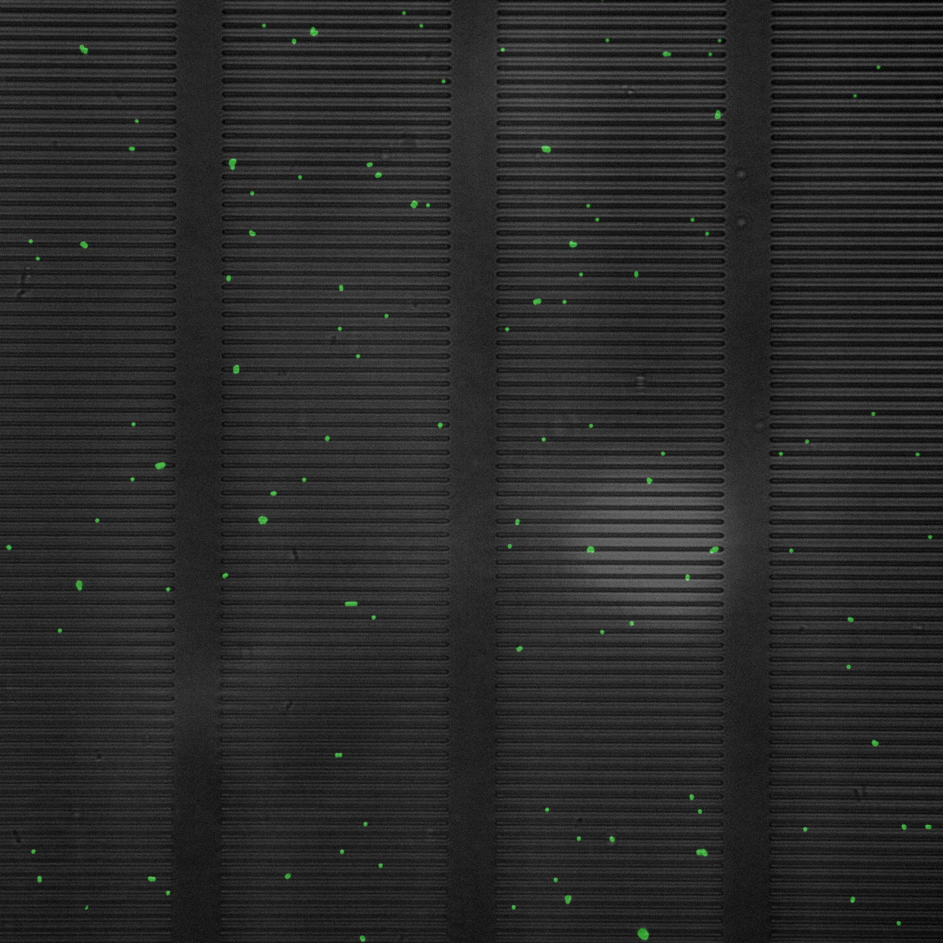
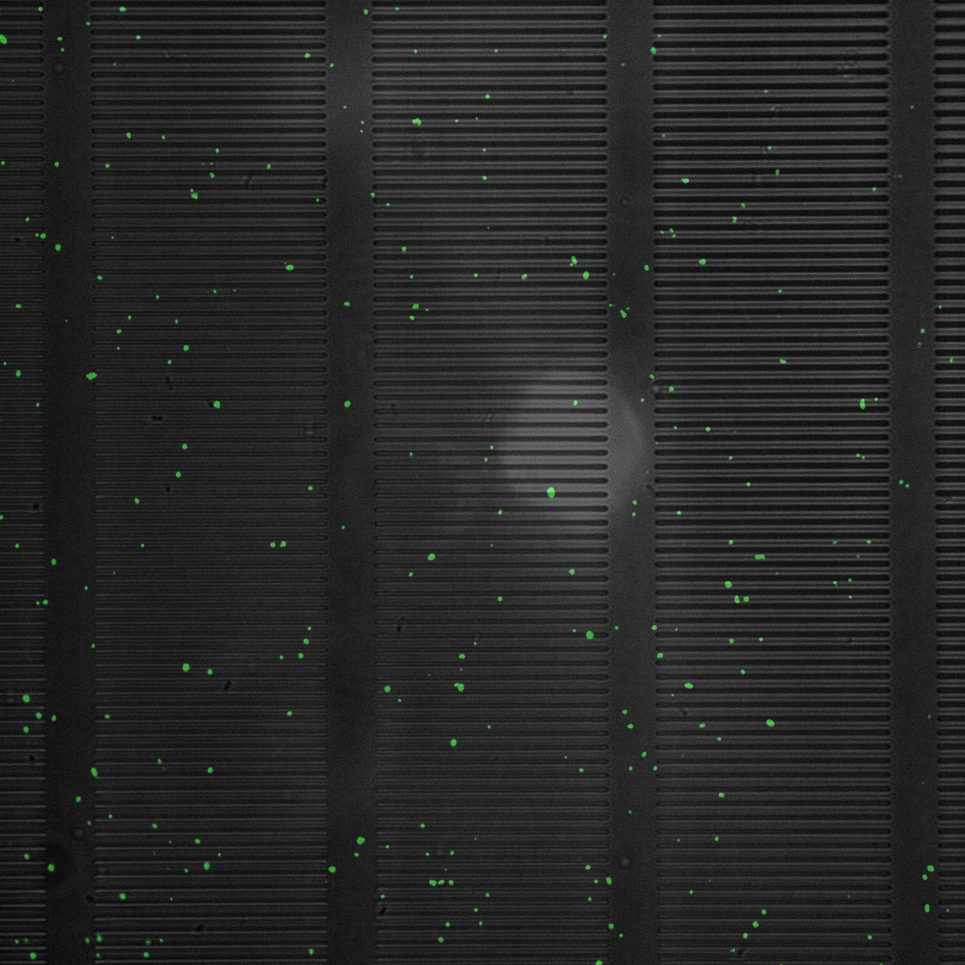
Imaging Beads
500 nm Beads
200 nm Beads
10X
60X
10X
60X

Slide 18
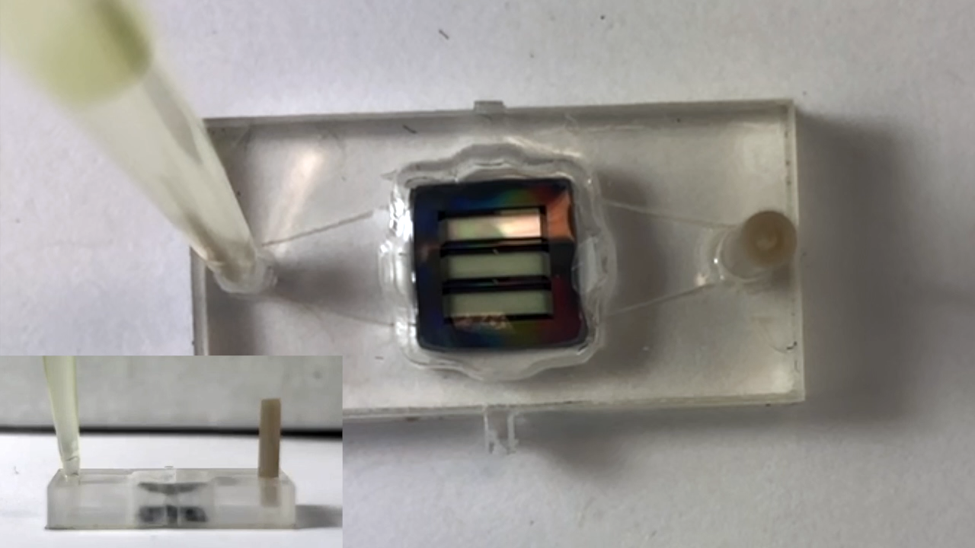
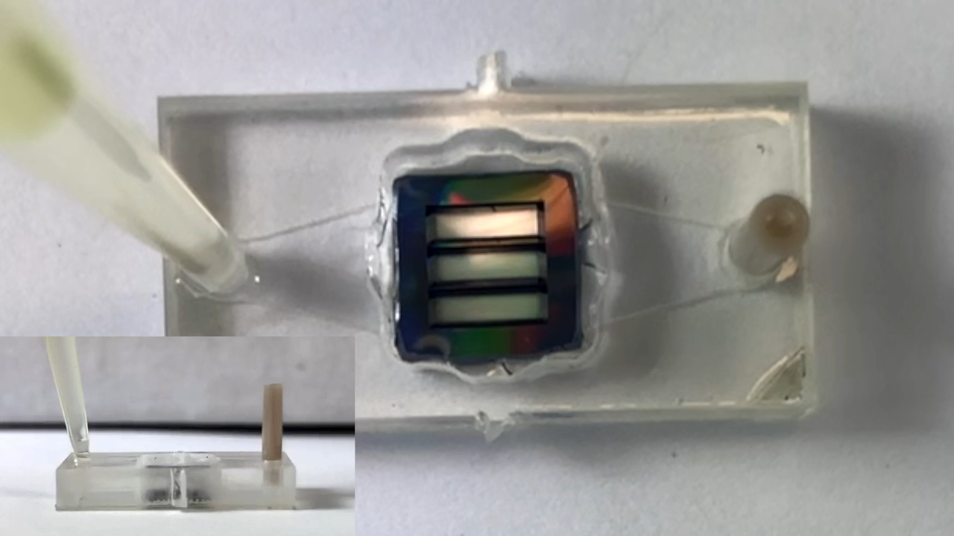
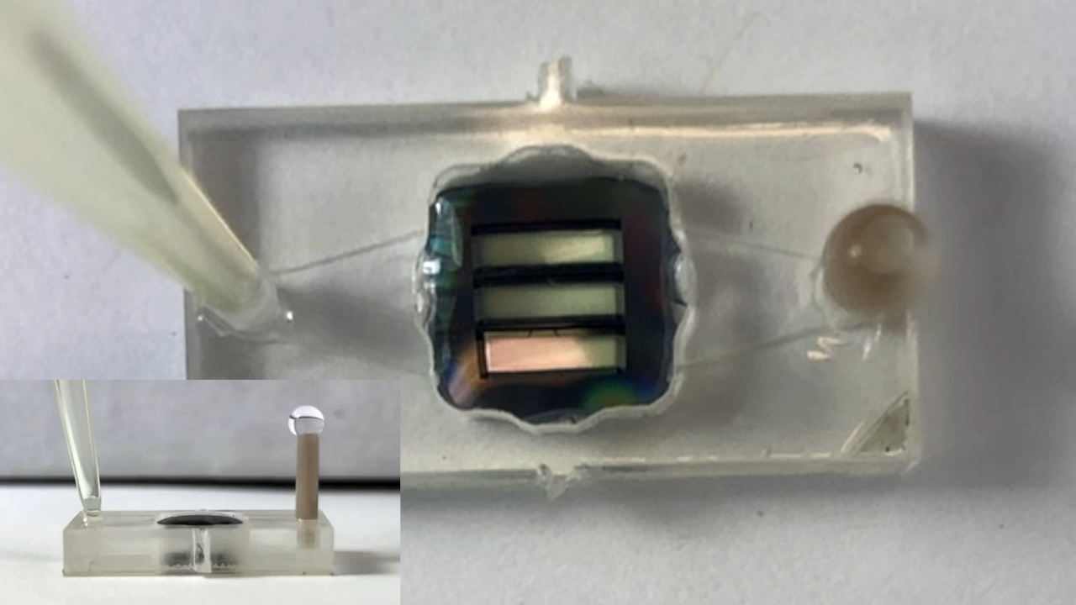
Sensor Test with Antibody Controls
Vaccinia with Vaccinia Antibody
Vaccinia
Vaccinia with Rabbit Antibody
Positive switch
Negative Partial Switch
Negative Partial Switch
All tests use 10^5 virus/mL

Slide 19
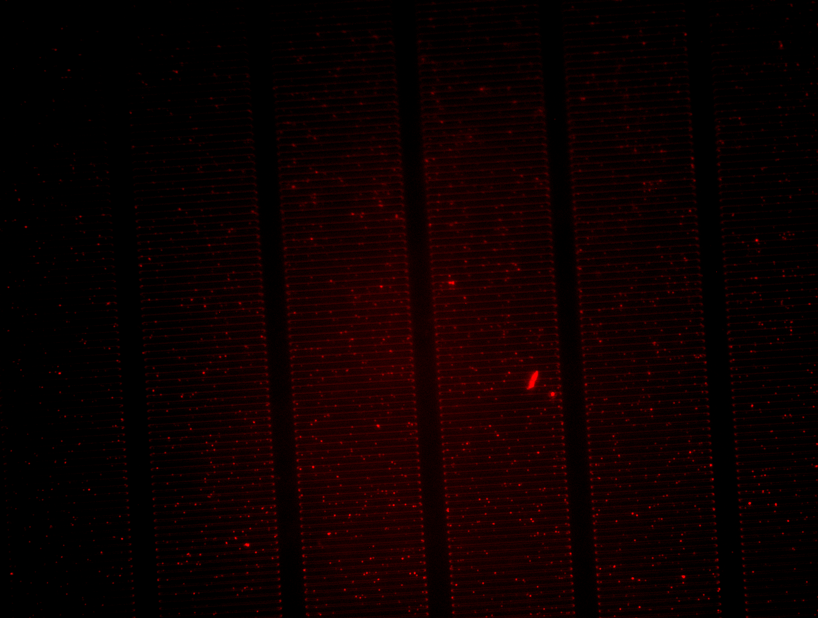
Imaging Vaccinia

Slide 20
μSIM-DX Performance

Slide 21
Particle Counting Experiments
Parameters
  Object:
  30 Nanomembrane Slits: Each slit is 50 µm x 0.5 µm, and the peak-to-peak distance is 2 µm
  A uniform number of particles per slit are ‘randomly’ released
  Particle Dimensions: 100 nm - 200 nm - 300 nm
  Particle Excitation and Emission Wavelengths: 588 nm and 633 nm
  High Microscope Objective:
  1.4 NA / 100X
  Camera Resolution:
  600 x 600 with a pixel pitch of 10 µm
  Microscopes:
  Widefield: Spatial Resolution is ~226 nm
  Confocal: Spatial Resolution is ~199 nm
  STED: Spatial Resolution is ~50 nm
      *Please note that spatial resolution is ‘artificially’ increased by changing the PSF parameters.

Slide 22
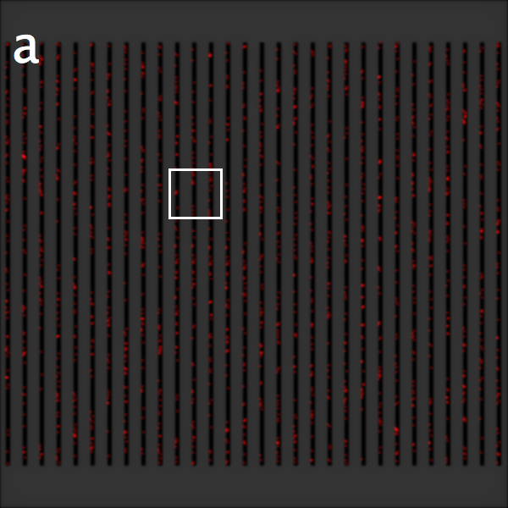
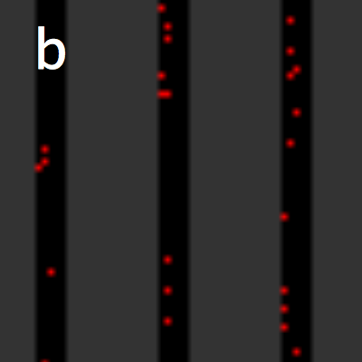
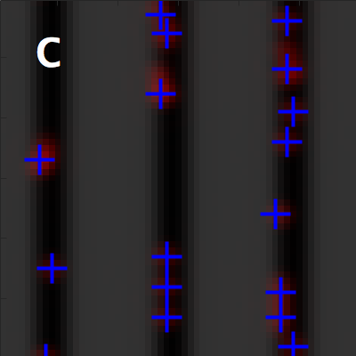
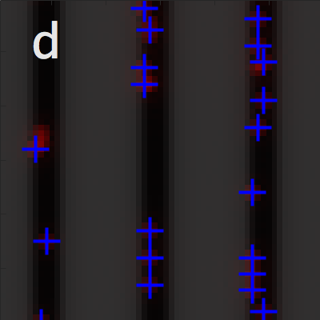
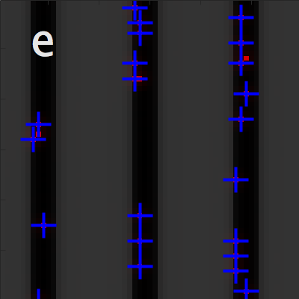
Simulating Particle Counting
Wide-field image
Cropped area
Wide-field counting
Confocal counting
STED counting

Slide 23
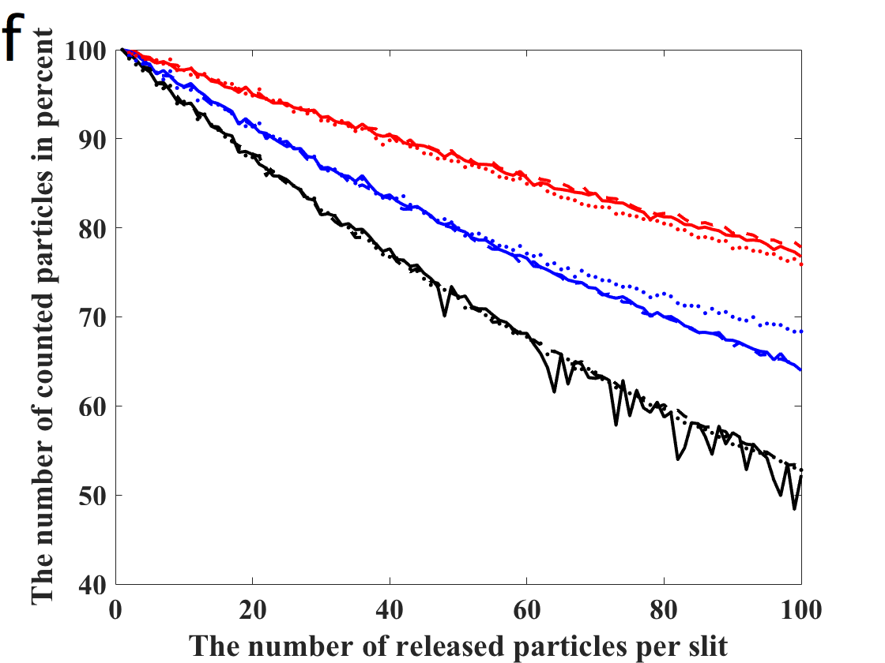
Particle Counting Analysis
STED
1.6E6 Particle Limit
Confocal
1.4E6 Particle Limit
Wide-field
1.1E6 Particle Limit
Max Countable Concentration= 10^8 particle/mL solutions

Slide 24
Acknowledgements
Mcgrath Lab
Professor James McGrath
Dr. Jonathan Flax
Baturay Ozgurun, PhD
Kilean Lucas, PhD
Alec Salminen, MS
Samuel Walker, MS
Danial Ahmad, MS
William Houlihan, PhD
Raquel Murillo, MS
Molly McCloskey, MS
Ward Lab
Professor Brian Ward
Funding Support from
NSF RAPID 2028537

