Slide 1
Quantitative Analysis of Extracellular Vesicles and Their Subpopulations
Aslan (Mehdi) Dehghani

Slide 2
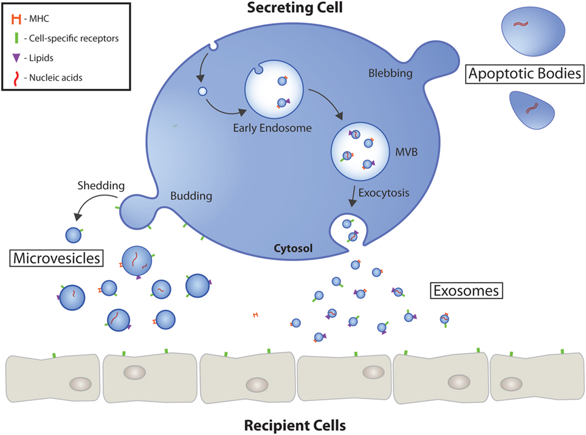
Extracellular Vesicles (EVs)
EVs are functionally involved in intercellular communications by different signaling pathways such as interacting with cells ligands or by delivering their cargo (RNA and proteins) into the recipient cells
EVs in both unmodified and modified states are advantageous candidates as therapeutic agents compared to synthetic delivery vehicles for drug delivery applications
EVs are of interest as novel biomarkers for noninvasive detection and monitoring of diseases, since they are secreted in all biological fluids
Since EVs are highly heterogeneous in their size, cargo, functional role and cells of origin, precise characterization is crucial for their diagnostic and therapeutic applications
Gustafson et al., Front. Cardiovasc. Med, 2017

Slide 3
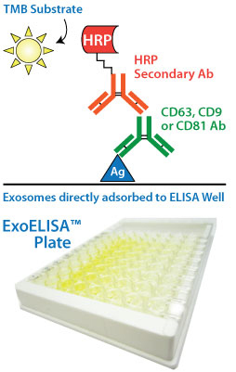
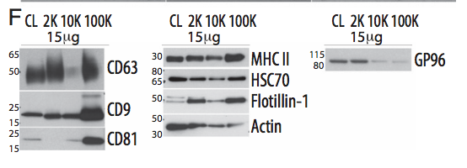
Characterization of EVs
Bulk Analysis:
  Proteomic
  Lipidomic
  Western Blot
  Small size and heterogeneity
  ﻿Small changes in specific vesicle subsets may be leveled out by bulk-based analysis and will therefore be easily overlooked → Masking Biological processes
  Difficult to determine the origin and function
Kowal et al., PNAS, 2019

Slide 4
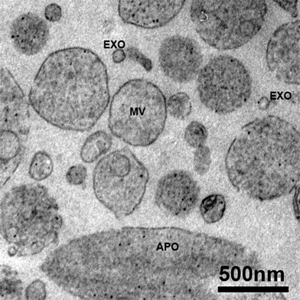
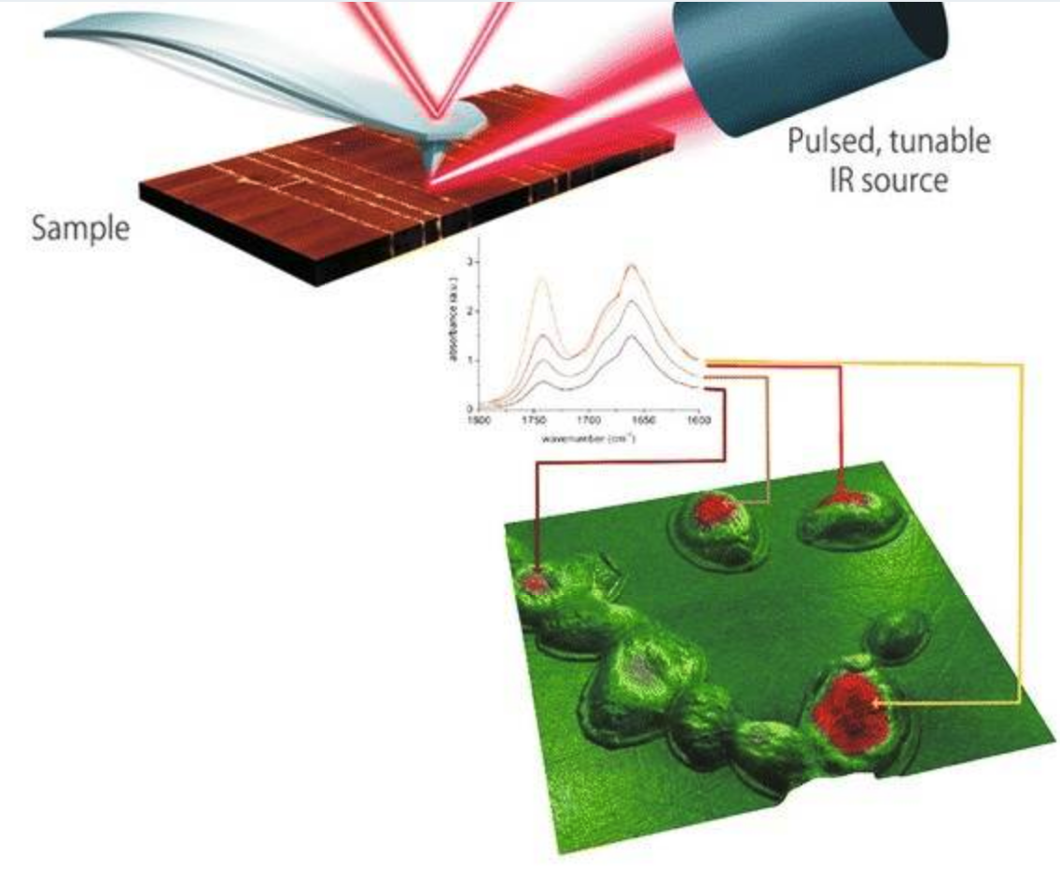
Characterization of EVs
Single Particle Analysis:
  Electron Microscopy
  Atomic Force Microscopy
Osteikoetxea et al., Org Biomol Chem, 2015
- Analysis of the large numbers of vesicles needed to study their quantity and heterogeneity
- Time consuming
Chiang et al., J Biomed Sci, 2019

Slide 5
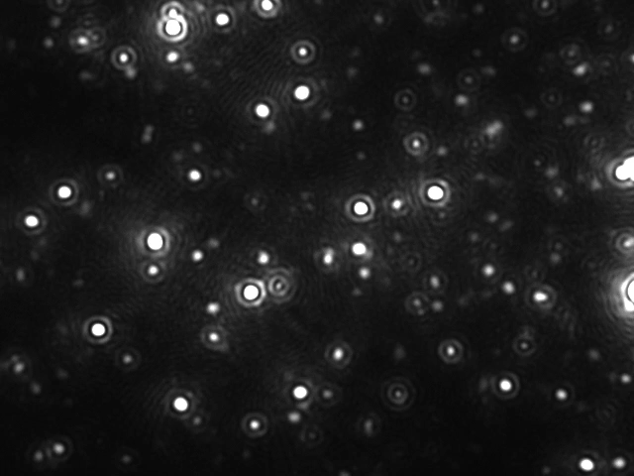
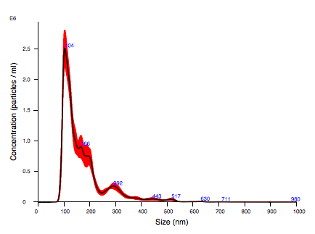
Characterization of EVs
NTA is a technique for measuring the size and concentration of nanoparticles in suspension in real time
Based on tracking the light scattered from suspended particles undergoing Brownian motion;
Tracking
Displacement
Diffusion Coefficient
Size and Concentration
Less accurate in heterogeneous samples
Has limited ability to characterize different parameters simultaneously

Slide 6
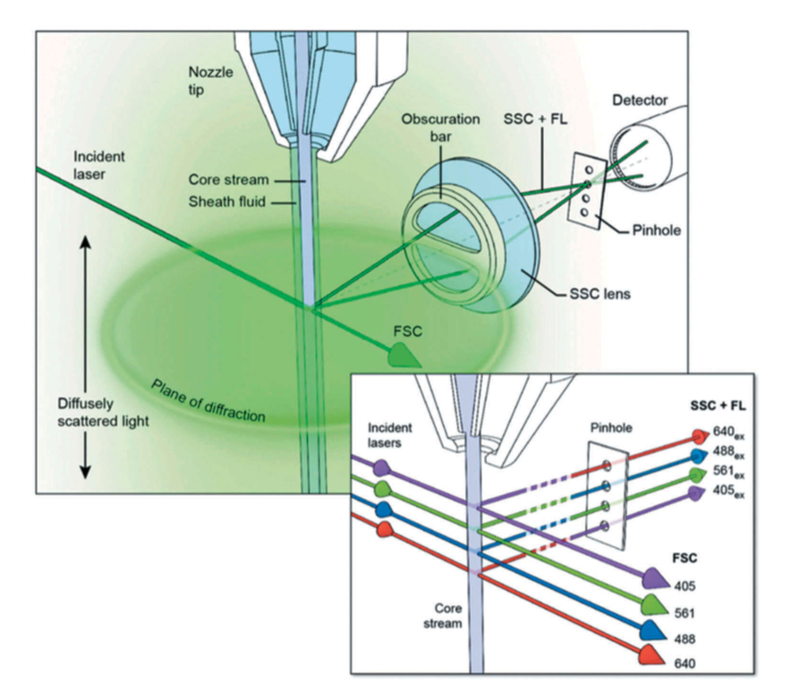
Characterization of EVs
(Flow Cytometry)
Conventional Flow Cytometry:
  Low resolution (not below 300 nm)
Optimized Flow Cytometry -> High resolution FC
  Custom electronics
  Higher laser power
  Slower flow rates
  Longer signal integration time
Morales et al., JEV, 2019

Slide 7
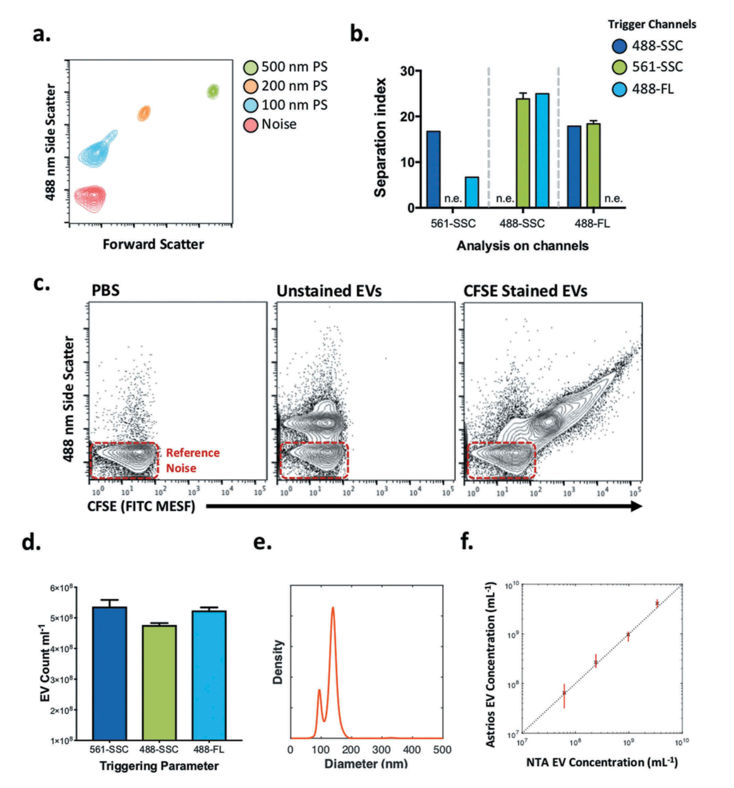
Characterization of EVs
(Flow Cytometry)
Scattering Based:
  Coincidence and swarm
  False positive events
  Low RI of EVs
  Reference materials with higher RI
  High background noise
  Unclear resolution
  Variations between instruments
Fluorescent Based:
  Lack of a generic marker
  Swarm and coincident
  Unclear about resolution (smallest size?)
  Detection of labelled contaminants
  Fluorescent intensity of EVs
Morales et al., JEV, 2019

Slide 8
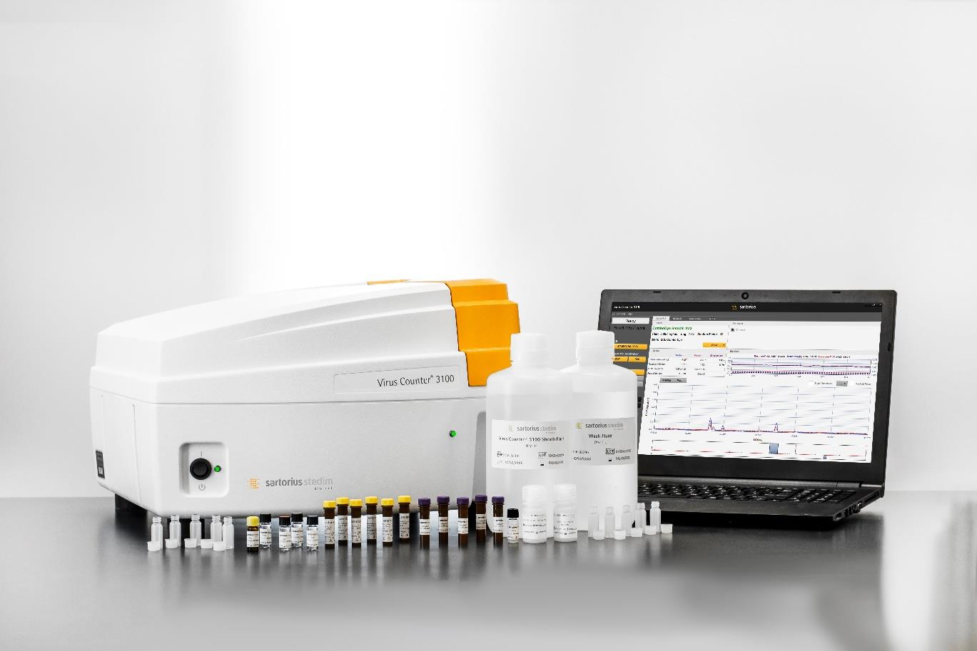
Virus Counter
Automated technology specifically developed to quantify virus particles
Fluorescent based
Reagents for labelling viruses

Slide 9
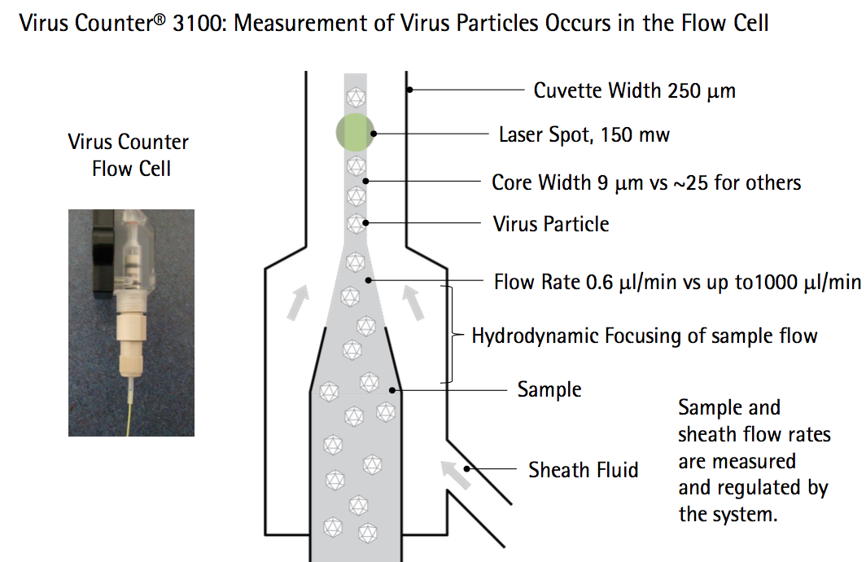
Virus Counter
Hypothesis:
Virus Counter can be used to
1. Count nanoparticles such as EVs accurately
2. Identify Subpopulation of EVs

Slide 10
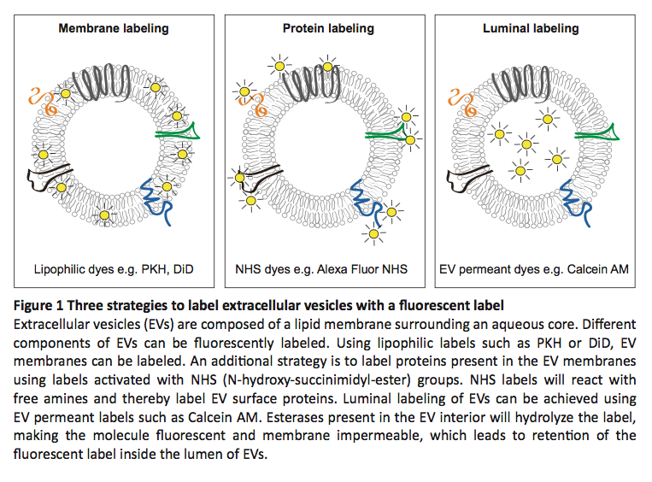
Experimental Plan
Comparing the performance of NTA and VC using fluorescent nanoparticles
Showing feasibility of Virus Counter for:
A. Counting EVs using a generic marker
B. Detection of subsets of EVs
Finding a generic marker to label and count EVs comparable to NTA count
Proving the detection of single EVs by appropriate control experiments
Testing EVs from different sources
Identifying the phenotype subsets of EVs by Virus Counter

Slide 11
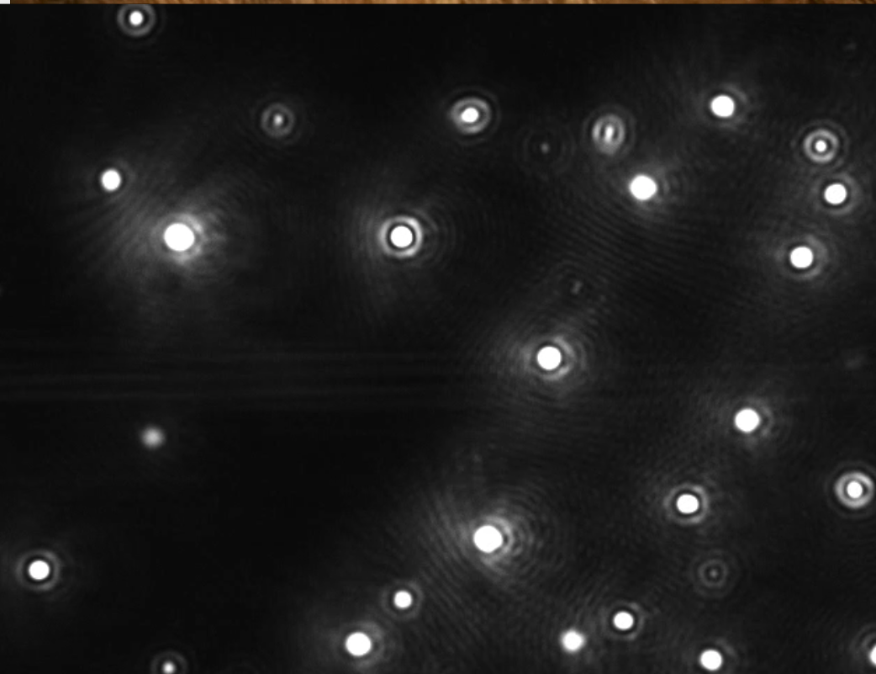
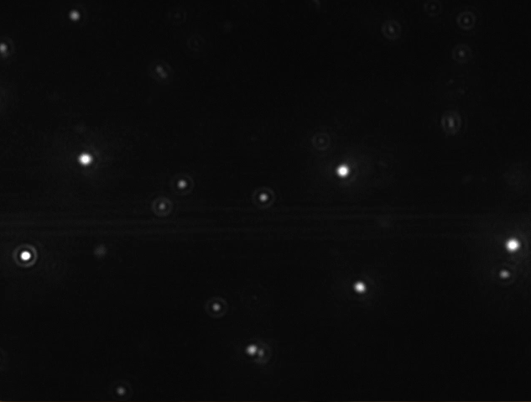
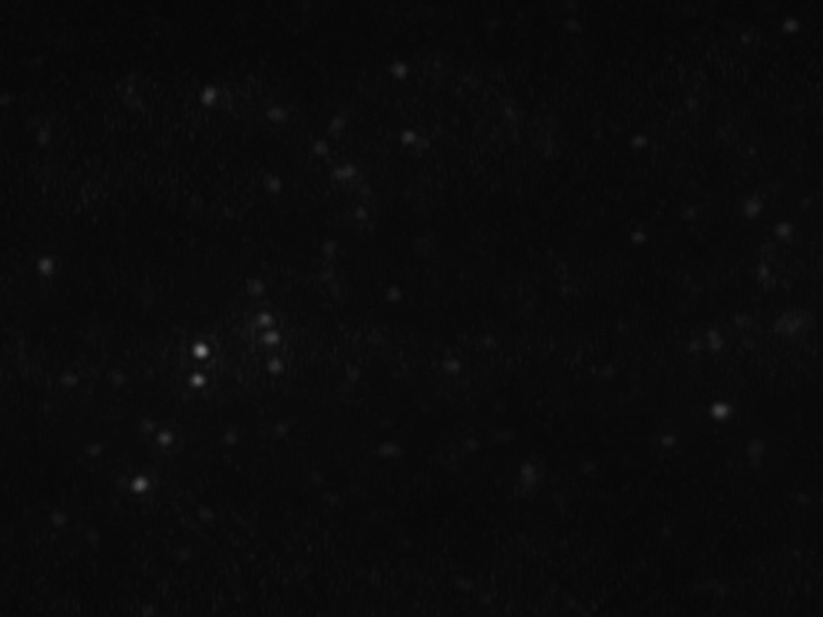
Nanoparticles Tracking Analysis
A
200 nm
Scattering Intensity:
1. Software Settings:
A. Cameral Level: Defines the sensitivity of the camera
B. Detection Threshold: Determines the minimum intensity required to consider the detected feature as a particle
2. Particles Properties:
A. Size: Intensity is proportional to the sixth power of their diameter
B. Refractive Index: EVs: 1.38-1.42
PS nanoparticles: 1.59-1.62
Silica nanoparticles: 1.46
B
100 nm
C
50 nm

Slide 12
Nanoparticle Tracking Analysis
(Size Determination)

Slide 13
Nanoparticle Tracking Analysis
(Camera Level Effect)
The effect of camera level on the measured concentration:
Significant effect on detection of 50 nm nanoparticles; Because 50 nm nanoparticles are very dim
NTA is operator dependent

Slide 14
Nanoparticle Tracking Analysis
(Linearity in Monodisperse Samples)
Measured concentration by NTA shows a linear relationship in monodisperse samples

Slide 15
Nanoparticle Tracking Analysis
(Polydisperse Samples)
Masking Effect: The intense light scattering of larger nanoparticles makes the smaller nanoparticles more difficult to detect and prevents some of them from being tracked by the software
Both 100 and 200 nm nanoparticles mask 50 nm ones leading to not detecting 50 nm particles
The masking effect in 200/100 nm mixture is not significant because both 100 and 200 nm nanoparticles are bright enough to be detected and tracked by NTA

Slide 16
Nanoparticle Tracking Analysis
(Polydisperse Samples)

Slide 17
Nanoparticle Tracking Analysis
(Polydisperse Samples)
A mixture of 50/100/200 nm particles with 1:1:1 ratio
50 nm particles are barely detected in this polydisperse sample due to the masking effect

Slide 18
Nanoparticle Tracking Analysis
(Polydisperse Samples)
Masking effect can be observed in different mixture ratio of 50/100/200 nm samples
Increasing the ratio of 50 nm to the ratio of 100 and 200 nm nanoparticles leads to detection of a larger number of 50 nm ones and the masking effect is less pronounced
This confirms the masking effect observed in polydisperse samples

Slide 19
Nanoparticle Tracking Analysis
(Concentration Analysis of Polydisperse Samples)
Masking effect in mixtures with 2 nanoparticles
(1:1 ratio)
Masking effect in mixtures with 3 nanoparticles
(Different ratio of 50:100:200 nm)

Slide 20
Virus Counter
(Linearity in Monodisperse Samples)
Measured concentration by VC shows a linear relationship in monodisperse samples

Slide 21
Virus Counter
(Polydisperse Samples)
Measured the true concentration by VC in mixtures of 2 nanoparticles

Slide 22
Virus Counter
(Polydisperse Samples)
Measured the true concentration by VC in mixtures of 3 nanoparticles

Slide 23
Virus Counter
(Polydisperse Samples)
Measured the true concentration by VC in mixtures of 3 nanoparticles with different ratios

Slide 24
Comparison of NTA and VC
Nanoparticle Tracking Analysis
Virus Counter

Slide 25
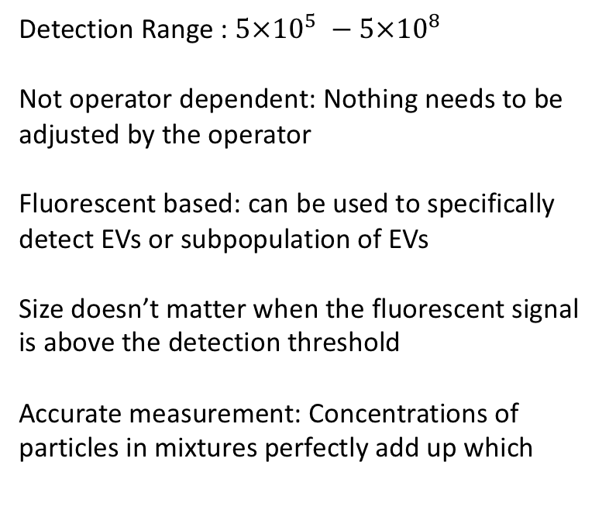
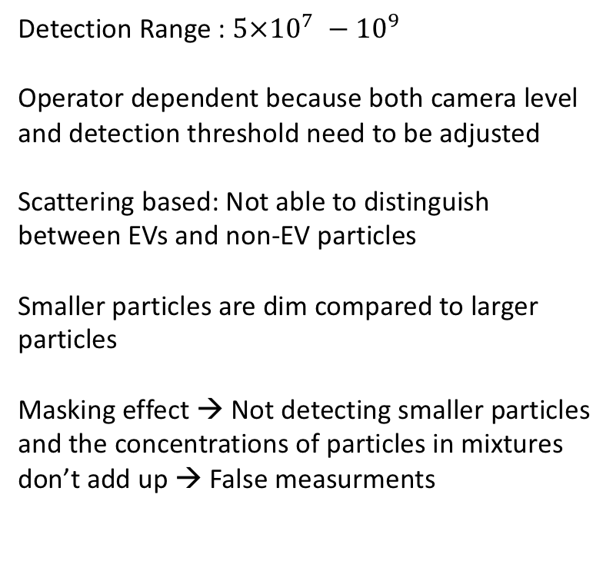
Comparison Conclusion
Nanoparticle Tracking Analysis
Virus Counter
Detection Range : ${5×10}^{7} −{ 10}^{9}$
Operator dependent because both camera level and detection threshold need to be adjusted
Scattering based: Not able to distinguish between EVs and non-EV particles
Smaller particles are dim compared to larger particles
Masking effect → Not detecting smaller particles and the concentrations of particles in mixtures don’t add up → False measurments
Detection Range : ${5×10}^{5} −{5×10}^{8}$
Not operator dependent: Nothing needs to be adjusted by the operator
Fluorescent based: can be used to specifically detect EVs or subpopulation of EVs
Size doesn’t matter when the fluorescent signal is above the detection threshold
Accurate measurement: Concentrations of particles in mixtures perfectly add up which

Slide 26
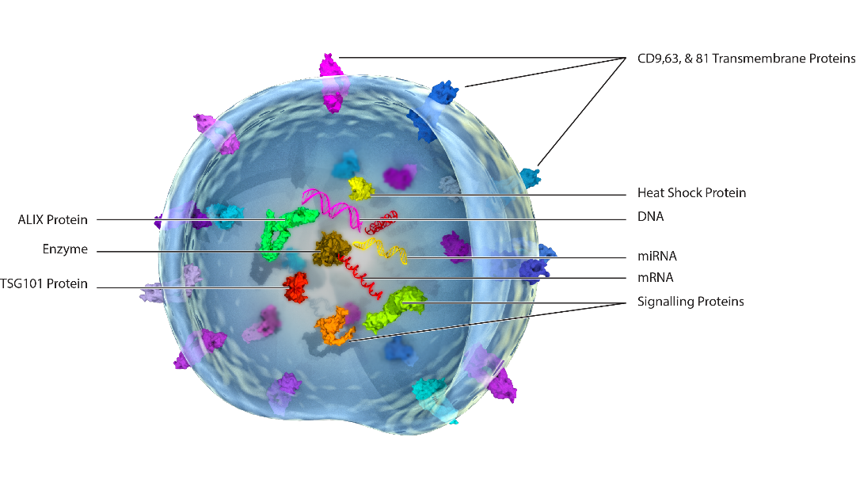
Analysis of EVs
Purified urinary exosomes were purchased from HansaBioMed
Exosomes were labelled using primary and secondary antibodies

Slide 27
Analysis of EVs
Coincident Region
Swarm Region
Linear Region

Slide 28
Analysis of EVs
Swarm Region
False Positive Linear Region
True Linear Region

Slide 29
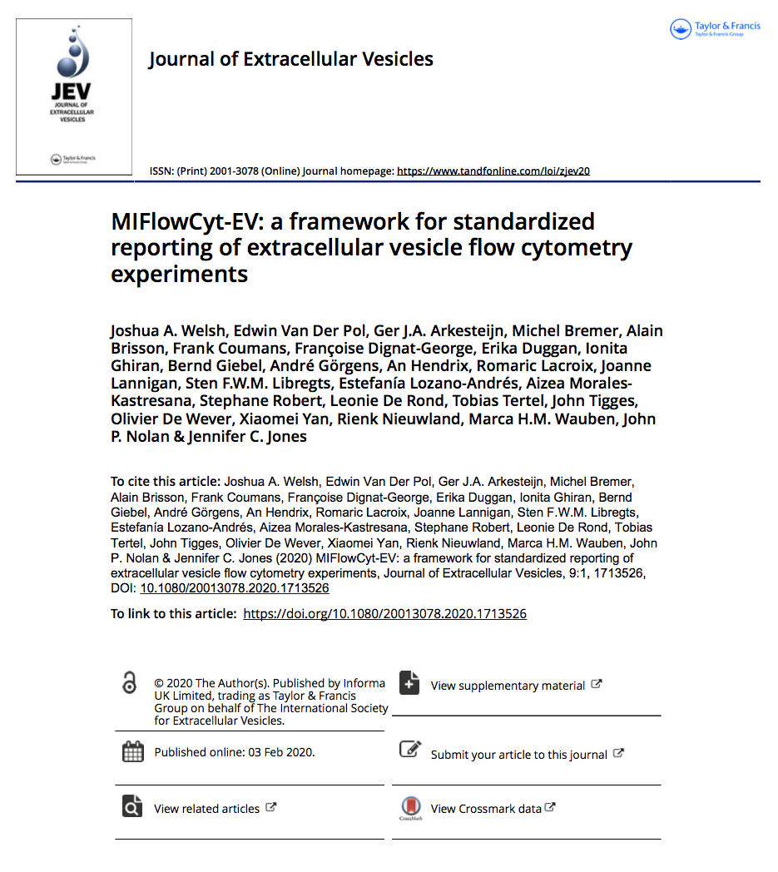
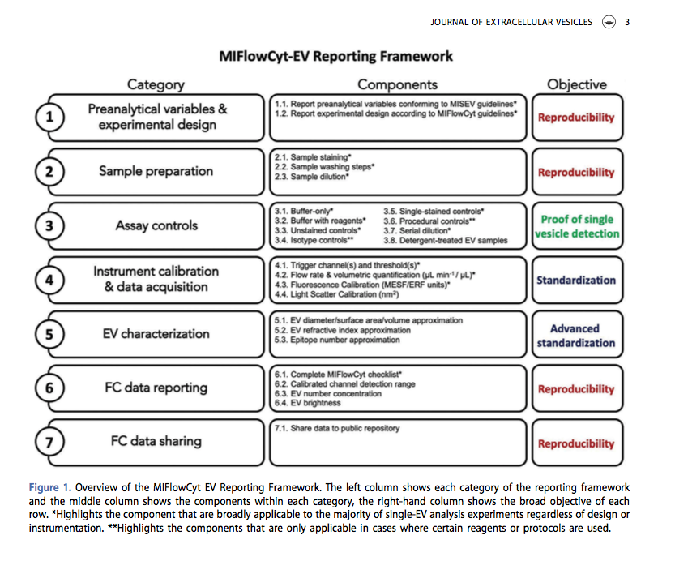
A Framework for Studying EVs by Flow Cytometry

Slide 30
Progress on the Experimental Plan
Comparing the performance of NTA and VC using fluorescent nanoparticle → (Completed)
Showing feasibility of Virus Counter for:
A. Counting EVs using a generic marker → (Completed)
B. Detection of subsets of EVs → (Completed)
Finding a generic marker to label and count EVs comparable to NTA count → On Going
Proving the detection of single EVs by appropriate control experiments → On Going
Testing EVs from different sources → On Going
Identifying the phenotype subsets of EVs by Virus Counter → On Going

Slide 31
Aims and Goals
EVs can be used as biomarkers and for clinical applications
Accurate and standardized quantification and detailed phenotypic analysis of EVs is important for biomarker profiling and therapeutic applications
The Big Problem: A robust and high resolution method for characterization and analysis of EVs
The narrower problem: Available methods are bulk measurements and unsuited for precise analysis of single vesicles
Yet narrower problem: Available single vesicle analysis methods can not detect large number of EVs to study their heterogeneity and has limited ability to study different parameters
We present a an accurate, automated, simultaneous, high throughput, single particle and multiparameter technique → Virus Counter

Slide 32
THANK YOU !!!!

Slide 33
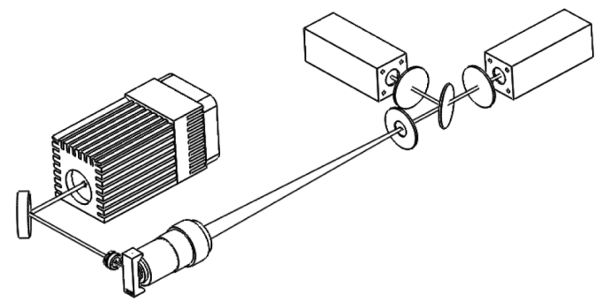
Optical Sub-System
Bandpass Filter
Protein / ViroTag® 2 PMT
Nucleic Acid / ViroTag® 1 PMT
Laser
Bandpass Filter
Dichroic Mirror
Spatial Filter
Collection Optic
Flow Cell
Mirror
Excitation Optic
19. Oktober 2017
Seite 50
Notes:
Explains the set up of laser, flow cell and the 2 PMTs

Slide 34
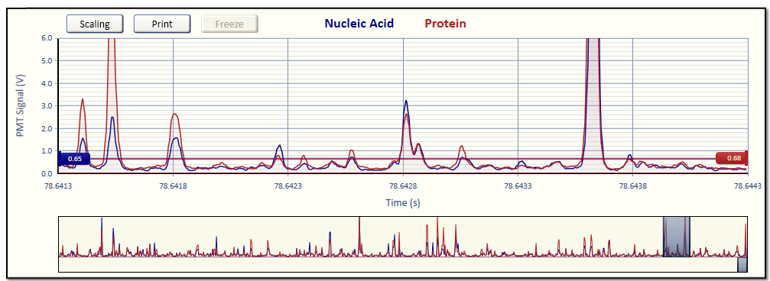
How Are Peaks Found?
Events: 211068 Total volume: 600 nL = 0.0006 mL
1 vp/event * 211068 events / 0.0006 mL = 3.52 x 10⁸ vp/mL
Notes:
Peaks are counted as events when certain criteria for height are met. We use a dynamic thresholding algorithm that makes a histogram of the voltages on a given PMT every 40 milliseconds and fits to a Gaussian. Threshold is 5 standard deviations. Counts are recorded and, at the end of the run, a concentration in vp/mL is extrapolated based on the number of counts and the total volume of sample.

Slide 35
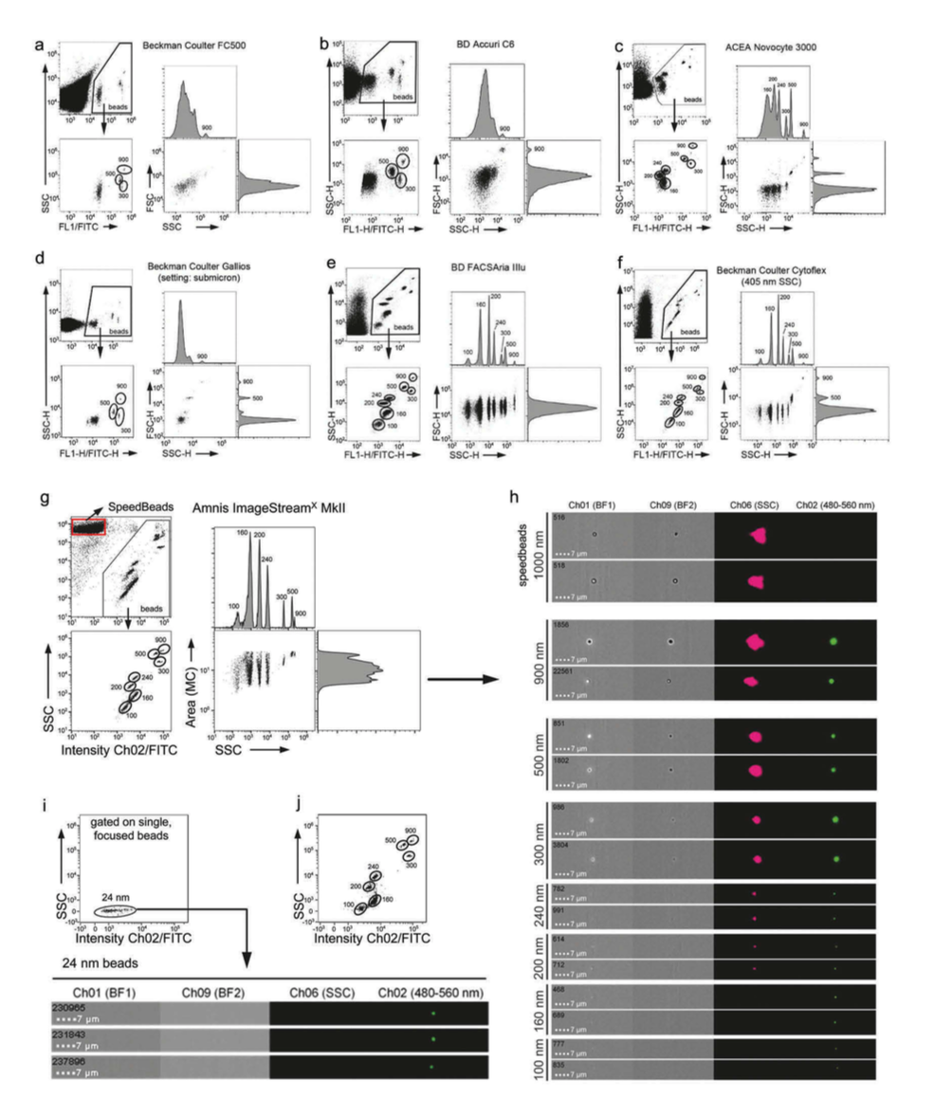
Characterization of EVs
(Flow Cytometry)
Imaging Flow Cytometry:
  Flow cytometry + Imaging
  Individual visualization and quantification
  Analyzed 24 nm fluorescent polystyrene beads

Slide 36
Background
It is a major aim of the field to set up and define methods in order to facilitate robust detection of such heterogeneity within given EV samples, especially in EV fractions containing EVs smaller than 200 nm (sEVs), which very likely are highly enriched for exosomes [5,8].
Cell-derived EVs are attracting wide attention as media- tors and indicators for a range of physiological and pathologi- cal processes, making them attractive therapeutic or diagnostic targets. However, their small size presents chal- lenges to the quantitative analyses required to realize their potential use. EVs present in blood or other bodily fluids are likely to be heterogeneous with respect to the cell of origin, their composition, and the physiological effects they mediate, which makes the analysis of bulk properties less meaningful. A better alternative would be to have a system that can perform single EV analysis and characterization.

