Slide 1
Research in Progress
Raman-Silent Magnesium Fluoride Nanomembranes and Their Uses in Biosensing
Greg Madejski, University of Rochester, Biomedical Engineering

Slide 2
Outline
Development of a non-silicon nanomembrane for Raman-compatible cell-culture
Development of a novel Raman sensing structure for sensitive identification of molecules
MgF₂
Si
Si
Au
MgF₂

Slide 3
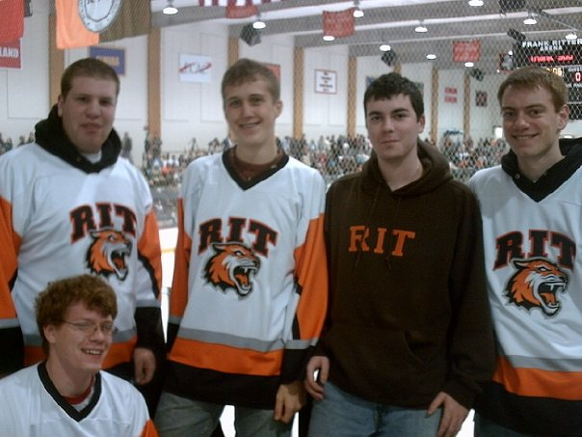
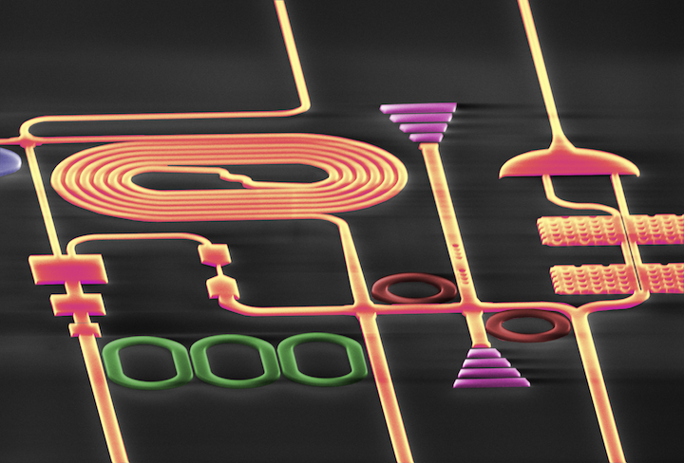
Who Am I? How did I get here?
2010 – Graduate RIT
2011 – Work in RIT Nanophotonics Lab
2012 – Pass First Year Exam, Work in McGrath Lab
Notes:
Microelectronic engineering: making computer chips. Semiconductor processing
I took a year after graduation and worked as a lab tech in a nanophotonics lab, where we worked on making really efficient waveguides for high speed computing. I decided that I’d prefer to try and see if I could apply my process engineering to biology, and I ended up with Jim McGrath in the nanomembranes research group.

Slide 4
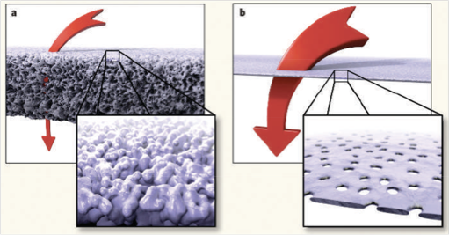
Si Nanomembrane Technology
Silicon filter material
          thin (50 nm)
          highly porous
          chemically stable
          mechanically robust
          scalable manufacturing
Abbreviations
Porous nanocrystalline silicon: pnc-si
Nanoporous silicon nitride: NPN
Nanoporous: np
a) van den Berg and M. Wessling, Nature 2007, b) Streimer, Nature 2007
Notes:
I work with silicon nanomembranes, based off a discovery by chris striemer back in 2007. He took a very thin sheet of silicon (50nm) and heated it up quickly to form little nanocrystals. Exposing the thin sheet of silicon revealed voids in the material, creating nanopores. There are many advantages to this kind of filter compared to a traditional polymer membrane.

Slide 5
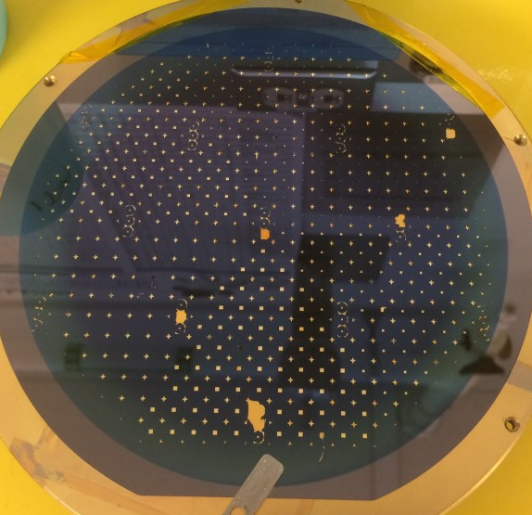
Enabling Technology
Develop new nanomembrane materials
  Keep optical, transport advantages of tiny nanomembrane geometries
  Adapt Si nanomembrane platform for new metrology methods (Raman)
  Add new sensing ability
6” wafer, hundreds of nanomembranes made with semiconductor processing
Notes:
My work in particular has been developing non-silicon versions of these membranes, to imitate the wonderful physical properties of these structures, but out of different materials to create new functionality. The techniques I use are all compatible with manufacturing these wafers at scale, extending the availability of these membranes.

Slide 6
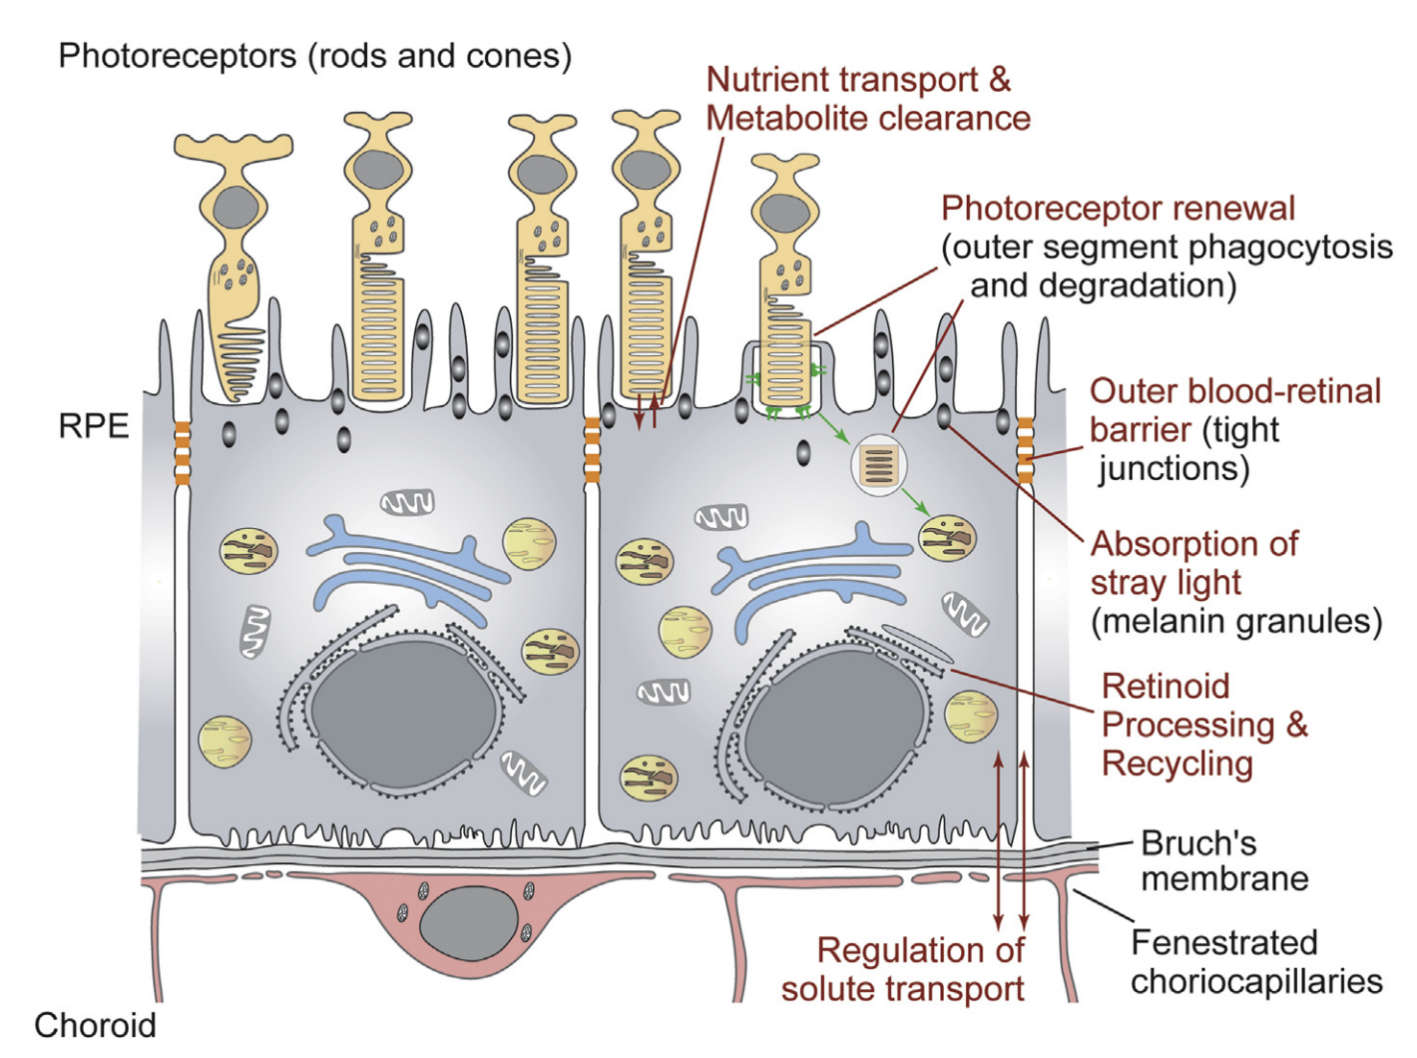
RPE Functions
Lehmann, G. L., et al. (2014). "Plasma membrane protein polarity and trafficking in RPE cells: Past, present and future." Experimental Eye Research 126: 5-15
Notes:
Why have I done this work? Degenerative eye disease. I am interested in a physiological question where we can study the retinal pigment epithelum in vitro. It’s responsible for many different functions and is disrupted in disease. Consider this layer of cells at the back of your eye, providing many different functions necessary to both the retinal cycle and homeostasis in general

Slide 7
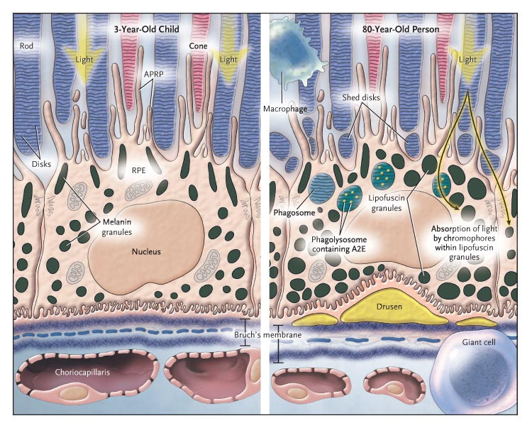

RPE Ocular Disease
Transport is compromised
Photoreceptor health is not maintained
Photoreceptor death leads to blindness
de Jong, P. T. V. M. (2006). "Age-Related Macular Degeneration." New England Journal of Medicine 355(14): 1474-1485.
Notes:
Macular degeneration causes people to go blind. Compared to the retina of a 3-year old, a dysfunctional RPE causes photoreceptors to die off. The accumulation of Drusen is the classic symptom of this disease, yellowish deposits underneath the RPE. AS the RPE maintains the health of the outer retinal, it governs the flow of water and solutes into the outer retinal space.

Slide 8
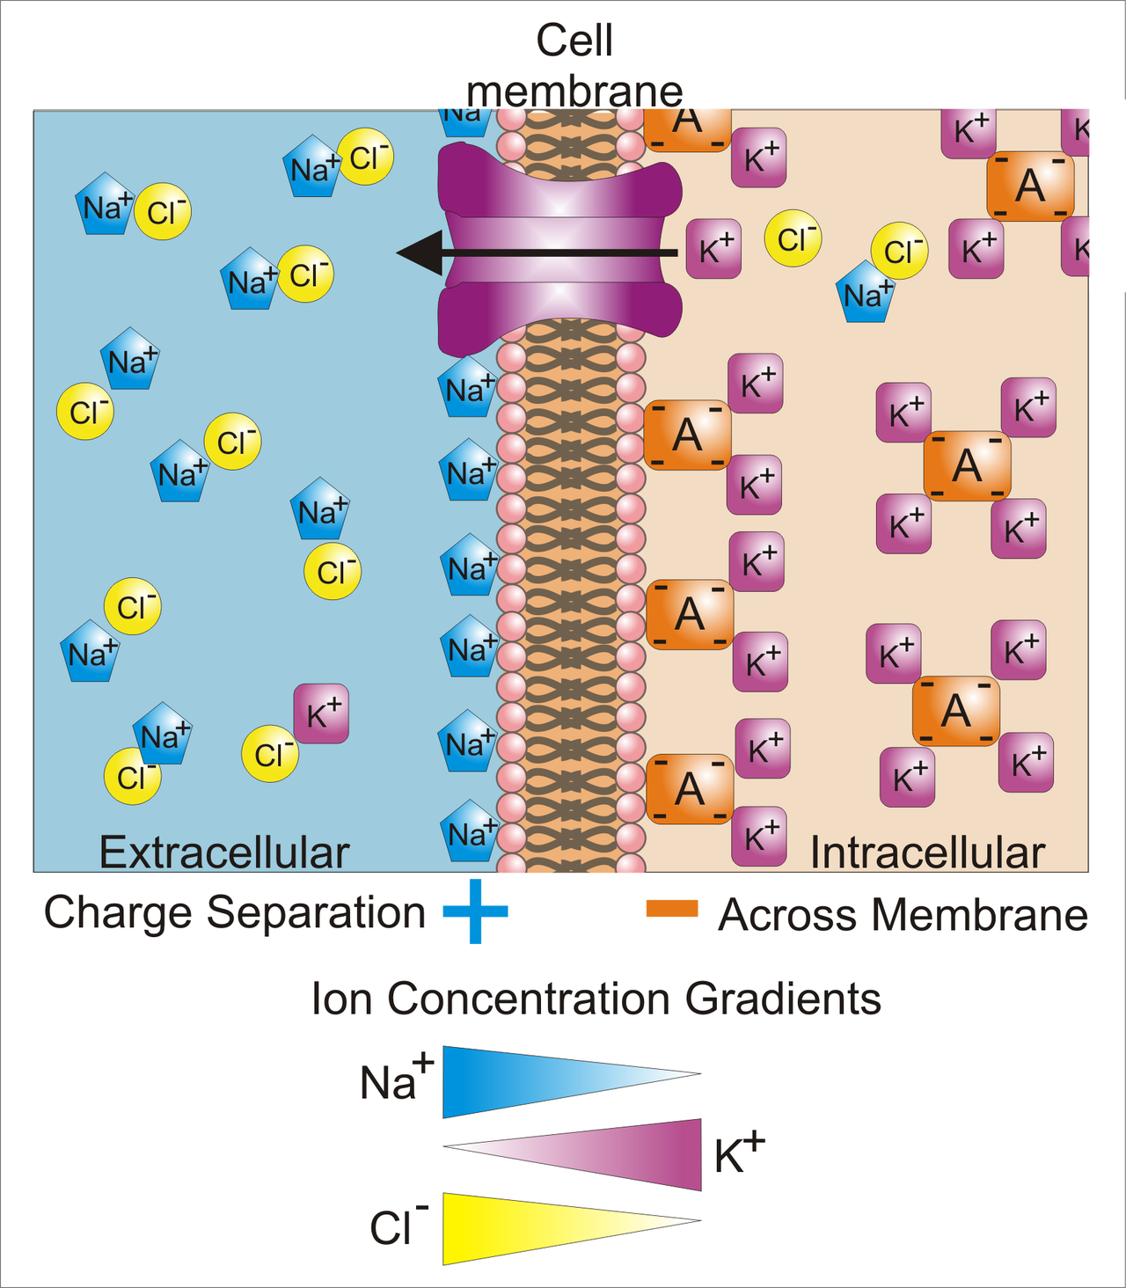
Barrier Study ex vivo
Ussing Chamber
  Late 1940’s
  Clamp Frog Skin
  Determine ionic permeability
    Add channel blockers to determine individual contributions
Wikipedia

Slide 9
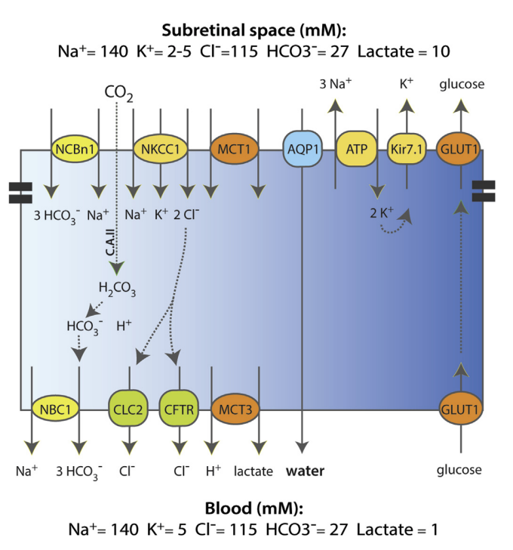
Human RPE Transport Diagram
Largely isotonic
Low Paracellular
Transport
Where does the water go?
Lehmann, G. L., et al. (2014). "Plasma membrane protein polarity and trafficking in RPE cells: Past, present and future." Experimental Eye Research 126: 5-15
Notes:
Over time we’ve built up a nice picture of different channels involved in maintaining the subretinal space. Sodium and potassium, and chloride gradients are largely isotonic, so there isn’t a lot of osmotic pressure driving fluid transport. Aquaporins move a lot of water.

Slide 10
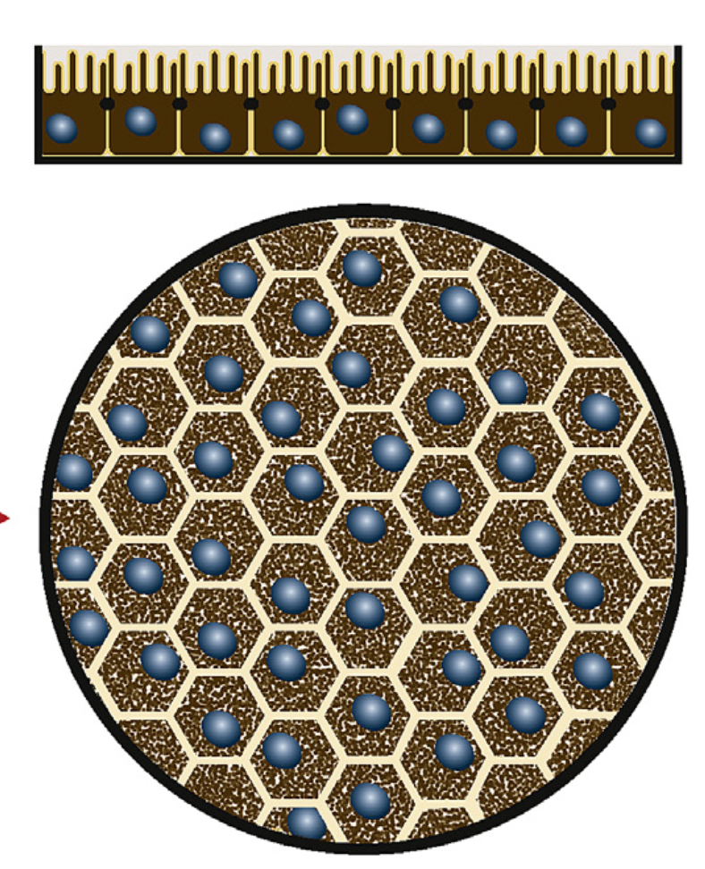
Water Transport Physiology
Outer Retina
H₂O
Needs a permeable support for proper morphology
Retinal Pigment Epithelium
in Vitro
Pffefer and Philp, “Cell Culture of the Retinal Pigment Epithelium”, Experimental Eye Research, 2014
Notes:
I am particularly interested in models of water transport in an in vitro model of the retina. It’s difficult to develop a method that looks at the water alone! Fluorophore diffusion is not the same as water diffusion

Slide 11
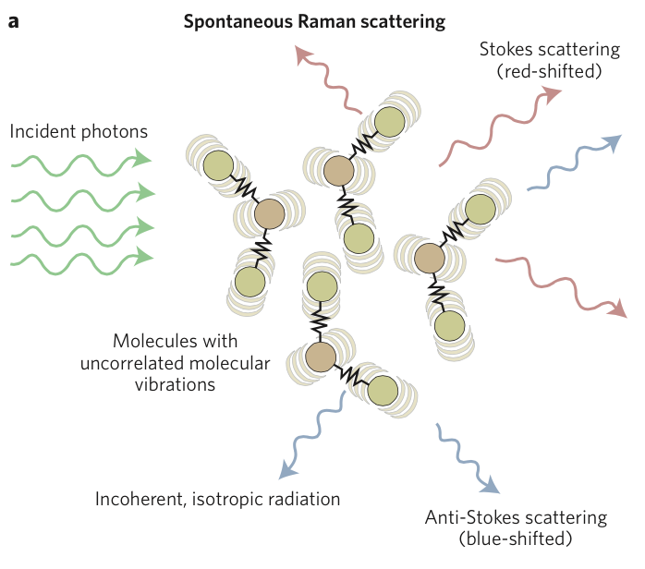
New Tool: Raman Spectroscopy
“Chemically sensitive bioimaging with coherent Raman scattering”, Camp and Cicerone, Nature Photonics, 2015
Notes:
I am interested in eye physiology and water transport. One technique that we can use to directly observe water transport is known as Raman spectroscopy. The process works off of a phenomenon known as the Raman shift. Most light is scattered elastically, that is green light scatters off a surface and remains green. But every one in few million photons comes out either blue or red. This inelastically scattered light can tell us what was illuminated. By collecting all the colors of light, we can create a spectrogram of the material.

Slide 12
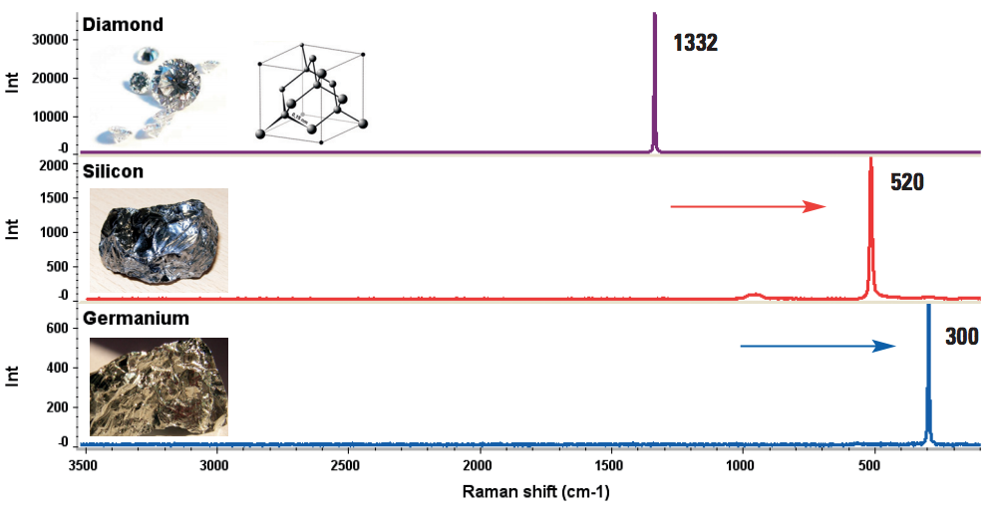
Raman Theory
Group IV Elements
‘Characterizing Carbon Materials with Raman Spectroscopy’ Joe Hodkiewicz, Thermo Fisher Scientific, Madison, WI, USA, App #51901
Notes:
Not all materials behave the same. Raman responds to molecular bond orientation. Here we have group 4 elements all producing a strong characteristic spike., shifted along different wavelengths.

Slide 13
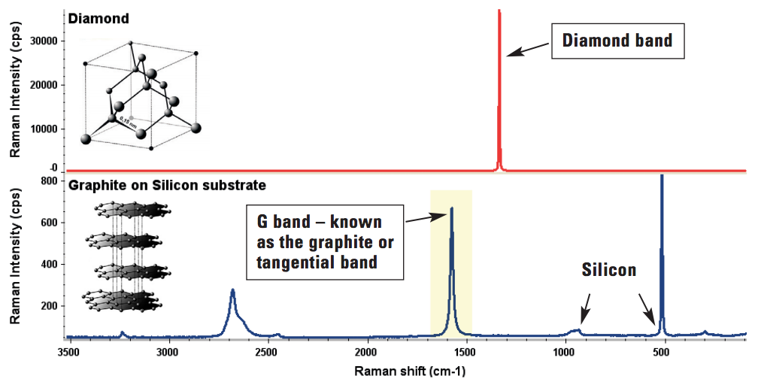
Raman Theory
‘Characterizing Carbon Materials with Raman Spectroscopy’ Joe Hodkiewicz, Thermo Fisher Scientific, Madison, WI, USA, App #51901
Notes:
All of the signals can add, and you can discriminate what is in the observation volume by pulling apart the superimposed signatures.

Slide 14
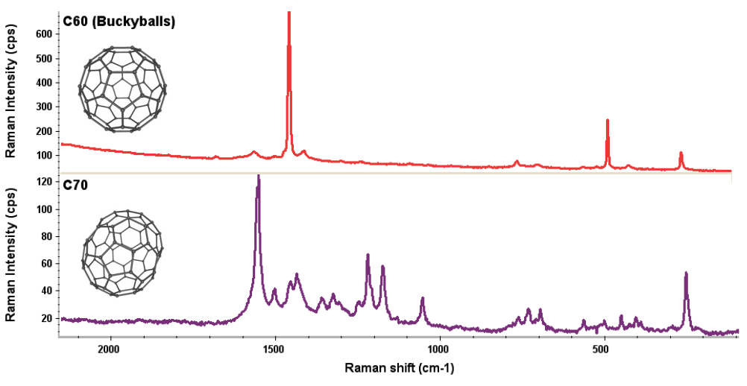
Raman Theory
“Raman-silent” materials: Quartz, CaF_{2,} MgF₂
‘Characterizing Carbon Materials with Raman Spectroscopy’ Joe Hodkiewicz, Thermo Fisher Scientific, Madison, WI, USA, App #51901
Notes:
Not all materials behave the same. Even allotrophic forms of carbon produce wildly different signatures.

Slide 15
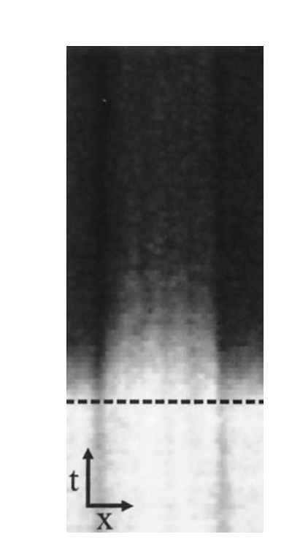
Imaging Water Transport by Raman
D₂O
Potma, E. O., et al. (2001). "Real-time visualization of intracellular hydrodynamics in single living cells." Proceedings of the National Academy of Sciences 98(4): 1577-1582.
Notes:
If you take a line scan above a bunch of isolated cells, you can observe the ratio of Deuterium to Water change

Slide 16
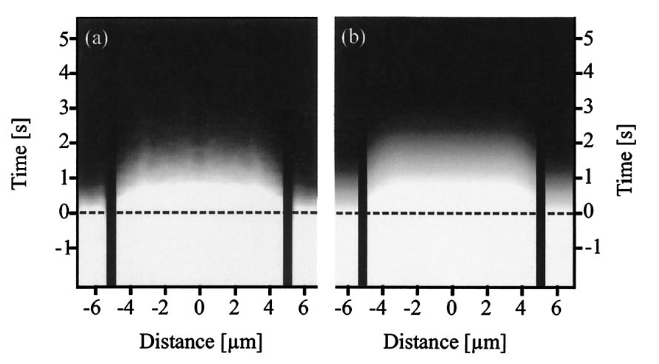
Imaging Water Transport by Raman
Experimental
Simulation
Potma, E. O., et al. (2001). "Real-time visualization of intracellular hydrodynamics in single living cells." Proceedings of the National Academy of Sciences 98(4): 1577-1582.
Notes:
If you lump together a bunch of these cells, you can calculate a time constant for water moving through the cells. A) experimental data, B) a simulation with a permeability of 2.2 um/s

Slide 17
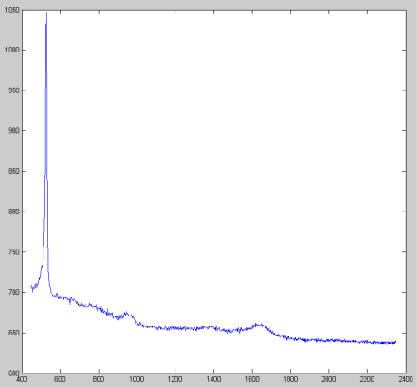
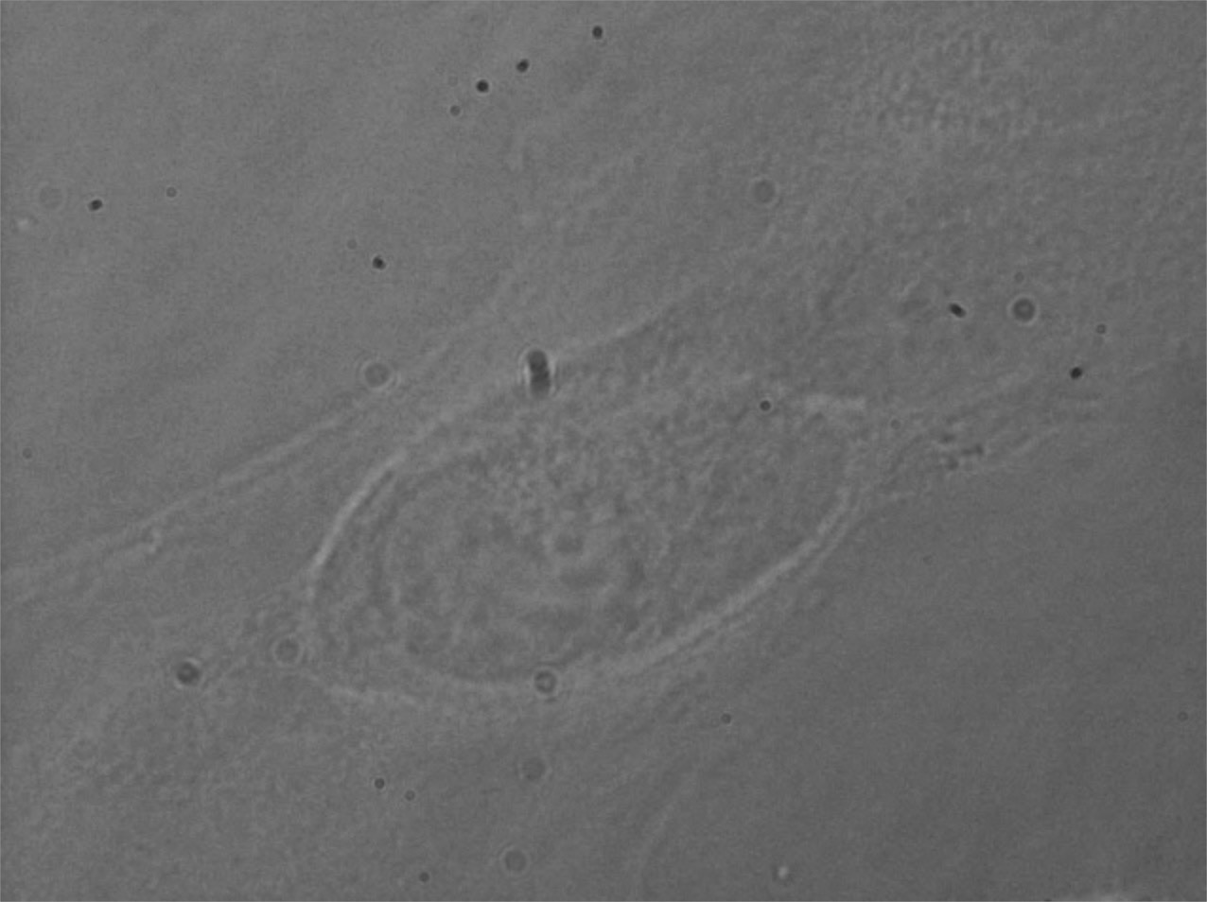
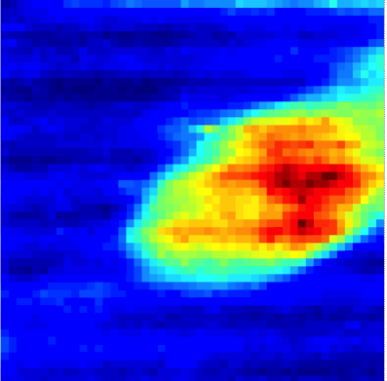
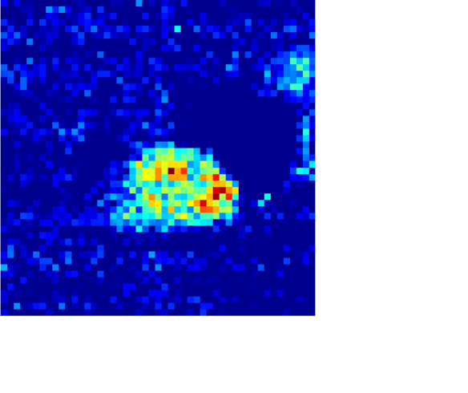
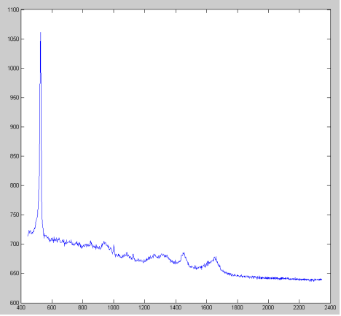
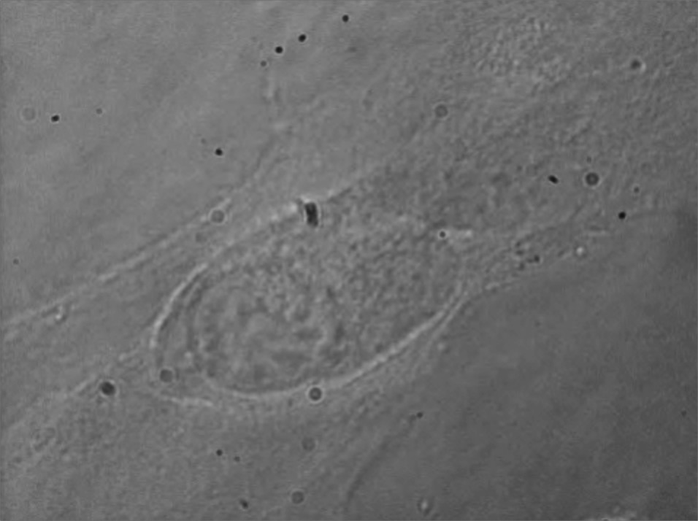
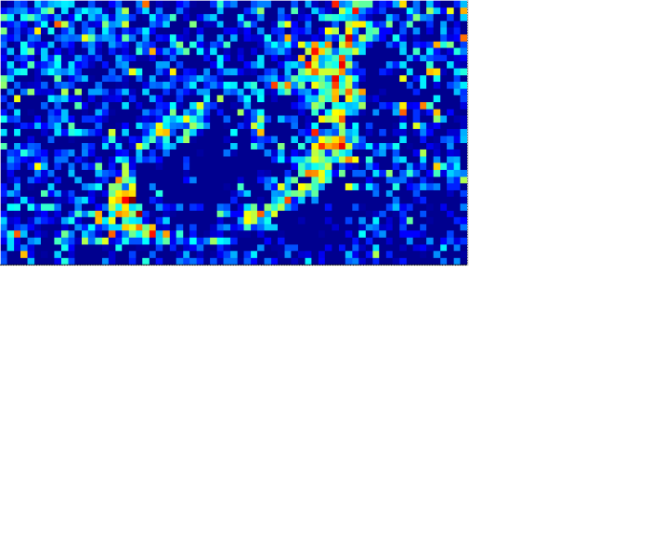
Brightfield
2d Raman
Si Nanomembrane
Raw
DNA
High background signal from Si
Measurement takes 2.5 hours!
Remove Si, make faster measurements
Si Nanomembrane + Cell
RNA

Slide 18
Fabrication - Strategy
Evaporation
50 nm MgF₂
50 nm NPN
Si
Si
RIE

Slide 19
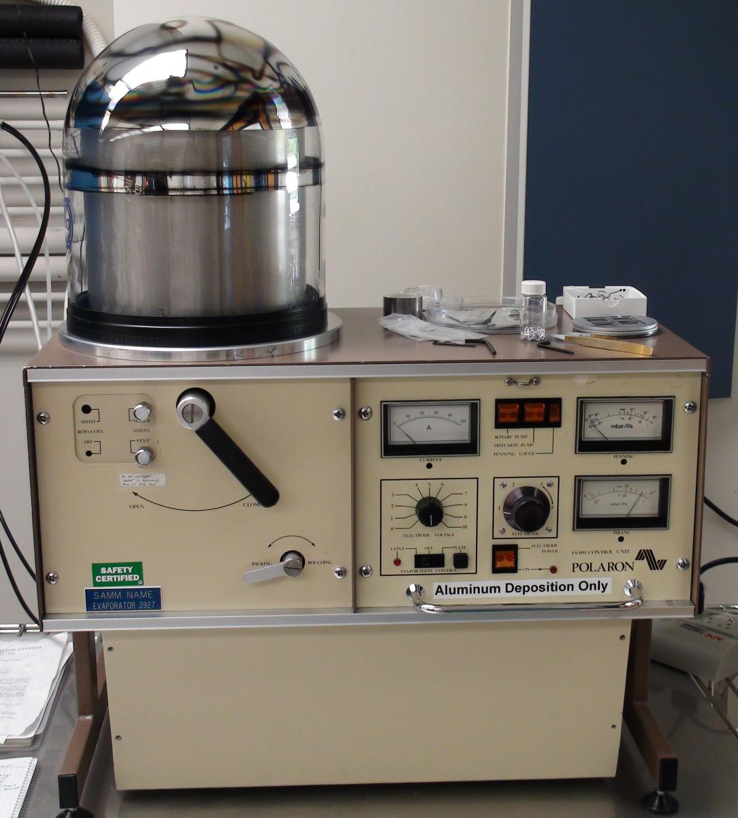
Fabrication - Technique
Evaporator
Create very even thin layers of material
  Melted in a crucible
  0.1-1.0 nm/sec

Slide 20
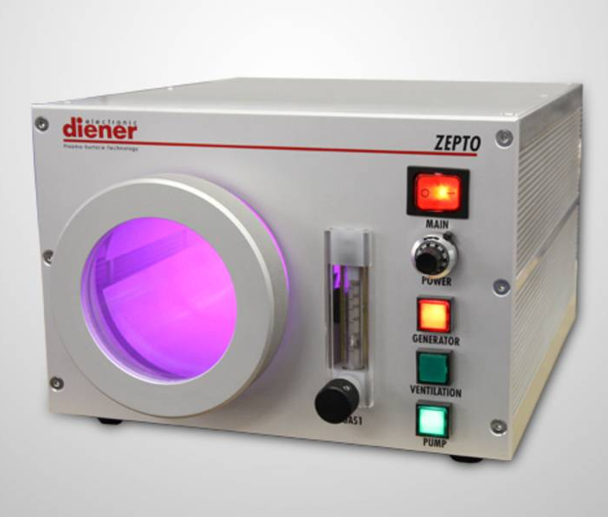
Fabrication - Technique
RIE Plasma Etcher
Selectively removes material through reactive ion volatility
  1-5 nm/sec
  Variable gas compositions give different etch characteristics

Slide 21
Fabrication - Structure
Evaporation
Nanopore Filling
Anneal, 700 C, 2 hrs
50 nm MgF₂
50 nm NPN
Si
Si
Evaporation: 0.2 nm/sec, MgF_{2,} 6KV, Platen Rotation, Room Temp
RIE: 9:1 CHF₃:O₂, 100 mTorr, 70 W, 40-50 nm/min
RIE

Slide 22
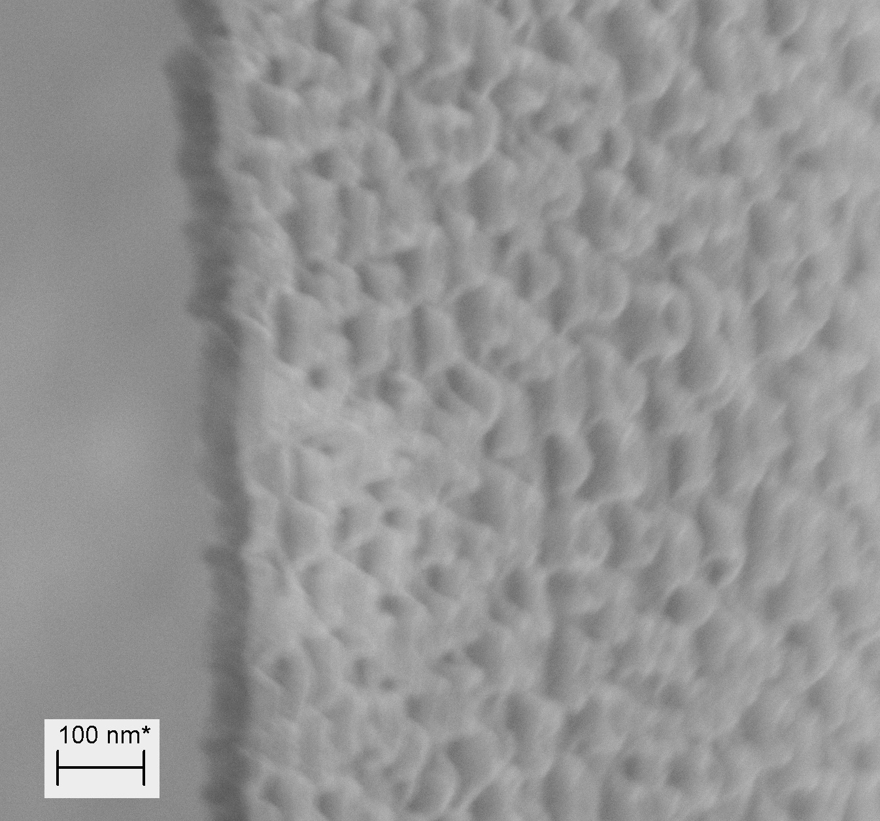
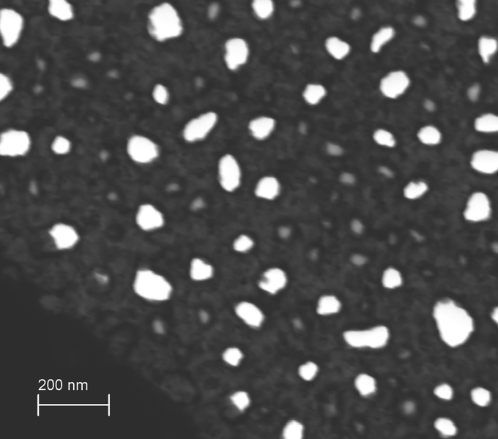
Electron Micrographs

Slide 23
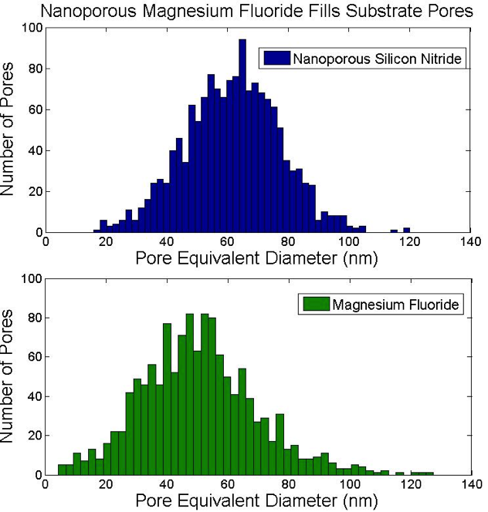
Pore Sizes

Slide 24
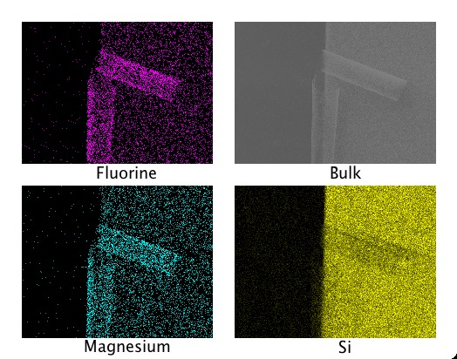
Material - EDS
Over 85% MgF₂

Slide 25
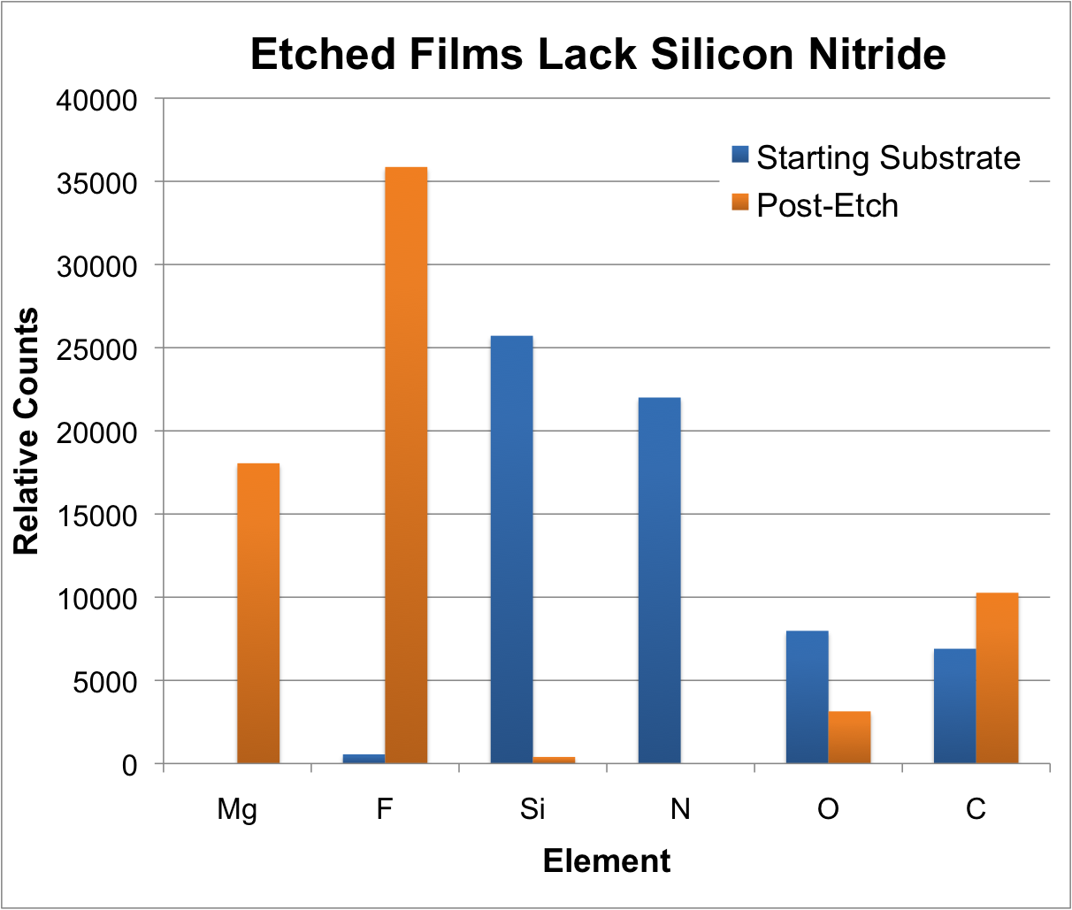
Material - XPS

Slide 26
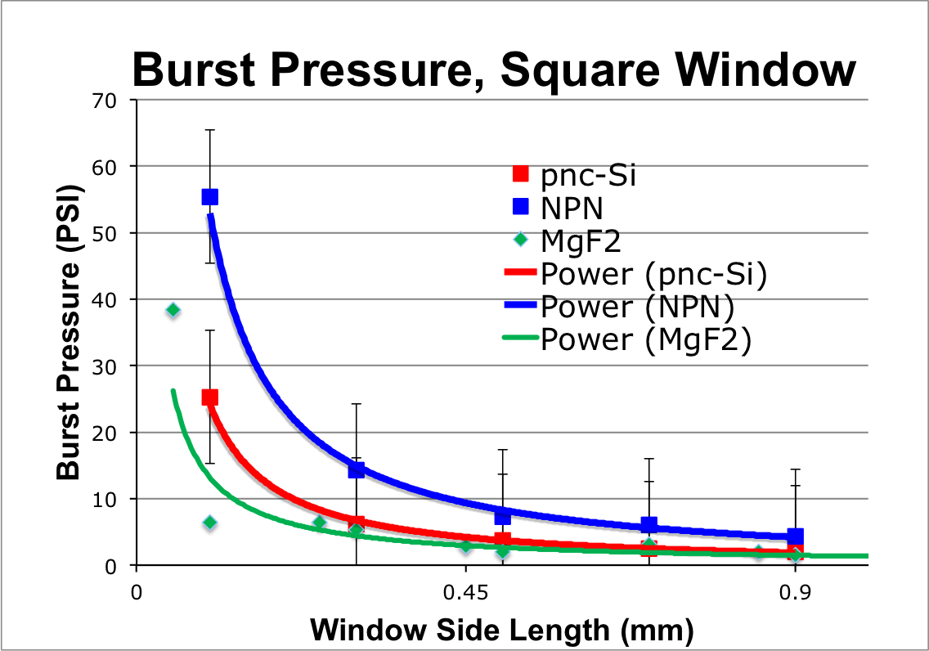
Mechanical Strength

Slide 27
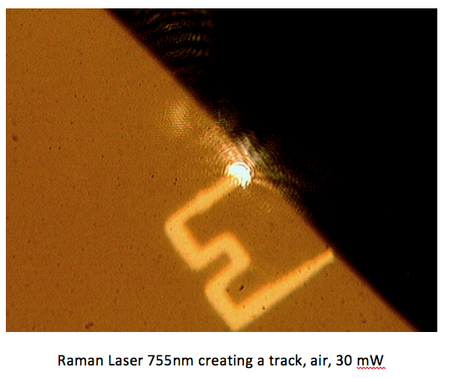
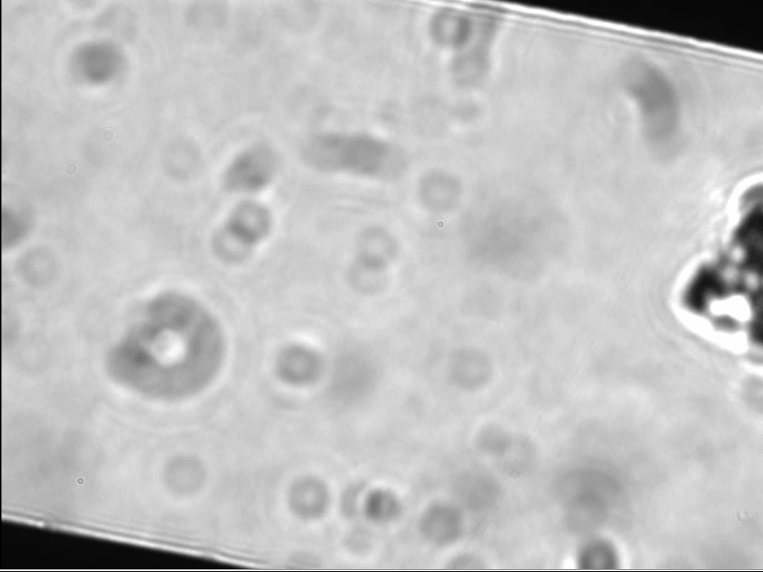
Membrane Durability Under Laser Exposure
pnc-Si
MgF₂
30 mW
450 mW
15x Power vs pnc-Si = 15x Quicker Measurements

Slide 28
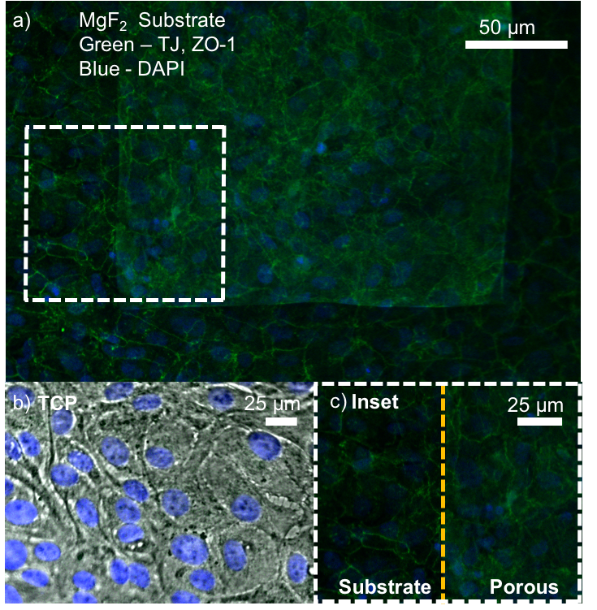
Cytocompatibility
D23 ARPE-19 cells on nanoporous MgF₂
TJ formed on whole of substrate

Slide 29
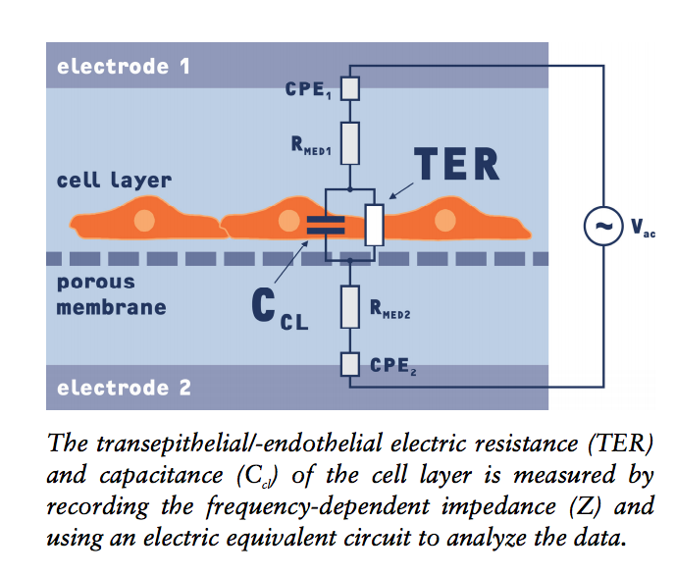
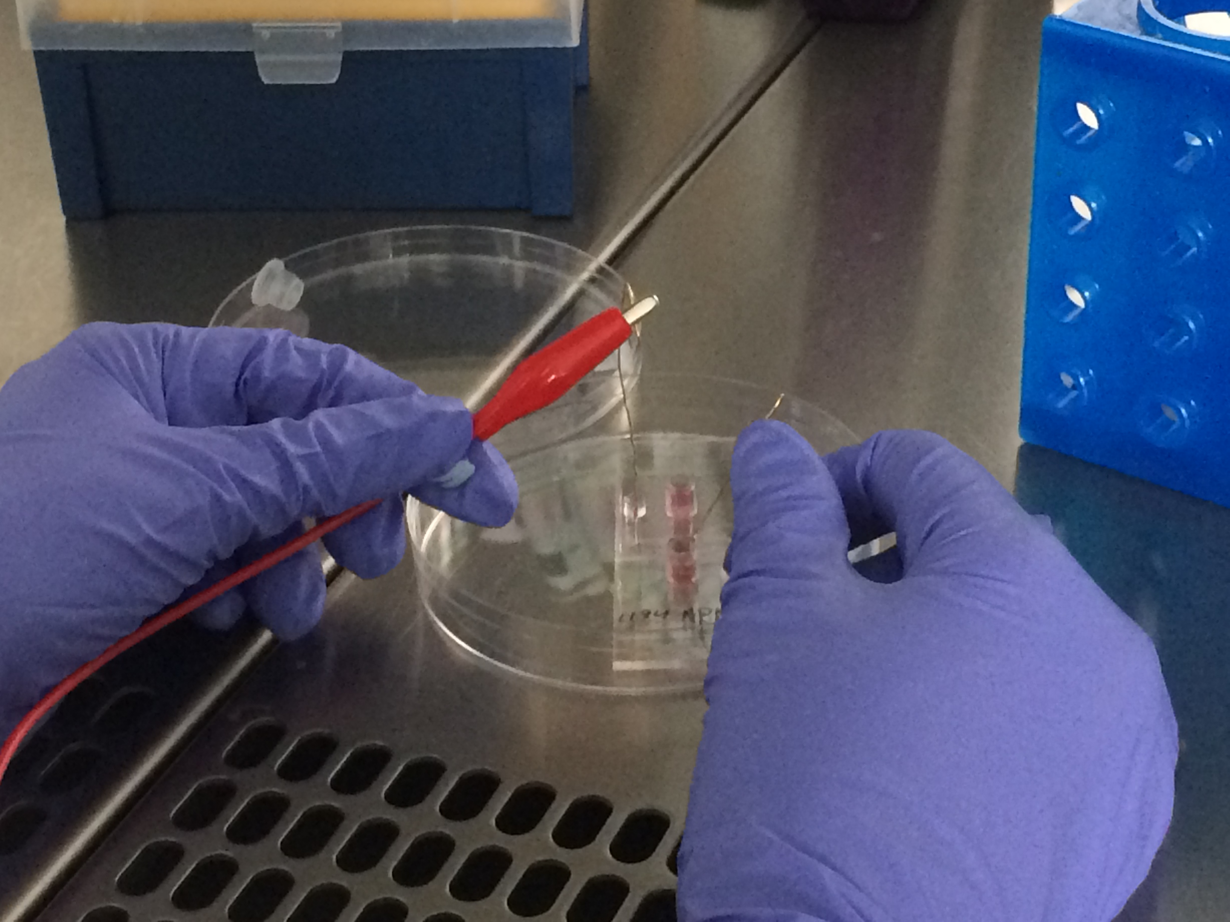
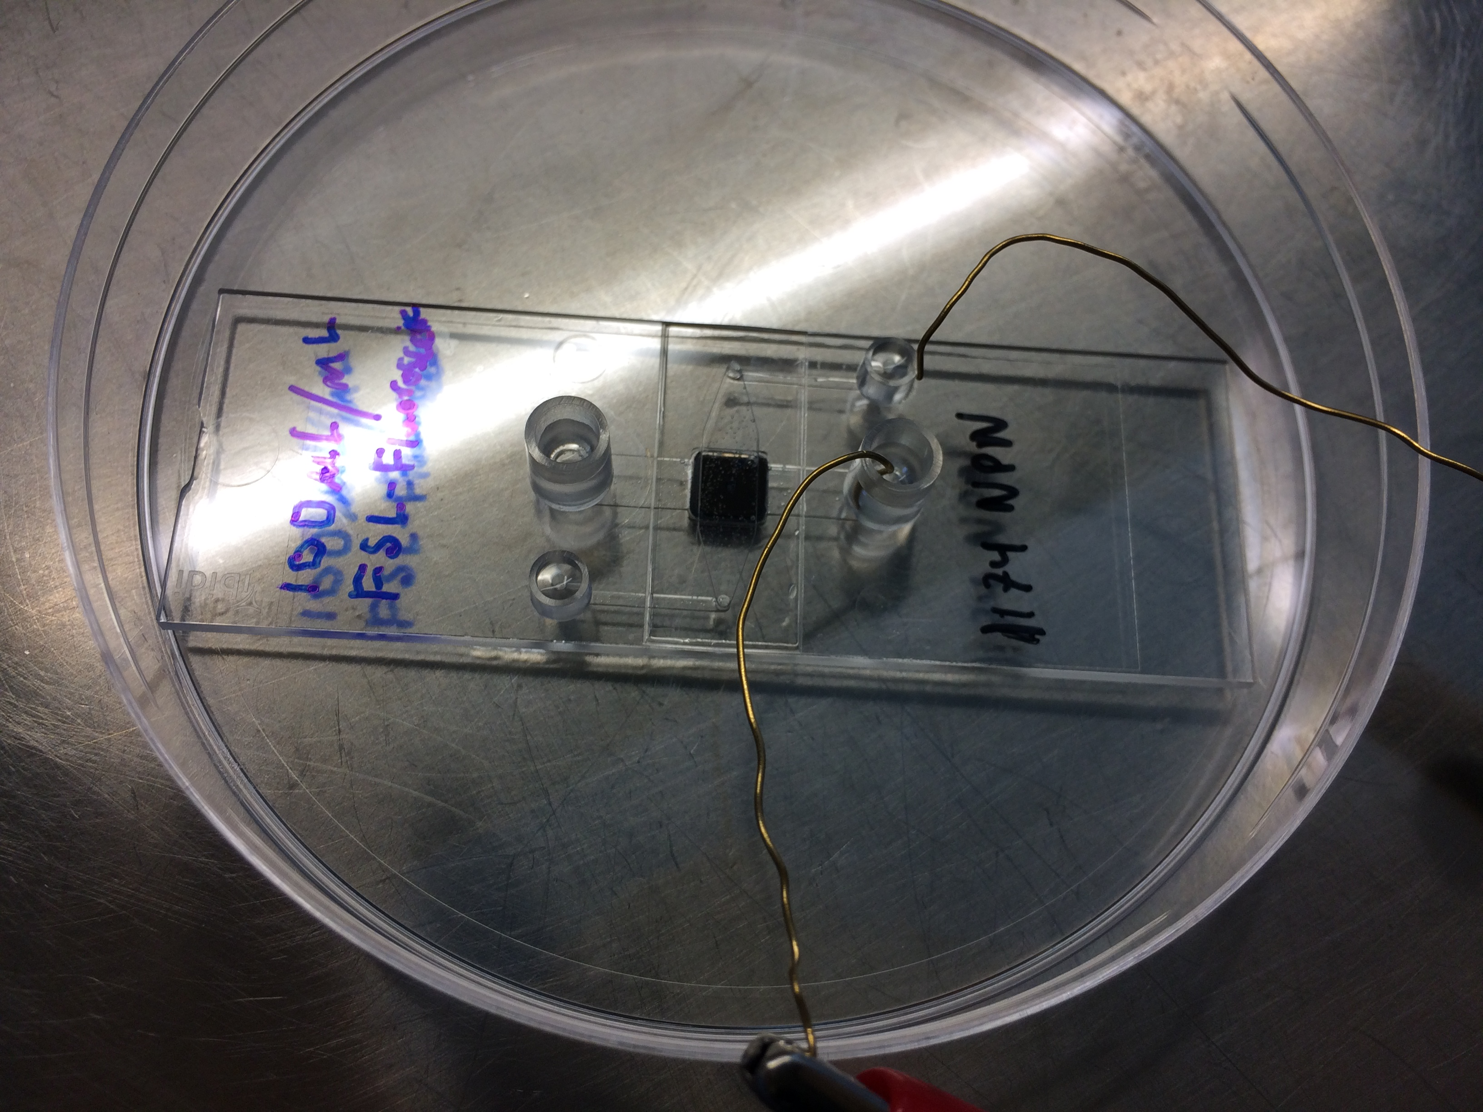
Cellular Health via TER
CellZscope, “How it Works”, http://www.nanoanalytics.com/en/hardwareproducts/cellzscope/literature/TN_cZs_How_It_Works.pdf

Slide 30
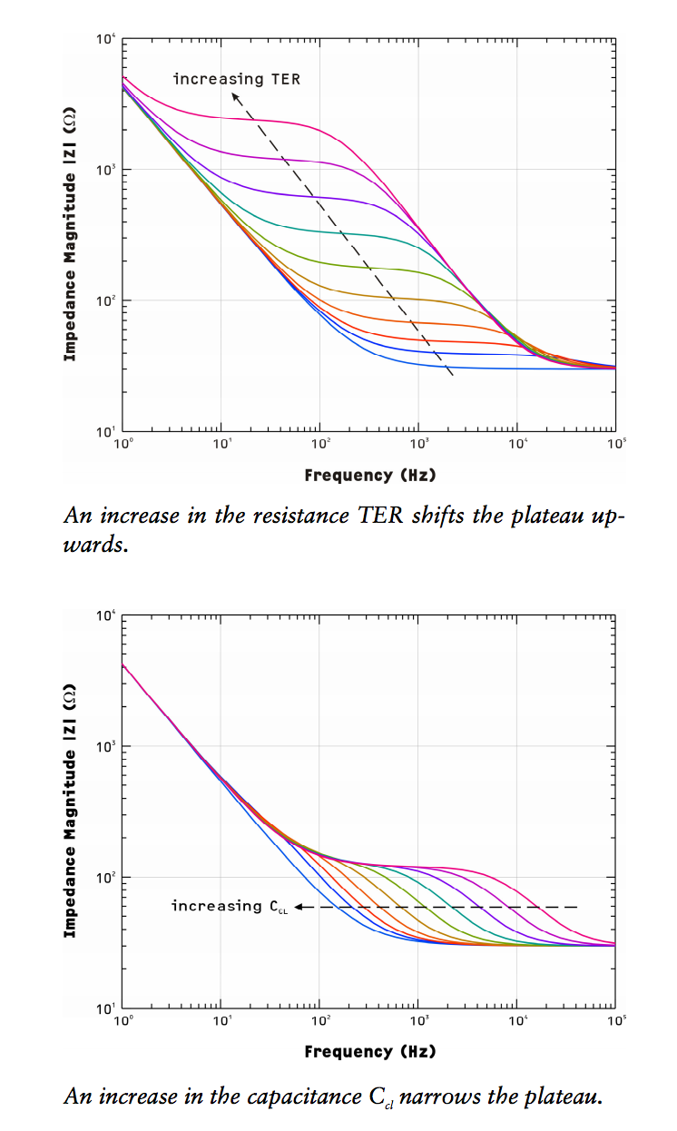
Cellular Health via TER
CellZscope, “How it Works”, http://www.nanoanalytics.com/en/hardwareproducts/cellzscope/literature/TN_cZs_How_It_Works.pdf

Slide 31
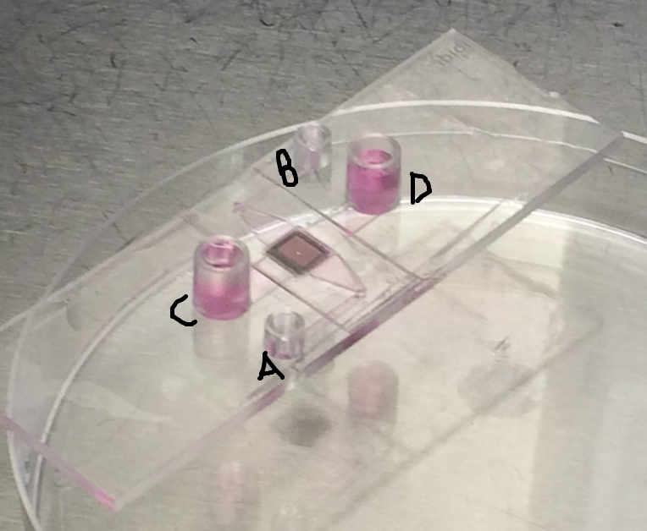
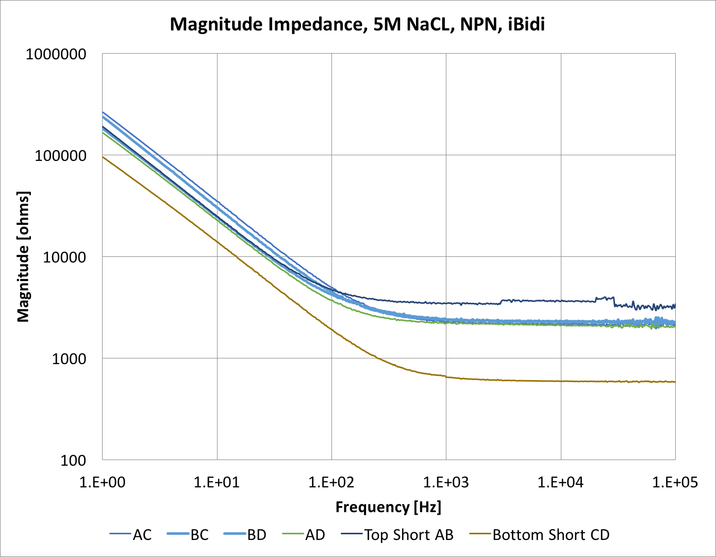
High Salt Measurements
Device doesn’t have perfect symmetry, but looks fairly repeatable
Notes:
Measuring the nanomembrane within the system large amount of background.

Slide 32
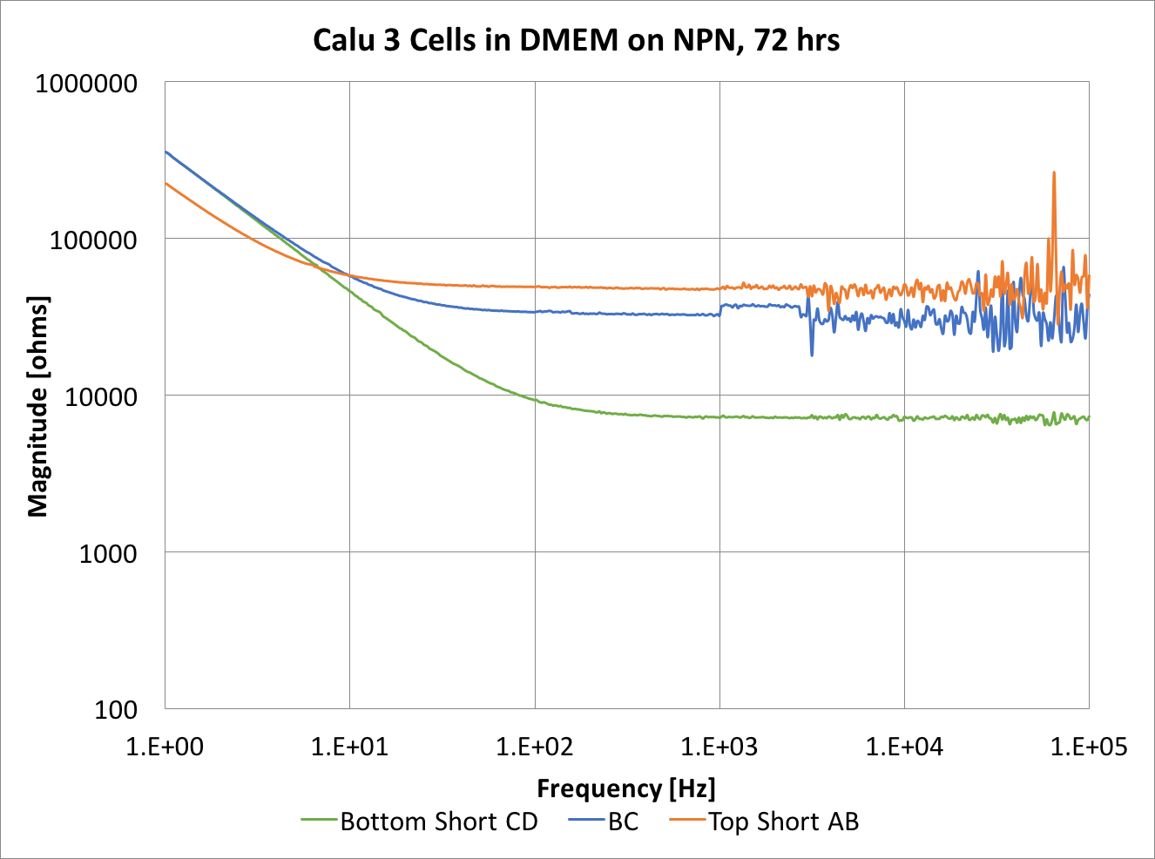
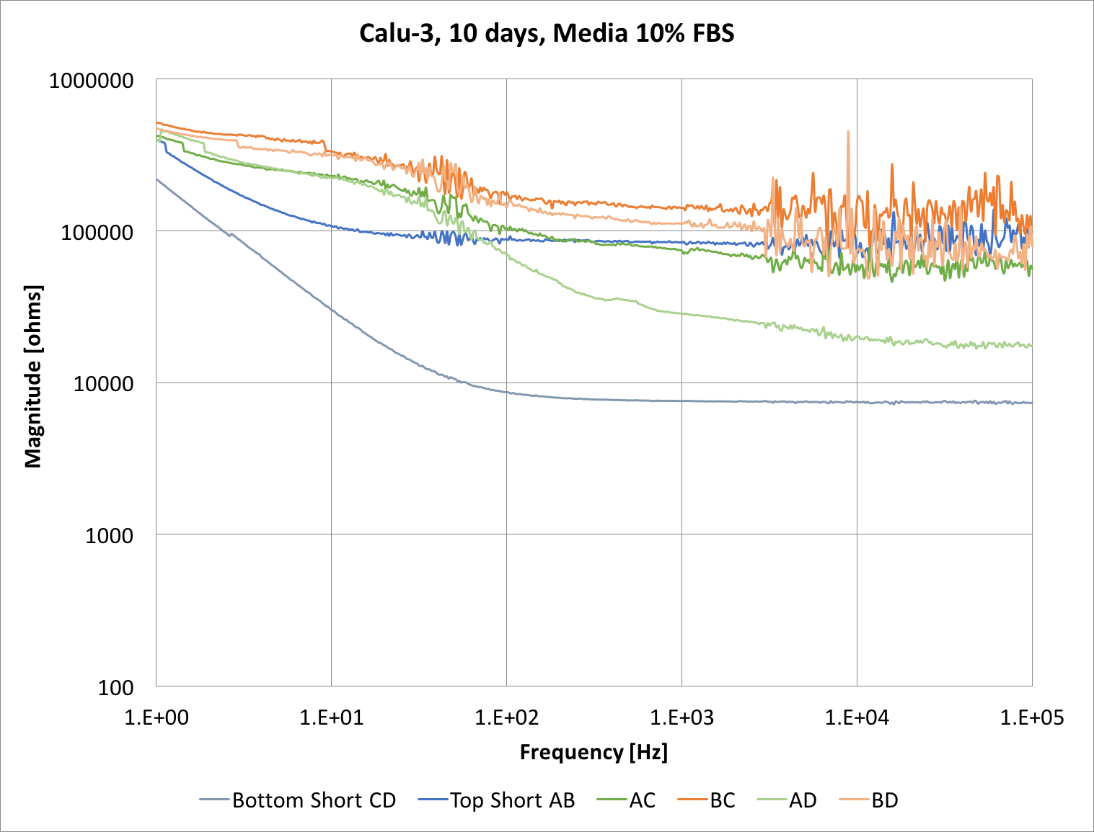
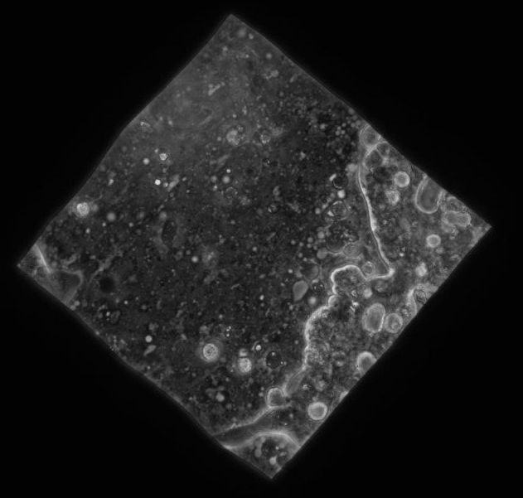
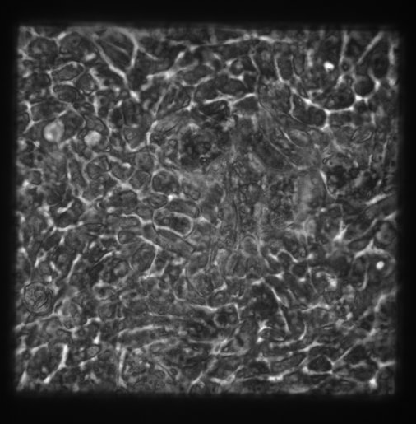
Cells Measurement
Cells become confluent
Lung epithelial cells on NPN

Slide 33
npMgF₂ Weaknesses
Yield is very low - $$$$
  20 quality chips out of 400
Membranes are flimsy
  10 chips out of 20 break during typical wetting processes

Slide 34
Improvements
Thicker = Stronger membrane
  Stronger membrane = higher yield
  Less costly
Weaken constraint on nanoporosity
  Allows thicker membrane fabrication

Slide 35
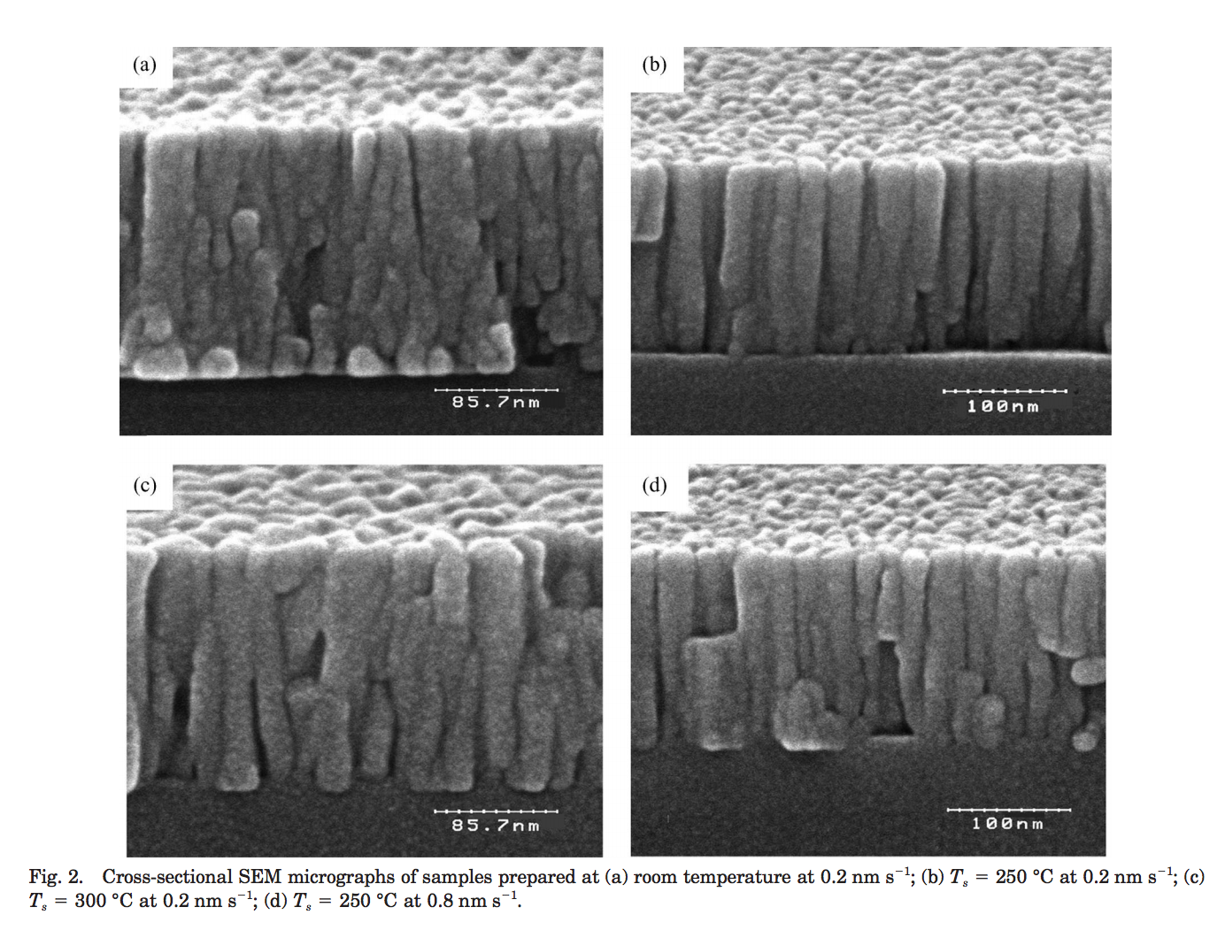
Literature

Slide 36
New Process
Evaporation
200 nm MgF₂
120 nm SiN
Si
Si
Evaporation: 0.2 nm/sec, MgF_{2,} 6KV, Platen Rotation, 200 C
RIE
RIE: 9:1 CHF₃:O₂, 100 mTorr, 100 W, 50 nm/min

Slide 37
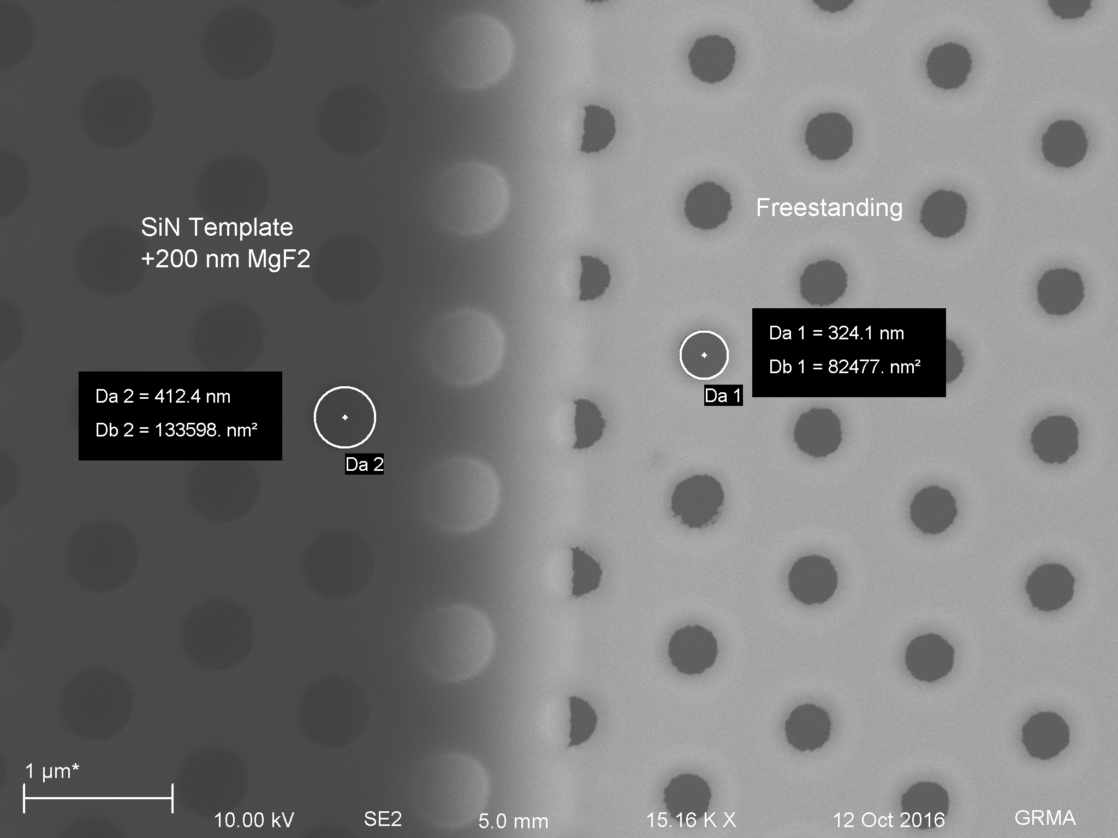
Microporous Results

Slide 38
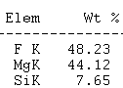
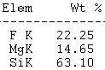
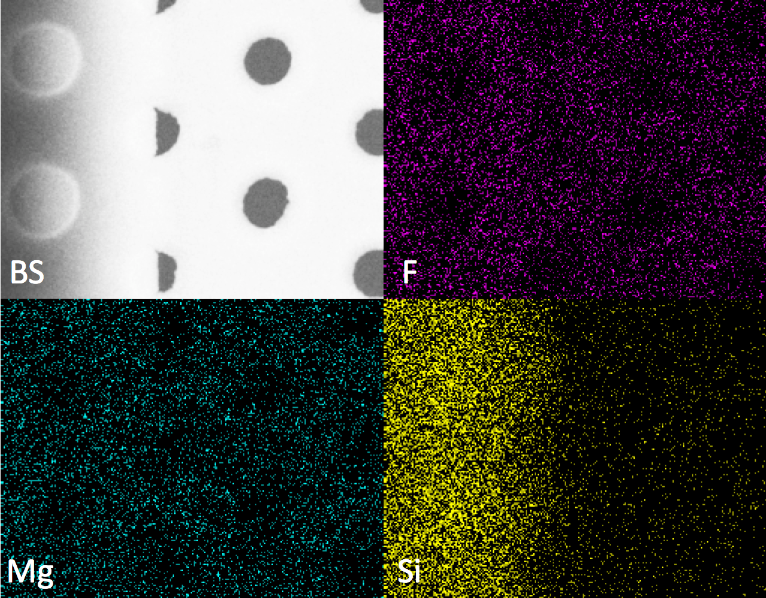
Microporous Material
Etched
Burst Pressure Strength
50 nm Microporous | 200 nm Microporous
0.8 +/- 0.2 PSI | 7.8 +/- 1.4 PSI

Slide 39
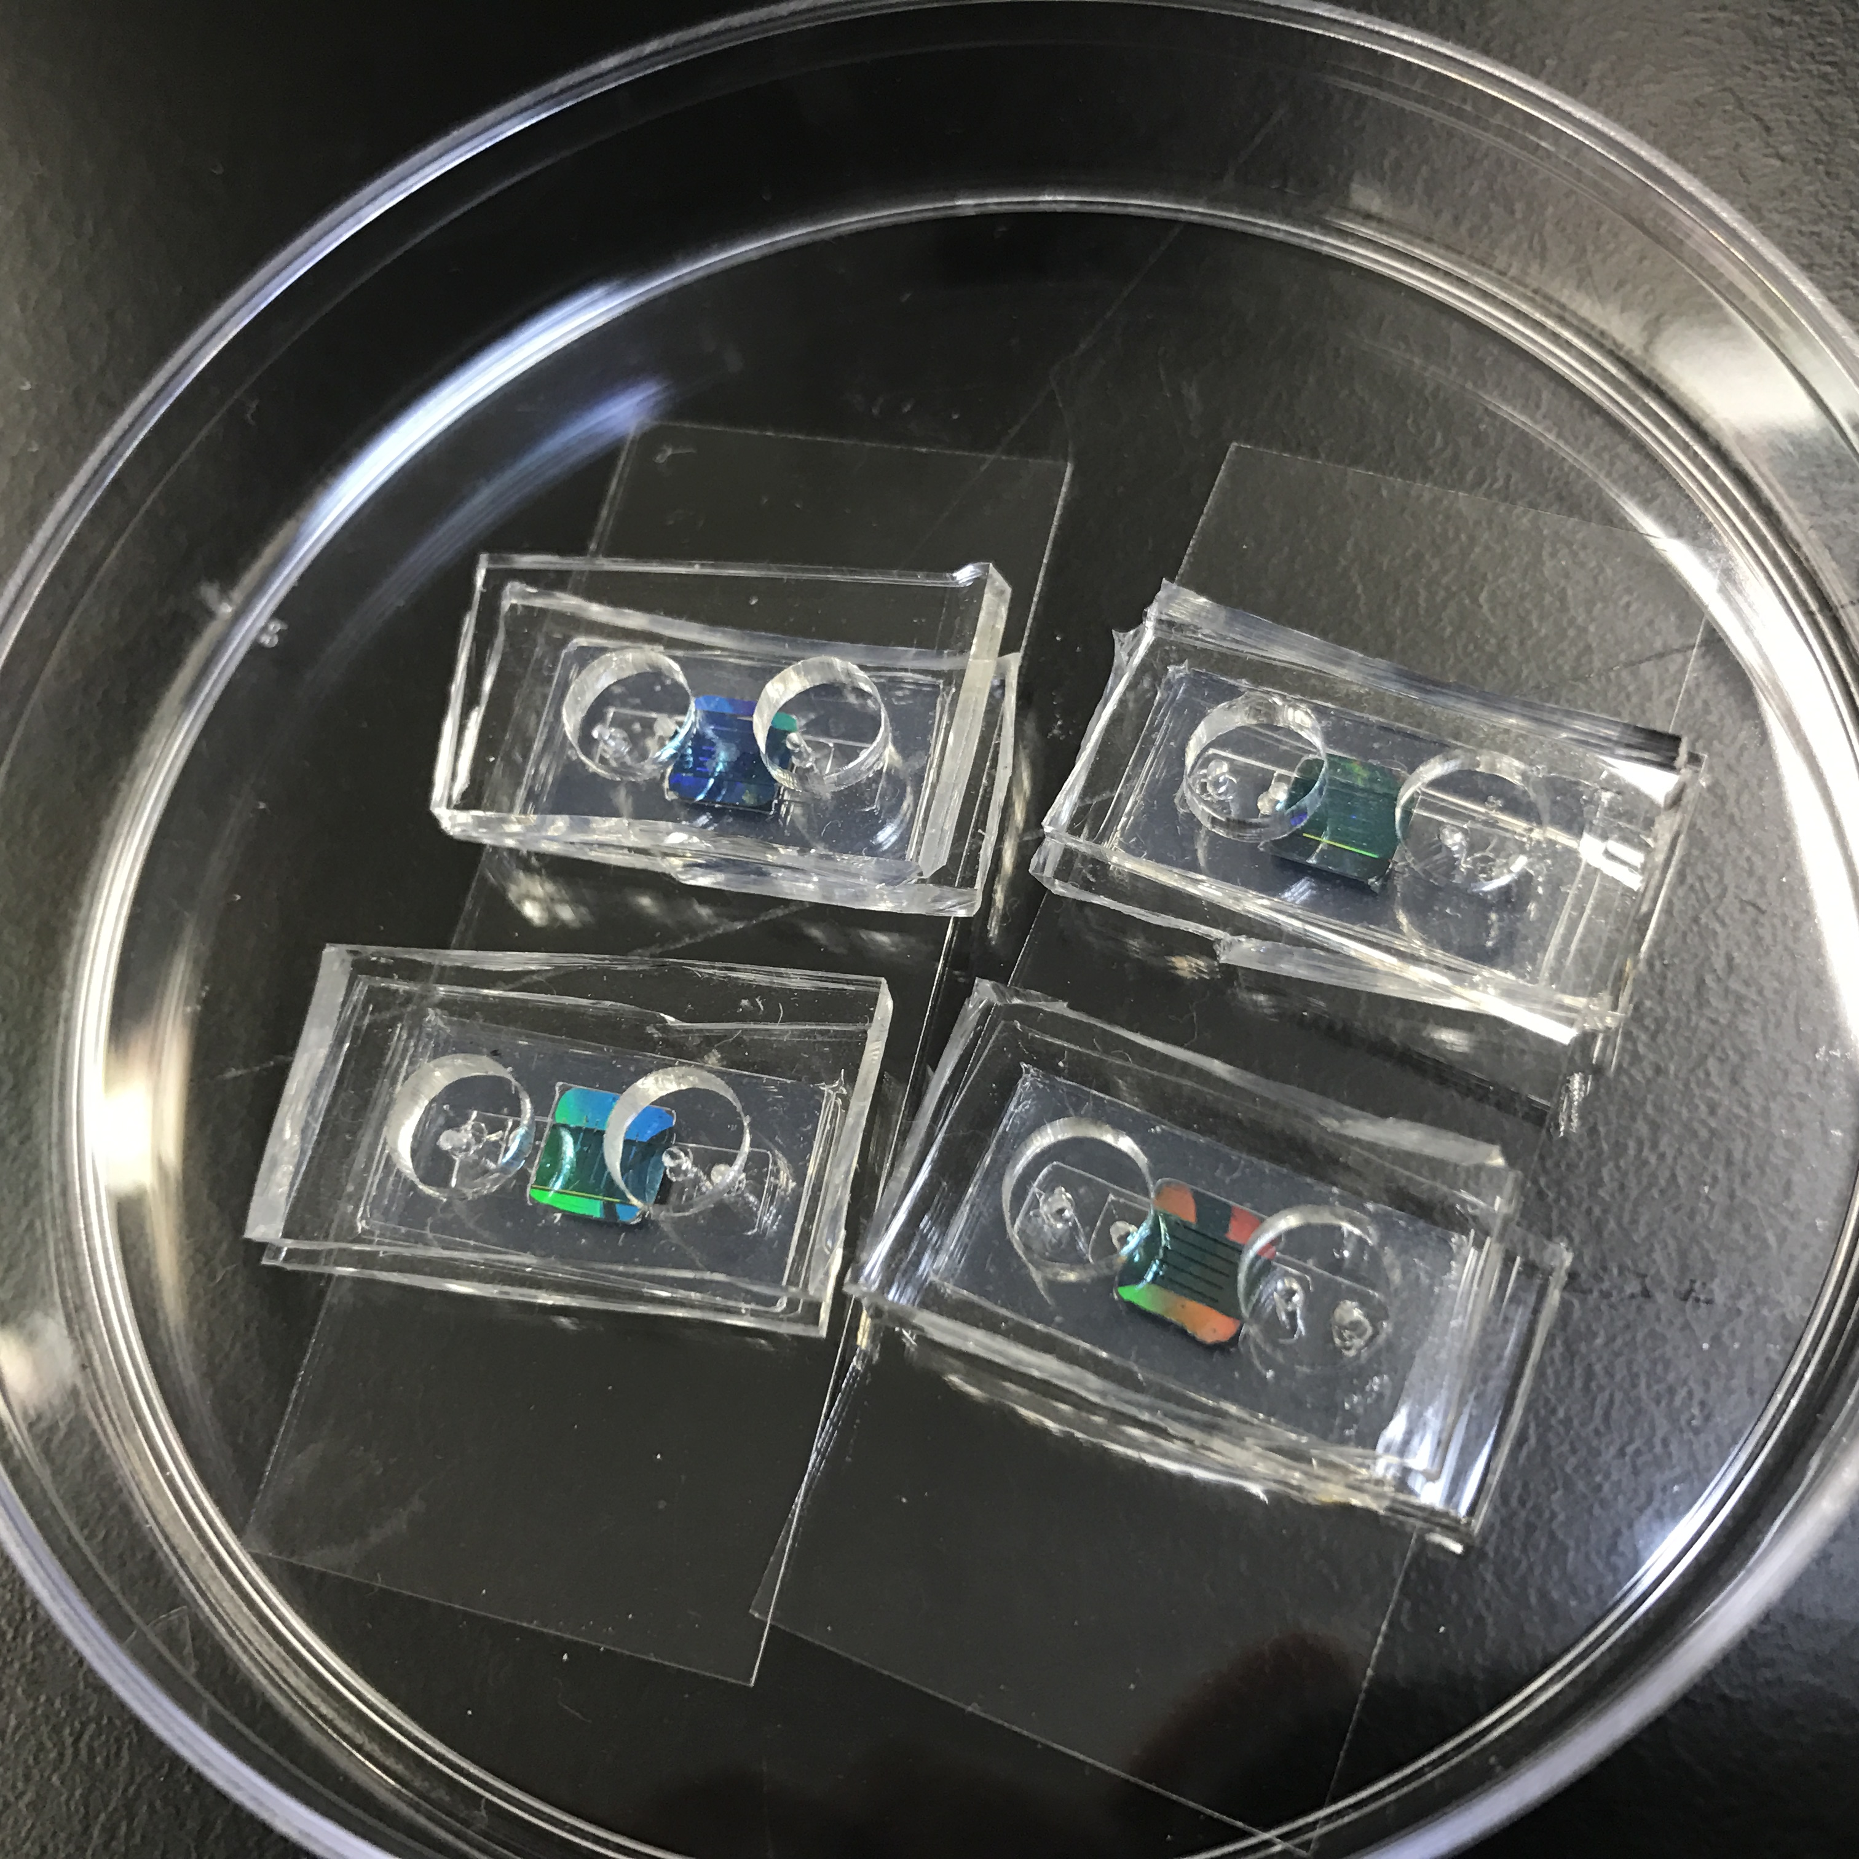
Combine With Microsystems
Ozone-bonded Silicone on glass coverslip
300 μm channel height
50 μL reservoirs
Static Cell culture

Slide 40
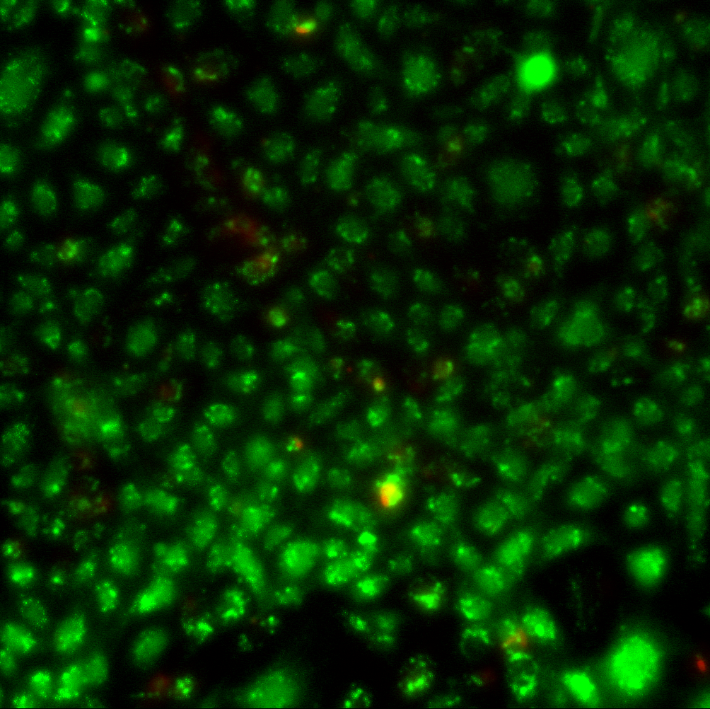

Summary For Cell Culture
D12 HUVEC on microporous MgF2
D7 Live/Dead Stain
78 - 96% Live

Slide 41
Research to be Progressed
Fabricate all-Raman compatible system
  Swap glass coverslips for MgF₂ coverslips
Multimodal Characterization
  Correlate the electrical barrier integrity (TER) with the optical measurements of water transport (Raman).

