Slide 1
Feasibility of Isolating Exosomes from Biofluids Using Ultrathin Nanomembranes

Slide 2
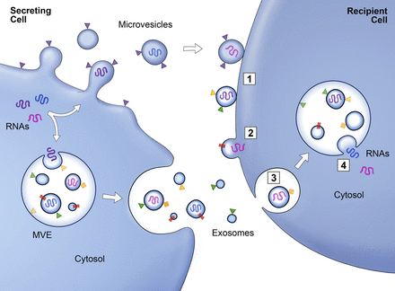
Motivation and background
The study of extracellular vesicles or exosomes.
Exosomes are 30-100 nm diameter lipid vesicles that result from the fusion of larger intracellular endosomes with the plasma membrane.
In biofluids such as blood, urine and media of cell cultured, but must be isolated from these often protein-rich fluids.
The nucleic acid and protein cargos carried within these vesicles reveal molecular fingerprints that are characteristic of the vesicles’ particular cells of origin.
Raposa et. al., J. Cell Biol, 2013

Slide 3
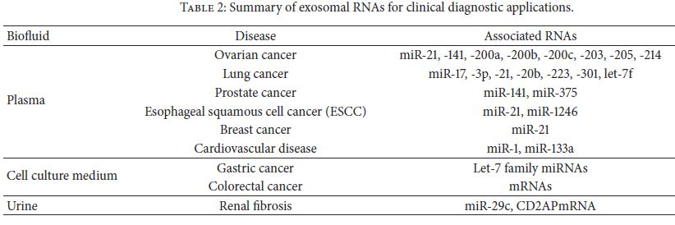
Motivation and background
Clinical trials that use exosomes in three different applications:
(1) As therapeutic drug delivery vehicles
(2) For cancer vaccination
(3) As diagnostic biomarkers in cancer
Mesenchymal stem cell-derived exosomes: as therapeutic products to treat auto-immune conditions and to improve recovery after myocardial infarction (significantly reduce the area of tissue damage).
Jin Lin et. al., scientificWorldJournal, 2015

Slide 4
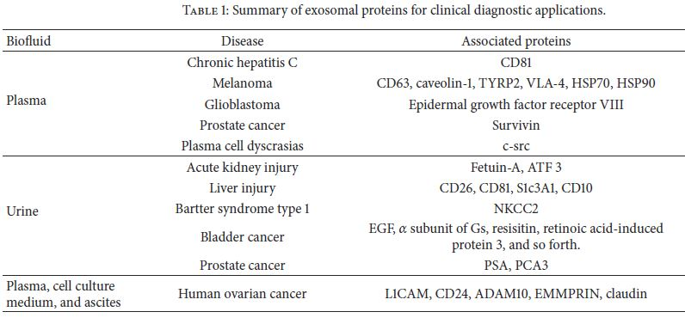
Motivation and Background
It has been suggested that exosomes derived from tumor cells may differ in size to those from normal cells.
Development of capture methods that produce intact exosome with preserved biological functions and also that contaminants such as protein aggregates are eliminated to avoid undesired immune responses.
Identifying specific proteins and RNAs within disease-related exosomes offers tremendous potential.
High-yield purification and isolation: extremely important
Jin Lin et. al., scientificWorldJournal, 2015

Slide 5
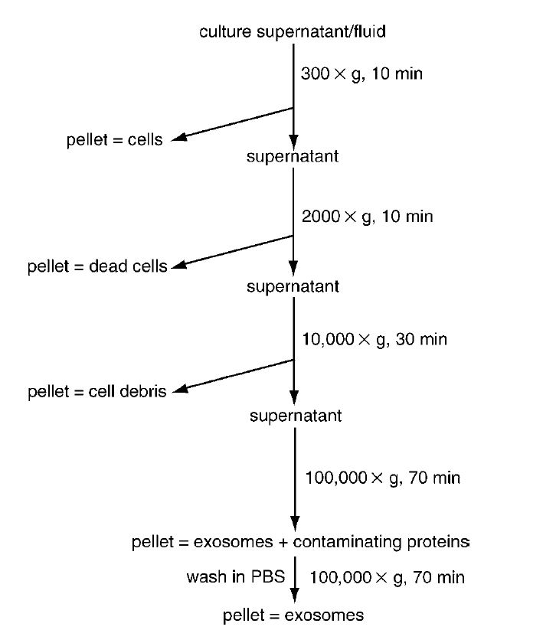
Purification protocols:
Ultracentrifugation
The current Gold Standard for the purification of EVs
1. Centrifugation at low speed:
Eliminate large dead cell and cell debris.
Pellets are discarded and the supernatants are used for following steps.
2. Ultracentrifugation:
Pellet= Exosomes + Contaminating Proteins.
Pellets are kept and supernatants are discarded .
Advantageous and Disadvantageous:
1. High purity, but low yield.
2. Slow Process: Overnight Centrifugation.
3. Low consumable cost, but high equipment start up.
4. Low throughput (~1 mL) .
5. Repeated steps can damage exosomes.
Thery et. al., Curr protol cell biol., 2006

Slide 6
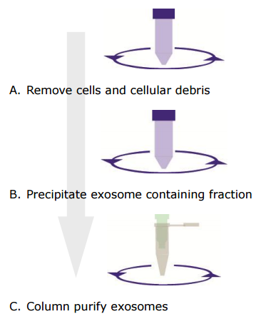
Purification protocols:
Commercial Protocols
Exo-Quick Reagent:
1. Based on precipitation by adding specific reagent.
2. For different Biofluids: Cell media, Blood, Urine, ..
3. No ultracentrifugation
4. Co-precipitates non-exosomal proteins and no step for removing them.
5. Low throughput (~1 mL) .
6. Very low purity
7. Time-Consuming (Incubation over night)
Exo-Spin Kit:
1. based on combination of precipitation and size-exclusion to purify exosomes.
2. Higher yield than Exo-Quick, indicating the importance of post-precipitation purification step.
3. less Time-Consuming than Exo-Quick
4. low purity
5. No ultracentrifugation
6. Higher throughput (1-50 mL)
Exo-spin Kit protocol overview

Slide 7
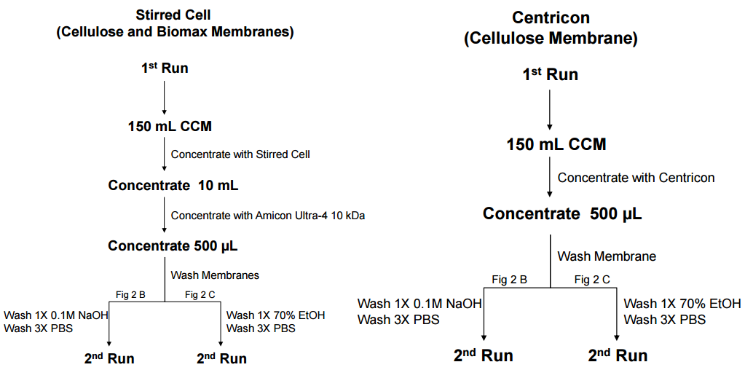
Purification protocols:
Research Protocols
Ultrafiltration: Alternative to ultracentrifugation, which is concentration of large volume of Cell Culture Media using ultrafiltration devices.
Concentration of 150 mL of CCM to 500 µL.
Ultrafiltration Device:
1. Pressure-driven: Stirred Cell (Cellulose and Biomax Membranes)
2. Centrifugation-Based: Centricon ( Cellulose Membrane)
Advantageous and Disadvantageous:
1. More rapid than ultracentrifugation
2. overall higher yield of exosome than ultracentrifugation
3. Higher range of volume
4. relative high purity
Lobb et. al., J Extracell Vesicles, 2015

Slide 8
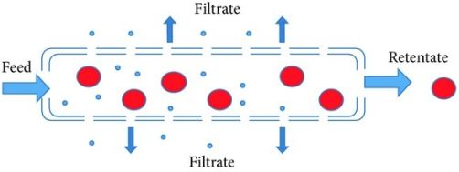
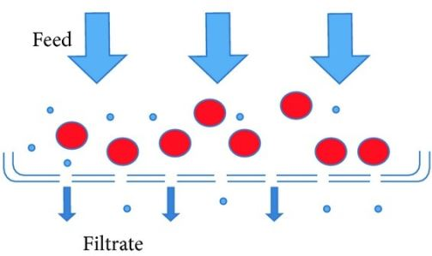
Filtration Techniques
Dead-End Filtration:
The most commonly method for separation.
The feed material is forced through the membrane: flow direction is perpendicular to the membrane.
Challenges:
1. Cake Formation
2. Blocking of the pores
Tangential Flow Filtration:
Flow direction is parallel to the membrane and pressure gradient is across the membrane.
Passage of smaller particles due to concentration gradient and transmembrane pressure.
Fluid shear across the membrane prevents cake formation.
https://openi.nlm.nih.gov/detailedresult.php?img=PMC3877584_BMRI2013-312709.002&req=4

Slide 9
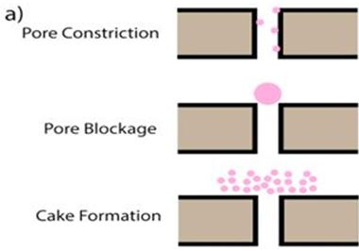
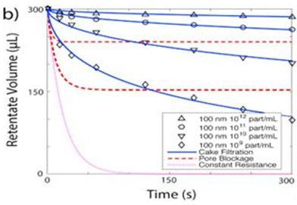
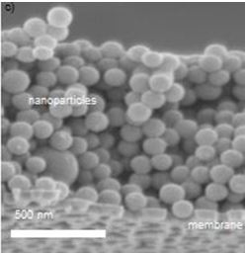
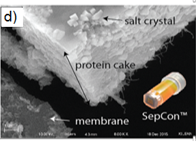
Technical Challenges with Dead-End Filtration
(a) Mechanisms of membrane fouling during normal or dead-end filtration.
(b) Plots showing retentate volume as a function of time during conventional centrifugal filtration/concentration (solutions of 100 nm particles) indicates cake formation dominates flux for all conditions studied.
(c) SEM of nanoparticle cake formation.
(d) Centrifugation of plasma in a dead-end filtration spin device with a nanomembrane results in significant protein cake formation.
Winans et. Al., J membrane science, 2016

Slide 10
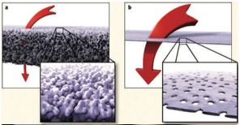
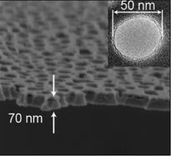
Nanoporous Silicon Nitride Membranes
(a) Conventional polymeric membranes are 100-1000x thicker than
(b) Ultrathin silicon-based nanomembranes, which have direct through-pores minimizing internal trapping and loss of filtered species.
Striemer et. al., Nature, 2007
Thickness: 70 nm
Pore Size: 50 nm
DesOrmeaux et. al., Nanoscale, 2014

Slide 11
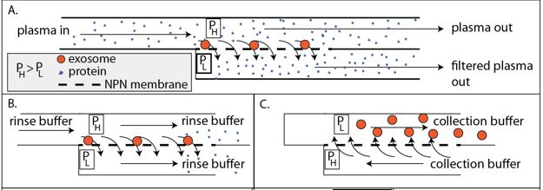
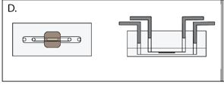
Fabrication and Optimization
Isolation of exosomes on nanomembranes by diffusion-driven physical sieving in a modified tangential flow device:
(A) Capture stage: Slightly lower pressure below the membrane than above pulls exosomes into the membrane pores as protein is cleared.
(B) Clean-up stage: Once the exosomes are extracted from plasma, buffer can be passed through the system to clear protein contaminants.
(C) Collection stage: After the exosome sample is cleared of protein, the transmembrane pressure can be reversed to allow the collection of exosomes in a controlled volume.
(D) Schematic of a chip based device with microfluidic access at the inlet and outlet of top and bottom chambers.

Slide 12
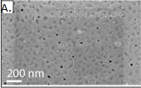
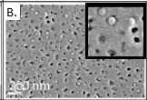
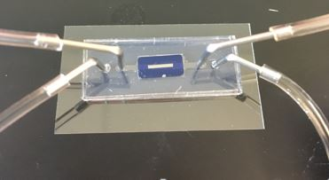
Results
Isolation of sample prepared with ExoQuick™ reagent. The contamination of the membrane by the ExoQuick™ polymer is evident from the texture and electron beam charging effects (shading).
Exosome capture from pure plasma on a nanomembrane showing exosomes trapped over pores. Inset shows captured exosomes adjacent to open pores.

Slide 13
Results
Purified Exosome from Plasma+Bodipy
PBS+Bodipy

Slide 14
Results
Media+Bodipy
Plasma+Bodipy

Slide 15
Summary
Exosomes are 30-100 nm diameter lipid vesicles that result from the fusion of larger intracellular endosomes with the plasma membrane.
Exosomes can be readily found in biofluids such as blood and urine, but must be isolated from these often protein-rich fluids.
There is no gold standard protocol for isolation of these small particles.
Tangential flow filtration has a great advantage over dead-end filtration like: prevents cake formation.
By using ultrathin silicon-based nanomembranes, we are minimizing internal trapping and loss of filtered species.
We are proposing a novel single-step tangential flow filtration device using ultrathin membranes to isolate exosomes from different biofluids with a high purity and size selectivity.
In this project, we will optimize a unique, yet simple TF device incorporating an ultrathin nanoporous membrane that can purify and isolate exosomes from plasma and cell culture media without addition of precipitation agents.
Primarily work demonstrated successful trapping of exosomes with our approach.

Slide 16
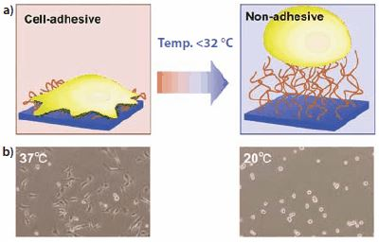
Future work
Thermo-responsive polymers:
PNIPAM: soluble in organic solvents, It is also soluble in water, as long as the solution is kept reasonably cold.
Nakamaya et. Al: Cultured cells can be harvested from the "smart" PNIPAM surfaces in the form of a tissue-like cellular monolayer or “cell sheet” simply by lowering the cell culture temperature from 37 °C to 20 °C and transplantation of cell sheets without the use of biodegradable polymer scaffolds.
Future study: Trapping of exosomes using modified membranes surface with thermo-responsive polymers.
The basic idea is that exosomes adhesion/detachment on PNIPAM-modified membranes can be achieved by a simple temperature switch.
Nakamaya et. al., 2010

Slide 17
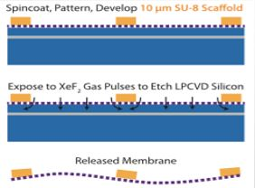
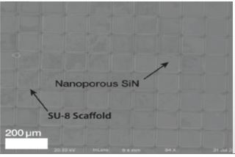
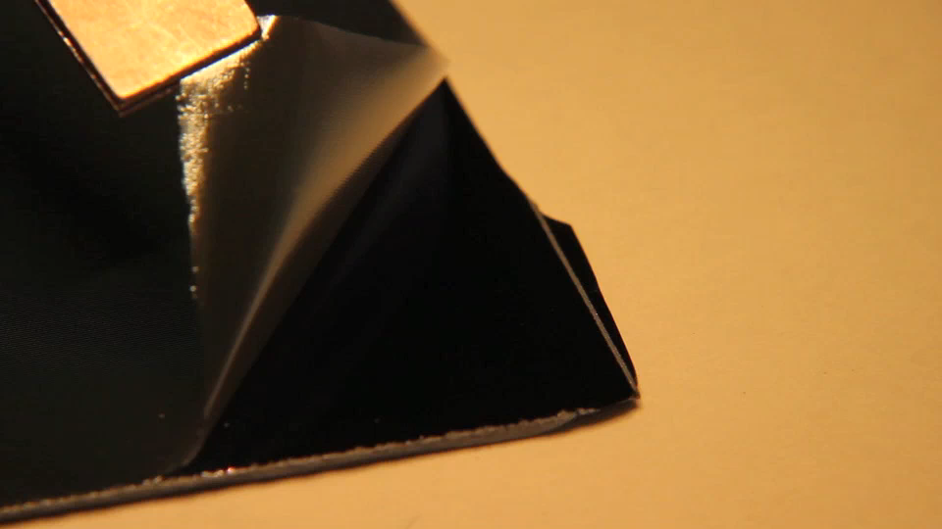
Large Area Nanomembranes
A novel approach for fabrication of nanoporous membranes with thickness less than 0.1 μm with tunable pore sizes between 5-100 nm.
membranes will be pre-patterned with an SU-8 scaffold that is 80% open.
The membrane and substrate will be exposed to XeF₂ that will etch an underlying sacrificial layer, releasing the membrane.
The lift off from the rigid silicon wafer results in a flexible, yet robust ultrathin membrane.
Use of ultrathin nanomembranes in a variety of life science applications ranging from cell culture to blood purification and hemodialysis.

Slide 18


Acknowledgments
Professor Thomas Gaborski laboratory:
Rochester Institute of Technology, Microsystems Engineering and biomedical engineering.
Professor James McGrath lab laboratory:
University of Rochester, Biomedical Engineering
Funding Sources:
Center of Emerging & Innovative science (CEIS)
Division of Science, Technology and Innovation (NYSTAR)

Slide 19
Thank You !!!!

