Slide 1
ICNMM2016-8052
Ultrathin Silicon Membranes for Improving Extracorporeal Blood Therapies
Tucker Burgin
with
Dean Johnson, Henry Chung, Alfred Clark, Jr., and James McGrath

Slide 2
Extracorporeal Therapies
Introduction
ECMO
Hemodialysis
Conclusion
What is an extracorporeal blood therapy?
External source or sink
Extracorporeal Circuit
Membrane
Solute input into circuit
𝚺
Solute output from circuit
𝚺
Patient’s Circulatory System
Solute consumed or produced

Slide 3
Hemodialysis and ECMO
Introduction
ECMO
Hemodialysis
Conclusion
Hemodialysis
ECMO
Primarily used to treat chronic kidney failure
Designed to clear a wide variety of “uremic toxins” from blood
  Toxins and their carriers vary in molecular weight (size and diffusivity) across three orders of magnitude
  Also variable: toxicity, rate of accumulation, etc.
Intensive care support for heart or lungs
Works by adding oxygen to and/or removing carbon dioxide from blood
Half of patients are neonatal; half of the remainder are pediatric
Notes:
Two examples of such a therapy are...

Slide 4
Hemodialysis and ECMO
Introduction
ECMO
Hemodialysis
Conclusion
Hemodialysis
ECMO
Usually four-hour treatments delivered three times per week
Terrible prognosis -- 3-5 years
More frequent, low-dose treatment would help
Miniaturization would enable wearable device → continuous treatment is more effective
High incidence of complications, mostly hemorrhage
Requires frequent blood transfusions -- increases death by 24% per 10 mL/kg/day ^{[1]}
Miniaturization would reduce volume or frequency of transfusions → treatment is safer
[1: A. H. Smith, D. C. Hardison, B. C. Bridges, and J. B. Pietsch. Red blood cell transfusion volume and mortality among patients receiving extracorporeal membrane oxygenation. Perfusion, 28(1):54–60, 2013.]

Slide 5
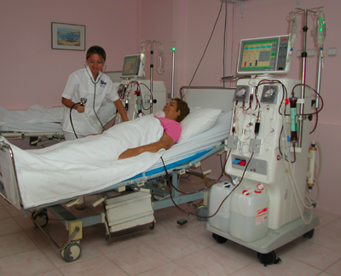
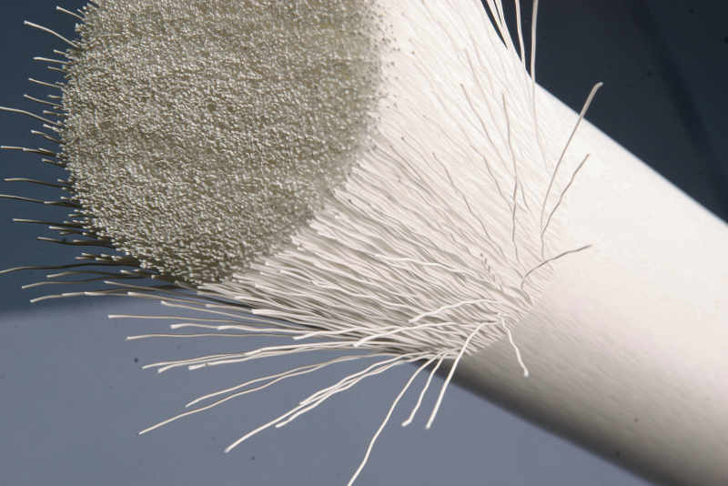
Traditional Membranes
Introduction
ECMO
Hemodialysis
Conclusion
[http://blog.instituteoftechnology.edu/hemodialysis-technician/understandinghemodialysis/, http://www.internationaltradenews.com/fibron_ag/portrait/]
Notes:
One of the primary reasons for the size of extracorporeal blood therapy devices is the membranes they use...

Slide 6
Traditional Membranes
Introduction
ECMO
Hemodialysis
Conclusion
Fiber bundle membrane
Separates blood from external fluid in flow-counterflow
Huge membrane surface area (1 to 3 m²)
Designed for maximal single-pass transport efficiency
Polymeric membrane, e.g. cellulose or polysulfone: many microns or millimeters thick
[http://www.internationaltradenews.com/fibron_ag/portrait/]
Notes:
Membranes of this type have been dominant since their invention in the 60’s, but over half a century later, we can do better...

Slide 7
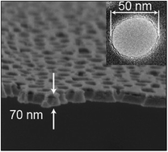
Silicon Nanomembranes
Introduction
ECMO
Hemodialysis
Conclusion
Silicon “nanomembranes”
Original discovery of porous nanocrystalline silicon (pnc-Si) by Striemer et al. in 2007
Progression to silicon nitride (SiN) reported by DesOrmeaux in 2014
  More mechanically robust
  Less chemically reactive
[DesOrmeaux, Winans, Wayson, Gaborski, Khire, Striemer, and McGrath, 2014. “Nanoporous silicon nitride membranes fabricated from porous nanocrystalline silicon templates.” Nanoscale 6: 10798–805.]

Slide 8
Silicon Nanomembranes
Introduction
ECMO
Hemodialysis
Conclusion
Membrane thickness in tens of nanometers
  Hundreds to thousands of times thinner than conventional polymer membranes
  Reduces average diffusion time across membrane by 10⁴ to 10⁶ times
Pore size of comparable scale
  Tunable for application
  Appropriate scale for size-based restriction of protein transport
[DesOrmeaux, Winans, Wayson, Gaborski, Khire, Striemer, and McGrath, 2014. “Nanoporous silicon nitride membranes fabricated from porous nanocrystalline silicon templates.” Nanoscale 6: 10798–805.]

Slide 9
Hypothesis and Approach
Introduction
ECMO
Hemodialysis
Conclusion
Hypothesis:
The extraordinary thinness of silicon nanomembranes can be leveraged to enable miniaturized extracorporeal blood therapy devices and in doing so improve treatment safety and/or efficacy.
Approach:
Build and validate models that describe these therapies, and then apply them towards evaluating the size and efficacy of nanomembrane-based equivalents to traditional devices.

Slide 10
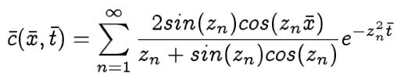
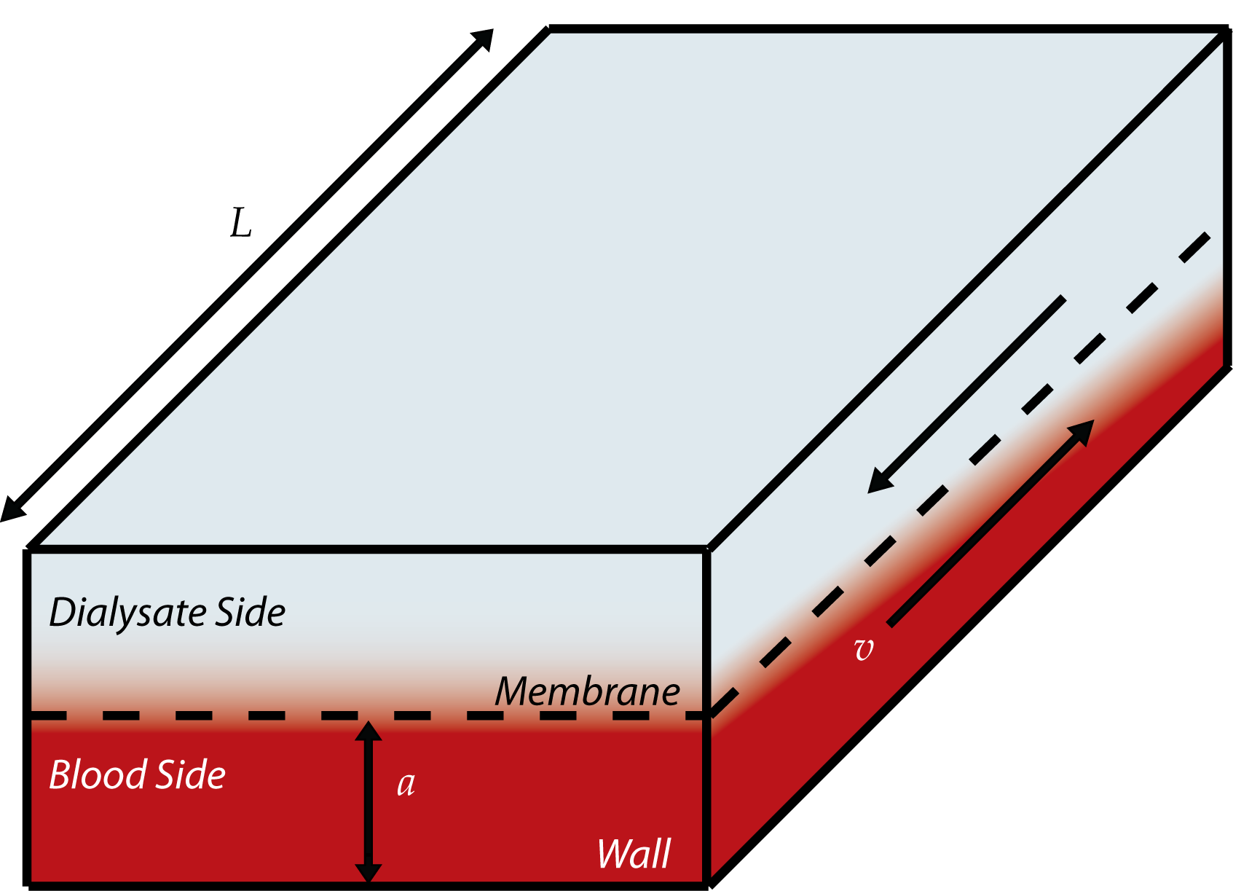
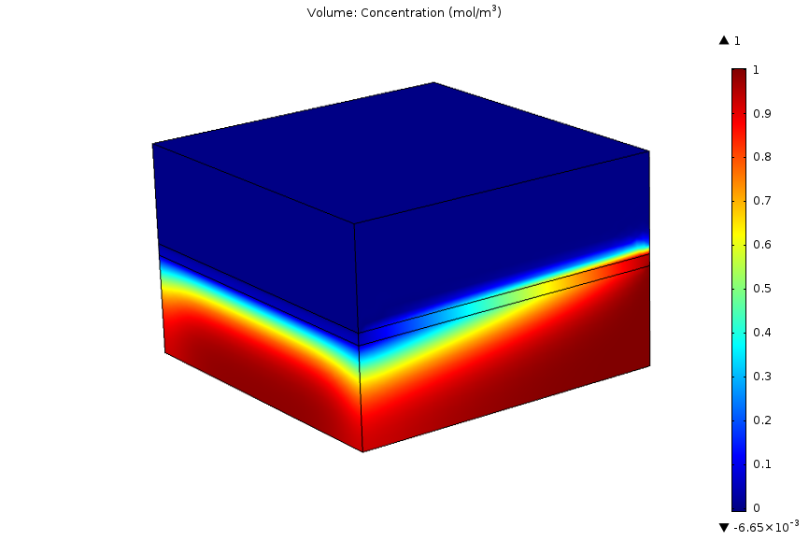
Hemodialysis Models
Introduction
ECMO
Hemodialysis
Conclusion
Analytical solutions to the Convection-Diffusion equation
General hemodialysis system
Computational modeling with COMSOL Multiphysics
Notes:
First, we’ll approach the problem of hemodialysis...

Slide 11
Analytical Model
Introduction
ECMO
Hemodialysis
Conclusion
Analytical
Simplifying Assumptions
Pros
Cons
Plug flow
velocity is constant everywhere
High Peclét number
diffusion only normal to membrane
No edge effects
thin-slit geometry only
Dialysate is a sink
no transport back into blood
Fast enough for many calculations
Accuracy depends only on model parameters
Restricted to simple geometry
Requires simplifying assumptions

Slide 12
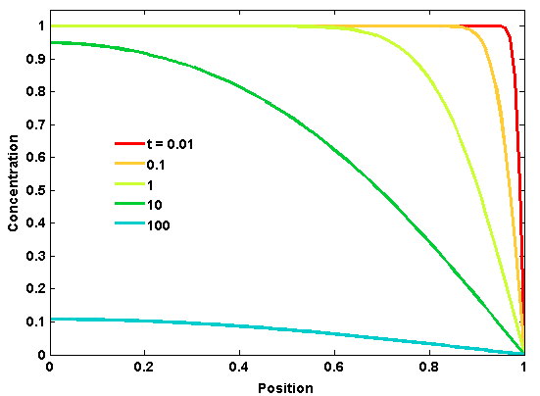


Analytical Model
Introduction
ECMO
Hemodialysis
Conclusion
Assumptions allow us to approximate hemodialysis by solving a very simple differential equation:

Slide 13
Computational Model
Introduction
ECMO
Hemodialysis
Conclusion
Dialysate
(convection and diffusion)
Computational
Pros
Cons
Applicable to much wider range of geometries
Requires no special assumptions
Potentially very slow solution time
Requires validation to ensure accuracy
x
Membrane (diffusion only)
z
y
Blood
(convection and diffusion)

Slide 14
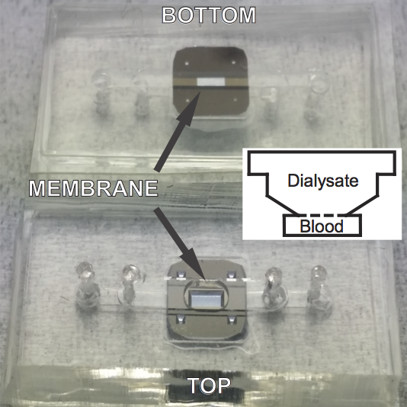
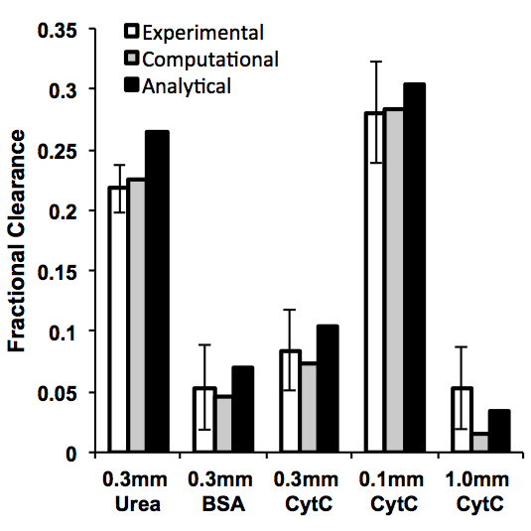
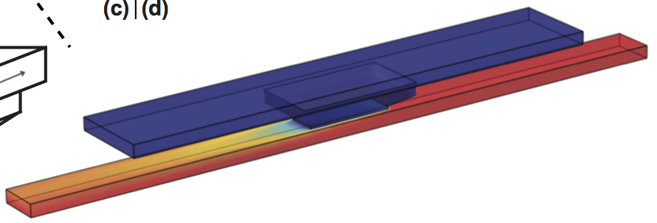
Experimental Validation
Introduction
ECMO
Hemodialysis
Conclusion
Notes:
“In order to validate that our models accurately describe real transport…”

Slide 15
Results
Introduction
ECMO
Hemodialysis
Conclusion
Now that we know the pros and cons of each model, we can put them to use cooperatively in designing a miniaturized hemodialyzer
Approach:
Model huge range of possible dialyzers, varying all parameters
Select designs that result in appropriate clearance of urea and retention of albumin
Implement these designs in COMSOL model for more accurate results
Tweak dialyzer characteristics as needed and choose best design
Taking advantage of fast solutions from the analytical model
Representing entire range of sizes in uremic toxins
The computational COMSOL model is slower but accommodates real device geometry
Fine tuning and final design selection are best done manually
Notes:
“Next, we want to use the models to validate our central hypothesis…”

Slide 16
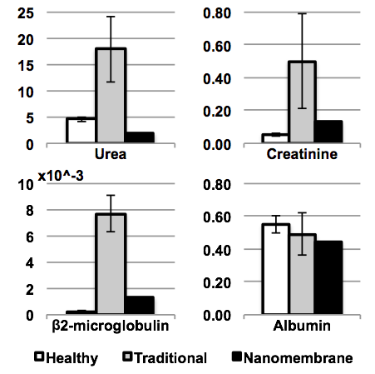
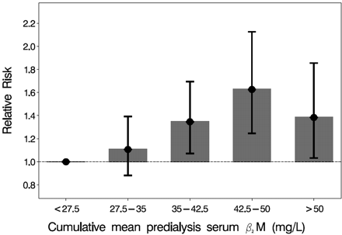
Results
Introduction
ECMO
Hemodialysis
Conclusion
All-Cause Mortality
[Cheung et al., 2005; Mumtaz et al., 2010.]
Notes:
Also cite Mumtaz here

Slide 17
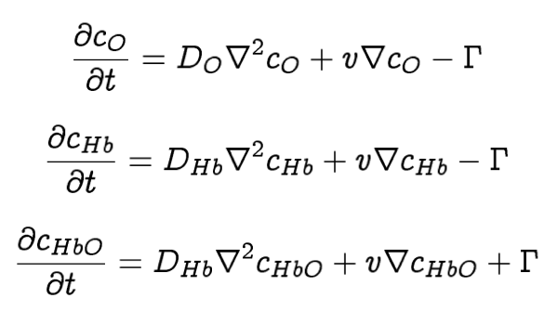
ECMO Model
Introduction
ECMO
Hemodialysis
Conclusion
ECMO is described by the same convection-diffusion equation as hemodialysis, but with the addition of a reactive term...
(Oxygen)
(Deoxyheme)
(Oxyheme)
All three equations must be solved simultaneously to account for the reaction!

Slide 18
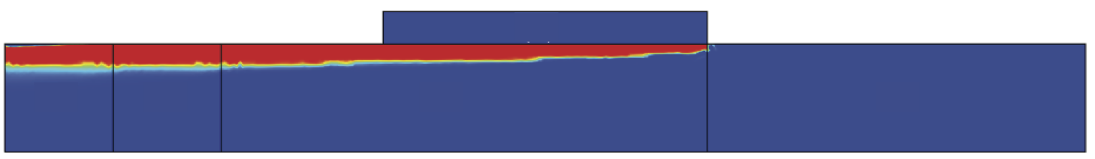
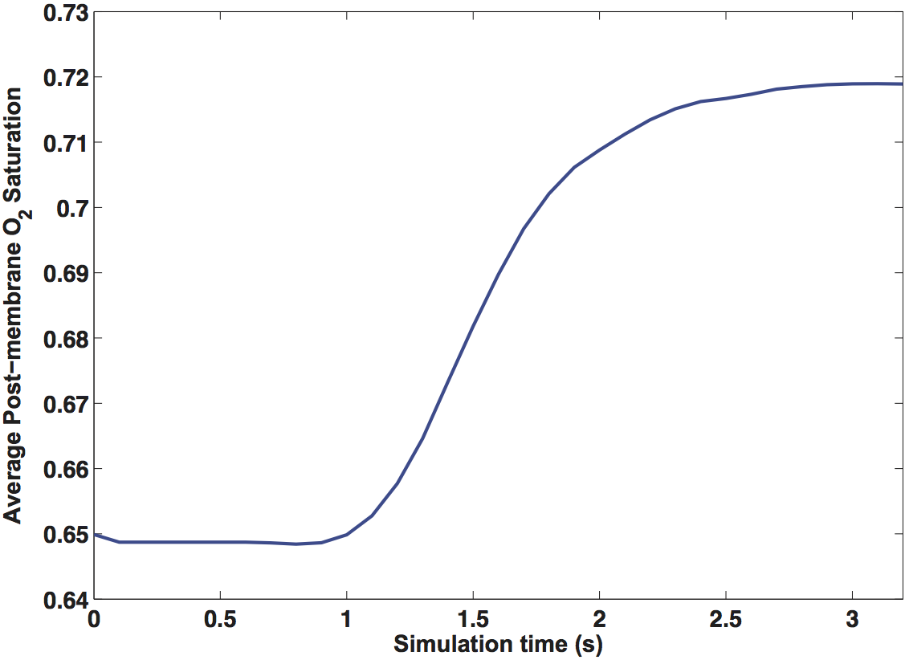
ECMO Model
Introduction
ECMO
Hemodialysis
Conclusion
Final
Experimental values
(to the nearest hundredth)
Initial

Slide 19
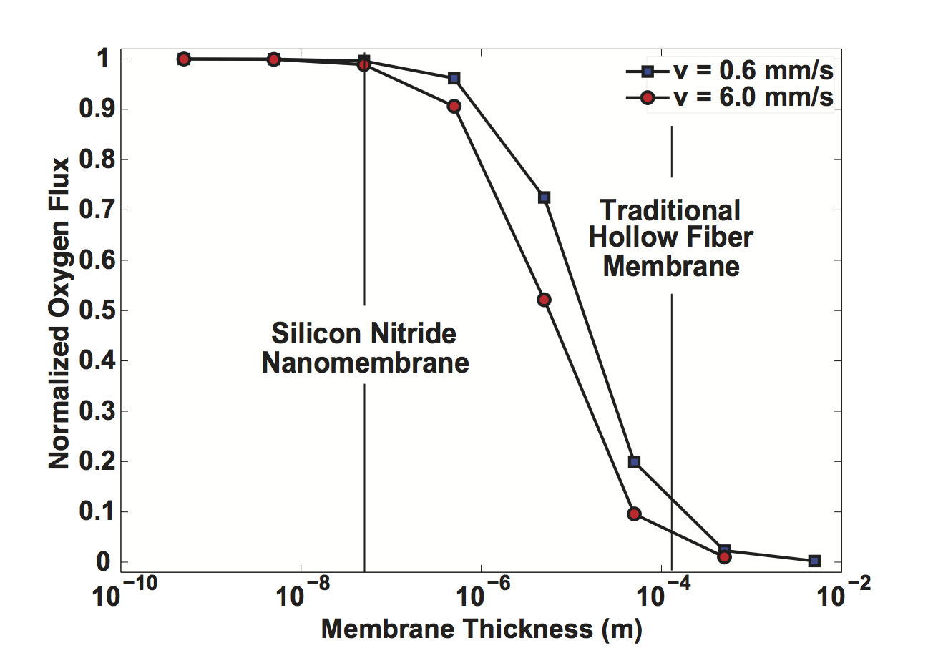
ECMO Model
Introduction
ECMO
Hemodialysis
Conclusion
Limited by transport away from membrane
Limited by diffusion within membrane

Slide 20
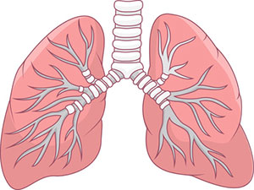
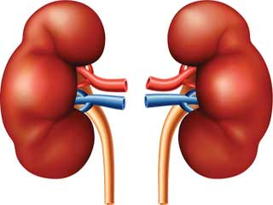
Comparative Analysis
Introduction
ECMO
Hemodialysis
Conclusion
Marginal improvement
ECMO
Transport area in cm²
10⁶
10⁵
10⁴
10³
10²
10¹
Hemodialysis
Regime change!

Slide 21
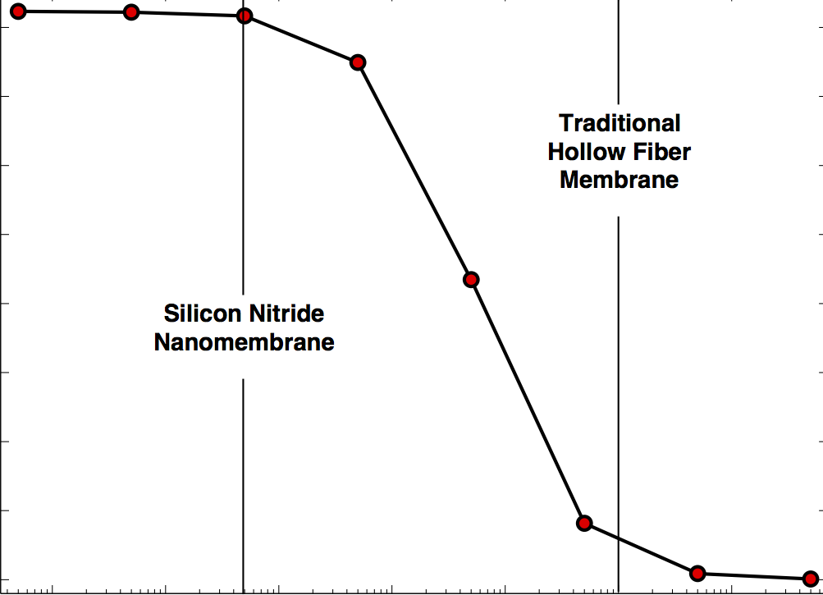
Conclusion
Introduction
ECMO
Hemodialysis
Conclusion
Extracorporeal blood therapies are in need of miniaturization
  Kept large by traditional hollow-fiber membranes
  Ultrathin nanomembranes enable device size reduction
Models allow us to predict and analyze membrane transport
  Modeling approach tailored to application and physics
  Models experimentally validated in the lab
Hemodialysis can be miniaturized to an extraordinary degree
  Allows for wearable, continuous-treatment device
  Regime change from traditional alternatives
ECMO can be miniaturized, but benefits are more limited
  Marginal improvement over traditional membranes
  Necessary membranes too large to produce with current tech
Notes:
These differences explain why moving to a continuous-treatment, miniaturized device is so valuable for hemodialysis while making only a marginal improvement to ECMO.

