Slide 1
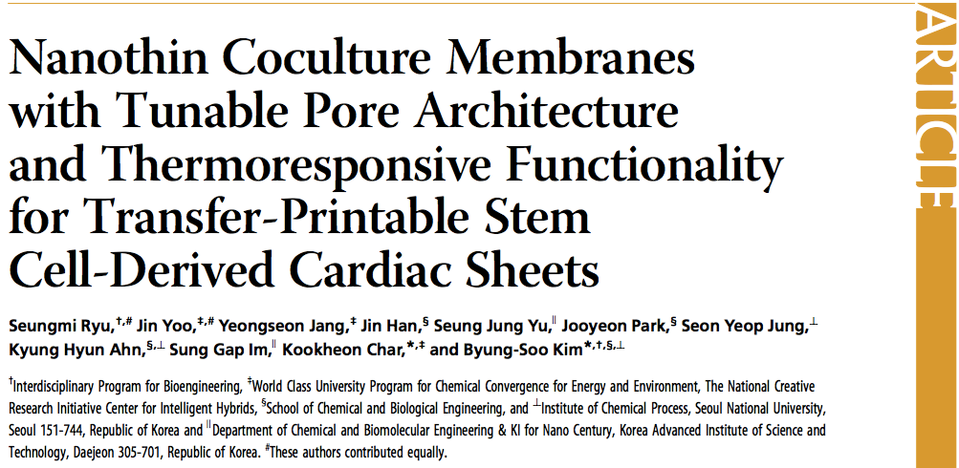
Journal Club Discussion:
Oct/06/2015

Slide 2
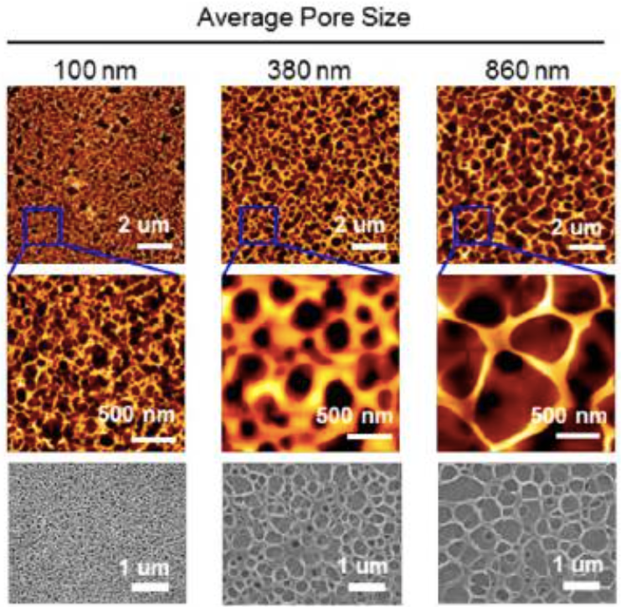
NTHP (nanothin and highly porous) membrane
Notes:
the thickness is similar to the respective average pore size
top two panels: AFM
bottom panel: SEM

Slide 3
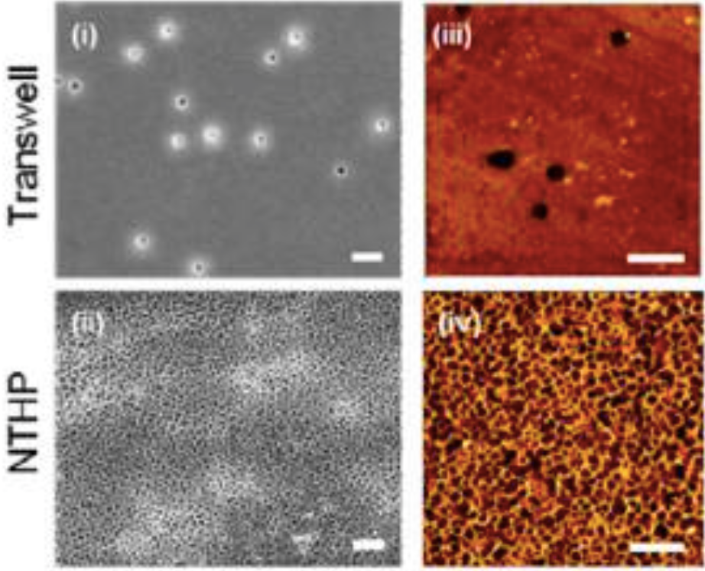
comparison to Transwell: porosity
porosity of 2% (transwell) vs 54% (NTHP)
Notes:
the thickness is similar to the respective average pore size

Slide 4
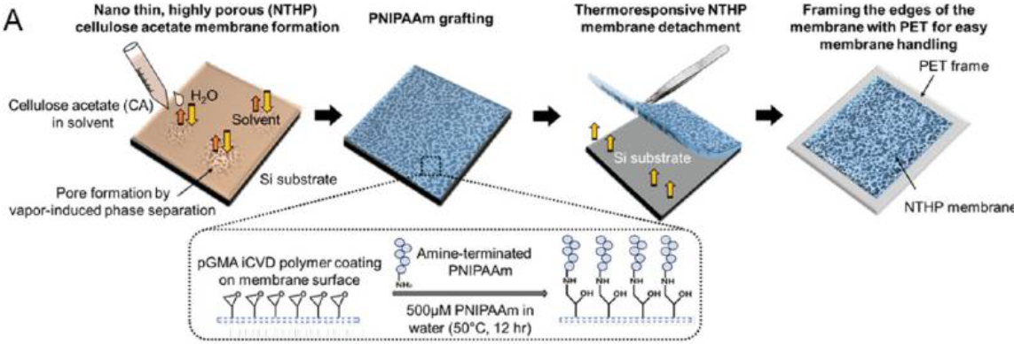
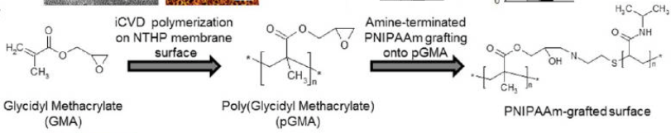
fabrication workflow of the NTHP membrane

Slide 5
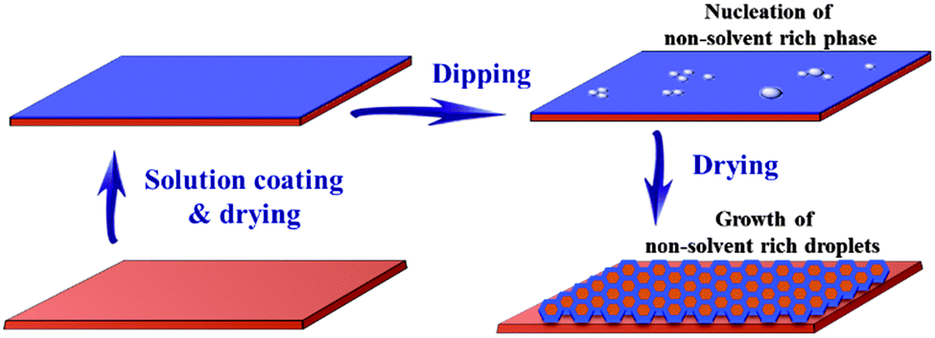
VIPS (vapor-induced phase separation)
“bubbling” non-solvent into solvent to create “pores”
VIPS is the technique used to create the cellulose acetate (CA) membrane
NTHP-100: CA in acetone (3 wt%), spin coated at 3000 rpm for 25 sec NTHP-380: CA in THF (4 wt%), spin coated at 3000 rpm for 25 sec
NTHP-860: CA in THF (3 wt%), spin coated at 1000 rpm for 25 sec
Notes:
reference:
Bui, V. T., Ko, S. H., & Choi, H. S. (2014). A surfactant-free bio-compatible film with a highly ordered honeycomb pattern fabricated via an improved phase separation method. Chemical Communications, 50(29), 3817-3819.

Slide 6
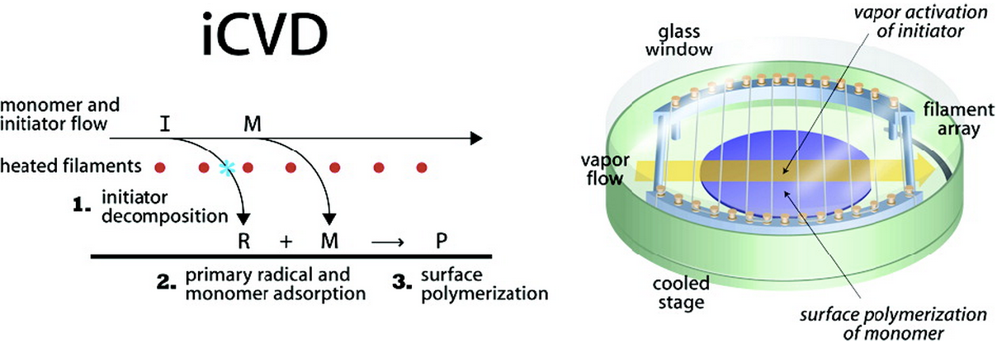
iCVD (initiator Chemical Vapor Deposition)
essentially, replicating solution phase free-radical polymerization in the vapor phase
initiator: TBPO (ter butyl peroxide)
monomer: GMA (glycidyl methacrylate)
amine-terminated PNiPAAm was then grafted onto the iCVDed sample via incubation
Notes:
reference:
http://web.mit.edu/gleason-lab/iCVD.html

Slide 7
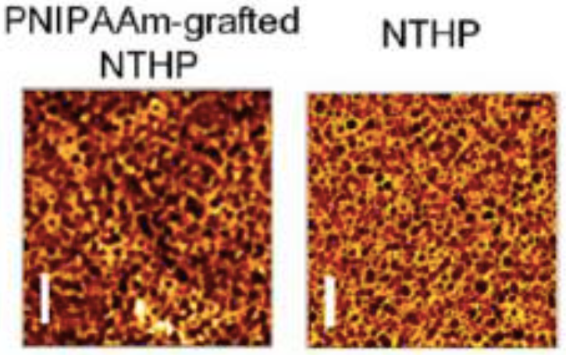
NTHP before and after PNiPMMAm grafting
scale bar = 2 μm
Notes:
somehow, the NTHO pore got bigger… maybe there are variation of pore sizes across region

Slide 8
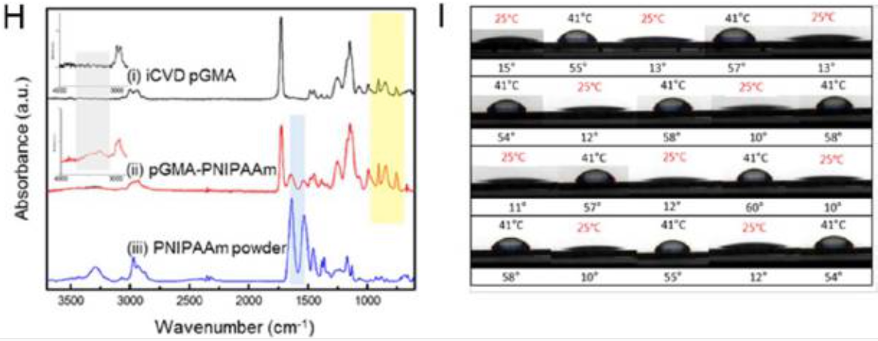
NTHP before and after PNiPAAm grafting
functional assay:
temperature dependence of hydrophobicity
FT-IR spectra
Notes:
the shaded box highlighted specific chemical bonding
somehow, the NTHO pore got bigger… maybe there are variation of pore sizes across region

Slide 9
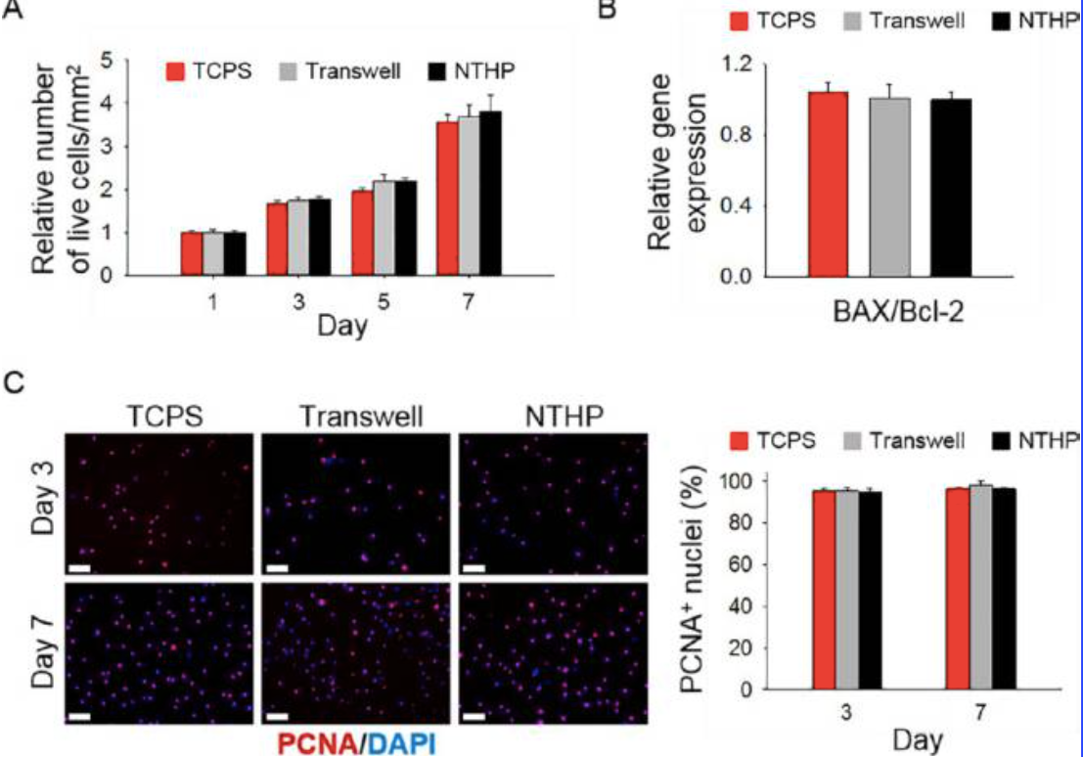
assessment of MSC proliferation and metabolic activity
Notes:
A: data obtained from Cell Counting Kit-8 Assay
B: pro-apoptotic regulatory gene, BAX, and an antiapoptotic regulatory gene, Bcl-2, on day 3 of the MSC culture.
C and D: PCNA is a proliferating cell nuclear antigen staining

Slide 10
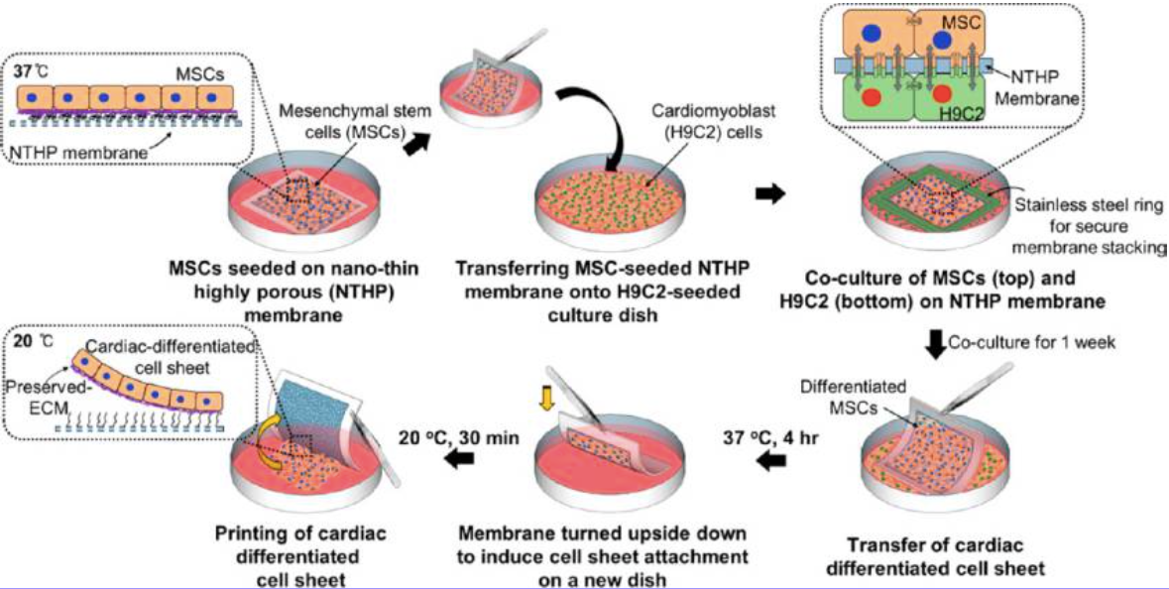
workflow of MSC/H9C2 co-culture
Notes:
interestingly, it seems that the MSC can stick to PNiPMAAm just fine (in media).

Slide 11
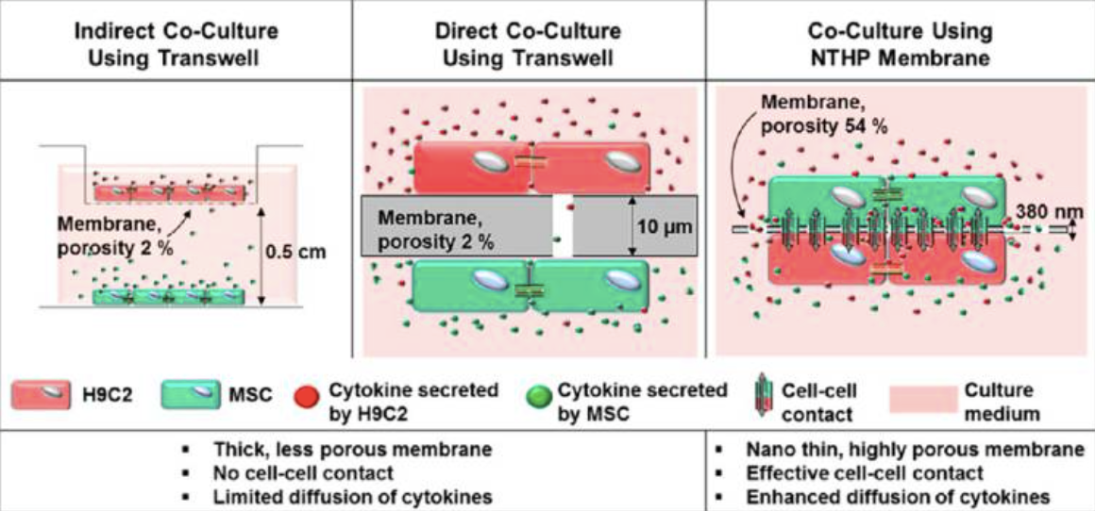
Transwell vs NTHP (in MSC/H9C2 co-culture)

Slide 12
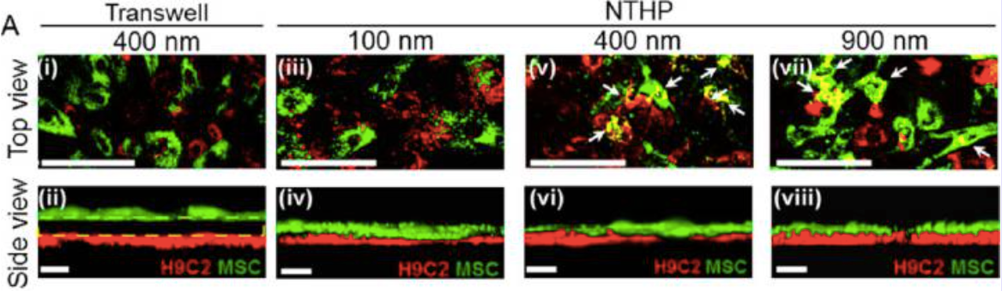
MSC/H9C2 contact in co-culture
Notes:
confocal imaging

Slide 13
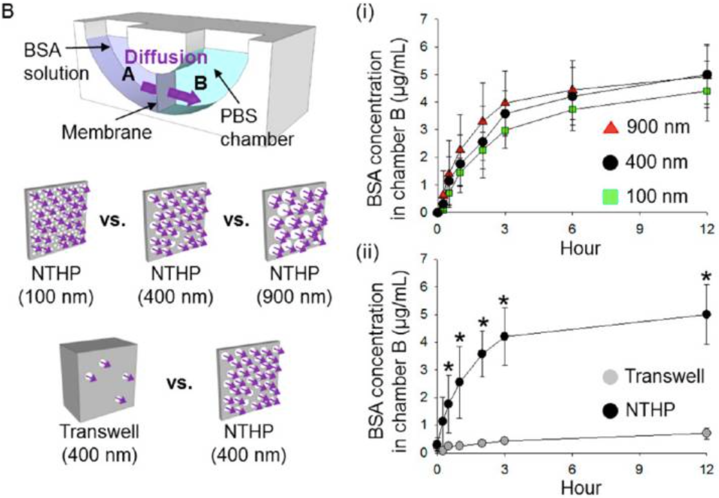
BSA diffusion across membrane
Notes:
we see the same trend… in that after some point the higher pore sizes does not lead to higher diffusive flux

Slide 14
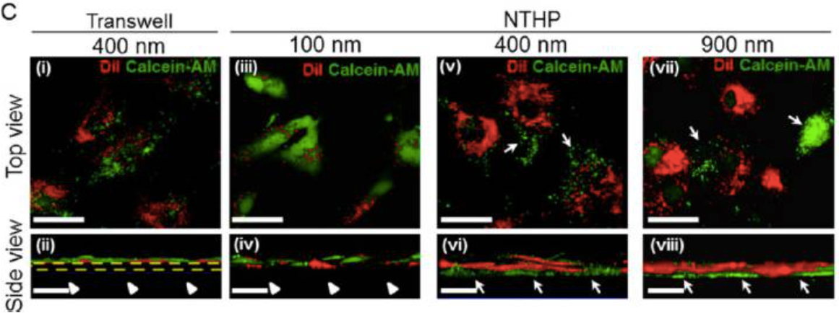
gap junctional transport
Dil: cell membrane marker, cannot transfer through cell-cell contact
Calcein-AM: becomes fluorescent after entering cell, and can only exit cell through cell-cell gap junction
Notes:
confocal imaging: Calcein AM for through the MSC layer, bit not the Dil

Slide 15
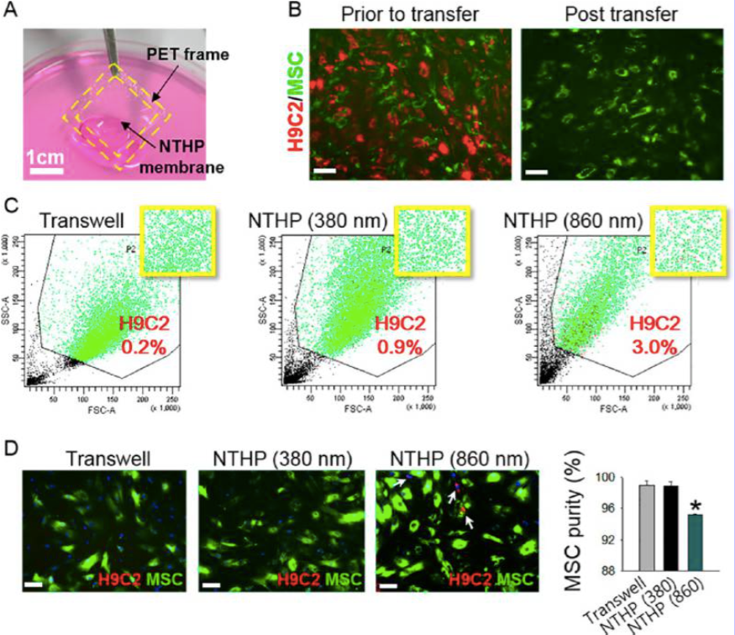
fidelity of MSC/H9C2 separation
Notes:
this data seem to imply MSC/H9C2 attachment can be separated simply through force….of PNiPAAm conformal change?

Slide 16
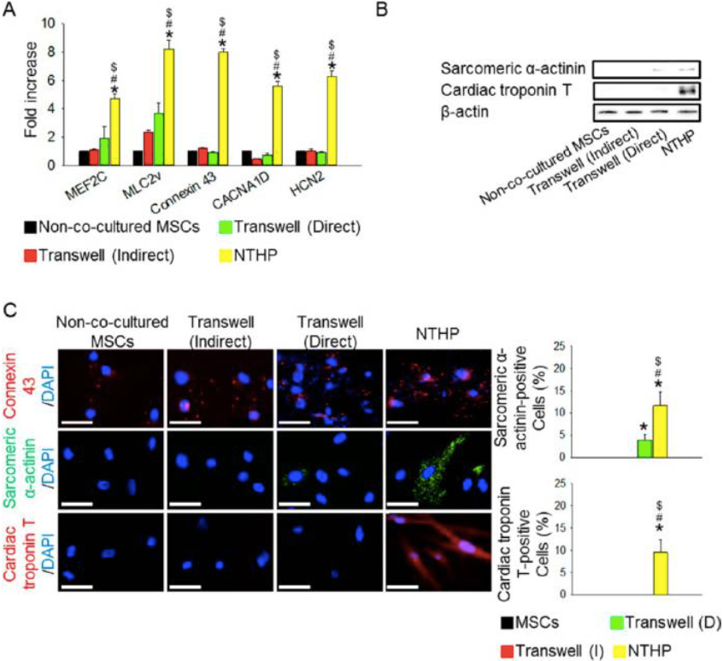
NTHP promoted higher degree of MSC differentiation in co-culture
Notes:
MEF2C: cardiac transcription factor
MLC2v: cardiac structural marker
connexin 43: gap junction marker
CACNA1D, HCN2: cardiac ion channel markers
cardiac structural proteins: sarcomeric R-actinin (SA) and cardiac troponin T (cTnT).

Slide 17
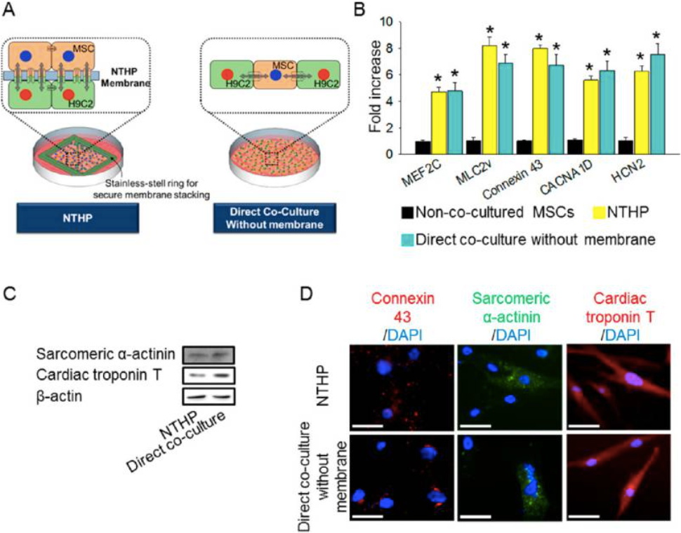
Notes:
MEF2C: cardiac transcription factor
MLC2v: cardiac structural marker
connexin 43: gap junction marker
CACNA1D, HCN2: cardiac ion channel markers
cardiac structural proteins: sarcomeric R-actinin (SA) and cardiac troponin T (cTnT).

Slide 18
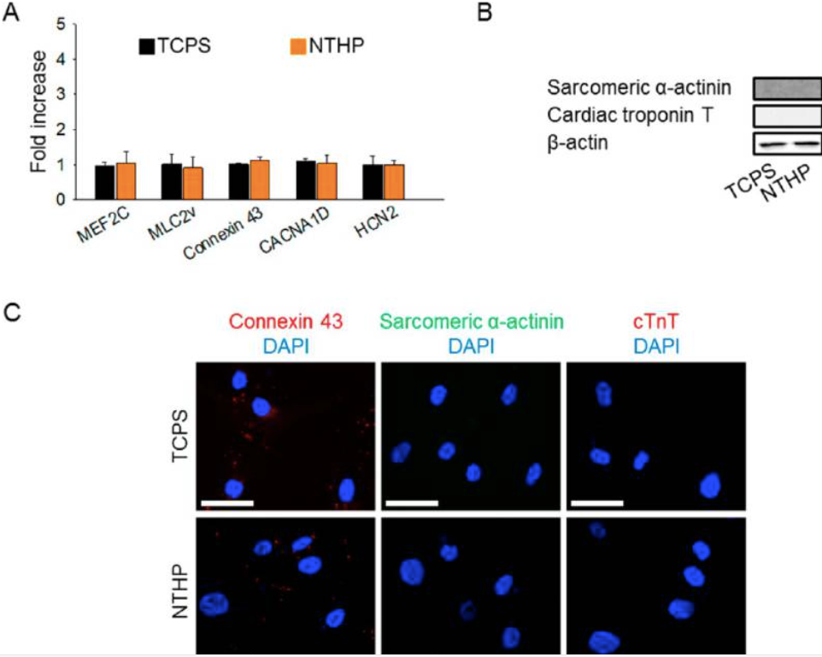
Notes:
MEF2C: cardiac transcription factor
MLC2v: cardiac structural marker
connexin 43: gap junction marker
CACNA1D, HCN2: cardiac ion channel markers
cardiac structural proteins: sarcomeric R-actinin (SA) and cardiac troponin T (cTnT).

Slide 19
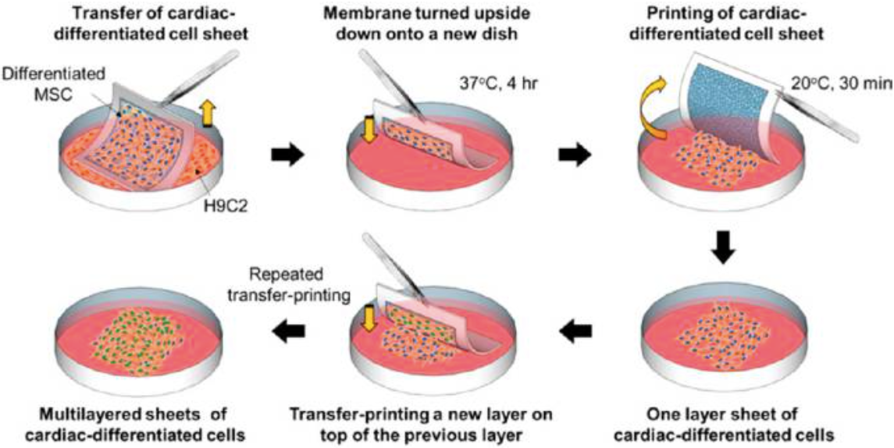
schematics of a multilayered culture

Slide 20
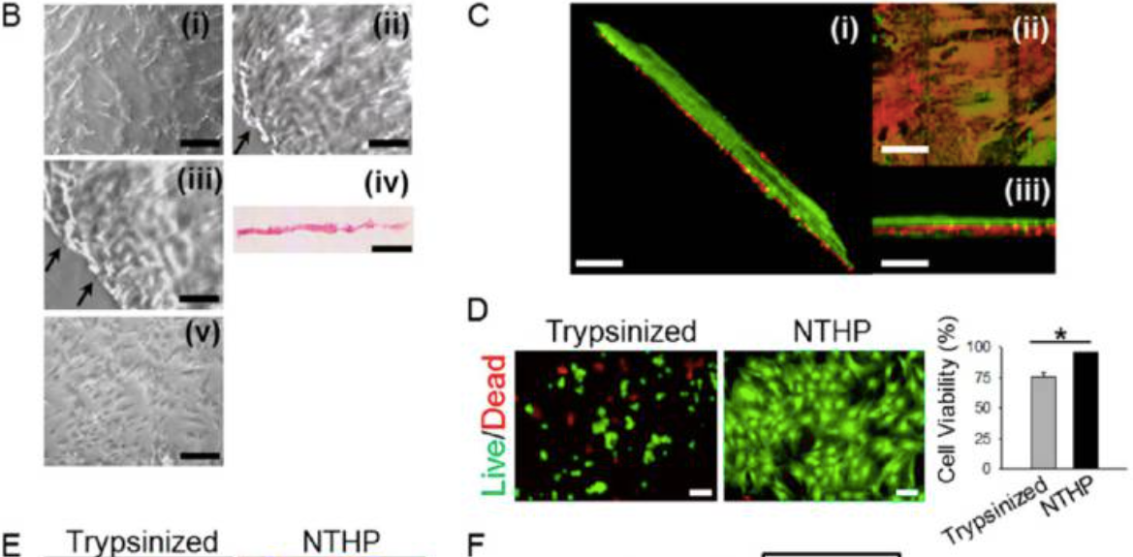
demonstration of proper cell detachment and multilayering
Notes:
Biv: hematoxylin and eosin (H&E) stain to demonstrate an intact monolayer
c: red (DiI) and green (DiO) labeled cell layer to demonstrate a biylayer culture

Slide 21
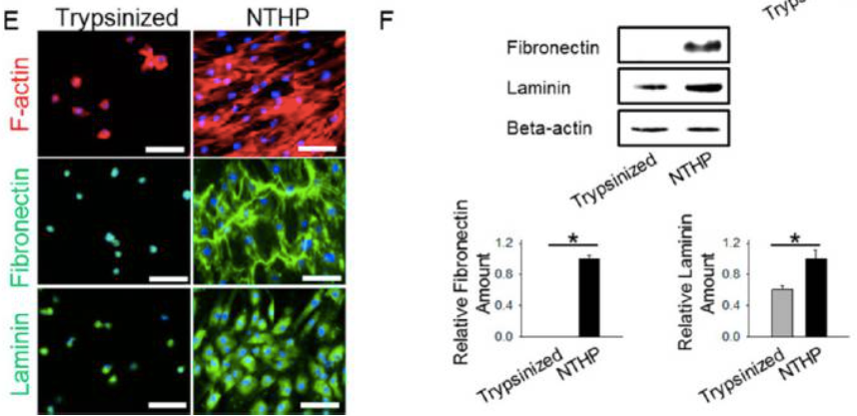
demonstration of ECM preservation post cell sheet detachment

