Slide 1

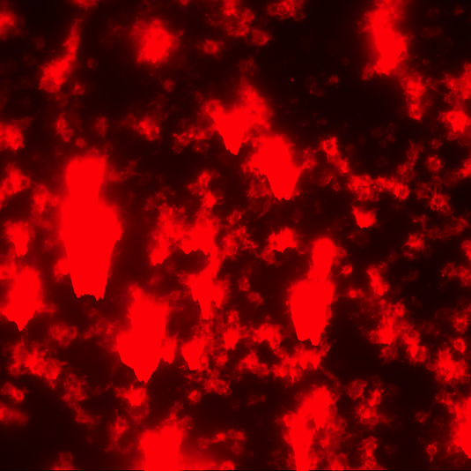
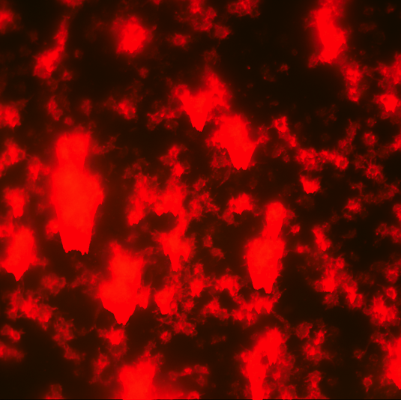



Platelet studies: control experiments
Platelets treated with ADP show overwhelming degree of aggregation and activation
CD41: Platelet Marker
CD62P: Activated Platelet Markers
Merge
No platelet adhesion and activation on Teflon surface

Slide 2
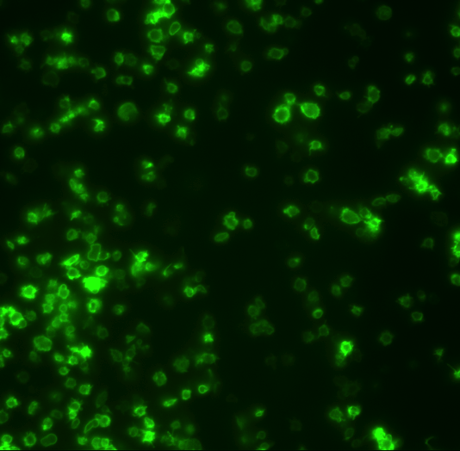
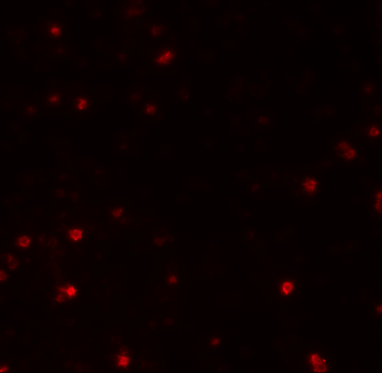
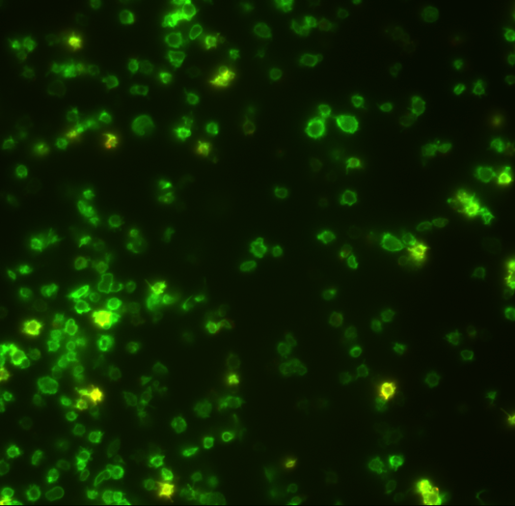
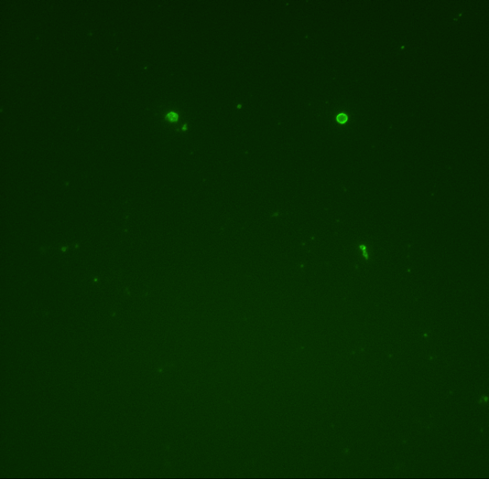

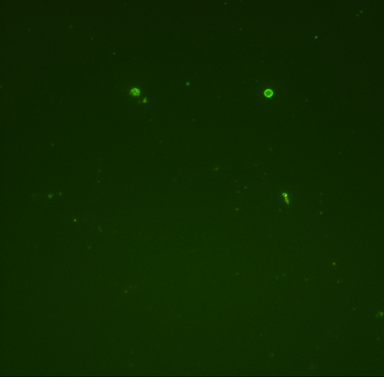
PEG treatment significantly reduces platelet adhesion/aggregation
Plasma treated pncSi Surfaces
CD41: Platelet Marker
CD62P: Activated Platelet Markers
Merge
PEG treated pncSi Surfaces

Slide 3
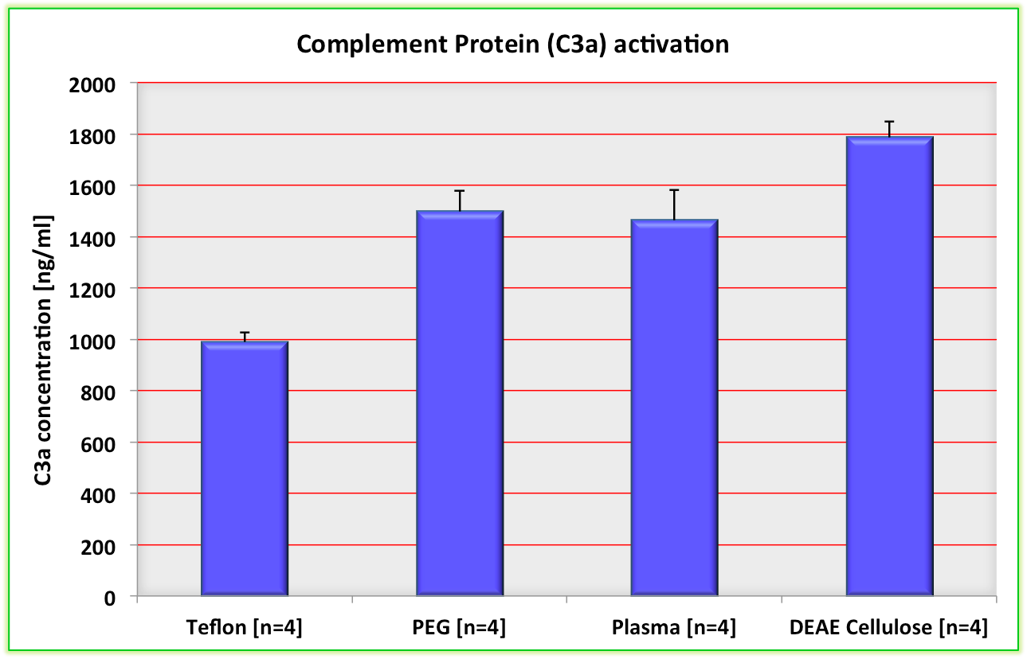
Complement protein activation

Slide 4
Thombin generation

