Slide 1
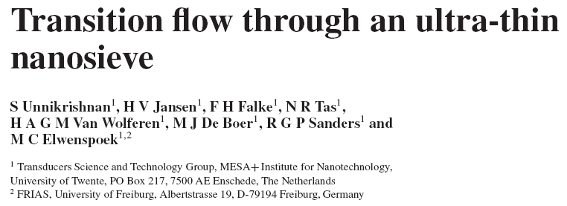

Slide 2
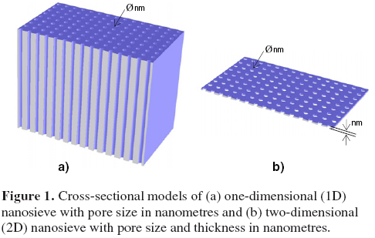
1D and 2D nanosieves
circular pores
45 nm thickness, 120 nm diameter
3.2 % porosity
flux and selectivity at different pressures are mesured
Transition flux is a linear addition of viscous and molecular fluxes, proved w/o fitting parameters

Slide 3
Fabrication
nanosieve (120 nm pore diameter)
  Silicon nitride 45nm LPCVD deposited (future membrane)
  Laser interference lithography (LIL) to create pore pattern
  Plasma etch to make pores
microsieve (6 micron pore diameter)
  Pores etched by deep reactive-ion etching DRIE
nanosieve and microsieve fusion bonded
nanosieve wafer carrier is etched away
  thermal oxide acts as stop layer which is removed after

Slide 4
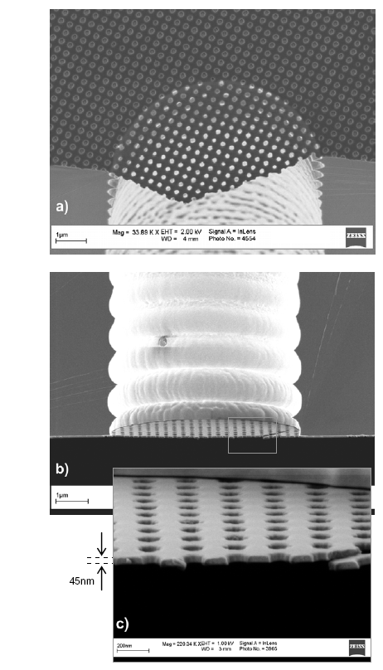
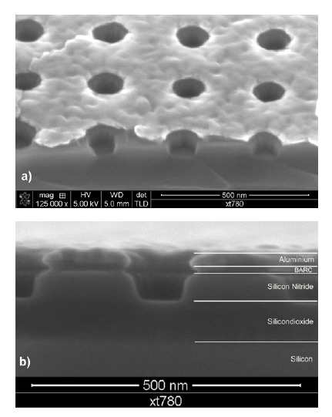
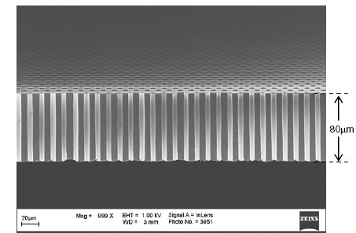
nanosieve
microsieve support

Slide 5
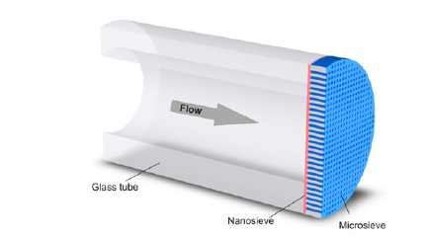
Device Fabrication
3.2% final porosity
glass tube of 3mm diameter fusion bonded to microsieve to measure gas flow

Slide 6
Theory and Characterization
viscous (Kn < 0.01), transition (0.01 < Kn < 1) and molecular (Kn > 1) flow regime, Knudsen number: Kn = λ/d
Knudsen described transition flow as superimposition of viscous and molecular flows, included wall interaction correction terms

Slide 7
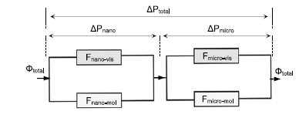


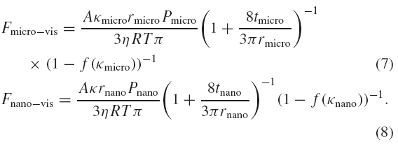
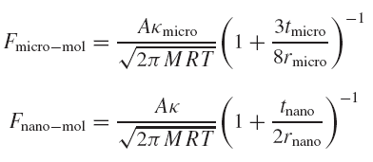
Theory and Characterization
ΔP- pressure drop (Pa), Ф – mass flow (mol/s), F – flow conductance (mol/s/Pa)

Slide 8
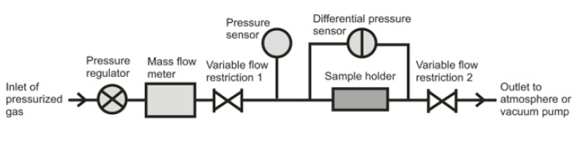
Theory and Characterization
ΔP- pressure drop (Pa), P- mean pressure (Pa)

Slide 9
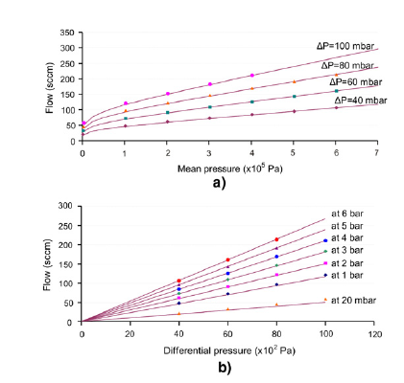
MOLECULAR FLOW
VISCOUS FLOW

Slide 10
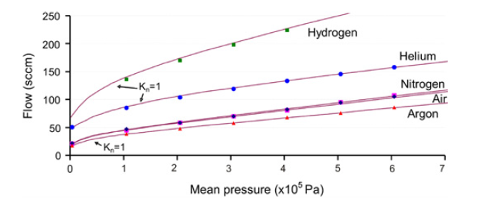

Pure gas flow experiments
Lager selectivity for higher Kn numbers
He/Ar selectivity is 3.1 at 20 mbar (close to theoretic) – molecular regime
2.39 at 1 bar due to viscosity differences b/w gases, it will disappear whith mixtures
Total strength is 5 bar and more

Slide 11
Gas permeability paper plan

Slide 12
Membrane, characterization, air permeability values (compared)
Gas transport in restricted geometries, Knudsen diffusion theory, pore processing + modeling molecular flow, theoretical and experimental data correlation, no pressure dependence, porosity determination and possible quality testing (pressure dependence if pinholes-viscous flow)
Single gas selectivities due to Knudsen diffusion (He, Co2, N2)
Probability of collision-free passage of gas molecule, enhancement in permeabilities of membranes with the same porosity but different average pore diameters

Slide 13
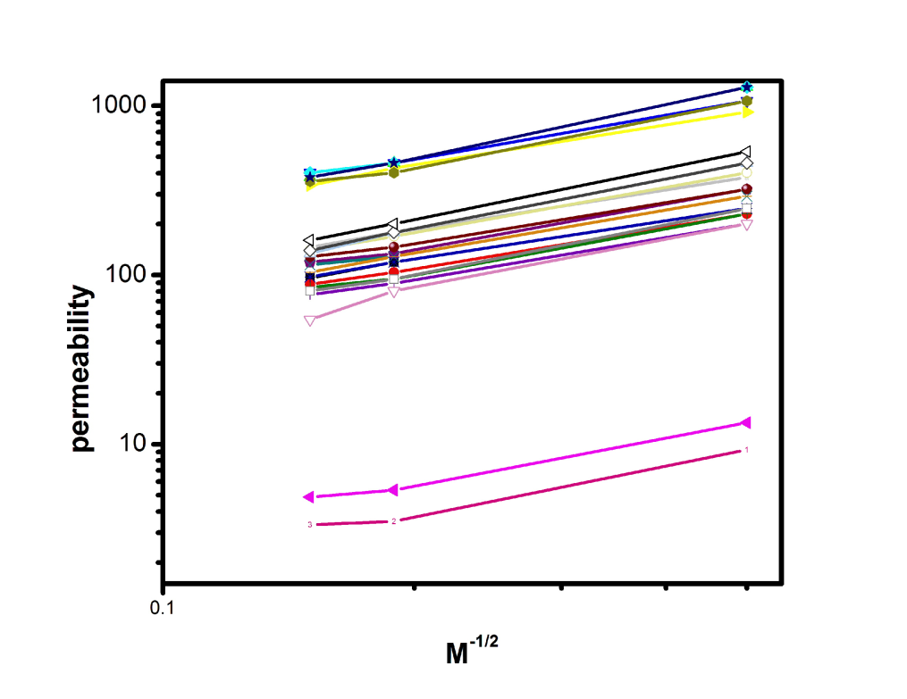
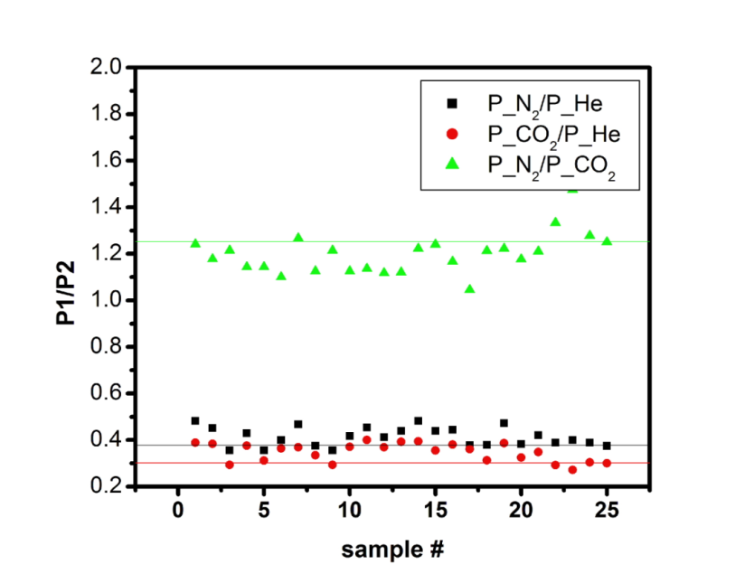
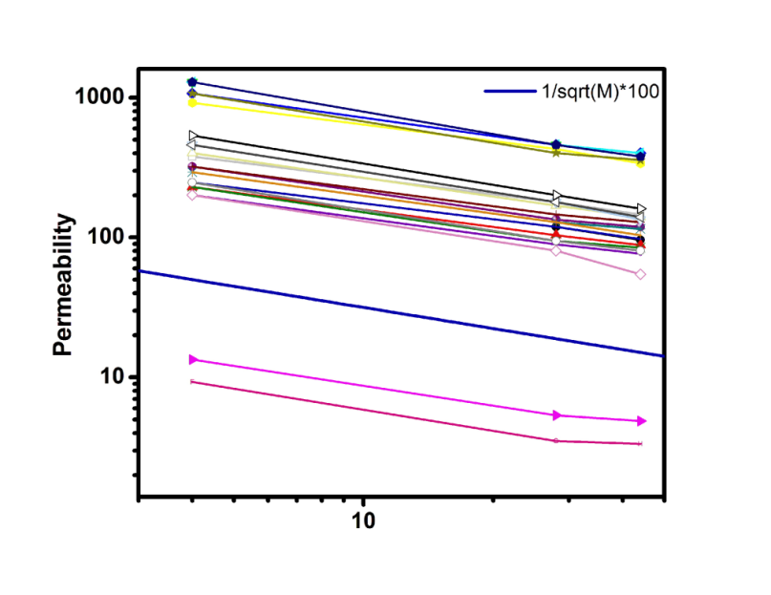
Gas Selectivity and M Dependence Experiments
Experimental M dependence for
membranes with different porosities
Single gas selectivities , experimental
and Knudsen prediction
He
CO₂
N₂
N2/Co2 average=1.1950, theory =1.2536, error=5%
N2/He average=0.3993, theory= 0.3780, error=5%
Co2/He average=0.3355, theory=0.3015, error=10%
He
CO₂
N₂

Slide 14
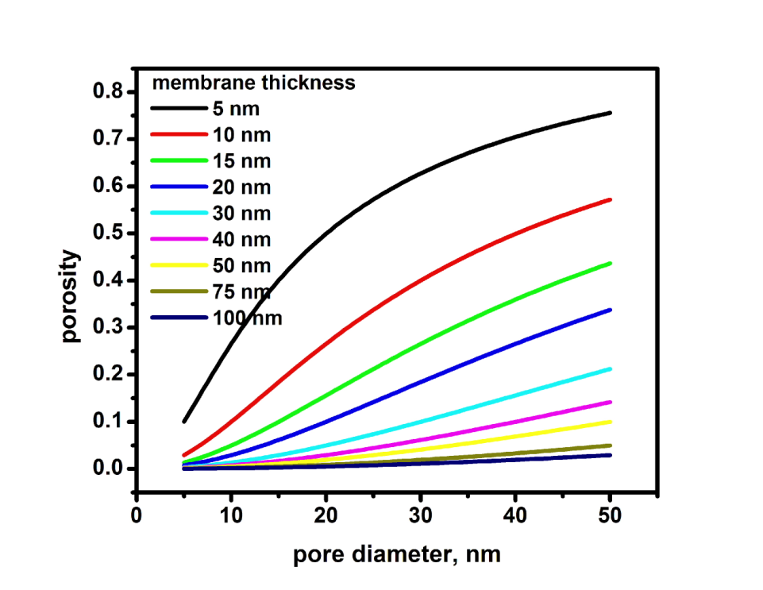
Collision-free transport
Average percent of molecule trajectories
which pass the pore certain diameter and
height without hitting a wall

Slide 15
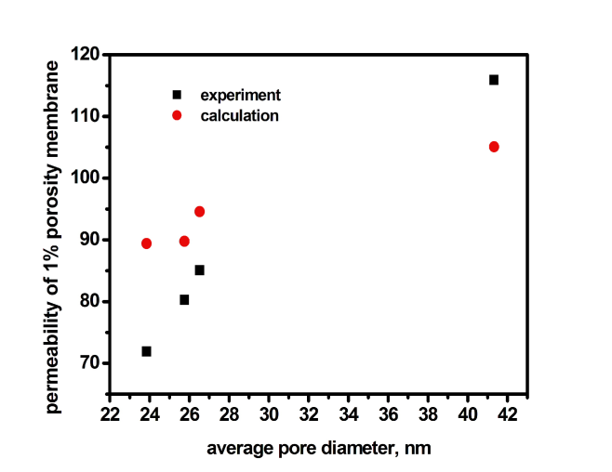
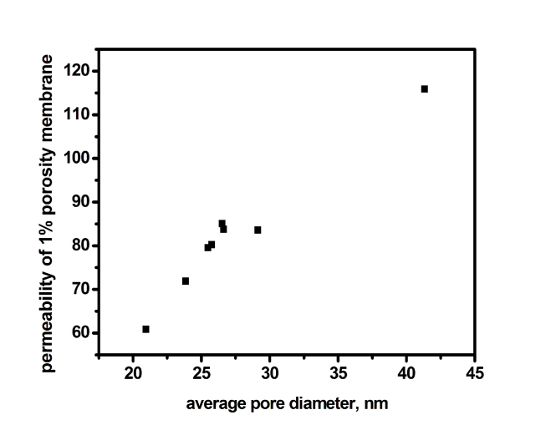
Permeability enhancement
Permeabilities of membranes with close
starting porosities, averaged to 1 % plotted
against average pore diameter. Calculated
value consists of sum of weighted
collision-free (Clausing factor=1) and
Knudsen permeabiliies calculated for
particular membrane.
different starting porosities

Slide 16
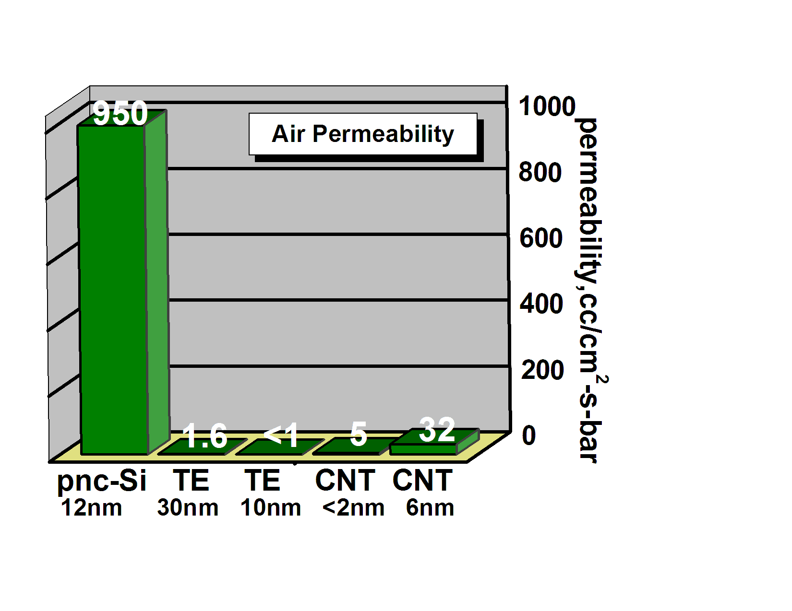
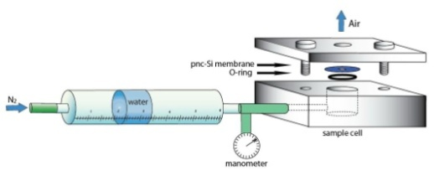
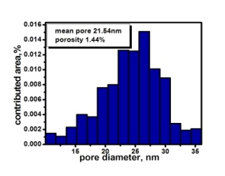
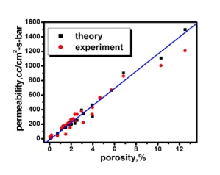
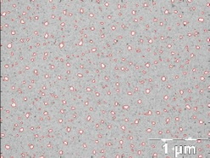
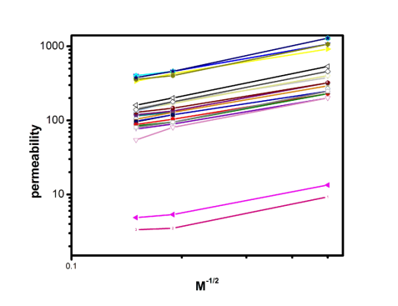



Paper Plan
1
2
3
4

