Slide 1
Active-passive microrheology using optical tweezers in type I/III collagen hydrogels
Victor Zhang
Advisors: Hani Awad and Jim McGrath

Slide 2
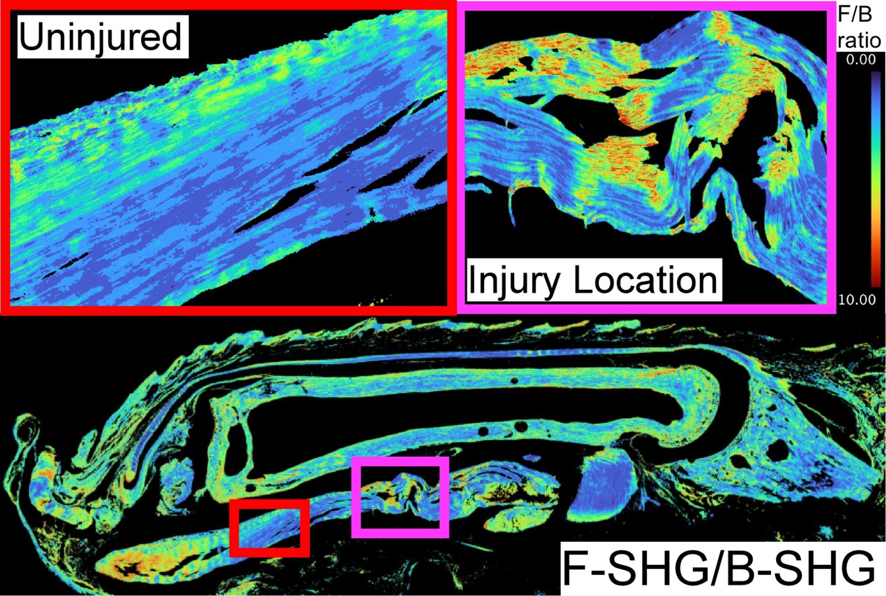
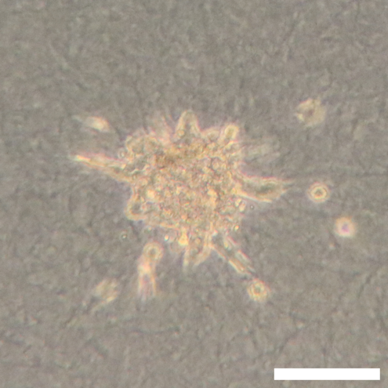
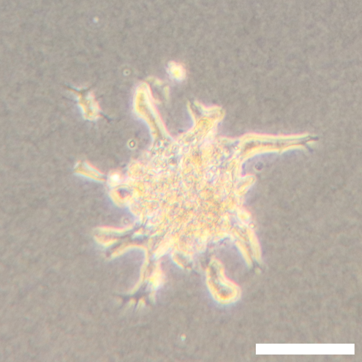
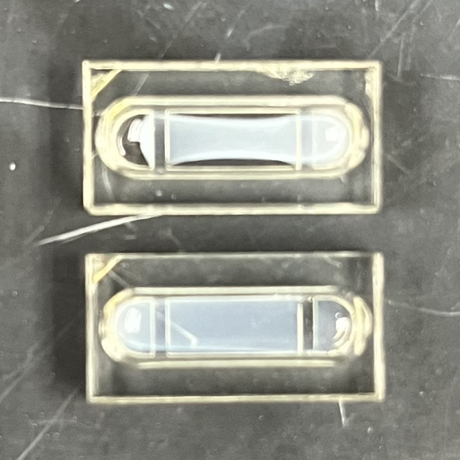
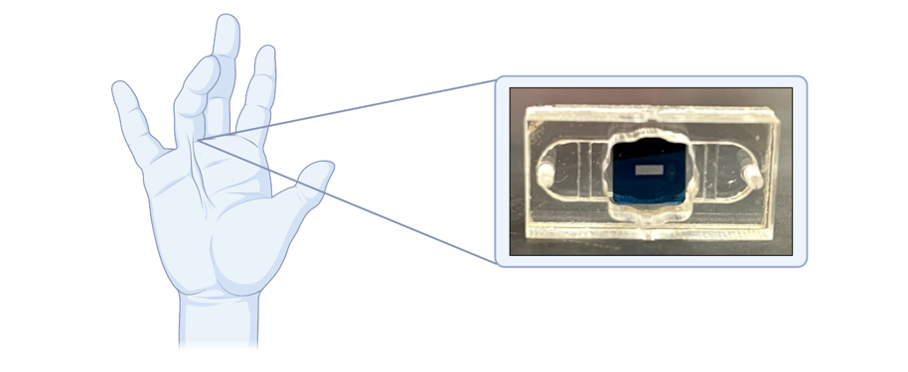
Type III collagen increases during repair but remains elevated in tendon scar tissue
Type III collagen measured by forward over backward second harmonic generation [1]
Adding type III collagen changes ultrastructure of hToC hydrogel
Type III collagen affects cellular components of hToC
5% Type III
20% Type III
Angiogenesis
5% Type III
Cell migration
Human Tendon-on-a-Chip (hToC)
Matrix remodeling
18 mm
20% Type III
[1] Rae M. Robertson-Anderson, ACS Macro Letters, 2018

Slide 3
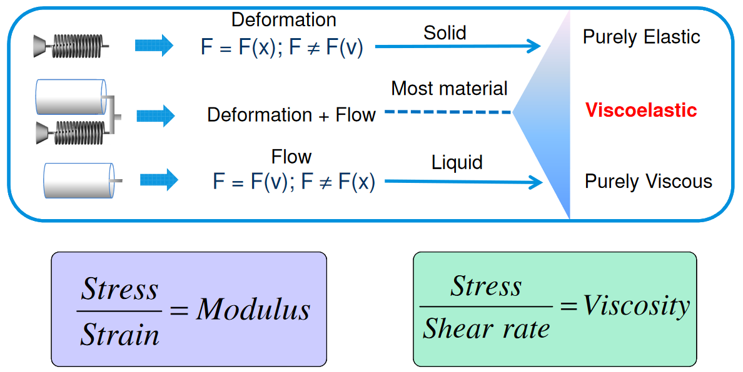
Viscoelastic properties can be measured using rheometry
Rheology: the study of deformation and flow of materials (with solid and fluid characteristics)
  Collagen hydrogel: collagen fibrils and PBS/culture media
TA Instruments

Slide 4
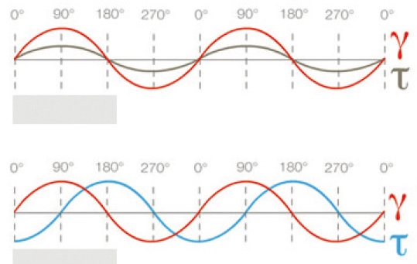
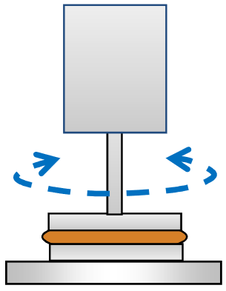
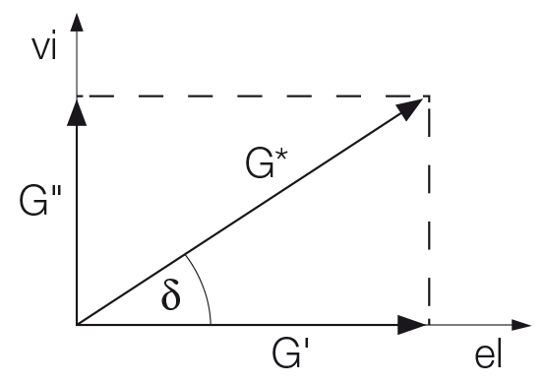
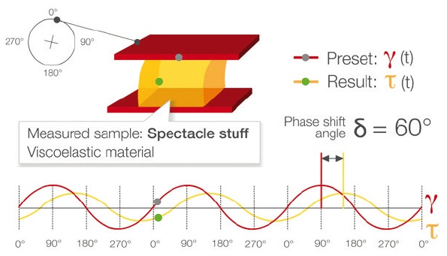
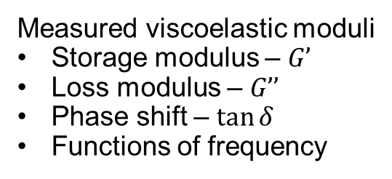
Oscillatory testing of viscoelastic behavior – Storage and Loss Modulus
Elastic
Oscillatory testing in parallel plate rheometer
Measured viscoelastic moduli
Storage modulus – $G’$
Loss modulus – $G’’$
Phase shift – $\tan{δ}$
Functions of frequency
Viscous
TA Instruments
Anton Paar

Slide 5
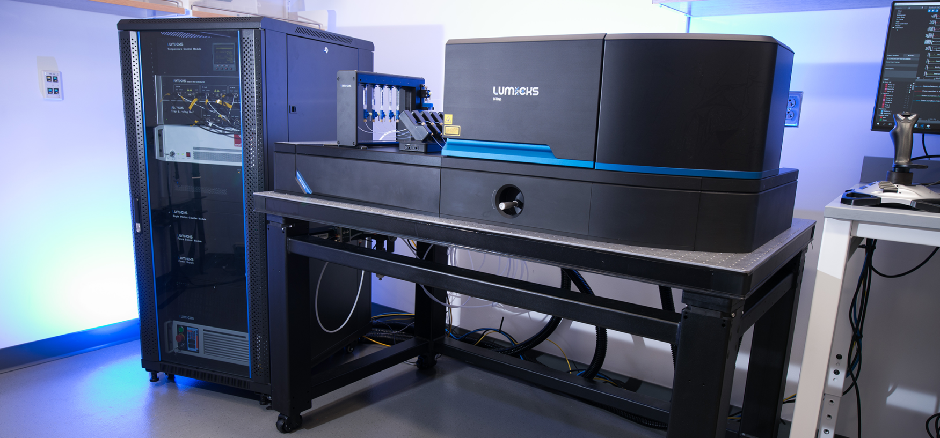
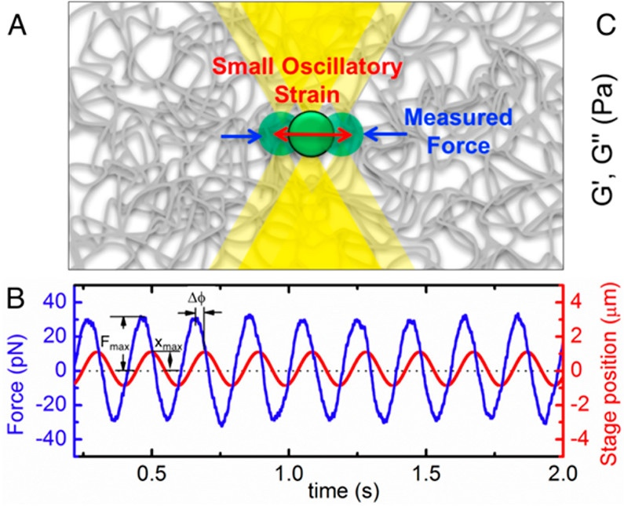
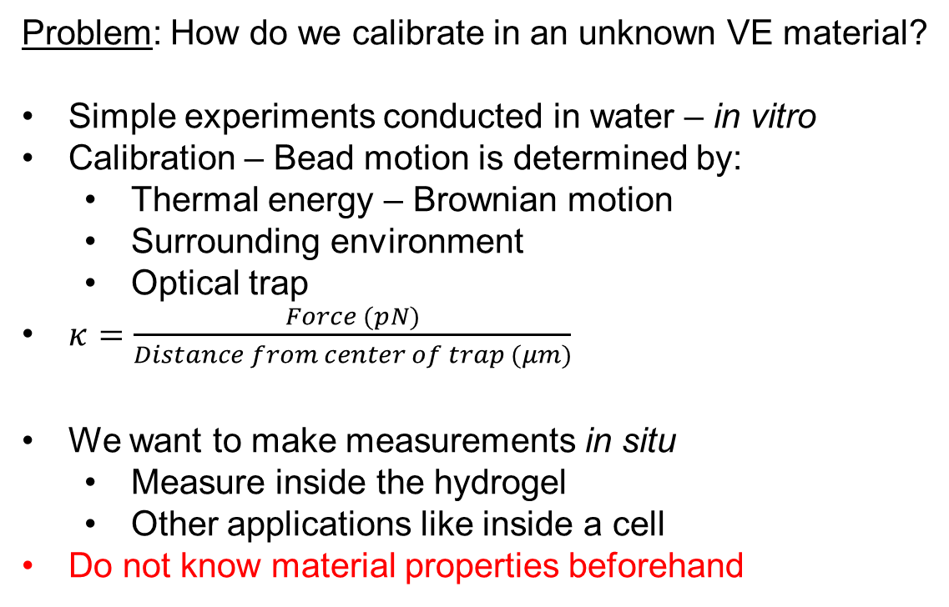
Optical tweezers allow us to make measurements at small scale
Lumicks – C-Trap
Problem: How do we calibrate in an unknown VE material?
Simple experiments conducted in water – in vitro
Calibration – Bead motion is determined by:
  Thermal energy – Brownian motion
  Surrounding environment
  Optical trap
$κ=\frac{Force (pN)}{Distance from center of trap (μm)}$
We want to make measurements in situ
  Measure inside the hydrogel
  Other applications like inside a cell
Do not know material properties beforehand
Lumicks
Rae M. Robertson-Anderson, ACS Macro Letters, 2018

Slide 6
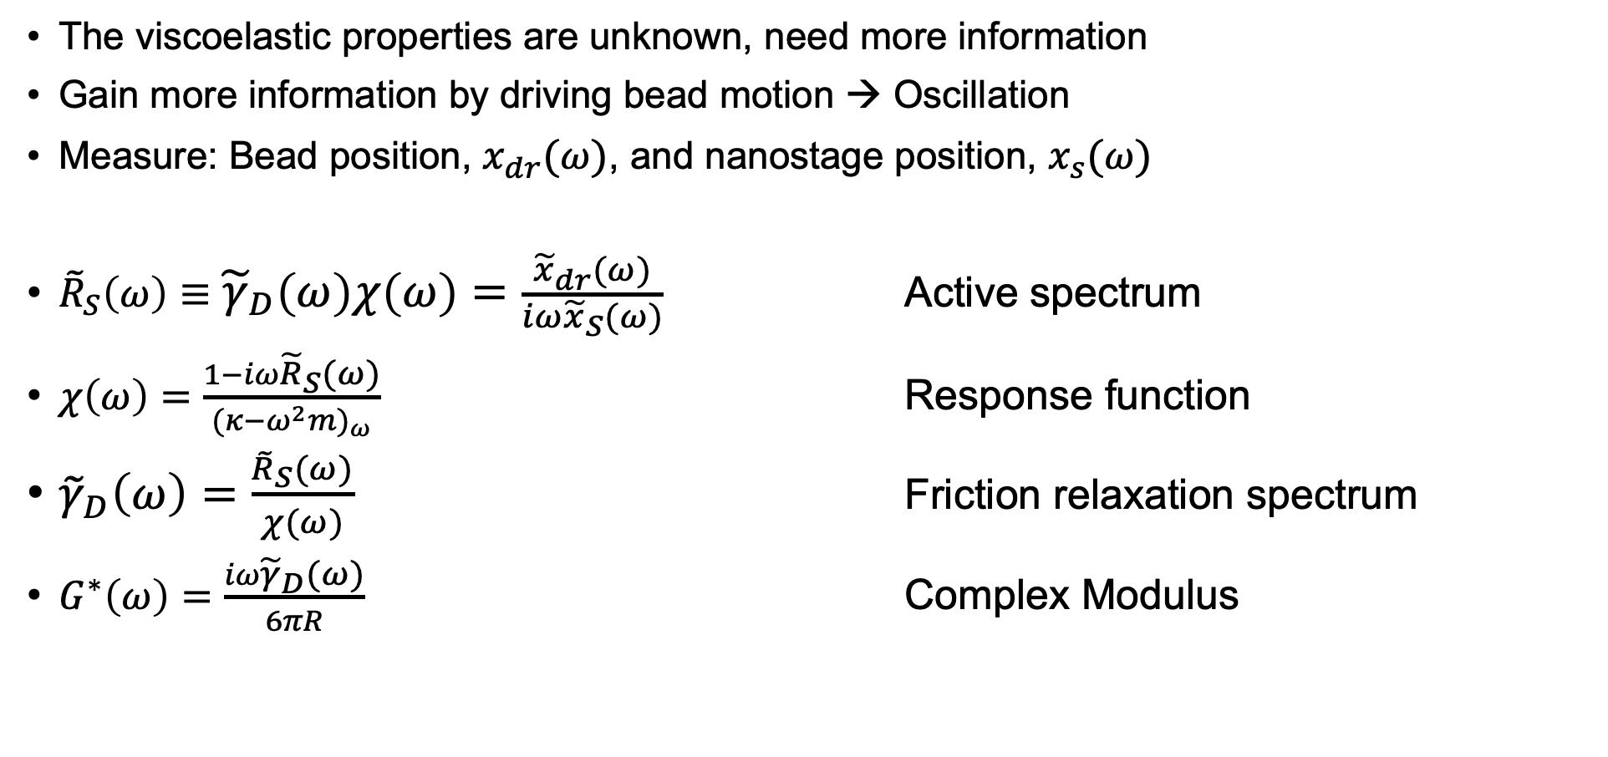
Active-passive calibration for in situ measurement of viscoelastic materials [1]
The viscoelastic properties are unknown, need more information
Gain more information by driving bead motion → Oscillation
Measure: Bead position, $x_{dr}(ω)$, and nanostage position, $x_{s}(ω)$
${\tilde{R}}_{S}\left(ω\right)≡{\tilde{γ}}_{D}\left(ω\right)χ\left(ω\right)=\frac{{\tilde{x}}_{dr}(ω)}{iω{\tilde{x}}_{S}(ω)}$ Active spectrum
$χ\left(ω\right)=\frac{1−iω{\tilde{R}}_{S}(ω)}{{(κ−ω^{2}m)}_{ω}}$ Response function
${\tilde{γ}}_{D}\left(ω\right)=\frac{{\tilde{R}}_{S}(ω)}{χ(ω)}$ Friction relaxation spectrum
$G^{∗}\left(ω\right)=\frac{iω{\tilde{γ}}_{D}(ω)}{6πR}$ Complex Modulus
[1] Mario Fischer and Kirstine Berg-Sørensen, 2007, J. Opt. A.: Pure Appl. Opt. 9 S239

Slide 7
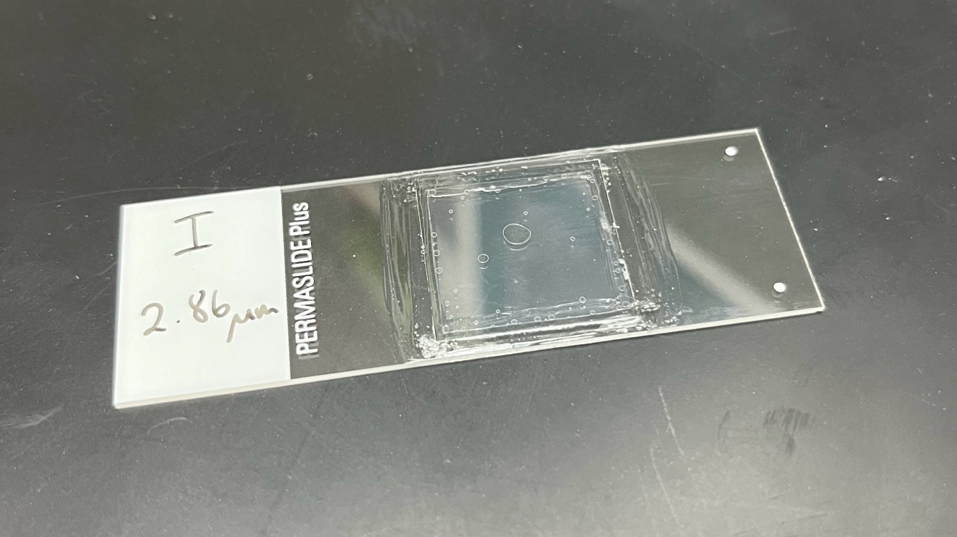
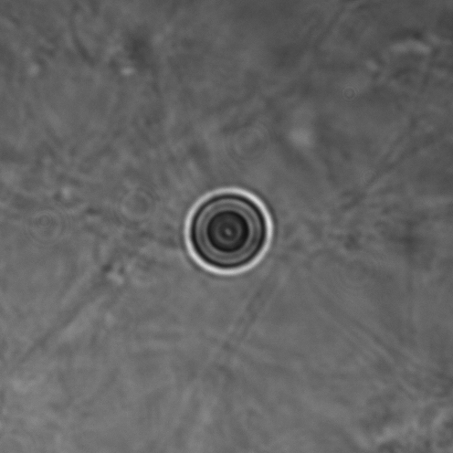
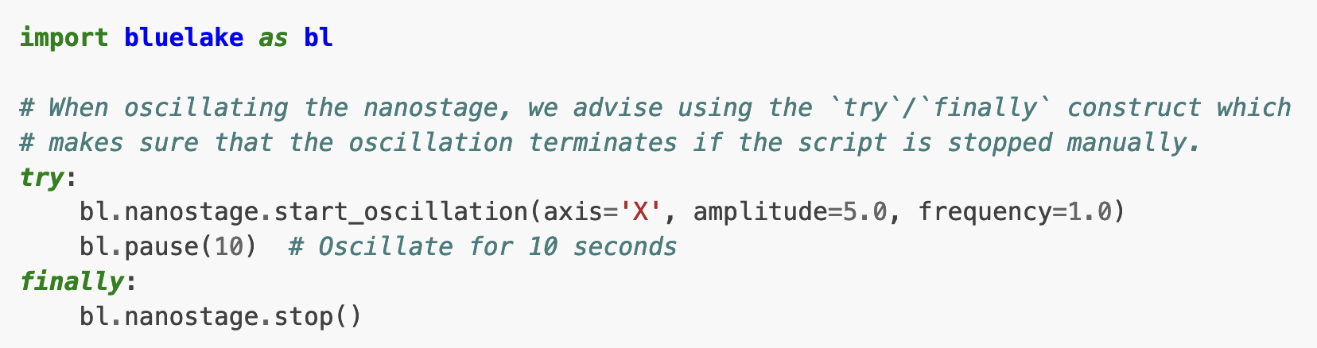
Oscillation of polystyrene bead using optical trap
Sample slide using cover slip and double-sided adhesive
Python based control
Set axis, amplitude, and frequency of oscillation
Sampling frequency of 78125 Hz
Notes:
Giant cell (fibroblast) meant to illustrate the scale of the experiment for single-cell (or even smaller than single cell). Human tendon fibroblasts are ~150 um long and the bead is 2.86 um

Slide 8


Discrete Fourier Transform of measured bead position to calculate passive/active spectra
Passive (No driving)
Active (1 Hz Oscillation)
$${(κ−ω^{2}m)}_{ω}=2k_{B}T\frac{Re\left\{{\tilde{R}}_{S}(ω)\right\}}{P_{U}(ω)}$$
$${\tilde{R}}_{S}\left(ω\right)≡{\tilde{γ}}_{D}\left(ω\right)χ\left(ω\right)=\frac{{\tilde{x}}_{dr}(ω)}{iω{\tilde{x}}_{S}(ω)}$$

Slide 9
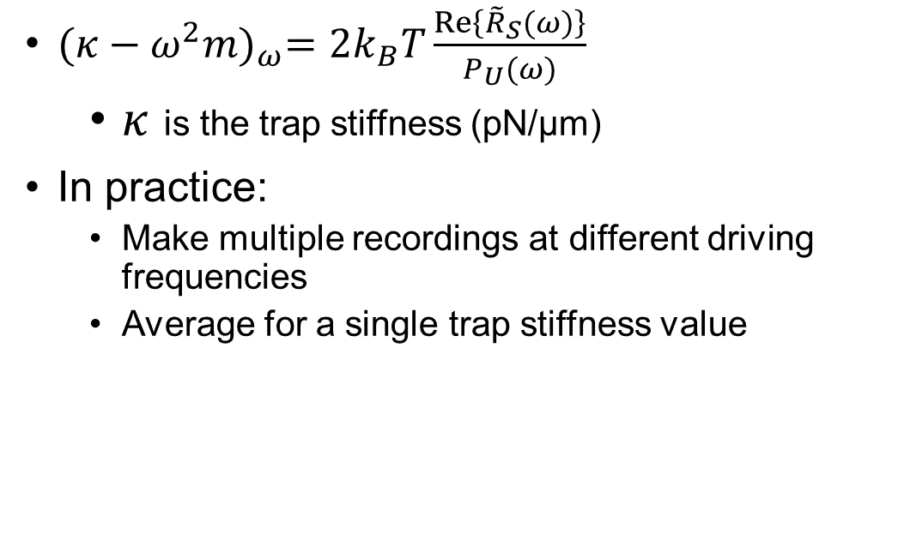
Calibrating the trap stiffness using active and passive spectra
${(κ−ω^{2}m)}_{ω}=2k_{B}T\frac{Re\left\{{\tilde{R}}_{S}(ω)\right\}}{P_{U}(ω)}$
  $κ$ is the trap stiffness (pN/µm)
In practice:
  Make multiple recordings at different driving frequencies
  Average for a single trap stiffness value

Slide 10
Early active-passive microrheology measurements approximate complex moduli from bulk rheology

Slide 11
Conclusions and next steps
Active-passive calibration of optical tweezers can make in situ measurements of viscoelastic materials
This technique can be applied to collagen hydrogels
We can learn how type III collagen affects the hToC
Future work
  Fine-tune experimental set-up and parameters to ensure measurements are accurate
  Greater sample sizes and signal processing to “clean up” data

Slide 12
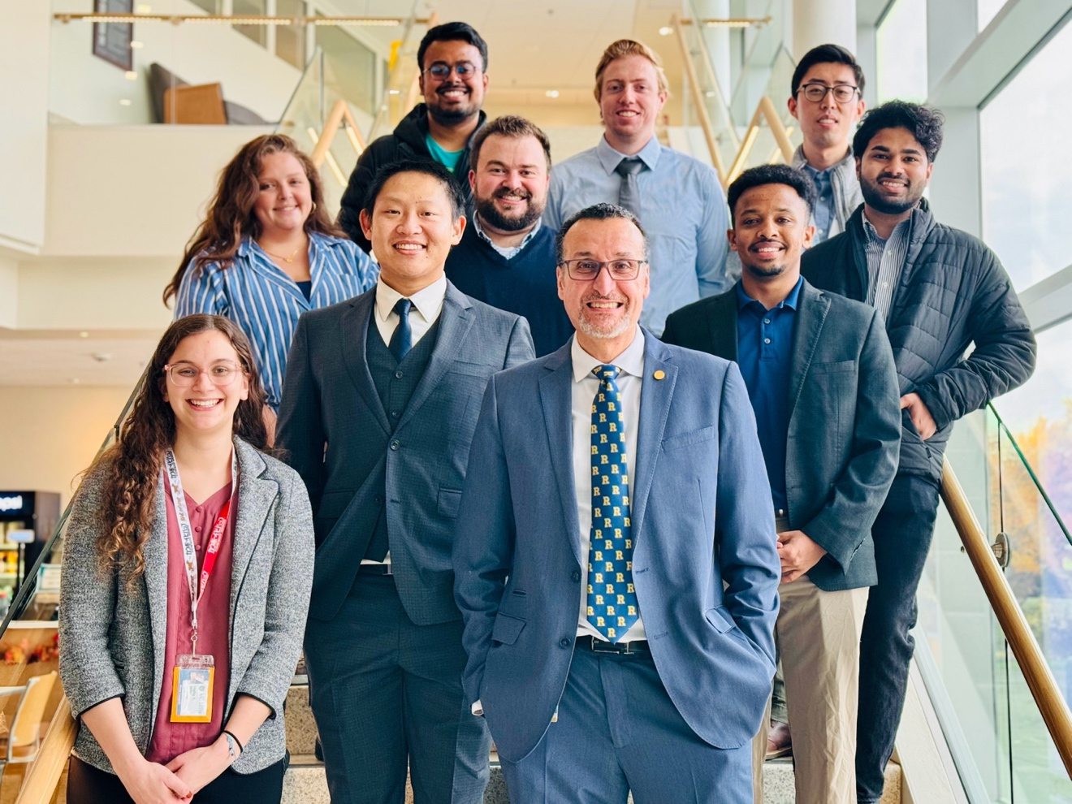



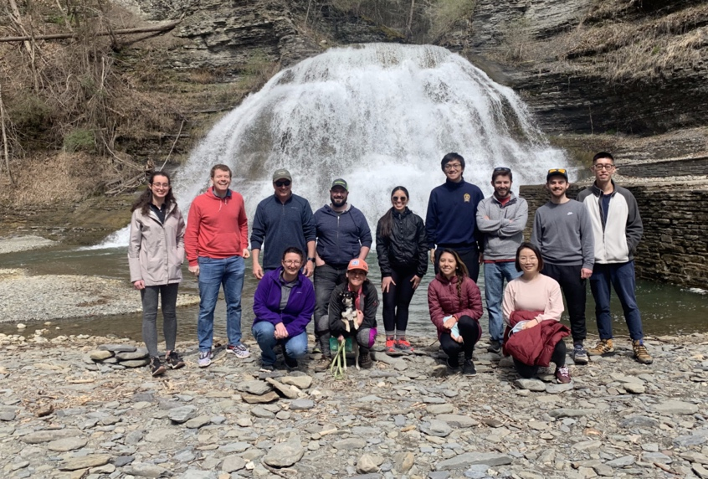



Thank you!
Awad Lab
HCIC
Lindsay Wysocki, PhD
Elio Abbondanzieri, PhD
McGrath Lab

