Slide 1
Melting Assay for Plastic Investigation
Ian Krout

Slide 2
Set up

Slide 3
Heat Gradient of Plate
29°C
150°C
400°C
511°C
482°C

Slide 4
Temperature and Ampere Gradient for Ceramic Set Up

Slide 5
Temperature Gradient at 3.5A On Chip

Slide 6
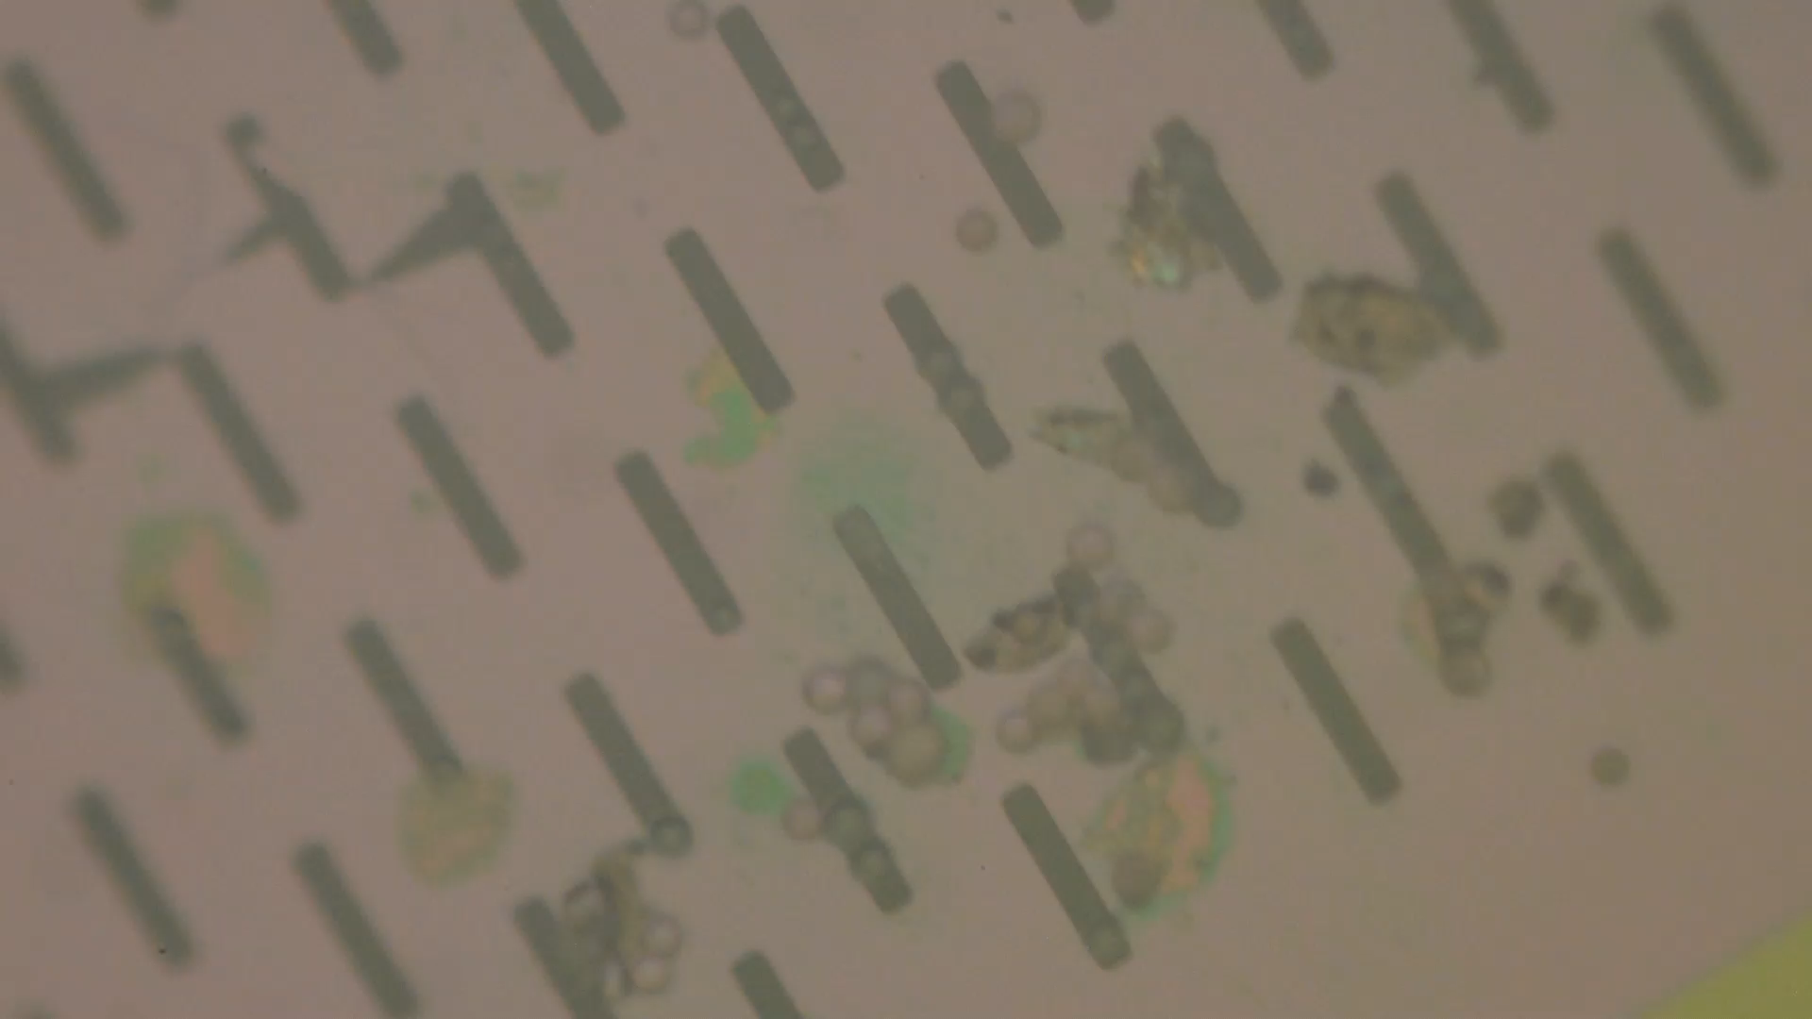
Melting of Polystyrene Beads

