Slide 1
Silicon Nanomembranes as an Enabling Platform for Multifunctional Microsystems
Greg Madejski, University of Rochester, Biomedical Engineering

Slide 2
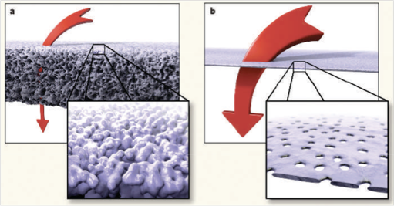
Si Nanomembrane Technology
Silicon filter material
          thin (50 nm)
          highly porous
          chemically stable
          mechanically robust
          scalable manufacturing
a) van den Berg and M. Wessling, Nature 2007, b) Streimer, Nature 2007
Notes:
I work with silicon nanomembranes, based off a discovery by chris striemer back in 2007. He took a very thin sheet of silicon (50nm) and heated it up quickly to form little nanocrystals. Exposing the thin sheet of silicon revealed voids in the material, creating nanopores. There are many advantages to this kind of filter compared to a traditional polymer membrane.

Slide 3
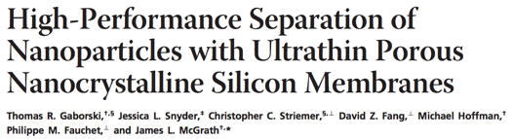
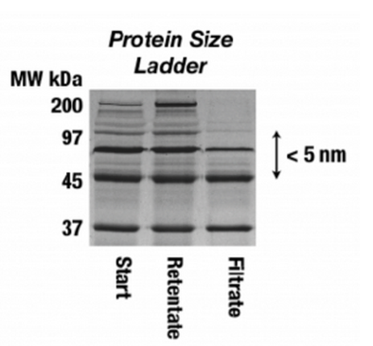

Si Nanomembrane Applications
Gaborski, T. R., et al. (2010). "High-Performance Separation of Nanoparticles with Ultrathin Porous Nanocrystalline Silicon Membranes." ACS Nano 4(11): 6973-6981
Notes:
We can use nanomembranes for a variety of operations. Pumping via electroosmosis, pure physical separation, electrostatic gating, and as a scaffold to promote cell growth in a permeable way.

Slide 4
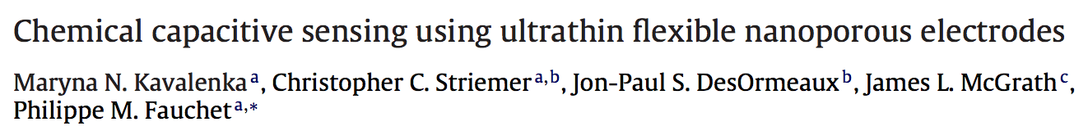
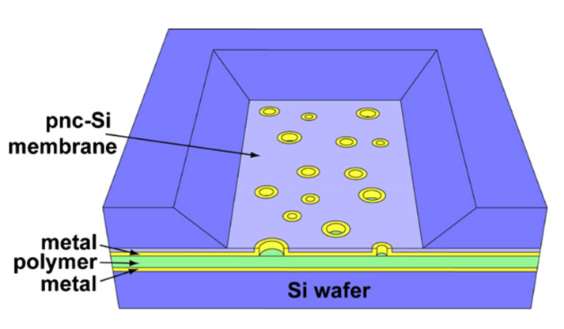
Si Nanomembrane Applications
Kavalenka, M. N., et al. (2012). "Chemical capacitive sensing using ultrathin flexible nanoporous electrodes." Sensors and Actuators B: Chemical 162(1): 22-26
Notes:
We can use nanomembranes for a variety of operations. Pumping via electroosmosis, pure physical separation, electrostatic gating, and as a scaffold to promote cell growth in a permeable way.

Slide 5
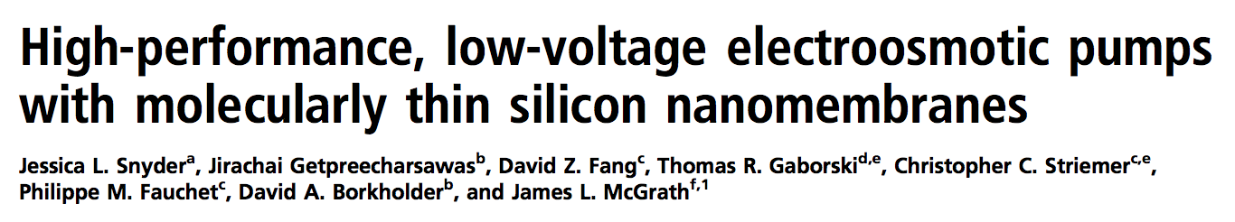
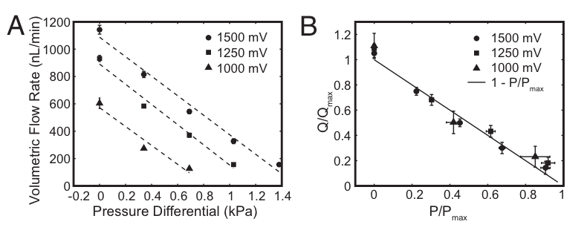
Si Nanomembrane Applications
Snyder, J. L., et al. (2013). "High-performance, low-voltage electroosmotic pumps with molecularly thin silicon nanomembranes." Proceedings of the National Academy of Sciences 110(46): 18425-18430.
Notes:
We can use nanomembranes for a variety of operations. Pumping via electroosmosis, pure physical separation, electrostatic gating, and as a scaffold to promote cell growth in a permeable way.

Slide 6
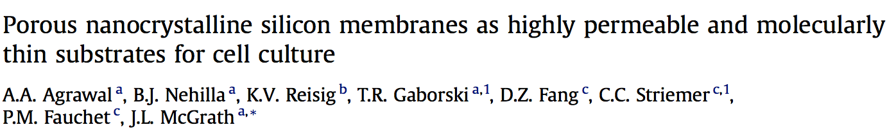
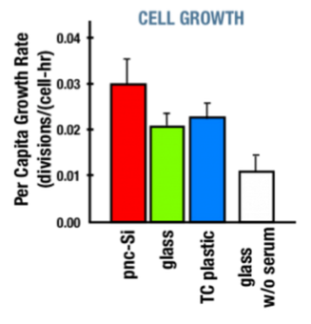
Si Nanomembrane Applications
Agrawal, A. A., et al. (2010). "Porous nanocrystalline silicon membranes as highly permeable and molecularly thin substrates for cell culture." Biomaterials 31(20): 5408-5417
Notes:
We can use nanomembranes for a variety of operations. Pumping via electroosmosis, pure physical separation, electrostatic gating, and as a scaffold to promote cell growth in a permeable way.

Slide 7
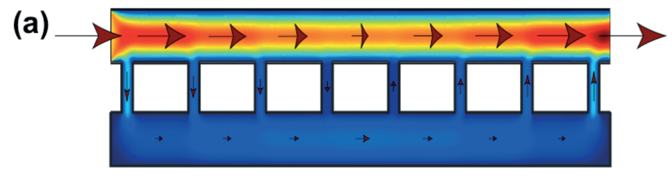
Si Nanomembrane Applications
Tangential Flow
Cells
10⁶ fold shear stress reduction
Chung et al. “Highly Permeable Silicon Membranes for Shear-free Chemotaxis and Cell Labeling” Lab Chip 2014
Notes:
Dr. Henry Chung published in Lab on a Chip where he used the properties of nanomembranes to effectively shield cells from fluid shear stress. This kind of protective effect would be really useful for other kinds of devices that are sensitive to flow or get gummed up by nonspecific binding. In other words the membrane could act as an upstream filter and still shield any device place underneath it.

Slide 8
Microsystem
Support
Filter
Microsystem
Miniaturized
Efficient
Parallelizable
Repeatable
Pump
Sensor
Notes:
A Microsystem combines many different elements to perform different processes that gain us better information or build us on a small scale. Because the activities are miniaturized, they are generally efficient compared to their counterparts, and they can be designed for repeatability and parallelization to take advantage of the minimal resources they consume individually.

Slide 9
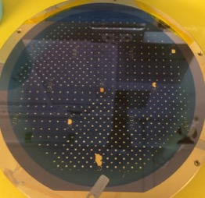
Integrated Nanomembrane Microsystem
10 mm
Flow Sensor
EO Pump
Cell Substrate
Filter A
Filter B
Filter C
Hundreds of microsystems fabricated at once
Notes:
All of these functions lead to my vision of a system where you can control these different functions and integrate them onto a single chip. Micrototal analysis systems, or ‘Lab on a chip’ type systems minaturize and combine all of these applications. Explain image

Slide 10
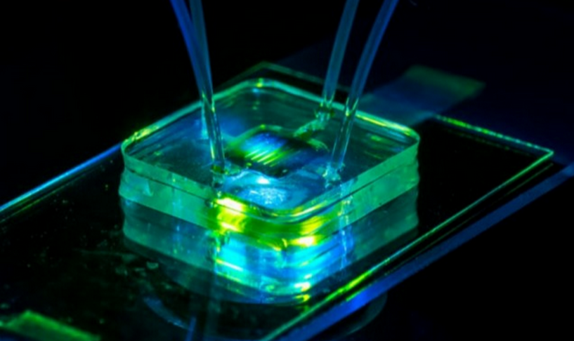
Lab-on-a-Chip (LOC)
“Membrane may shrink Lab-on-a-chip power source”, University of Rochester Currents, 11/23/13, Vol. 41, No. 3
Notes:
Integrating all of these functions together to tackle a biomedical problem puts us squarely in the realm of Lab on a chip systems. Here’s an picture of a simple silicon nanomembrane that’s been combined with silicone microfluidic channels that can fit onto a microscope slide. Putting many different operations into a small space can be complicated

Slide 11
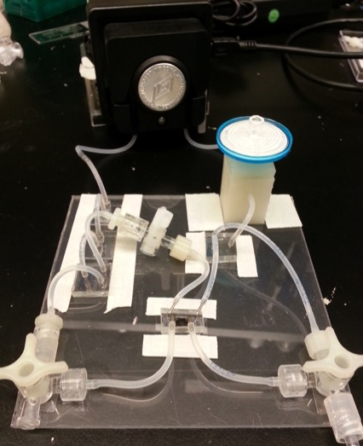

Lab-off-a-Chip
Pump
Filter
Microfluidic
Tubing
Cell Culture
Notes:
It’s difficult to fit all of the necessary microsystem operations in the same place. These are not neglectable decisions, especially when dealing in the confined space of a microscope.

Slide 12
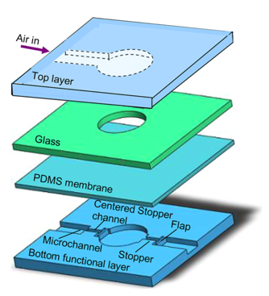
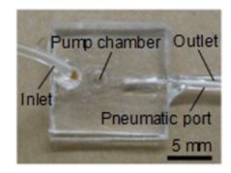
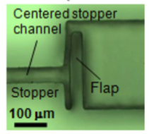
Existing Pumping Technology
75 μL/min
Bulky additional control hardware
Backend integration complexity
Pneumatic PDMS
Ni, J., et al. (2012).
Microelectronic Engineering 99: 28-32

Slide 13
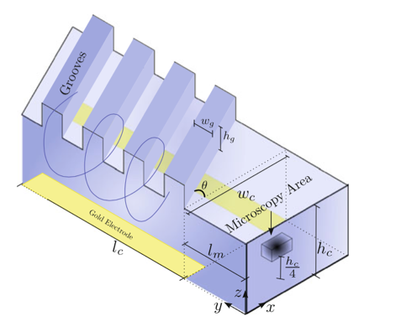
Existing Pumping Technology
~1 μL/min, 10 V
Inefficient Pumping
10 Pa stall pressure
Photoresist EO
Jahanshahi, A., et al. (2012).
Microfluidics and Nanofluidics 12(5): 771-777.

Slide 14
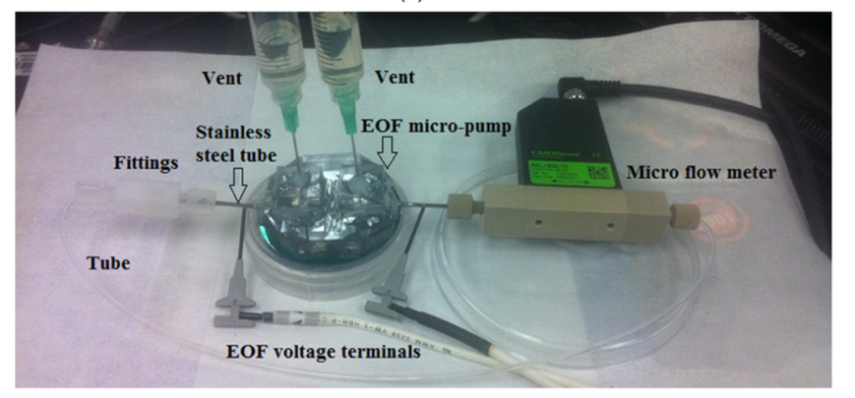
Existing Miniaturization
500 V
~75 μL/min
Flow meter is bigger than the device!
Al-Rjoub, M. F., et al. (2015). "Improved Flow Rate in Electro-Osmotic Micropumps for Combinations of Substrates and Different Liquids With and Without Nanoparticles." Journal of Electronic Packaging 137(2): 021001-021001.

Slide 15
What can be done better?
Create a generalizable Microsystems Platform
Simple miniaturization – small components, not a lot of supporting equipment, low dead volume
Design cues – connect pump regions, filter regions, sensor regions together
Compatible with existing
technology, materials, procedures
Flow Sensor
EO Pump
Cell Substrate
Filter A
Filter B
Filter C

Slide 16
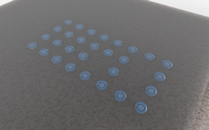
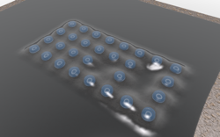
What applications could be improved?
Add protection layers to sensors
  DNA Sequencing
  Photonics
Multimodal sensing in a confined space
  Tissue on a chip
  Concurrent optical, electrical, physical sensing under a microscope
Individualized miniature pumps/sensors
Notes:
Upon the successful completion of these aims we will have achieved….

Slide 17
Aims
Aim 1 – Fabrication of Nanomembrane Tented Structures to Extend the Lifetime of Delicate Sensing Devices
Aim 2 – Fabrication of Raman-Silent Nanomembranes to Enable the Chemical Fingerprinting of Cellular Components by Raman Spectroscopy
Aim 3 – Integration of Nanomembrane Operations to Create a Multimodal Measurement System for the Study of Water Transport through Retinal Epithelial Monolayers
Notes:
I hope to demonstrate these characteristics through three aims that tackle problems in biomedical LOC settings.

Slide 18
Aims
Aim 1 – Addition of a nanofilter into existing process
Aim 2 – Bottom up fabrication of new nanomembrane materials
Aim 3 – Combine nanomembrane functions to build a miniaturized fluid transport model
Notes:
Translating those titles a little, the chief microsystem activities we want to achieve here are

Slide 19
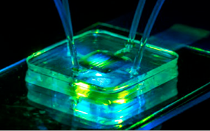
Tents, New Materials, Epithelial LOC
Evaporation
50 nm MgF₂
50 nm NPN
Si
Si
RIE
Aim 1
Aim 2
Aim 3
Notes:
Nanofilter protecting delicate sensor underneath.

Slide 20
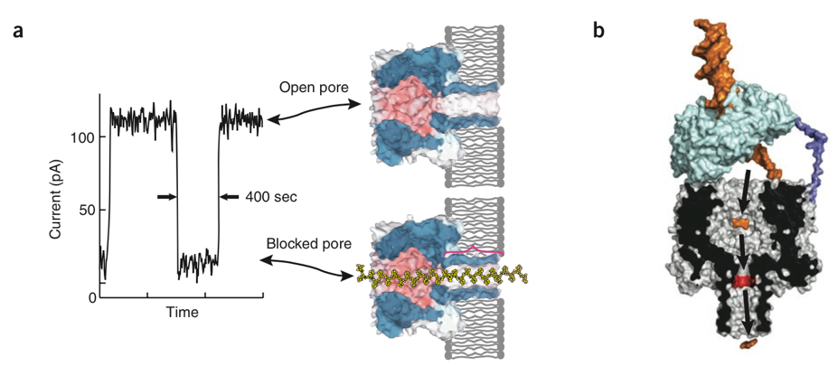
DNA Nanopore Sequencers
Alpha Hemolysin
Biological Nanopore, ~$1000/genome, Oxford Nanopore
Branton, D., et al. (2008). "The potential and challenges of nanopore sequencing." Nat Biotech 26(10): 1146-1153.
Notes:
A large area of biomedical microsystem literature is devoted to DNA sequencing. DNA nanopore sequencers promise to usher in an age of personalized medicine, where individual genomes are sequenced cheaply and effectively to make better healthcare decisions. The dominant commercial technology, through a biological protein-based nanopore is approaching about $1000/genome.

Slide 21
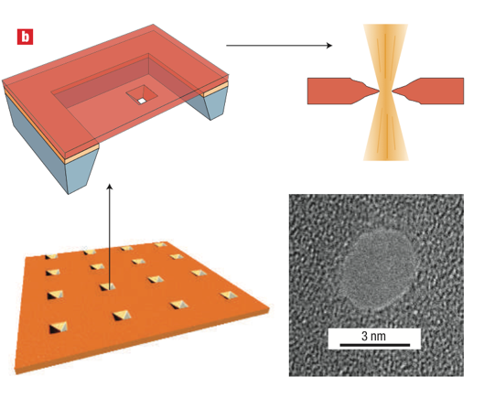
DNA Nanopore Sequencers
Single Silicon Nanopore
Cheap Fabrication
Stable Shelf Life
Poor base pair resolution
Single point of failure
Dekker, C. (2007). "Solid-state nanopores." Nat Nano 2(4): 209-215.
Notes:
Newer silicon nanopore technology is being developed as a lower-cost, more stable alternative, as you don’t have to worry about the condition of the biological pore.

Slide 22
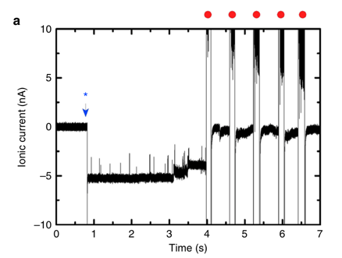
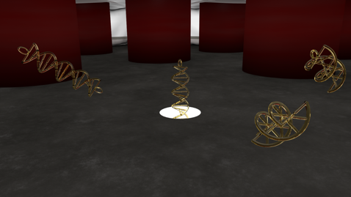
DNA Blockage
A filter could screen out ‘clogging’ DNA configurations
Schneider, G. F., et al. (2013). "Tailoring the hydrophobicity of graphene for its use as nanopores for DNA translocation." Nat Commun 4.
Notes:
Unfortunately, these devices have a major limitation; a single point of entry. This means that if DNA gets balled up, or garbage gets near the device, the DNA sensor would stop working.

Slide 23
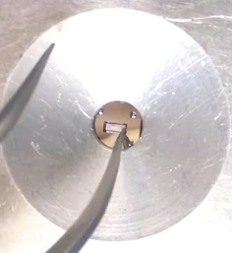
Nanomembrane-Vapor Transfer

Slide 24

Tenting
Notes:
Tenting video, dropping a thin sheet of nanoporous membrane on top of a structure to protect devices underneath it.

Slide 25
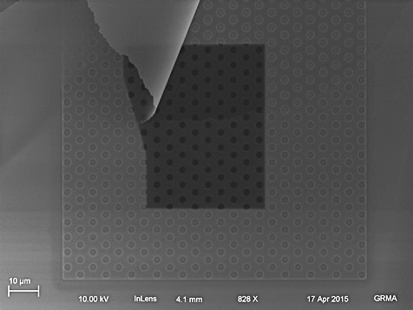
Tenting - SEM

Slide 26
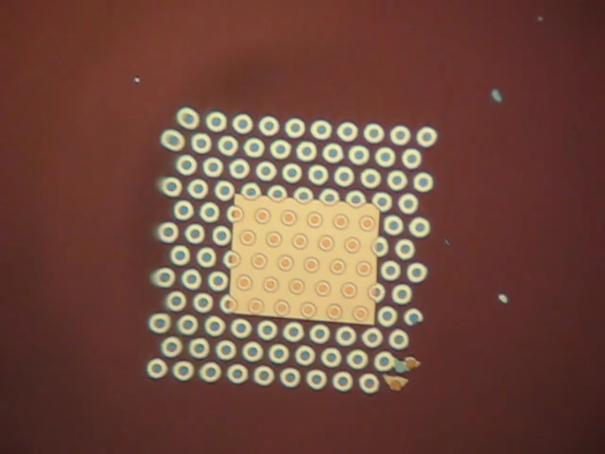
Tenting - Wetting
Notes:
Repeated applications of water vapor swell the nanomembrane, but ultimately is fixed in place. Water can diffuse into cavity spaces

Slide 27
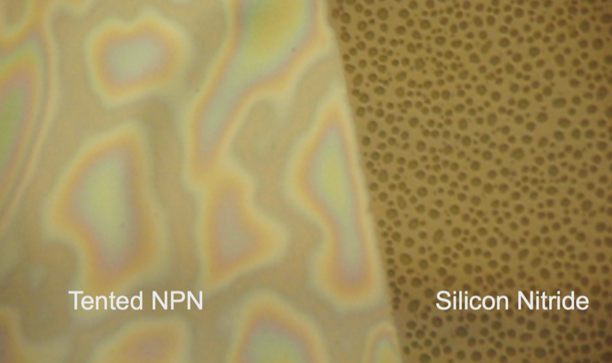
Tenting - Wetting
Notes:
The wetting behavior is unusual. The NPN and silicon nitride are the same material composition, but display different wetting behavior

Slide 28
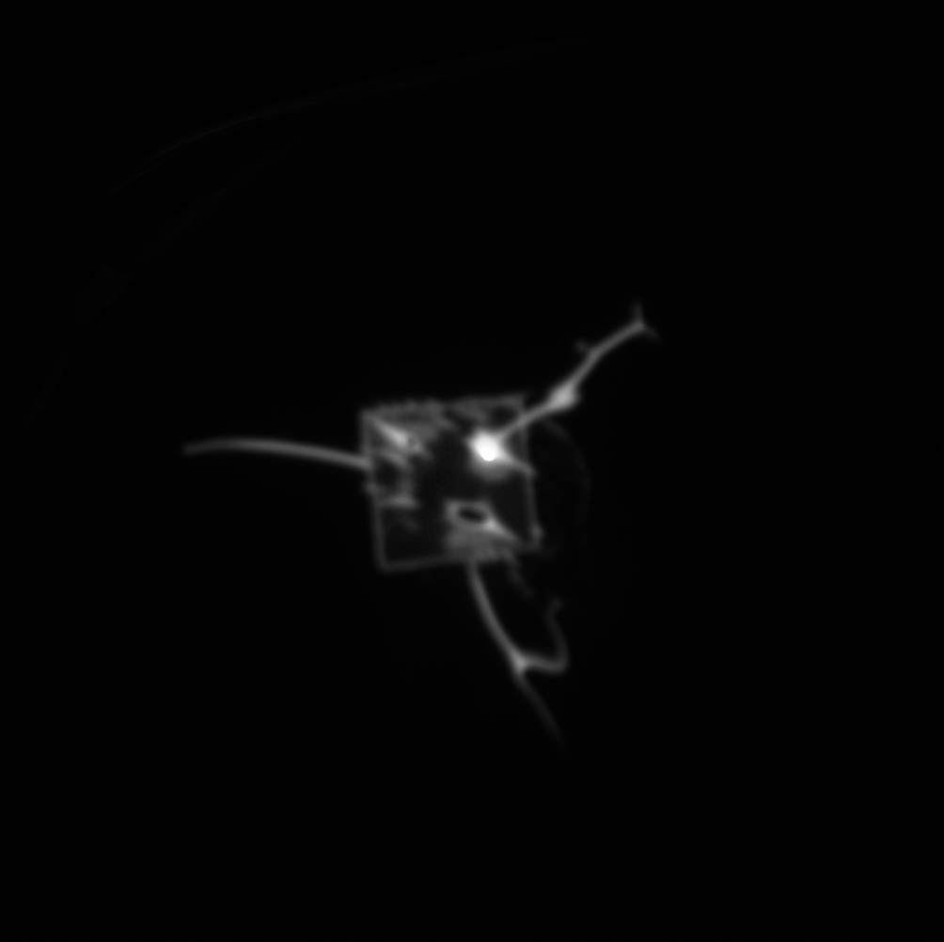
Tenting - Wetting
Notes:
Nonporous membranes actually can trap water underneath. Gif shows fluorophore diffusing around underneath a nonporous membrane

Slide 29
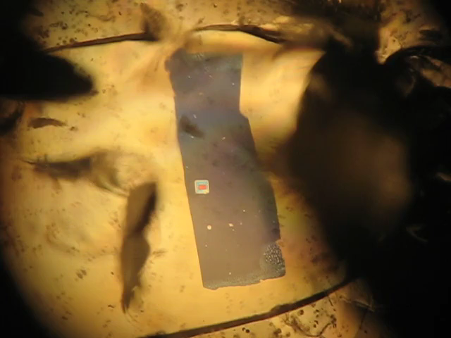
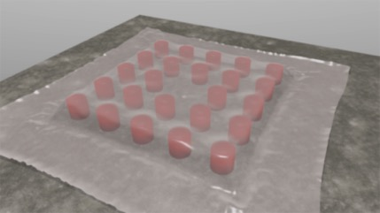
Tent Stability
Stability under shear stress
3 dynes/cm²
Notes:
The perturbation into the fluid flow is small, stable under shear stress.

Slide 30
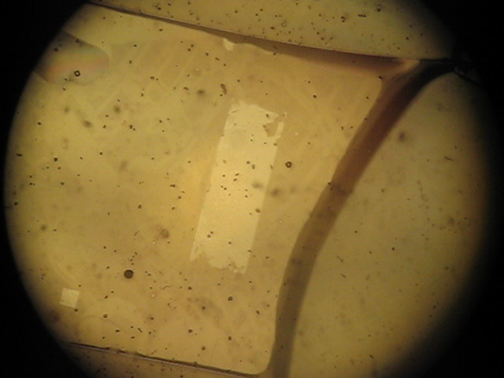
Tenting – Adhesion Model
Stable for a week, submerged in water
Water provides adhesion
Notes:
We need to know more about this process in order to integrate it into other flows potentially.

Slide 31
Tenting – Adhesion Model
Si₃N₄
NPN
Intermolecular Forces
VanDerWaals Forces
Hydrogen Bonding
Dipole-Dipole Interaction
vs
Si₃N₄
NPN
vs
Si₃N₄
NPN

Slide 32
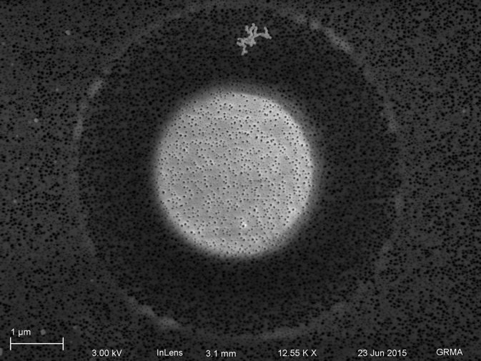
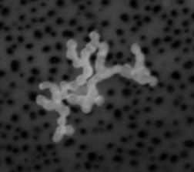
Tented Filtration
60 nm Au
aggregate
Notes:
Filtering out aggregates is important analagous to DNA coiling on itself

Slide 33
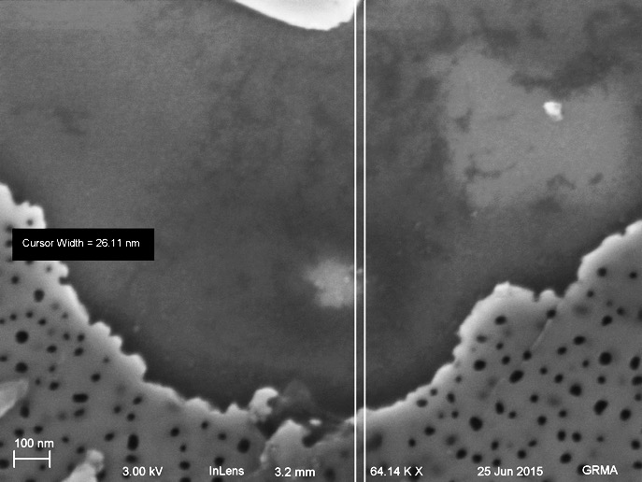
Tented Filtration
Notes:
Small pieces can still get through!

Slide 34
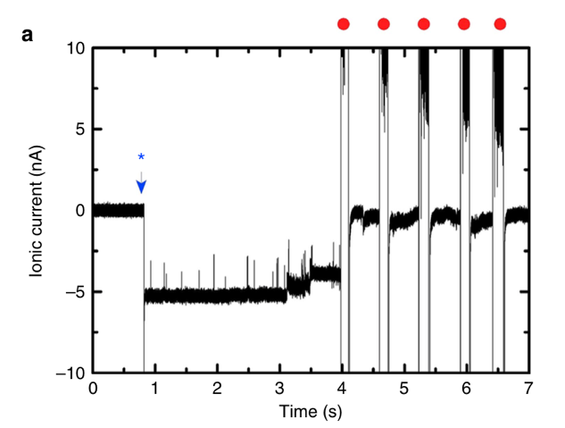
Tented Nanopore Sequencing
Extend the lifetime of silicon nanopore sequencers
Tent in Place

Slide 35
Aim 1 Summary
Integrating nanomembranes into microsystems will allow us to create/improve multifunctional microsystems (tenting protects devices)
However, silicon is not always the optimal material choice for the application at hand!

Slide 36
Tents, New Materials, Epithelial LOC
Evaporation
50 nm MgF₂
50 nm NPN
Si
Si
RIE
Aim 1
Aim 2
Aim 3
Notes:
All of these functions lead to my vision a system where you can control these different functions and integrate them onto a single chip. Micrototal analysis systems, or ‘Lab on a chip’ type systems minaturize and combine all of these applications. The creation of tissue models within these microsystems are often referred to as organ on a chip models. I am particularly interested in models of water transport in an in vitro model of the retina. With nanomembranes having so much functionality, it should be easier to remove macroscopic pumps and sensors and produce high fidelity information. More information on this later.

Slide 37
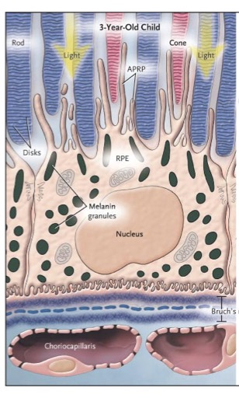
Retinal Pigment Epithelium (RPE)
Keeps the photoreceptors alive
Governs the transport of nutrients into and water out of the outer retina space
Digests old photoreceptor segments
de Jong, P. T. V. M. (2006). "Age-Related Macular Degeneration." New England Journal of Medicine 355(14): 1474-1485.
Notes:
Macular degeneration causes people to go blind. Compared to the retina of a 3-year old, a dysfunctional RPE causes photoreceptors to die off. The accumulation of Drusen is the classic symptom of this disease, yellowish deposits underneath the RPE. AS the RPE maintains the health of the outer retinal, it governs the flow of water and solutes into the outer retinal space.

Slide 38
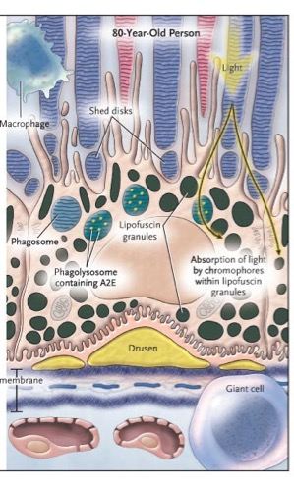
RPE Ocular Disease
Transport is compromised
Photoreceptor health is not maintained
Photoreceptor death leads to blindness
de Jong, P. T. V. M. (2006). "Age-Related Macular Degeneration." New England Journal of Medicine 355(14): 1474-1485.
Notes:
Macular degeneration causes people to go blind. Compared to the retina of a 3-year old, a dysfunctional RPE causes photoreceptors to die off. The accumulation of Drusen is the classic symptom of this disease, yellowish deposits underneath the RPE. AS the RPE maintains the health of the outer retinal, it governs the flow of water and solutes into the outer retinal space.

Slide 39
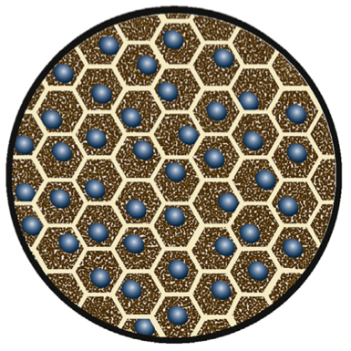
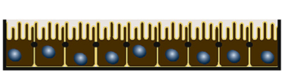
Water Transport Physiology
Outer Retina
H₂O
Needs a permeable support for proper morphology
Retinal Pigment Epithelium
in Vitro
Pffefer and Philp, “Cell Culture of the Retinal Pigment Epithelium”, Experimental Eye Research, 2014
Notes:
I am particularly interested in models of water transport in an in vitro model of the retina. With nanomembranes having so much functionality, it should be easier to remove macroscopic pumps and sensors and produce high fidelity information. RPE nourishes the photosensitve cells in the back of the retina, and supports it.

Slide 40
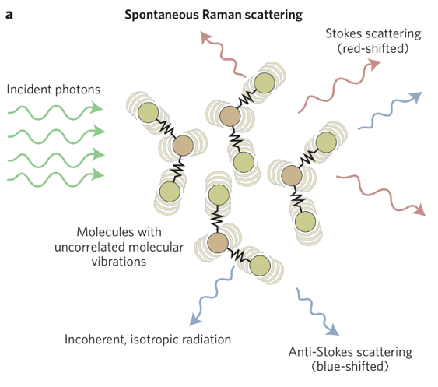
Raman Theory
“Chemically sensitive bioimaging with coherent Raman scattering”, Camp and Cicerone, Nature Photonics, 2015
Notes:
I am interested in eye physiology and water transport. One technique that we can use to directly observe water transport is known as Raman spectroscopy. The process works off of a phenomenon known as the Raman shift. Most light is scattered elastically, that is green light scatters off a surface and remains green. But every one in few million photons comes out either blue or red. This inelastically scattered light can tell us what was illuminated. By collecting all the colors of light, we can create a spectrogram of the material.

Slide 41
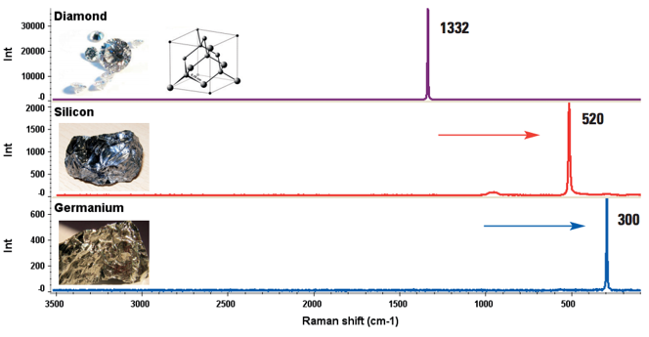
Raman Theory
‘Characterizing Carbon Materials with Raman Spectroscopy’ Joe Hodkiewicz, Thermo Fisher Scientific, Madison, WI, USA, App #51901
Notes:
Not all materials behave the same. Raman responds to molecular bond orientation. Here we have group 4 elements all producing a strong characteristic spike., shifted along different wavelengths.

Slide 42
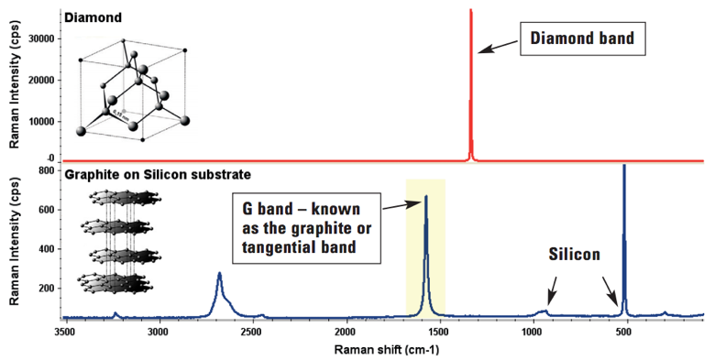
Raman Theory
‘Characterizing Carbon Materials with Raman Spectroscopy’ Joe Hodkiewicz, Thermo Fisher Scientific, Madison, WI, USA, App #51901
Notes:
All of the signals can add, and you can discriminate what is in the observation volume by pulling apart the superimposed signatures.

Slide 43
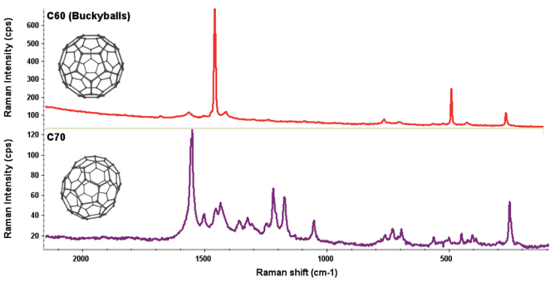
Raman Theory
Notes:
Not all materials behave the same. Even allotrophic forms of carbon produce wildly different signatures.

Slide 44
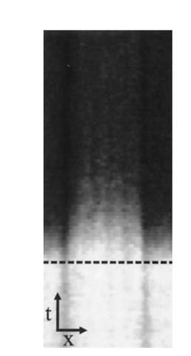
Imaging Water Transport by Raman
D₂O
Potma, E. O., et al. (2001). "Real-time visualization of intracellular hydrodynamics in single living cells." Proceedings of the National Academy of Sciences 98(4): 1577-1582.
Notes:
If you take a line scan above a bunch of isolated cells, you can observe the ratio of Deuterium to Water change

Slide 45
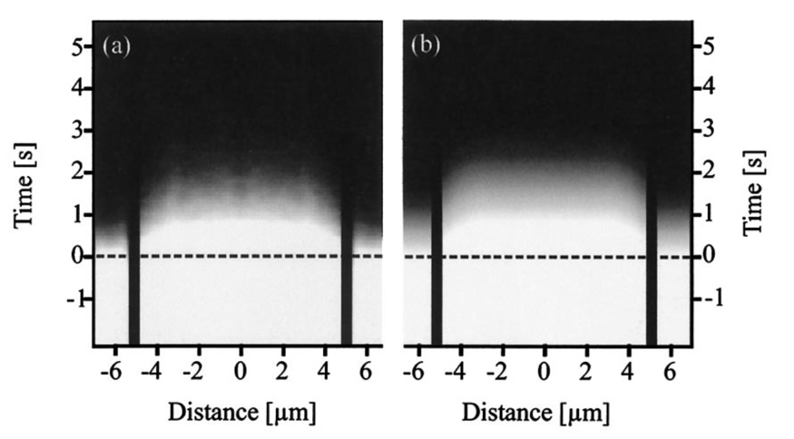
Imaging Water Transport by Raman
Experimental
Simulation
Potma, E. O., et al. (2001). "Real-time visualization of intracellular hydrodynamics in single living cells." Proceedings of the National Academy of Sciences 98(4): 1577-1582.
Notes:
If you lump together a bunch of these cells, you can calculate a time constant for water moving through the cells. A) experimental data, B) a simulation with a permeability of 2.2 um/s

Slide 46
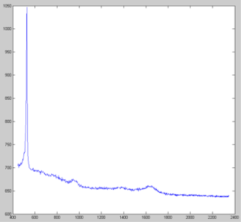
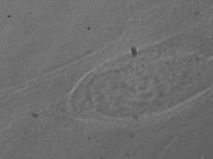
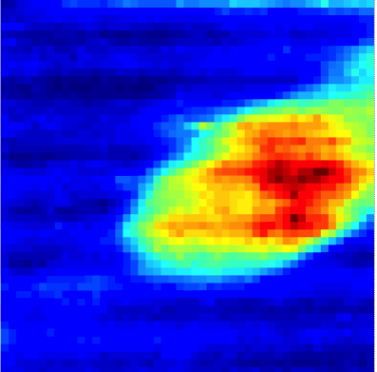




Brightfield
2d Raman
Si Nanomembrane
Raw
DNA
High background signal from Si
Measurement takes 2.5 hours!
Remove Si, make faster measurements
Si Nanomembrane + Cell
RNA

Slide 47

Fabrication - Strategy
Evaporation
50 nm MgF₂
50 nm NPN
Si
Si
RIE

Slide 48
Fabrication - Structure
Evaporation
Nanopore Filling
Anneal, 700 C, 2 hrs
50 nm MgF₂
50 nm NPN
Si
Si
RIE

Slide 49


Electron Micrographs

Slide 50

Material - EDS
Over 85% MgF₂

Slide 51

Material - XPS

Slide 52

Mechanical Strength

Slide 53
Cytocompatibility
P5 HUVECs on nanoporous
MgF₂

Slide 54


Membrane Durability Under Laser Exposure
pnc-Si
MgF₂
30 mW
450 mW
15x Power vs pnc-Si = 15x Quicker Measurements

Slide 55

Reduction of Silicon Peak

Slide 56


Fabrication – Au, Pt
Evaporation
Nanopore Filling
50 nm Au
50 nm NPN
Si
Si
RIE

Slide 57
Aim 2 Summary
Silicon nanomembrane physical characteristics can be transferred into other material systems, enabling Raman microscopy to be used on this microsystem platform

Slide 58
Tents, New Materials, Epithelial LOC
Evaporation
50 nm MgF₂
50 nm NPN
Si
Si
RIE
Aim 1
Aim 2
Aim 3

Slide 59



Electroosmotic Pumping
Snyder, J. L., et al. (2013). "High-performance, low-voltage electroosmotic pumps with molecularly thin silicon nanomembranes." Proceedings of the National Academy of Sciences 110(46): 18425-18430.
Notes:
Rice-Whitehead theory

Slide 60


EO Flow
Pore Wall

Slide 61


Electroosmotic Pumping
Snyder, J. L., et al. (2013). "High-performance, low-voltage electroosmotic pumps with molecularly thin silicon nanomembranes." Proceedings of the National Academy of Sciences 110(46): 18425-18430.

Slide 62


Streaming Potential Sensor
Run the electroosmotic pump in reverse
Park, H. and S.-H. Choa (2014). "Measurement of liquid flow rate by self-generated electrokinetic potential on the microchannel surface of a solid." Sensors and Actuators A: Physical 208: 88-94.

Slide 63

3d Printed Microsystem

Slide 64


Cell Growth
PolyLactic Acid 3d printed, fits in a 24 well plate
Transfer cells after cell confluence

Slide 65



Resealable Microsystem
Bottom
Open
Top

Slide 66


Water Transport Measurement
MgF₂ Cytoscaffold
Raman D₂O/H₂O
NPN Pumps
NPN Flow Sensor

Slide 67

Combined Measurements
Manipulate the epithelial pumping rate
  Osmotic Challenge
  pH Challenge
  Stall Pressure (EO pump)
Measure water flow through streaming potential sensors
Mechanical Challenge
Raman D₂O/H₂O

Slide 68
Tents, New Materials, Tissue LOC
Evaporation
50 nm MgF₂
50 nm NPN
Si
Si
RIE
Notes:
Upon the successful completion of these aims we will have achieved….

Slide 69
Summary
Integrate different nanomembranes to improve microsystem characteristics
  Pumping Regions
  Protection Regions
  Sensing Regions
  Supporting Regions
Create a generalizable Microsystems Platform
Simple miniaturization – small components, not a lot of supporting equipment, low dead volume
Compatible with existing
technology, materials, procedures

Slide 70



Acknowledgements
University of Rochester
Prof. James McGrath
Dean Johnson, PhD
Joshua Winans, PhD
Henry Chung, PhD
Tejas Khire
Karl Smith
Sarah Wayson
Meghan Kazanski
Tucker Burgin
J.P. DesOrmeaux
Josh Miller
Jamie Roussie, PhD
University of Nottingham
Prof. Kevin Webb
Flavius Pascut, PhD
Emilia Moradi, PhD
RIT
Prof. Tom Gaborski
Bob Carter, PhD
University of Ottawa
Prof. Vincent Tabard-Cossa
Kyle Briggs
URnano – Brian McIntyre

Slide 71
Questions?

