Slide 1
INTENSITY – CONCENTRATION
ASLAN DEHGHANI

Slide 2
Experiment Plan
 | Dilution | Reported Concentration | Average Intensity | Counted Concentration
Sample 1 | 25X | 8E11
Sample 2 | 50X | 4E11
Sample 3 | 100X | 2E11
Sample 4 | 500X | 4E10
Sample 5 | 1000X | 2E10
Sample 6 | 2000X | E10
Stock Concentration: 2E13

Slide 3
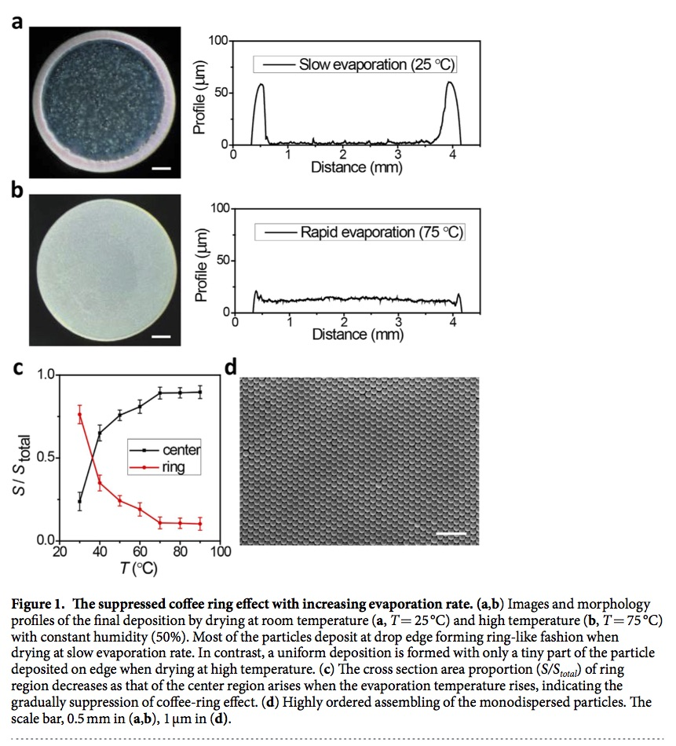
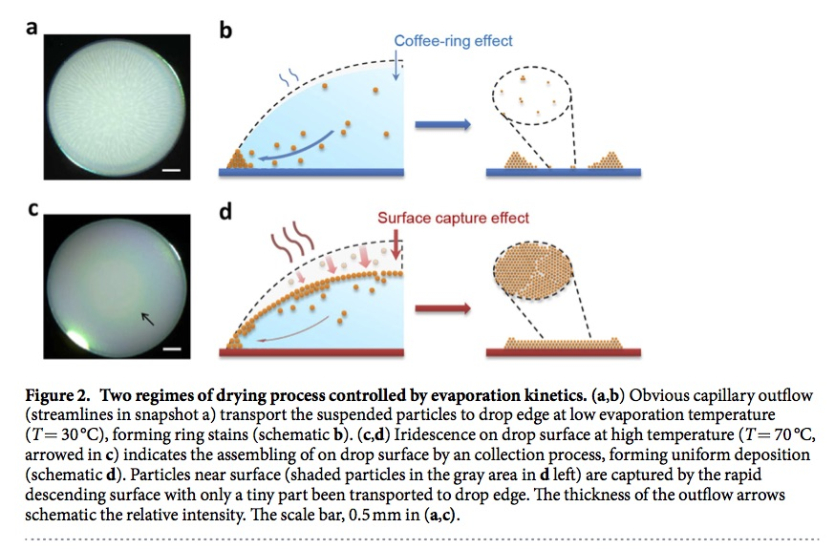
Idea
Li et al, Nature, 2016

Slide 4
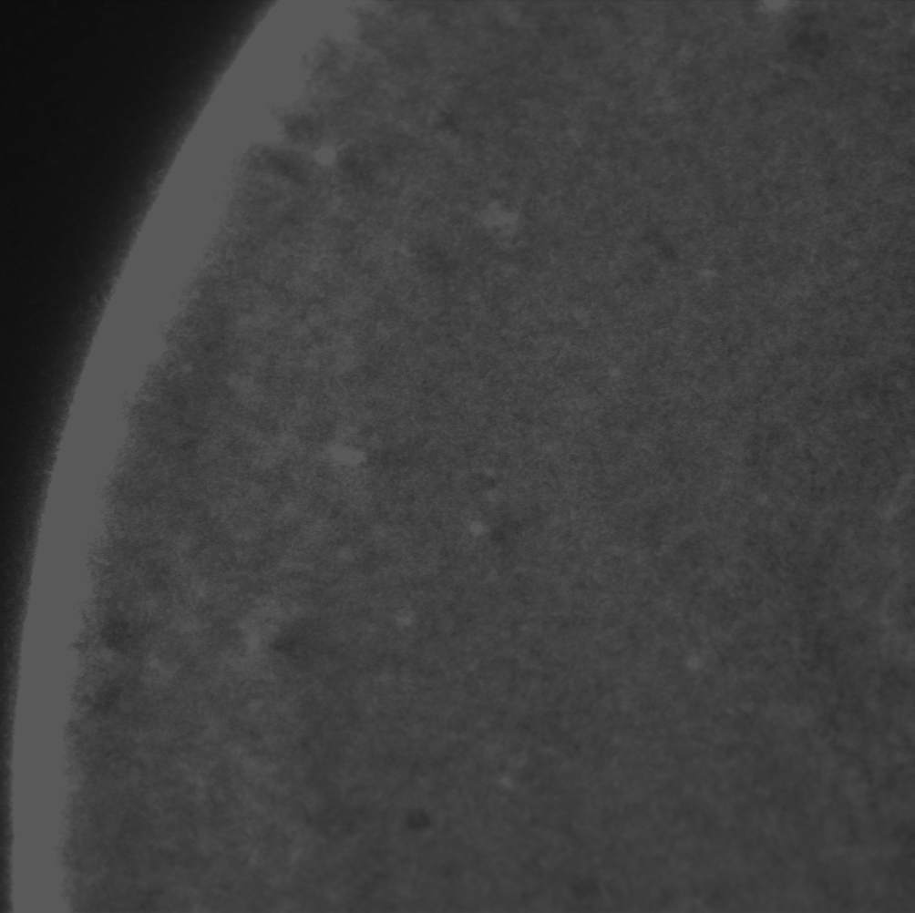
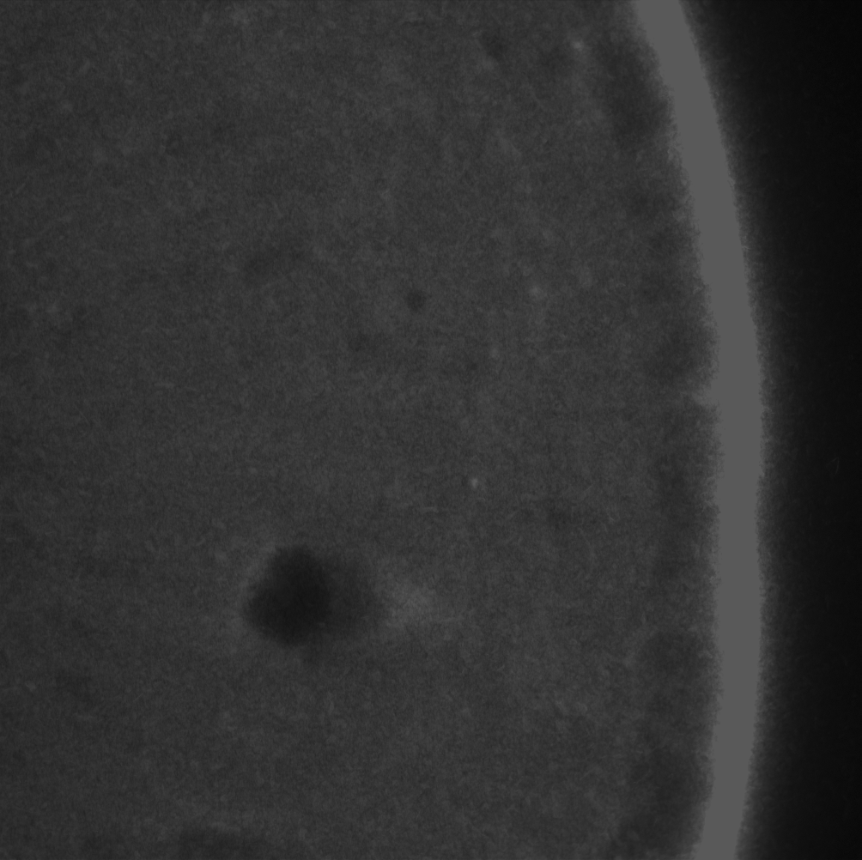
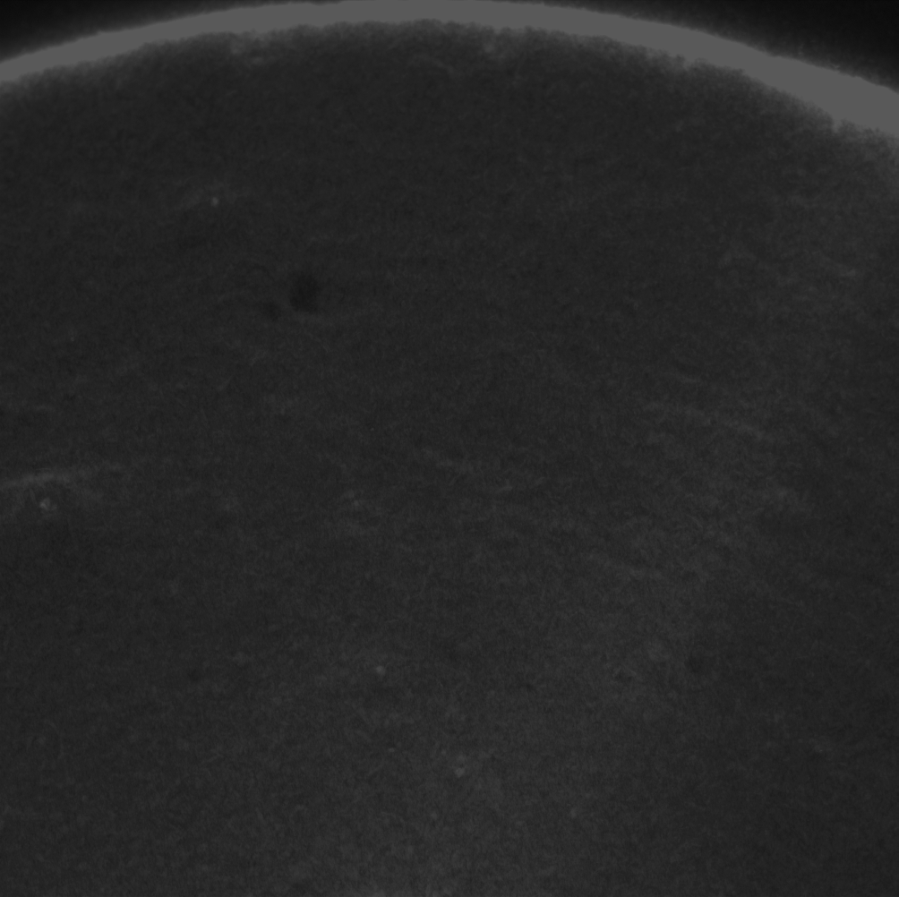
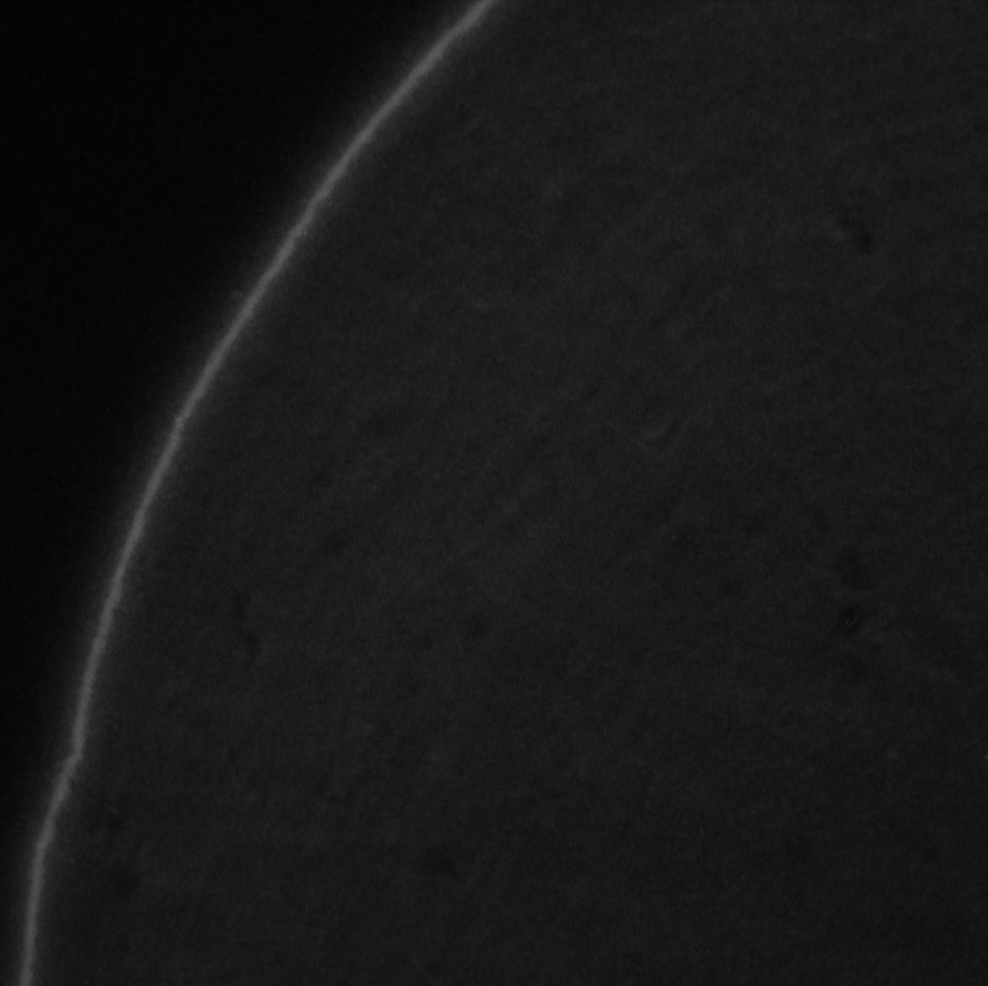
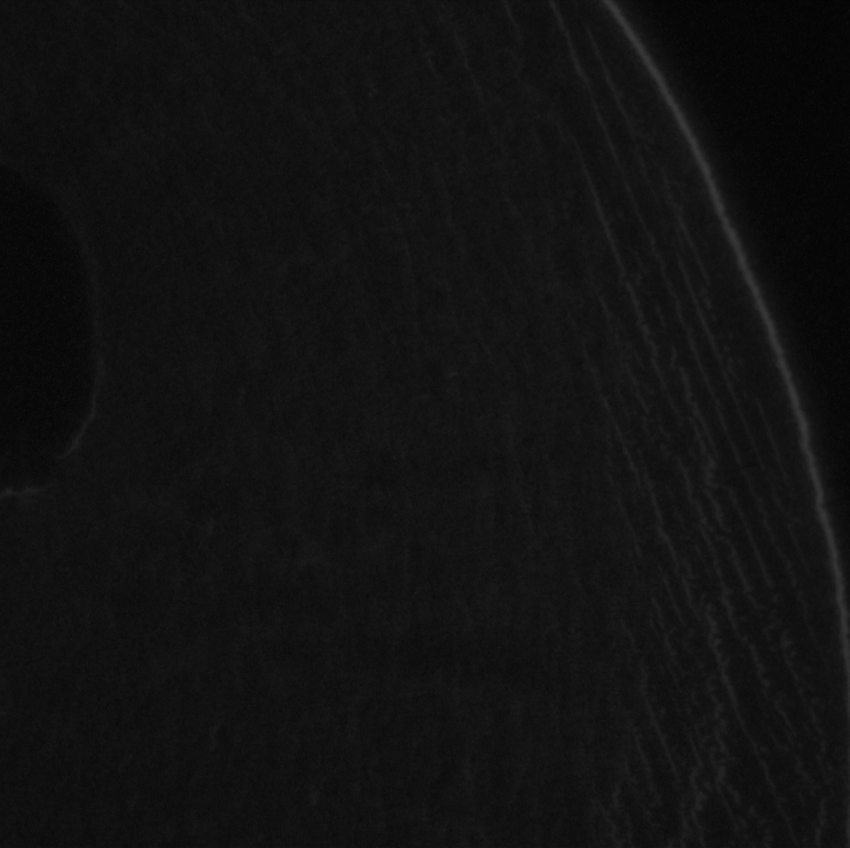
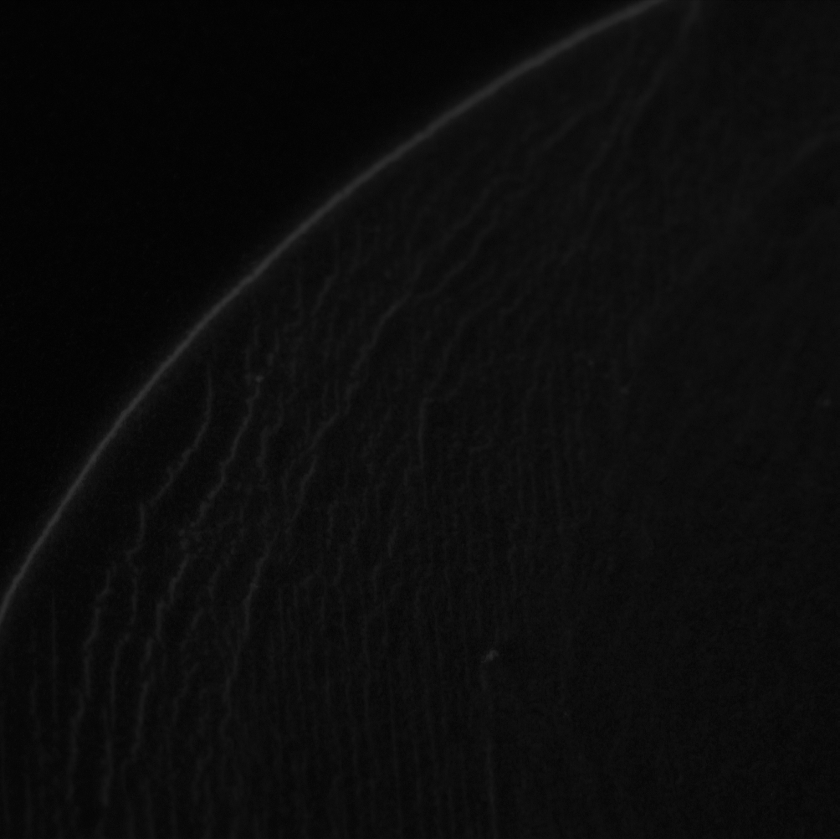
Fluorescent Images
Sample 1 – 25X
Sample 2 – 50X
Sample 3 – 100X
Sample 4 – 500X
Sample 5 – 1000X
Sample 6 – 2000X

Slide 5
Experiment Plan
 | Dilution | Reported Concentration | Average Intensity | Counted Concentration
Sample 1 | 25X | 8E11 | 8867.956042
Sample 2 | 50X | 4E11 | 5289.628717
Sample 3 | 100X | 2E11 | 3338.125
Sample 4 | 500X | 4E10 | 826.15685
Sample 5 | 1000X | 2E10 | 460.0510889
Sample 6 | 2000X | E10 | 281.6682917
Stock Concentration: 2E13

Slide 6
INTENSITY – REPORTED CONCENTRATION
2000X
500X

Slide 7
SEM Images – Sample 1 (25X)

Slide 8
SEM Images – Sample 1 (50X)

Slide 9
SEM Images – Sample 3 (100X)

Slide 10
SEM Images – Sample 4 (500X)

Slide 11
SEM Images – Sample 5 (1000X)

Slide 12
SEM Images – Sample 6 (2000X)

Slide 13
Intensity VS Reported Concentration
100X
1000X
2000X
500X

Slide 14
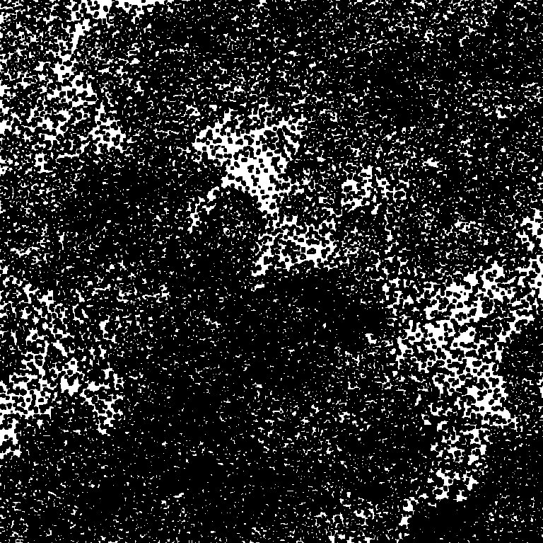
Counted Concentration
Sample 3 – 100 X

Slide 15
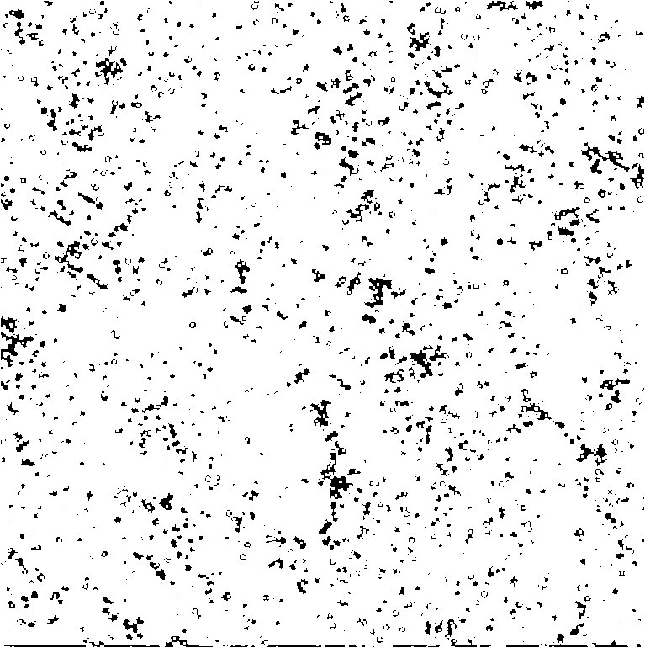
Counted Concentration
Sample 6 – 2000 X

Slide 16
Experiment Plan
 | Dilution | Reported Concentration | Average Intensity | Counted Concentration
Sample 1 | 25X | 8E11 | 8867.956042
Sample 2 | 50X | 4E11 | 5289.628717
Sample 3 | 100X | 2E11 | 3338.125 | 84515445.82
Sample 4 | 500X | 4E10 | 826.15685 | 33356635.66
Sample 5 | 1000X | 2E10 | 460.0510889 | 16442860.07
Sample 6 | 2000X | E10 | 281.6682917 | 5866852.367
Stock Concentration: 2E13

Slide 17
Intensity VS Counted Concentration
50X
1000X
500X
2000X

Slide 18
Nano Scale Proof of Concept Experiments
Transmembrane pressure applied
No transmembrane pressure applied

Slide 19
Beads Concentration
 | Fluorescent Intensity | Number of beads
Background | 100 | 0
After Capturing | 1015 | 2.7E7
After Cleaning | 540 | 1.56E7
After Releasing | 165 | 6.57E6
 | Captured | Floating | Non-Specific
Fluorescent Intensity | 321 | 381 | 78
Number of beads | 1.27E7 | 1.42E7 | 6.89E6

Slide 20
Subtracting Background
 | With Background | With Background
Fluorescent Intensity | 321 | 182
Number of beads | 1.27E7 | 9.39E6
Porosity: 4E8/cm2
Number of pores in the interaction area: 1.6E7

Slide 21
Another Experiment
Experiment 14
 | Average Intensity in 10 X | Number of beads in 10X | Interaction area Concentration
Releasing or capturing | 45.272 | 2.47E+06 | 6.09E+06
Cleaning or floating | 101.864 | 3.05E+06 | 7.45E+06
Non Specific Absorption | 50.226 | 2.52E+06 | 6.21E+06
Total | 197.362 | 8.04E+06 | 1.98E+07

