Slide 1
Committee Meeting
Jan 13, 2017

Slide 2
Recap …
Old Objective: Develop a microsystem to study endothelial barrier functions in sepsis
Current focus: Study neutrophil-endothelial interactions during inflammation
Now: Strictly an in vitro device development to observe neutrophil diapedesis, not a model of sepsis

Slide 3
Project description: Background
Goal 1: To develop and characterize a microfluidic system to study neutrophil-endothelial interactions in vitro
Goal 2: To understand the effects of neutrophil transmigration on the permeability of endothelial monolayers

Slide 4
Neutrophil and Endothelial Permeability
Multiple ways of altering permeability
  Secretion products
    granules of different types
  Intraluminal events involving active endothelial interaction (Luminal adhesion, integrin arrest etc.)
  Transmigration mechanisms: para- vs trans-cellular
  ROS and NO species balance
  Barrier strengthening effects

Slide 5
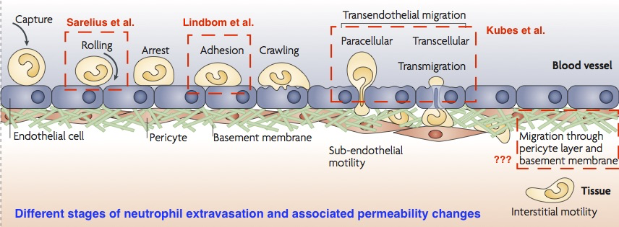
Neutrophil Diapedesis and
Endothelial Permeability
Adopted from Nourshargh et al 2010

Slide 6
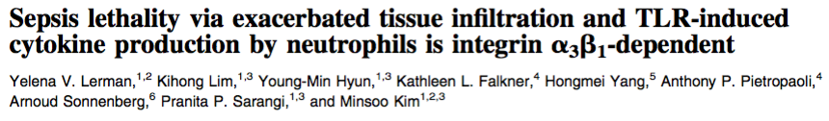
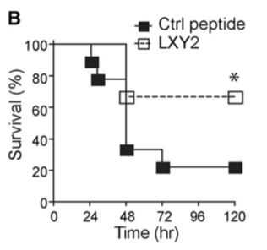
Why neutrophils and basement membrane integrity?
LXY2 peptide blocks α3β1 integrin specifically
Preventing neutrophils from entering ECM improved survival
Signaling inhibition or physical sequestering?
How does vascular permeability ties up with inhibiting neutrophil extravasation?

Slide 7
Questions to be addressed
How does the subendothelial migration of neutrophils affect the overall barrier properties?
Specifically, does the breach of basement membrane allow the vessel to leak further?

Slide 8
Platform Requirements/Needs
A bi-compartmental device to culture ECs under flow with a basal ECM and fluid access
Ability to induce and monitor (via imaging) neutrophil diapedesis by chemotactic gradient
Ability to allow/prohibit the complete neutrophil migration through ECM space
Ability to measure the permeability changes in each scenario for comparison

Slide 9
Device design: Vision
In Situ TEER Measurement (Tetra-polar)
I1
LUMINAL COMPARTMENT
V1
Physiological Shear Stress
Human
Endothelial
Cells
Ultrathin
Microporous
Si Membrane
ECM Gel
Fluidic
Access
Silicon
Substrate
Biochemical Assays
I2
ABLUMINAL COMPARTMENT
V2
Transparent ITO Electrodes

Slide 10
Aims
Develop an analytical framework to interpret TEER measurements for silicon membrane systems.
Develop a novel vascular mimetic to study the influence of neutrophil extravasation on vascular barrier function.
Examine the importance of complete neutrophil extravasation on vascular barrier function.

Slide 11
Aim 1
Develop an analytical framework to interpret TEER measurements for silicon membrane systems.

Slide 12
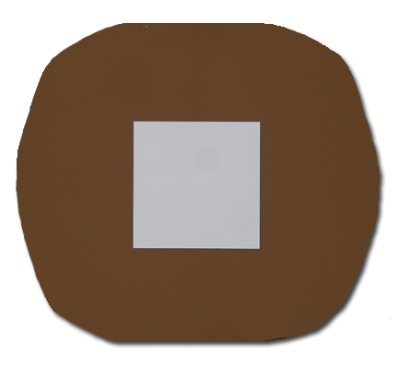
Device Characterization
Silicon nanomembranes: beneficial for cell culturing applications and microfluidics
Some limitations working these membranes
Physical/Chemical Characterization ✔
Optical Performance ✔
Biocompatibility ✔
Electrical Characterization ?
Inactive Area
5.4 cm
Porous
Area
5.4 cm

Slide 13
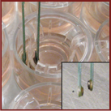
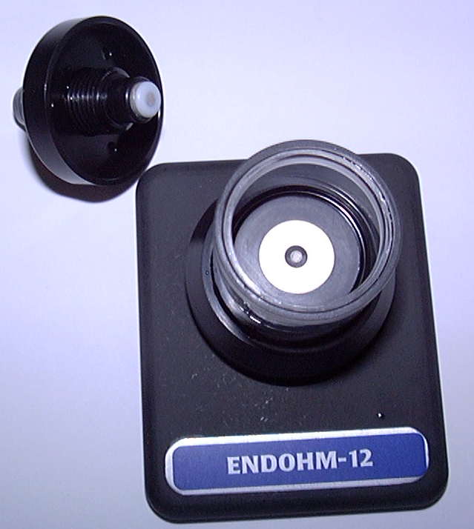
Trans endothelial electrical resistance
Crone and Olesen, 1982

Slide 14
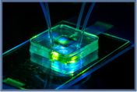
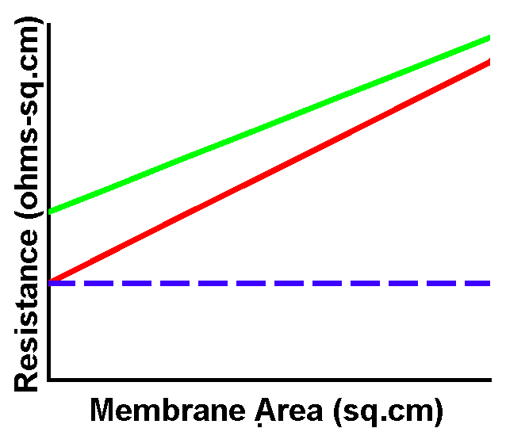

Trans endothelial electrical resistance
Limited active area
(“Nanomembrane”)
Different well sizes
(Real Transwell)
Ideal Behavior

Slide 15
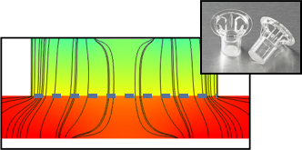
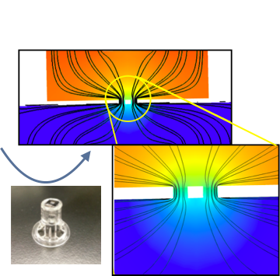
Modeling TEER:
Endohm Cup
EVOM Meter: 12.5 Hz 10 μA

Slide 16
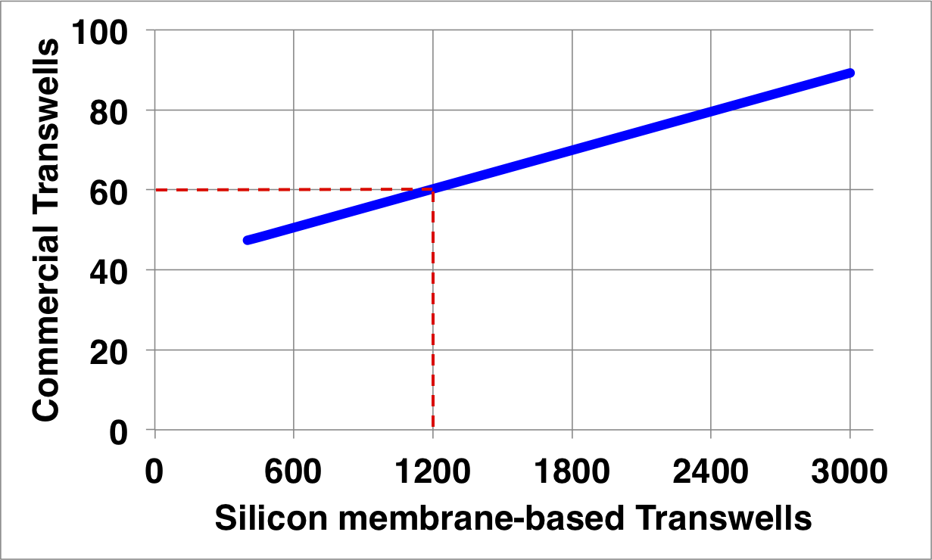
Mapping Function

Slide 17
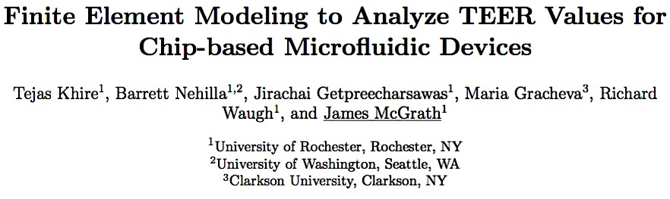
Current Status of Aim 1
In preparation for Biomedical Microdevices

Slide 18
Aim 2
Develop a novel vascular mimetic to study the influence of neutrophil extravasation on vascular barrier function.

Slide 19
Device Features
Growth of endothelial cells under physiological shear stress
Growth of endothelial cells in the proximity of 3D ECM separated by thin permeable barrier
Enable visualization of all the events of neutrophil extravasation cascade
Continuous measurement of barrier function before and during neutrophil egress

Slide 20
Success Metrics
EC growth under physiological levels of shear stress (10 dynes/cm²) with cell alignment
Molecular verification of tight junction expression to indicate barrier formation
Stable TEER values at confluence elevated by shear stress
Diminished TEER values in response to barrier-disrupting agents like thrombin
Imaging neutrophil extravasation

Slide 21
Metric 1
Developing a system for growing the cells under 10 dynes/cm² of shear stress

Slide 22
Challenge 1: Growth under shear
Peristaltic pump
Filter for
gas exchange
Nutrient
reservoir
Fluidic
Capacitor
Flow
Device
Assembly
board
Initial work performed on nanoporous substrates

Slide 23
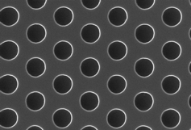
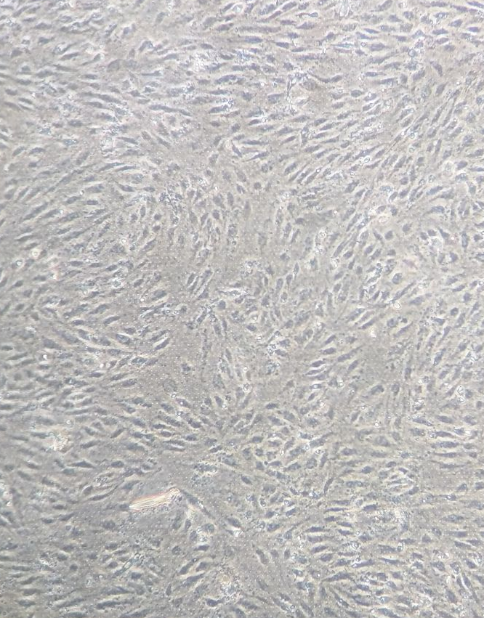
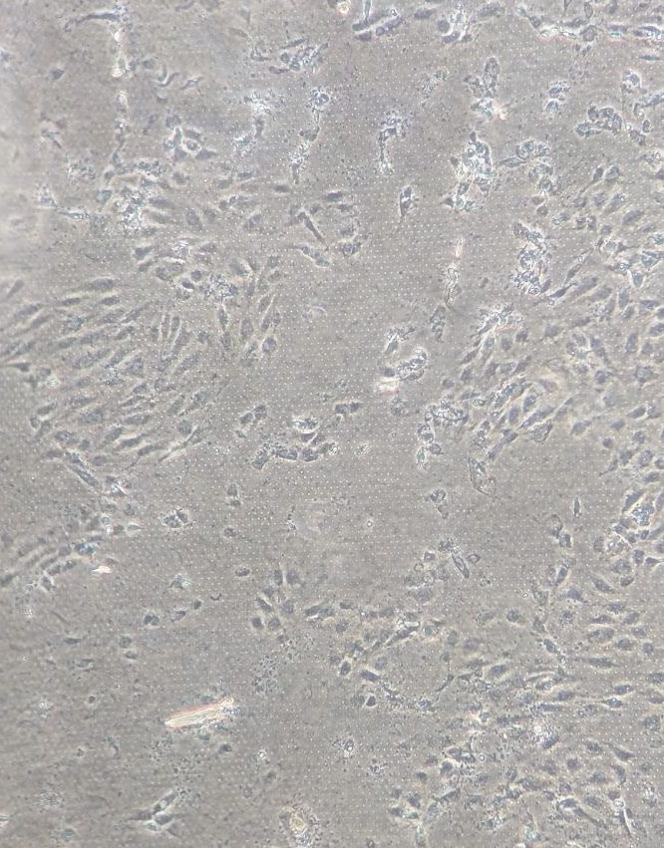
Challenge 2: Cell adhesion on microporous substrates
Microporous (3 um) membranes are essential for neutrophil transmigration
Shear stress is introduced
Within 2 hours post-shear

Slide 24
Solution
100 micron thick coating of Type 1 Collagen gel prevented cells from getting detached
ECM Gel
Bottom Perfusion
            Rationale and Benefits:
Collagen 1- major component in extra-cellular space
Stiffness of collagen gel is in physiological range
Endothelial cells won’t directly interact with silicon (artificial substrate)
Cell adhesion is enhanced

Slide 25
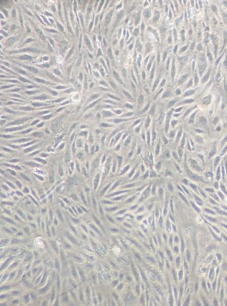
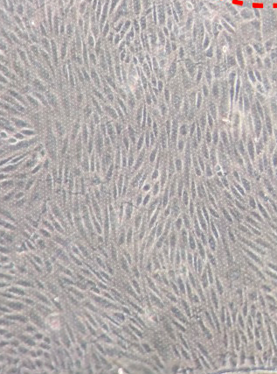
Metric Achieved
100 micron thick coating of Type 1 Collagen gel prevented cells from getting detached
Direction of flow
Static growth of 24 hours
10 hours at 10 dynes/cm²

Slide 26
Metric 2
Establish a healthy endothelial monolayer as demonstrated by stable and reproducible TEER values

Slide 27
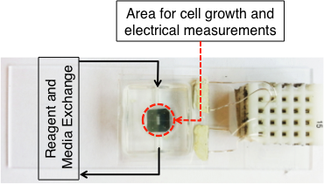
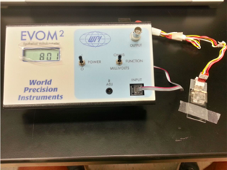
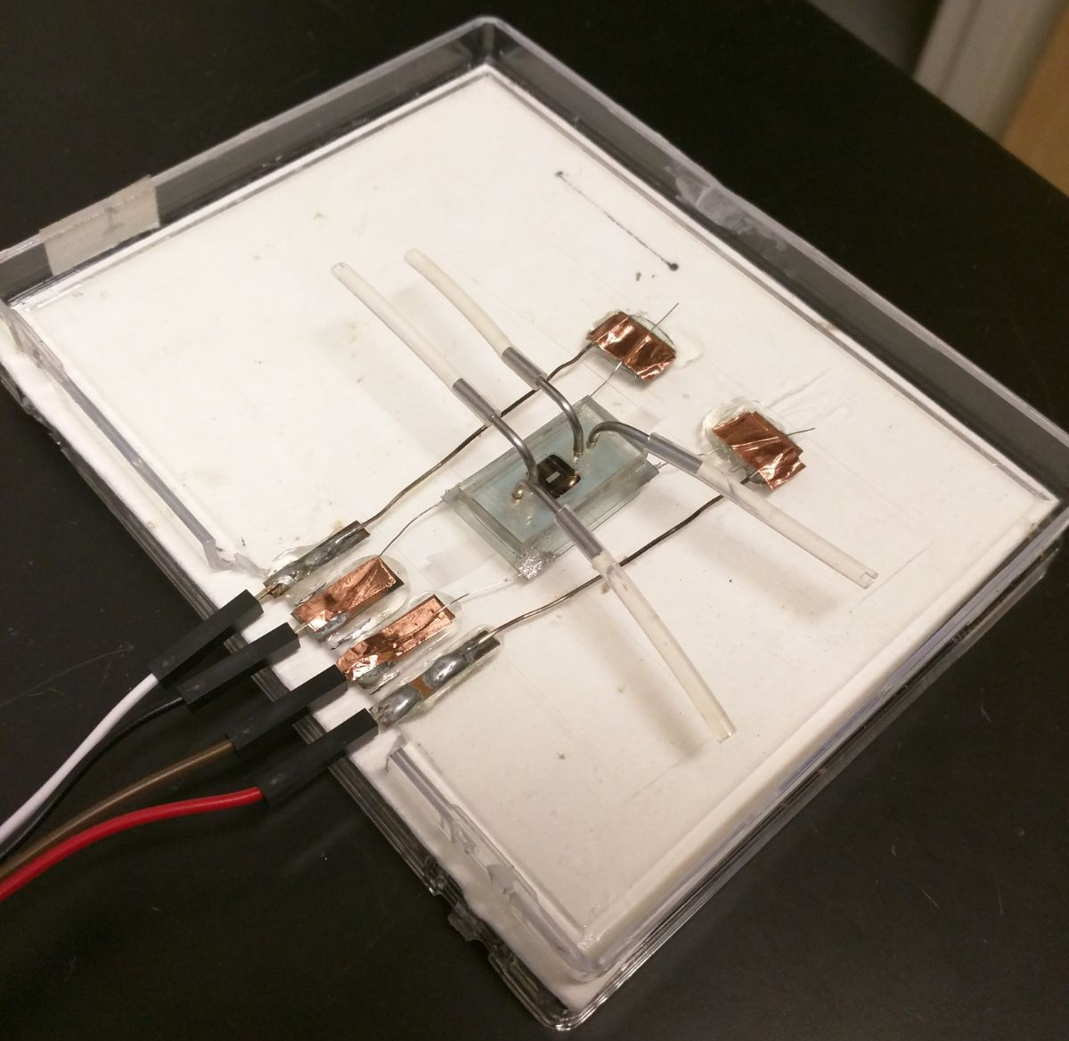
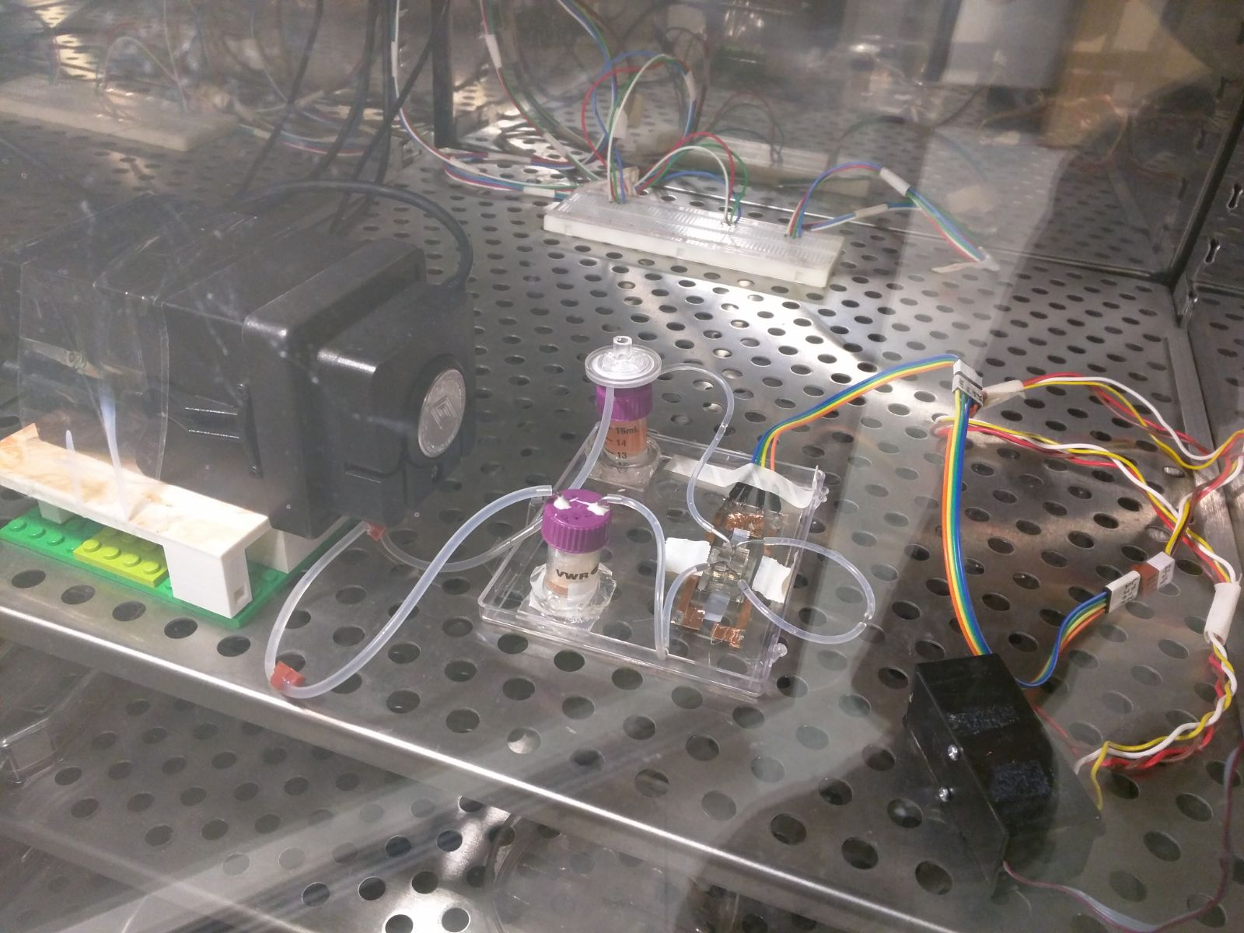
Engineering challenges and solution

Slide 28
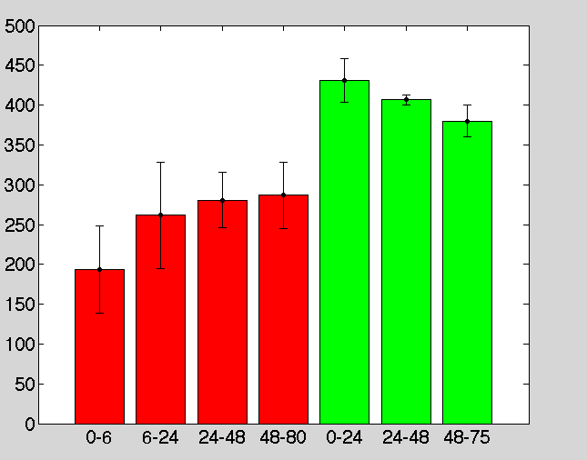
Challenge: Reproducible TEER values
Variance in the time points potentially leads to large error bars in the TEER data
*
X axis: Time in hours Y axis= TEER is ohms
Red = TEER values during static growth Green = TEER values during flow (+ shear)

Slide 29
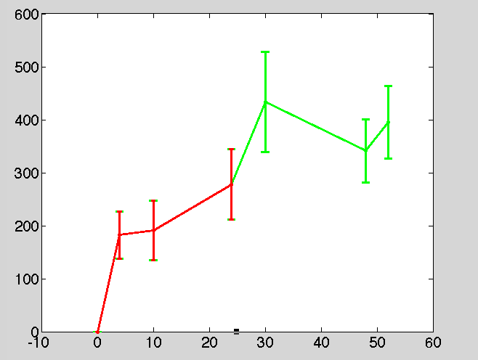
Challenge: Reproducible TEER values
Standardized Operating Procedure (SOP) helps in eliminating the variance in measurements and reduces the error bars
X axis: Time in hours Y axis= TEER is ohms
Red = TEER values during static growth Green = TEER values during flow (+ shear)

Slide 30
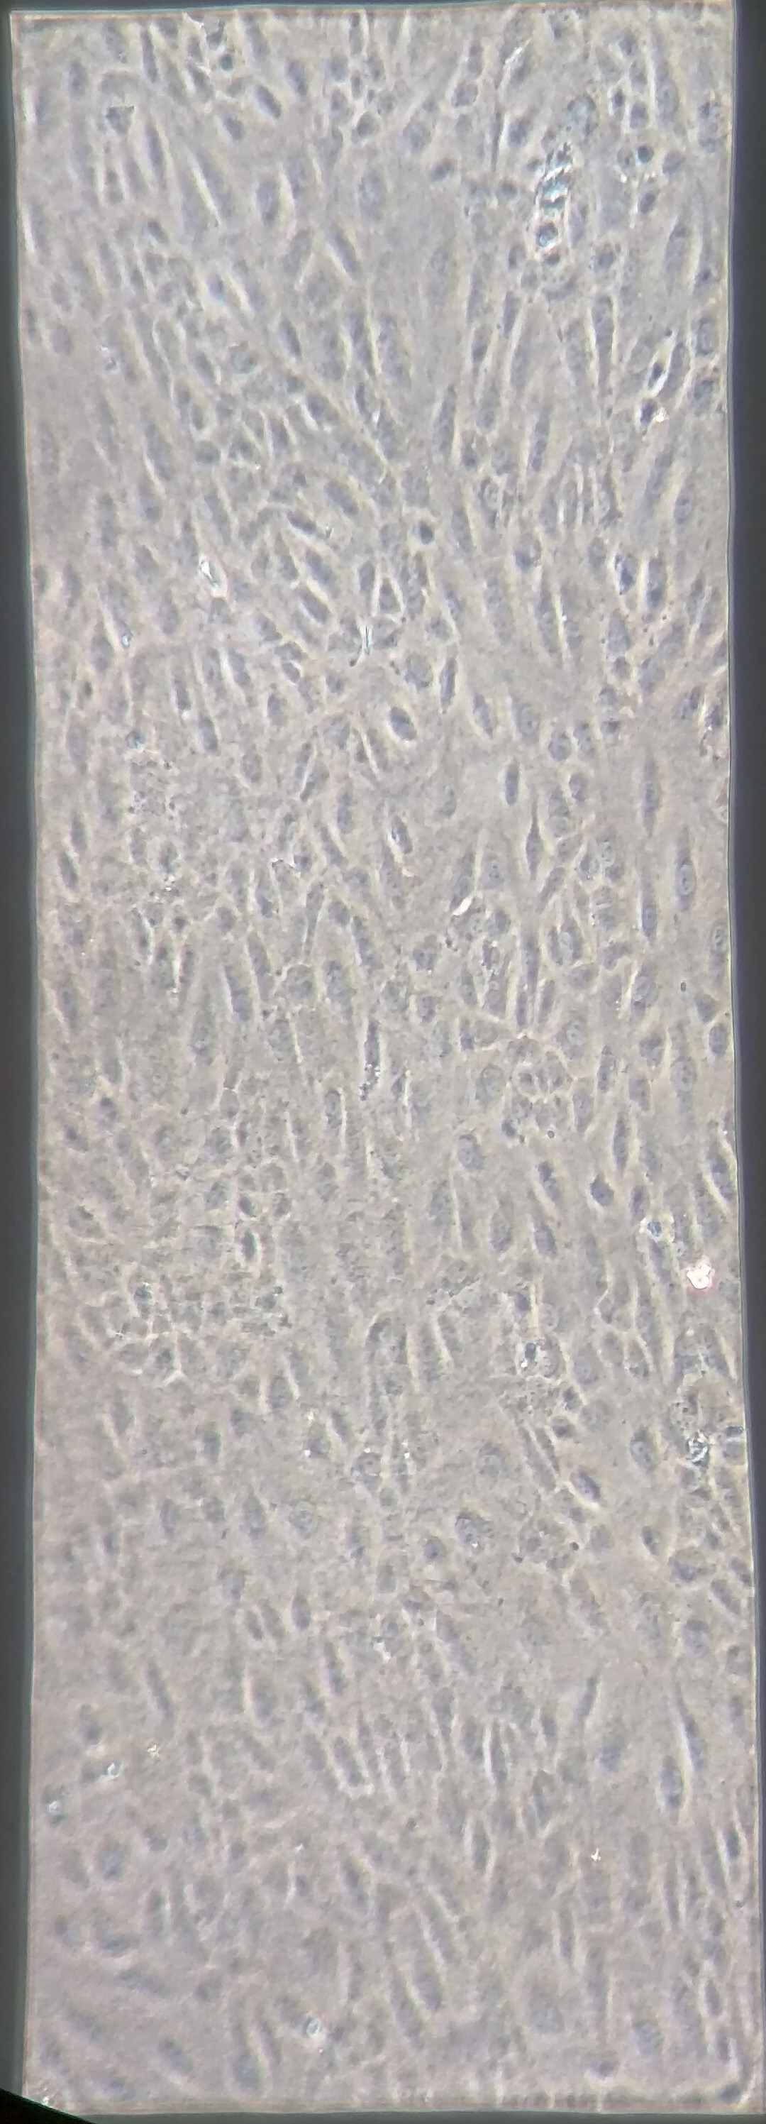
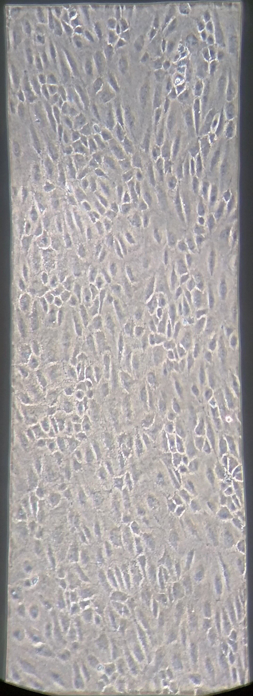
Metric 3
Ability to respond to a barrier-disruptive agent and record the subsequent TEER drop
Thrombin Assay
Confluent Monolayer
Before and After adding thrombin
Notes:
Just to show that the thrombin doesn’t destroy the cell monolayer but only the junction.

Slide 31
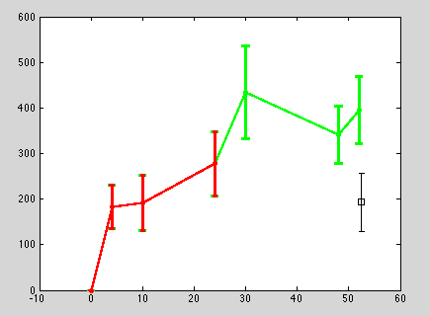
Thrombin Assay – Undergoing work
20 mins
Adding 5 units/ml of thrombin to a confluent monolayer immediately drops the TEER values in ~20 minutes, as captured by the graph

Slide 32
Success Metric
Enable visualization of neutrophil egress from endothelial monolayer

Slide 33
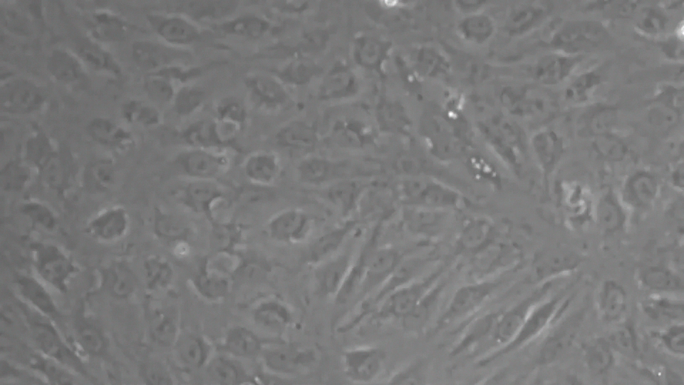
Work under progress
Leukocyte transmigration on Endothelial Cells on Nanoporous substrates
Video from Britta Engelhardt, Univ. of Bern

Slide 34
Achieve 3D chemotaxis w/microporous (no ECs yet)

Slide 35
Current Status of Aim 2
Device engineering and characterization done
Successfully able to demonstrate aligned growth of ECs on thin collagen gels under physiological shear levels
TEER increases with shear stress induction (matching Cucullo et al., Brain Research, 2006)- preliminarily, under progress
TEER reproducibility and thrombin assay- almost there!
Imaging leukocyte TEM – achieved on nanoporous substrates (by collaborators); repeated on microporous substrates by us soon
Tight junction staining to further validate the EC monolayer- yet to be done

Slide 36
Aim 3
Examine the importance of complete neutrophil extravasation on vascular barrier function
Hypothesis to be tested: Preventing neutrophil migration from entering the ECM will partially mitigate a loss in barrier function with complete transmigration

Slide 37
Reminder: Why neutrophils and basement membrane integrity?
LXY2 peptide blocks α3β1 integrin specifically
Preventing neutrophils from entering ECM improved survival
Signaling inhibition or physical sequestering?
How does vascular permeability ties up with inhibiting neutrophil extravasation?

Slide 38
Experimental design and expected outcomes
?

Slide 39
Overall Summary
Aim 1 : Device characterization and TEER analysis almost finished
Aim 2: Reproducible TEER values with tight junction staining underway
Aim 3: Feasibility of neutrophil transmigration and imaging established; actual hypothesis testing yet to begin

Slide 40
Proposed Timeline
Aim 1: Finished, manuscript under preparation
Aim 2: Thrombin assay and TJ junction staining: 2-3 weeks [Feb 1st week];
Transmigration w/ imaging: ~2-3 weeks [Feb end]
Tentative proposal exam: 2 months from today (~ March 15)? [Doc. Submission: Feb 28]
Aim 3: Integrin blockade and physical inhibition experiments: 4-5 months [April-Sep]
Committee meeting [Fall’17]
Defense

Slide 41
THANK YOU!

Slide 43
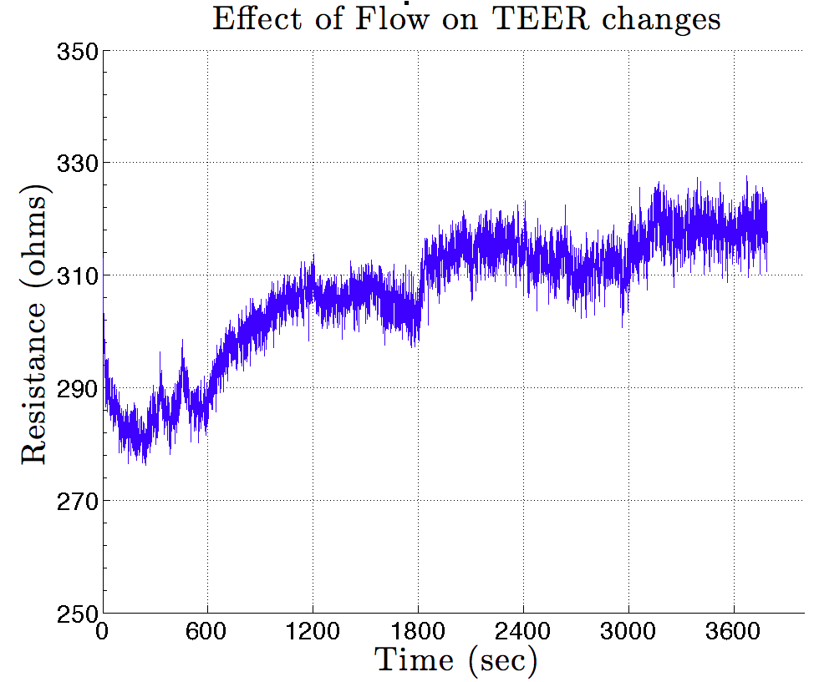
ON
OFF

Slide 44
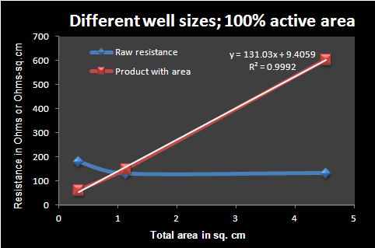
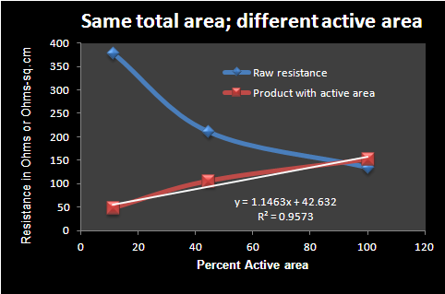
BACK UP

Slide 45
Preliminary Data
Endohm Chamber is a commercially available system for TEER measurement
Transwell consisting silicon membranes as well as polymer membranes were used
Brain Endothelial (bEnd3) cells used for this preliminary work
Total Area available for cell growth = 33 mm²
Active (permeable) Area = 0.4 mm²

Slide 46
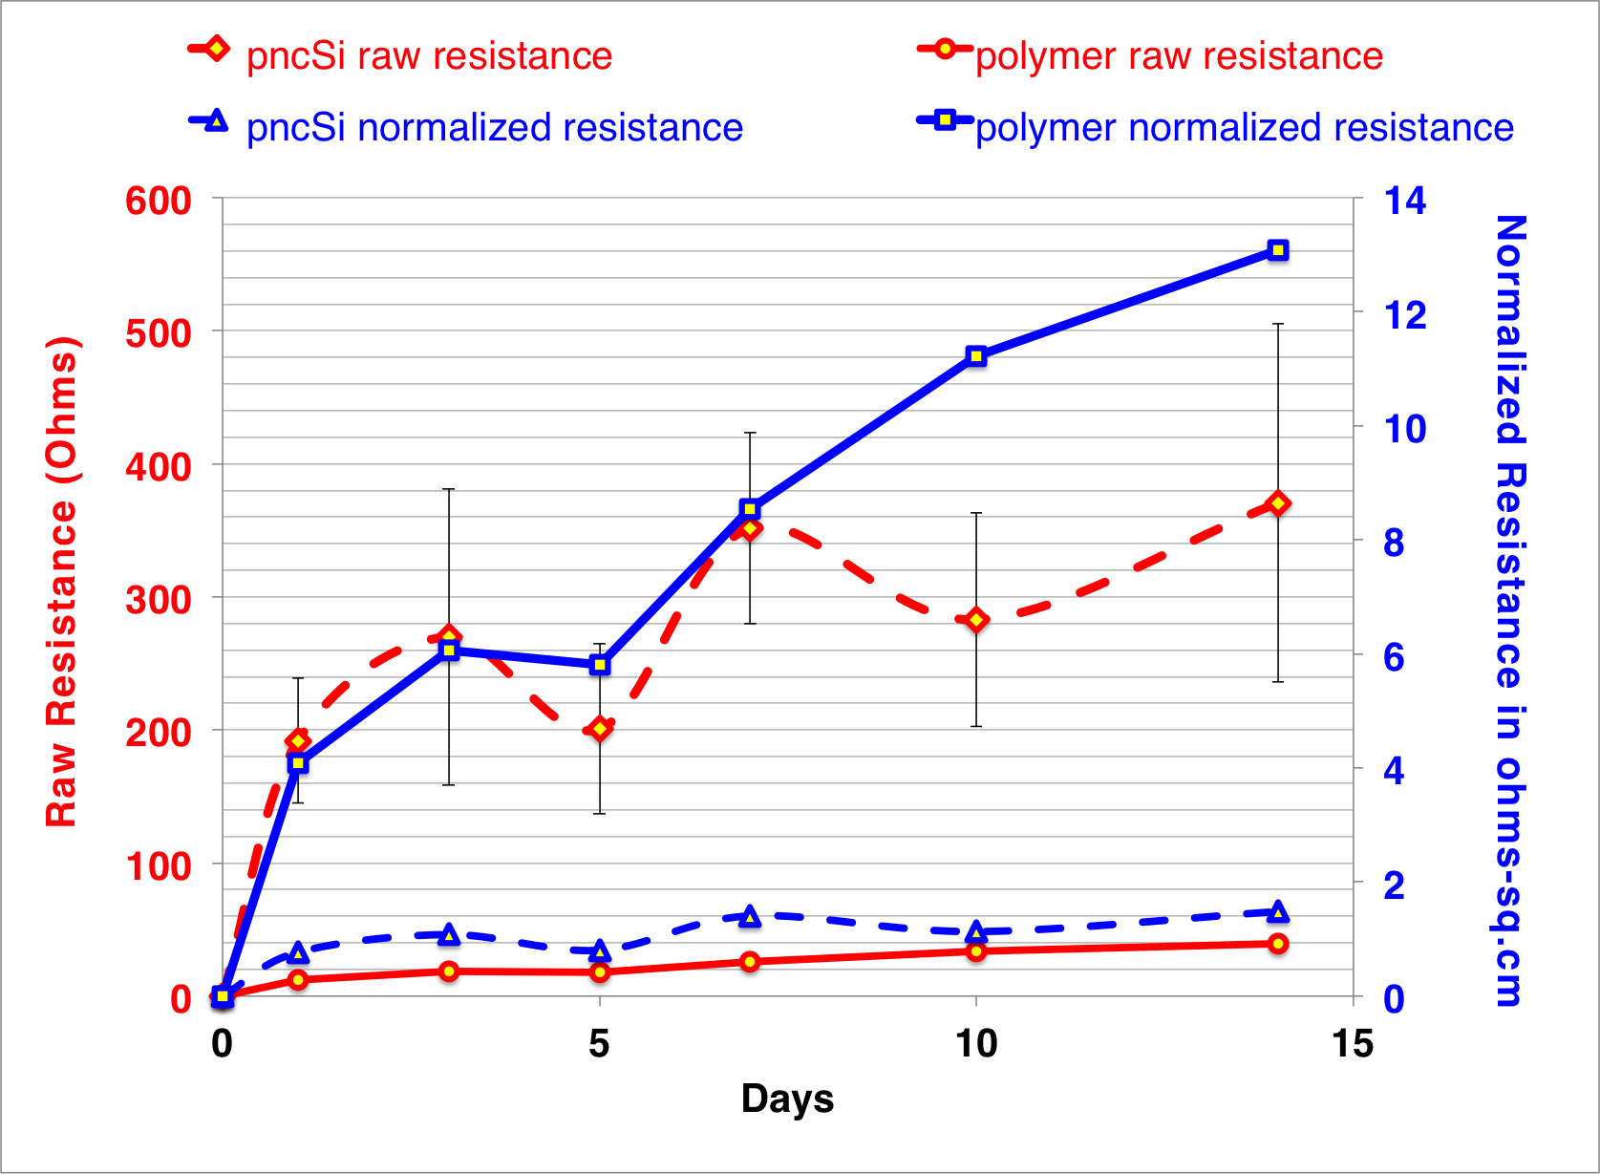
Preliminary Data
SOLID = POLYMER
DASHED = SILICON

Slide 47
Non-uniformity in Pore-distribution
+
R_{electrolyte}
R_{cells}
R_{membrane}
R_{electrolyte}
-
TRACK-ETCHED POLYMER MEMBRANE
+
R_{electrolyte}
R_{cells}
R_{membrane}
R_{electrolyte}
-
SILICON MEMBRANE

Slide 48
How to resolve this?
“ … The diameter of the permeable membrane must be compatible with the geometry of the electrodes to achieve uniform current density....
To verify the uniformity of current density, an electrical simulation or modeling study should be performed in cases in which nonconventional electrode designs are incorporated into a TEER measurement system...”

Slide 49
Finite Element Analysis: COMSOL

Slide 50
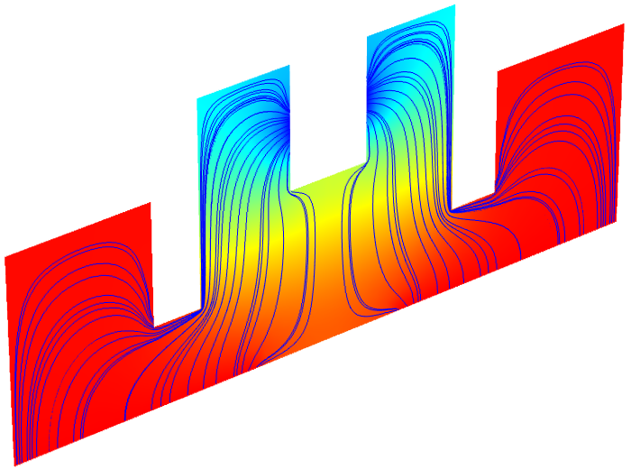
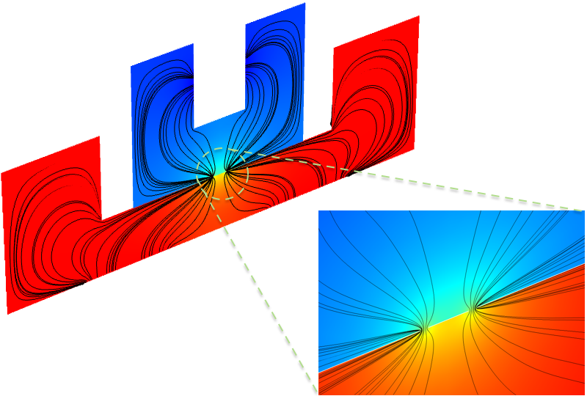
COMSOL Model

Slide 51
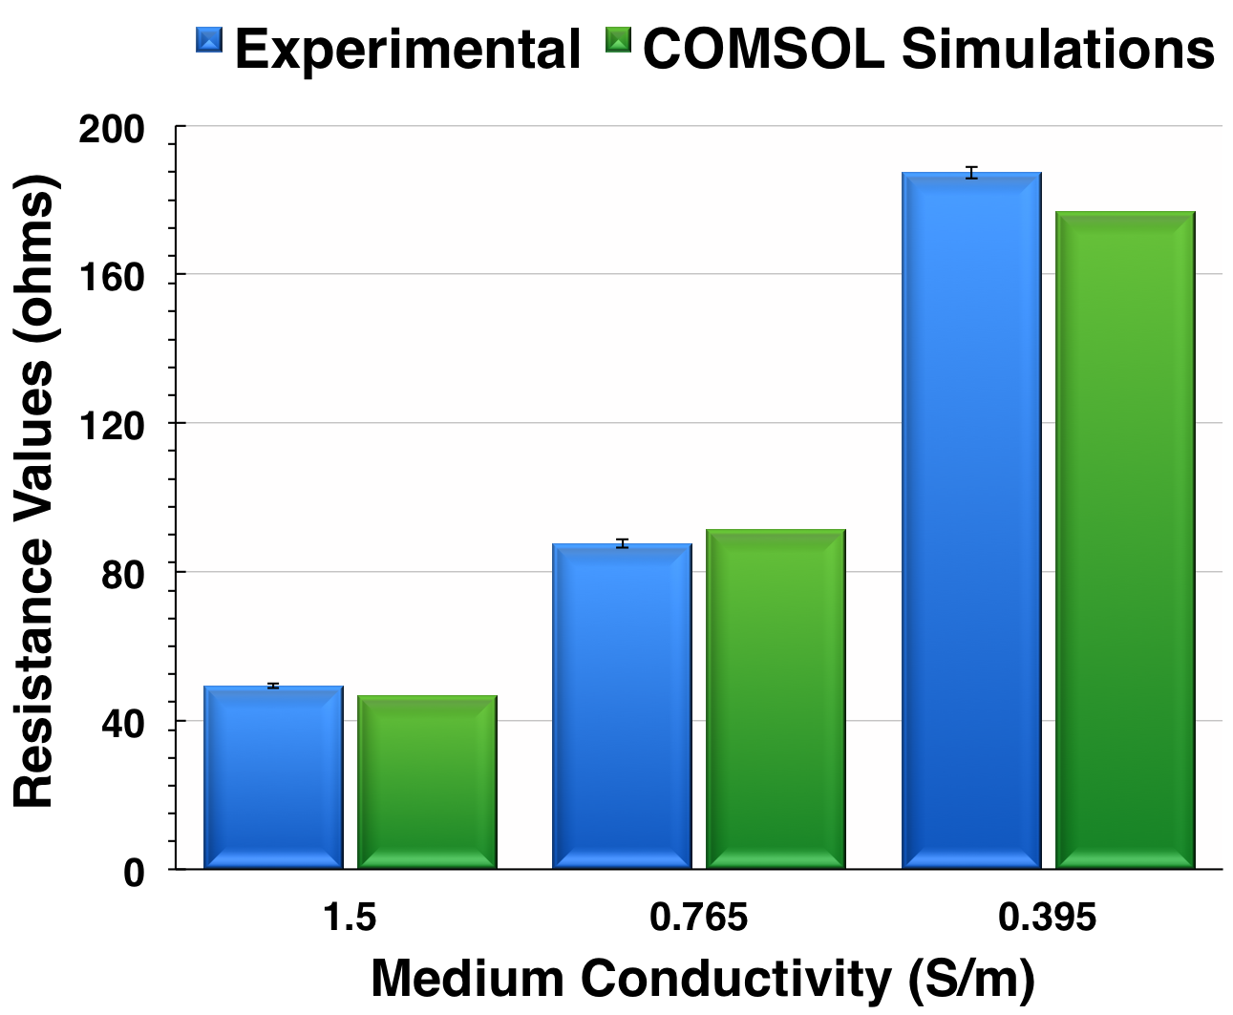
COMSOL Model Verification

Slide 52
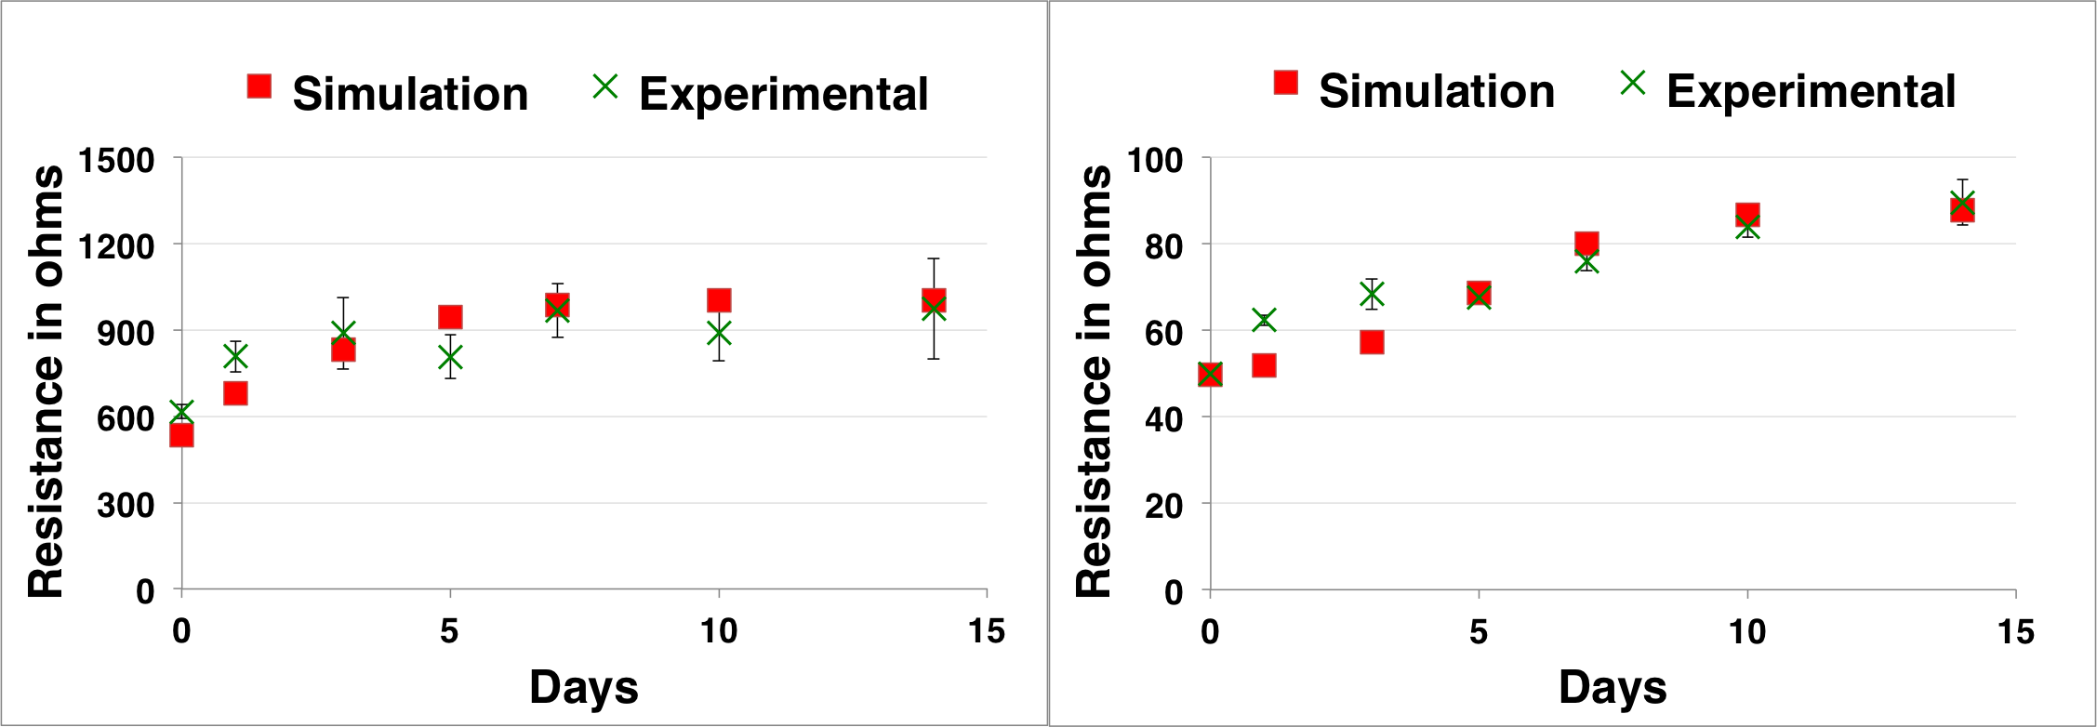
Using Model for Data Correction

