Slide 1
SERS Sensing
Greg Madejski, University of Rochester, Biomedical Engineering

Slide 2
Sensing
Development of a non-silicon nanomembrane for Raman-compatible cell-culture
Development of a novel Raman sensing structure for sensitive identification of molecules
MgF₂
Si
Si
Au
MgF₂

Slide 3
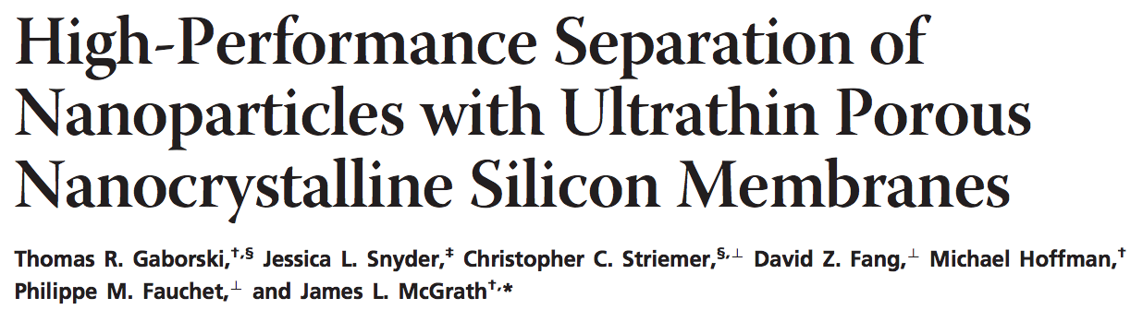
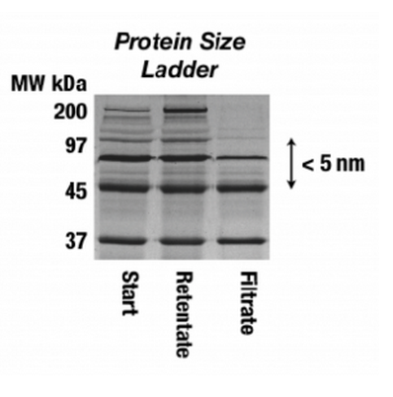

Si Nanomembrane Applications
Gaborski, T. R., et al. (2010). "High-Performance Separation of Nanoparticles with Ultrathin Porous Nanocrystalline Silicon Membranes." ACS Nano 4(11): 6973-6981
Notes:
We can use nanomembranes for a variety of operations. Pumping via electroosmosis, pure physical separation, electrostatic gating, and as a scaffold to promote cell growth in a permeable way.

Slide 4
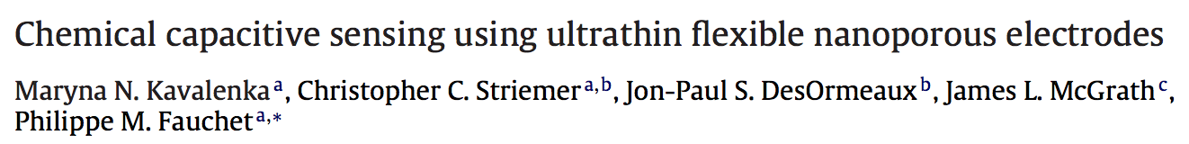
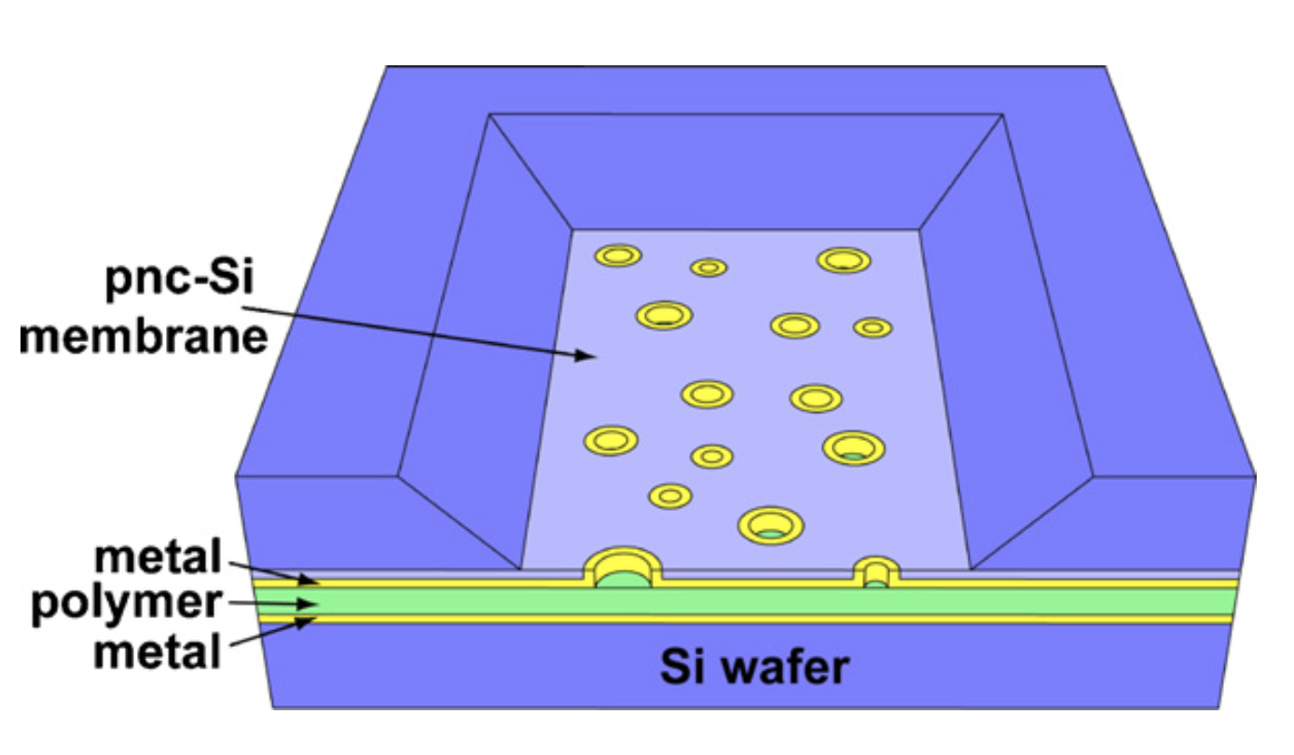
Si Nanomembrane Applications
Kavalenka, M. N., et al. (2012). "Chemical capacitive sensing using ultrathin flexible nanoporous electrodes." Sensors and Actuators B: Chemical 162(1): 22-26
Notes:
We can use nanomembranes for a variety of operations. Pumping via electroosmosis, pure physical separation, electrostatic gating, and as a scaffold to promote cell growth in a permeable way.

Slide 5
Raman Sensing: SERS
Surface Enhance Raman Spectroscopy
  Roughened metals have sharp features that can condense an electric field around them
  Raman Scattering Effect is proportional to the strength of the electric field
  Enhancement factors can be enormous, up to 1,000,000x better

Slide 6
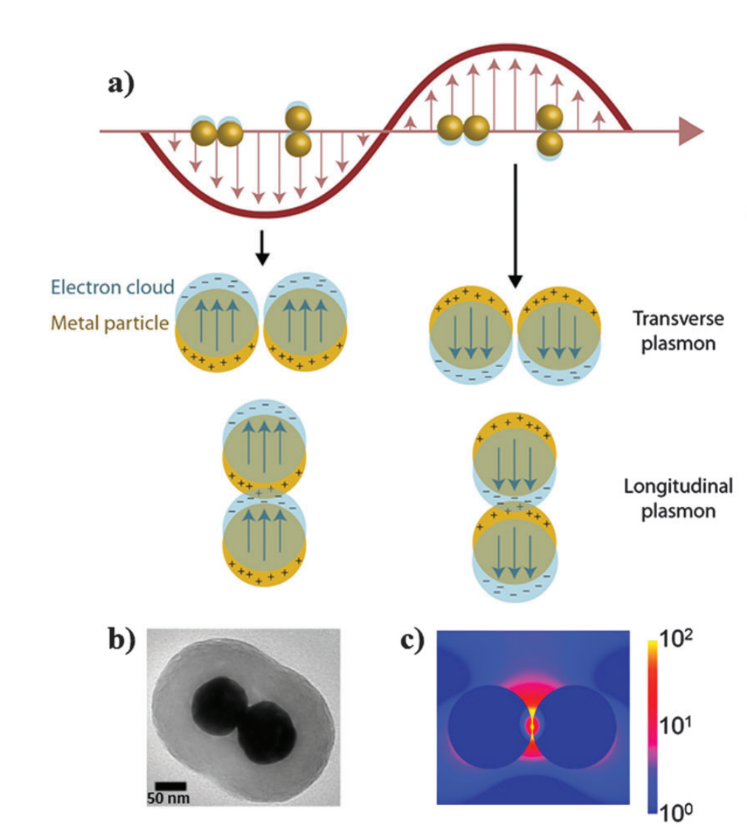
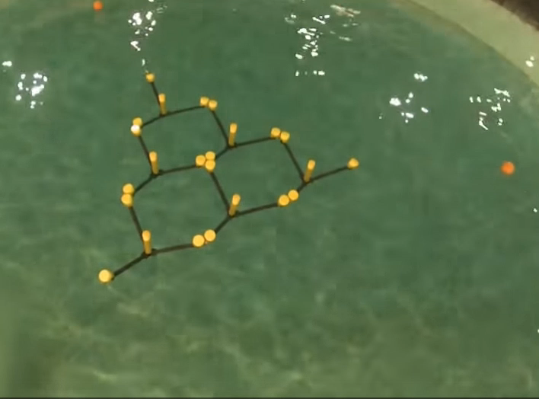
SERS Plasmonics
WaveNET Tank Testing :: FloWaveTT 2014, Edinbugh University
J. M. McMahon, S. Li, L. K. Ausman and G. C. Schatz, J. Phys. Chem. C, 2012, 116, 1627–1637
Notes:
Electron oscillation produces a stronger electric field from a traveling wave

Slide 7
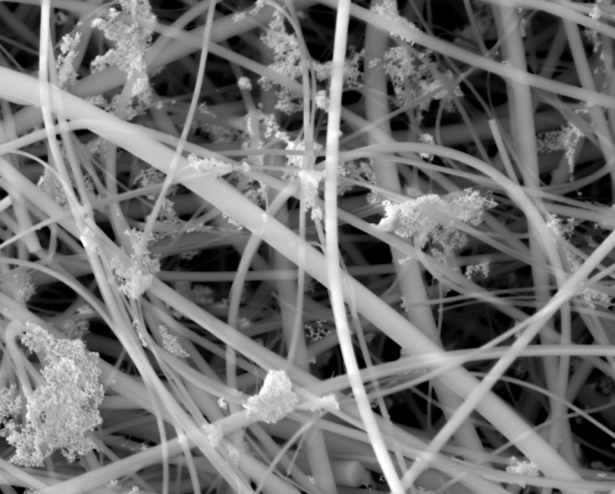
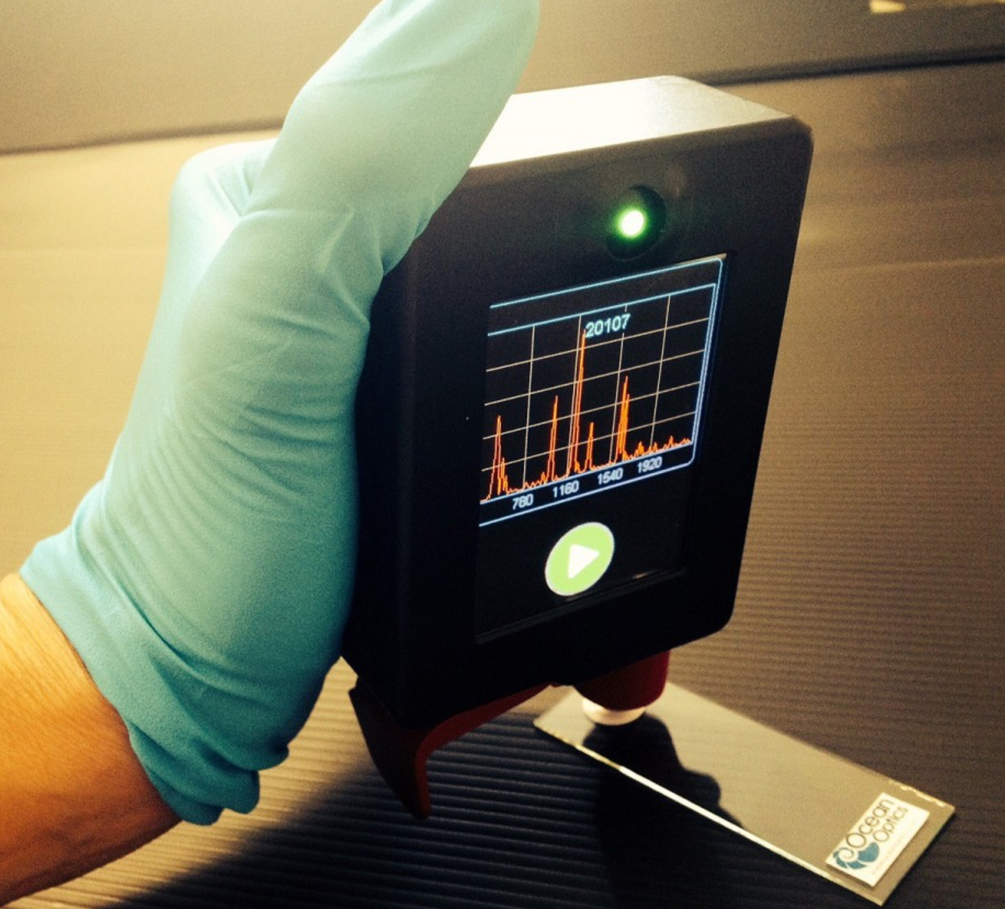
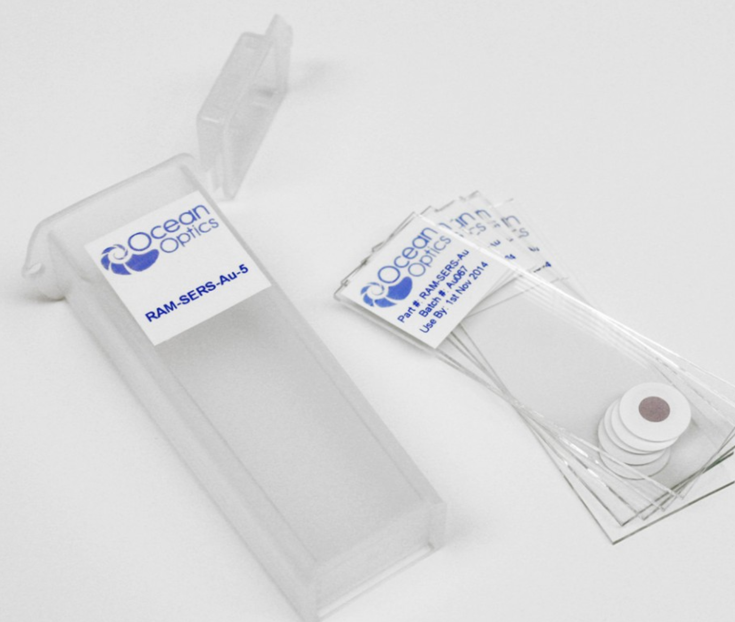

How is SERS Useful?
Detect many different molecules simultaneously
  Excellent specificity and resolution (fM-pM)
  Glucose, Residue, Food-Safety

Slide 8
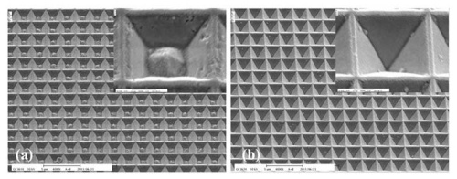
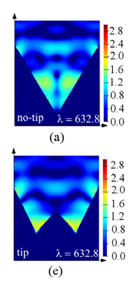
Raman Sensing: SERS
Modification of commercial Klarite SERS substrate
Sharper features will produce a stronger enhancement
Hsin-Hung Cheng et al. "Effects of the tip shape on the localized field enhancement and far field radiation pattern of the plasmonic inverted pyramidal nanostructures with the tips for surface-enhanced Raman scattering," Opt. Express 19, 22125-22141 (2011)
Notes:
Scale is logarithmic: eg 1=10x stronger 2=100x stronger

Slide 9
Metallic SERS Structures
Nanosphere
Nanoshell
Nanowire
Nanotip
Nanohole
“Recent Progress in SERS Biosensing”, Phys Chem Chem Phys. 2011 June 28; 13(24): 11551–11567. doi:10.1039/c0cp01841d

Slide 10
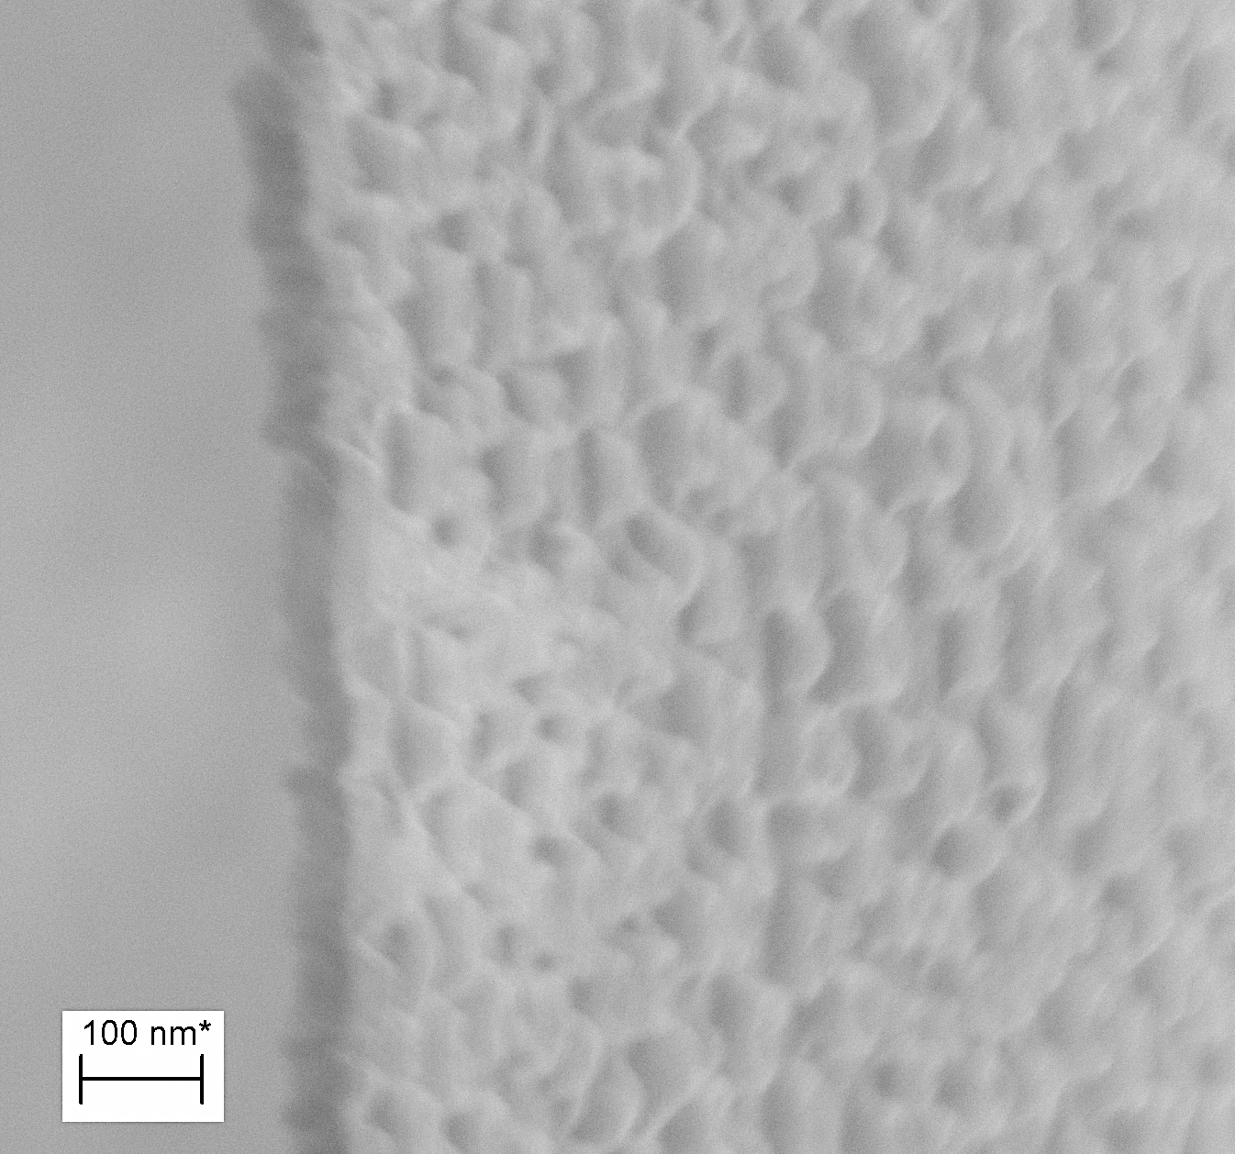
NanoVolcanoes
Can I make a nanomembrane like this out of Au?
MgF₂ Infill from production produces conical structures
30 nm height

Slide 11
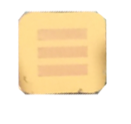
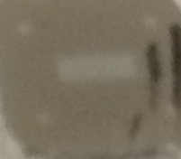
Fabrication – Au, Pt
Evaporation
Nanopore Filling
50 nm Au
50 nm NPN
Si
Si
RIE
5.4 x 5.4 mm chips

Slide 12
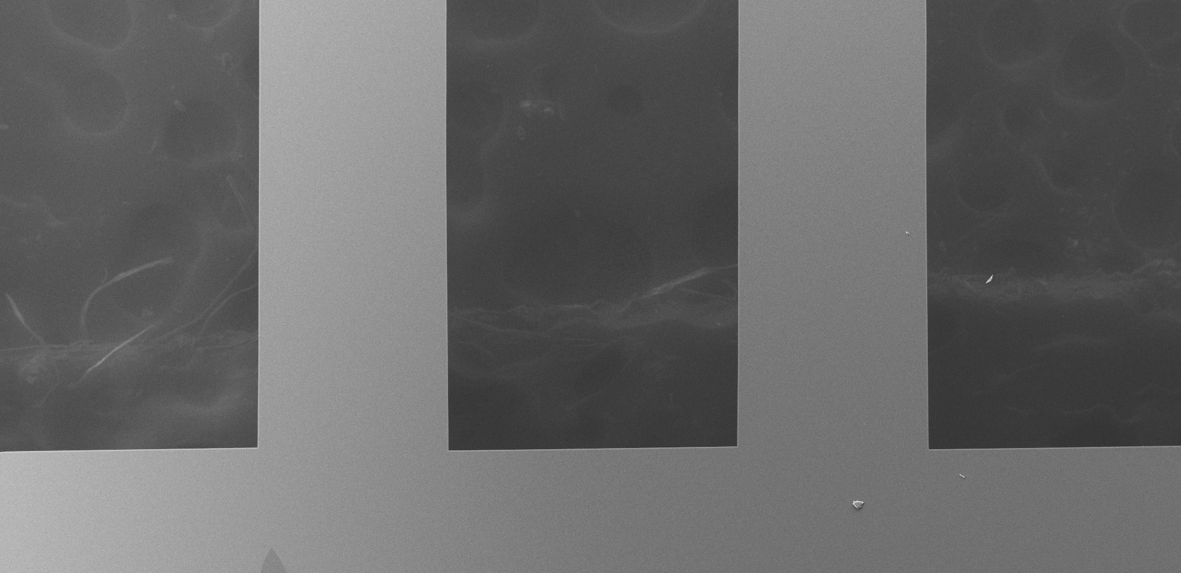
Freestanding Au Nanomembranes
Freestanding 50 nm Au

Slide 13
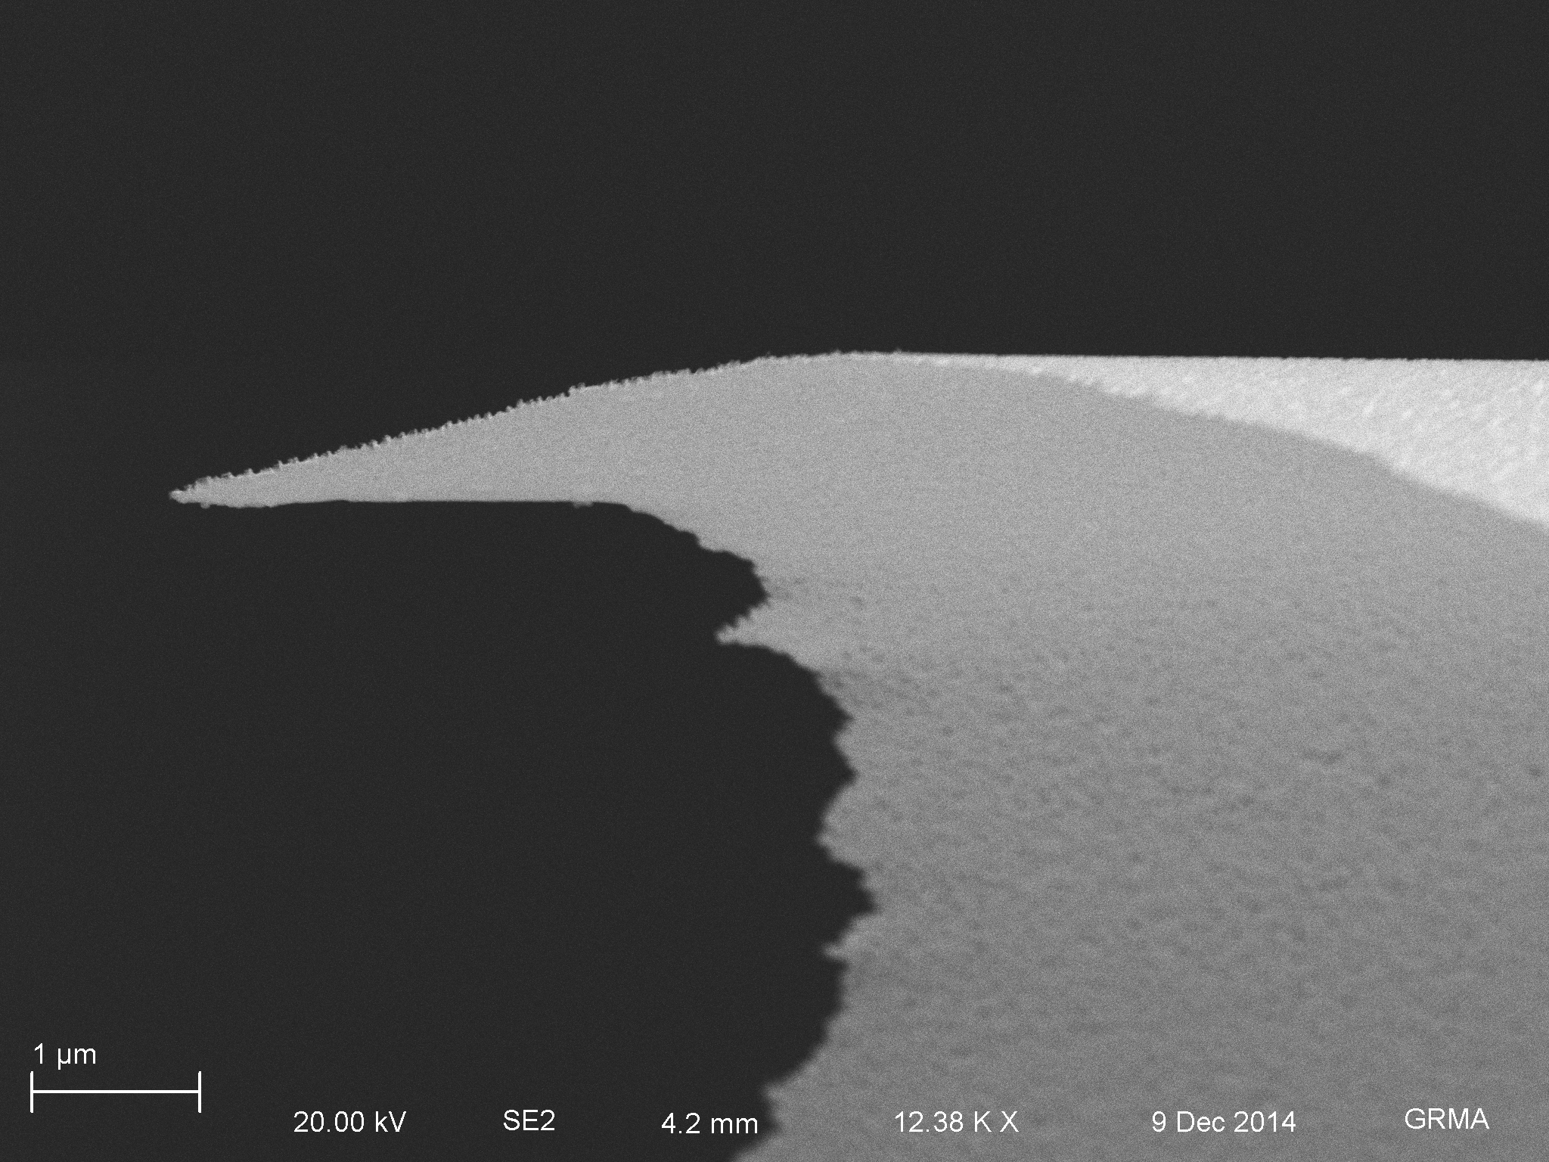
Freestanding Au Nanomembranes
Rough Structures Evident in Crossection
Extremely flimsy – 50 nm of holey gold

Slide 14
Adding Au to MgF₂
Evaporation
Sputtering
Nanopore Filling
50 nm Au
50 nm MgF₂
50 nm NPN
Si
Si
RIE
5.4 x 5.4 mm chips

Slide 15
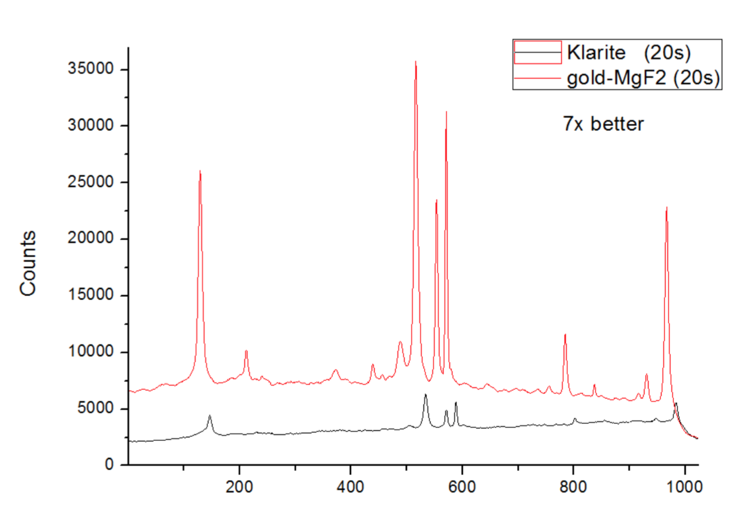
Superior Performance
Pixel
Credit: Flavius Pascut

Slide 16
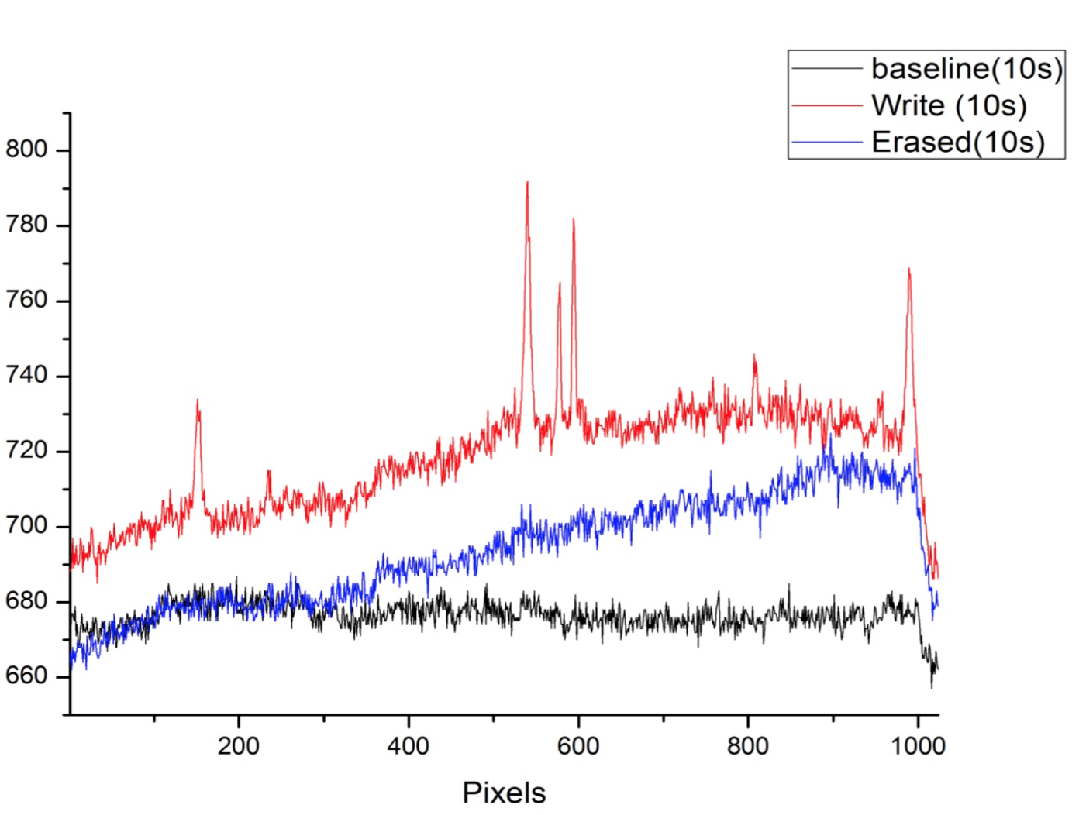
Write-Erase
Electroplate benzenthiol onto gold sensor
Read SERS
Reverse voltage on sensor, remove benzenthiol
+/-
Credit: Flavius Pascut

Slide 17
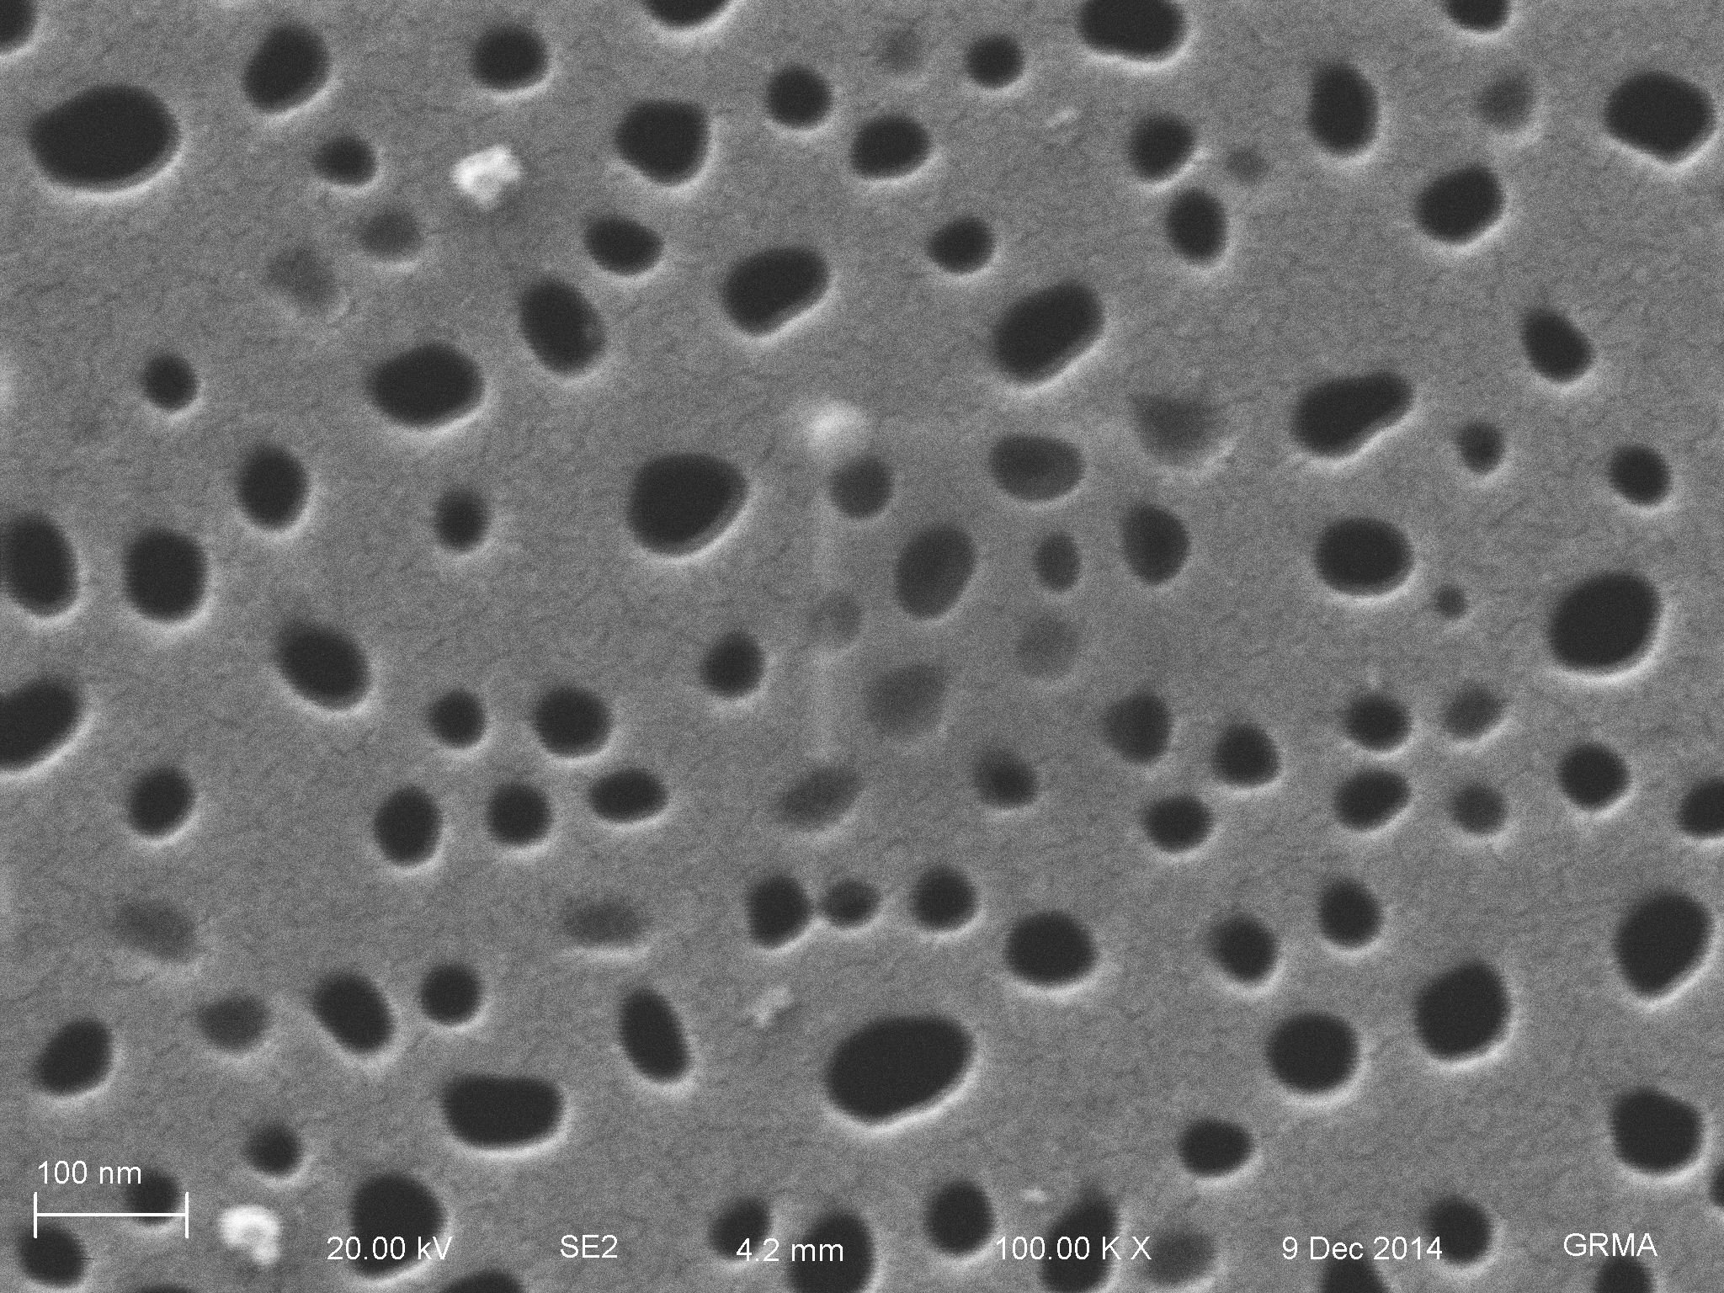
Porous
100-200 cones in a 1000 nm spot

Slide 18
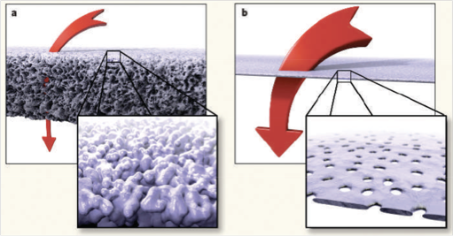
Flow-through
SERS detectors are usually limited by Diffusive Transport!
Our transport is much better – small molecules can be ballistic
  Optimal dwell times?

Slide 19


Flow-Through
How do analytes reach the sensor?
Move to sensor from bulk
Bind to sensor
L₂
1
L₁
2
L_{sens}
Diffusion + Convection
$$τ_{2}= \frac{L_{2}^{2}}{D}$$
$$τ_{1}= \frac{L_{1}}{v}$$
Eftekhari et al. “Nanoholes As Nanochannels: Flow-through Plasmonic Sensing”, Anal. Chem. 2009, 81, 4308–4311

Slide 20
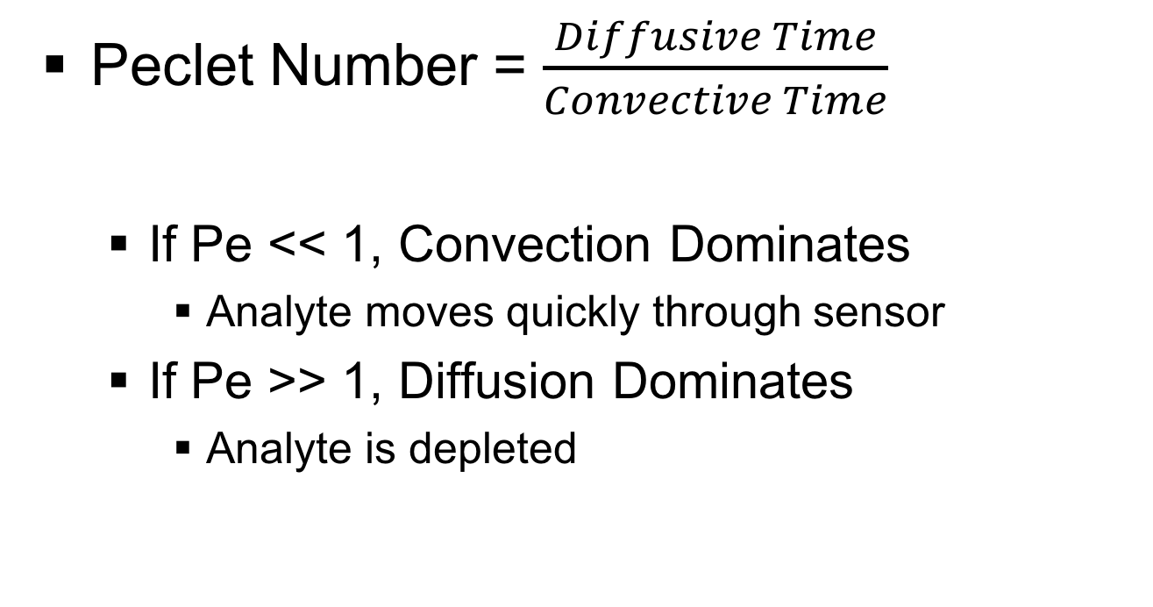
Flow-Through
Peclet Number = $\frac{Diffusive Time}{Convective Time}$
  If Pe << 1, Convection Dominates
    Analyte moves quickly through sensor
  If Pe >> 1, Diffusion Dominates
    Analyte is depleted
Notes:
Hard to compare different types of systems, use dimensionless numbers

Slide 21
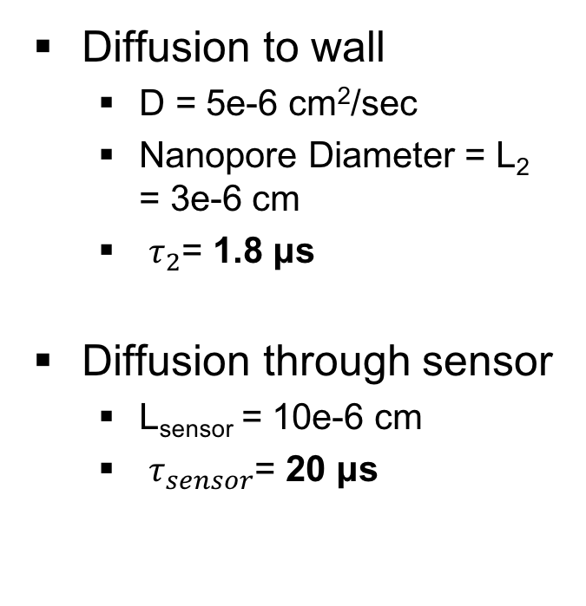
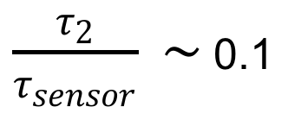
Flow-Through
Diffusion to wall
  D = 5e-6 cm²/sec
  Nanopore Diameter = L₂ = 3e-6 cm
  $τ_{2}$= 1.8 μs
Diffusion through sensor
  L_{sensor} = 10e-6 cm
  $τ_{sensor}$= 20 μs
$\frac{τ_{2}}{τ_{sensor}} \sim$ 0.1
L₂
L_{sens}
Small scale flows can bring more analyte to the sensor without blowing past it!

Slide 22
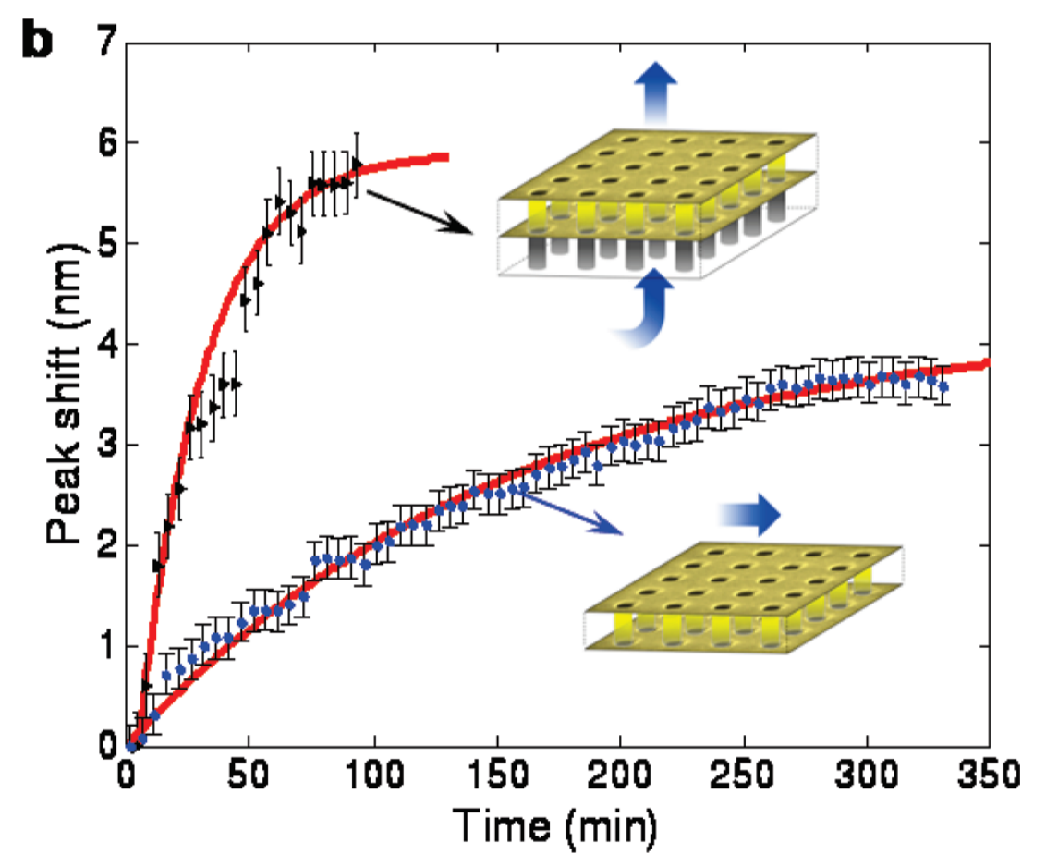




Flow-Through
Diffusion + Convection
3.8e-2 reactions/min
$$τ_{2}= \frac{L_{2}^{2}}{D}$$
vs
$$τ_{1}= \frac{L_{1}}{v}$$
Diffusion Alone
$$τ_{2}= \frac{L_{2}^{2}}{D}$$
$$τ_{1}= \frac{L_{1}^{2}}{D}$$
5 μL/min = 6x improvement
6.4e-3 reactions/min
Eftekhari et al. “Nanoholes As Nanochannels: Flow-through Plasmonic Sensing”, Anal. Chem. 2009, 81, 4308–4311
Notes:
SPR sensor, Tangential flows rate constant, 200 nm thick holely sensor

Slide 23
Future Work
Model Structure
  How does the structure create the enhanced SERS properties?
  What molecules can be detected ideally?
Detect many different types of molecules
  Every molecule has a different crossection

Slide 24

Summary
New Raman-silent nanomembrane materials are enabling some exciting biosensing!

Slide 25



Acknowledgements
University of Rochester
Prof. James McGrath
Dean Johnson, PhD
Joshua Winans, PhD
Henry Chung, PhD
Tejas Khire
Karl Smith
Sarah Wayson
Meghan Kazanski
Tucker Burgin
J.P. DesOrmeaux
Josh Miller
Jamie Roussie, PhD
University of Nottingham
Prof. Kevin Webb
Flavius Pascut, PhD
Emilia Moradi, PhD
URnano
RIT
Prof. Tom Gaborski
Bob Carter, PhD
University of Ottawa
Prof. Vincent Tabard-Cossa
Kyle Briggs

Slide 26
Questions?

