Slide 1
DNA Nanopore Sequencers
Greg Madejski, University of Rochester, Biomedical Engineering

Slide 2
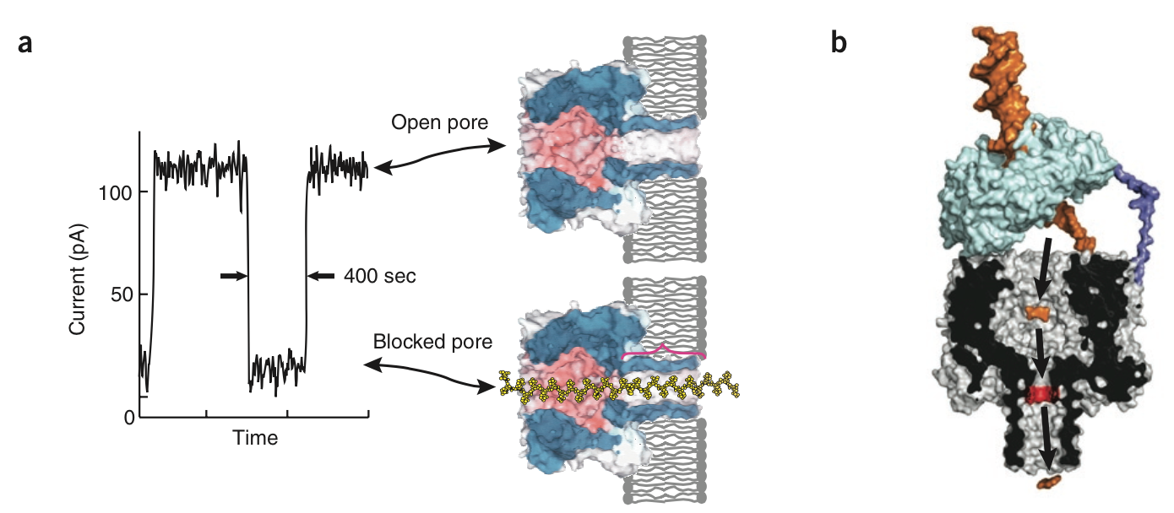

DNA Nanopore Sequencers
Alpha Hemolysin
Biological Nanopore, ~$1000/genome, Oxford Nanopore
Branton, D., et al. (2008). "The potential and challenges of nanopore sequencing." Nat Biotech 26(10): 1146-1153.
Notes:
A large area of biomedical microsystem literature is devoted to DNA sequencing. DNA nanopore sequencers promise to usher in an age of personalized medicine, where individual genomes are sequenced cheaply and effectively to make better healthcare decisions. The dominant commercial technology, through a biological protein-based nanopore is approaching about $1000/genome.

Slide 3
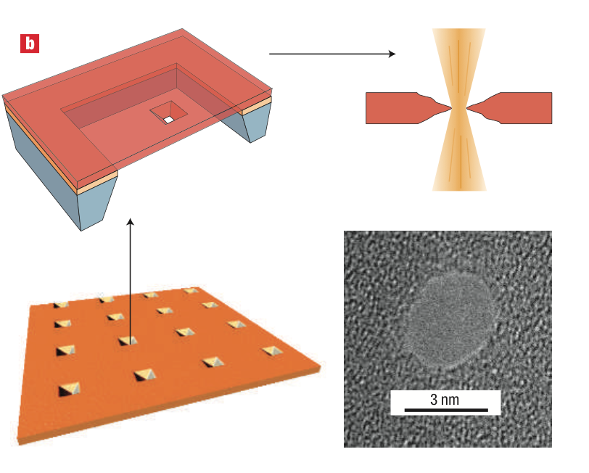
DNA Nanopore Sequencers
Single Silicon Nanopore
Cheap Fabrication
Stable Shelf Life
Poor base pair resolution
Single point of failure
Dekker, C. (2007). "Solid-state nanopores." Nat Nano 2(4): 209-215.
Notes:
Newer silicon nanopore technology is being developed as a lower-cost, more stable alternative, as you don’t have to worry about the condition of the biological pore.

Slide 4
How does the SSNP work?
DNA is near pore, then electrophoretically captured
  ~200-300 nm away
DNA threads through tiny nanopore, causing a drop in current

Slide 5
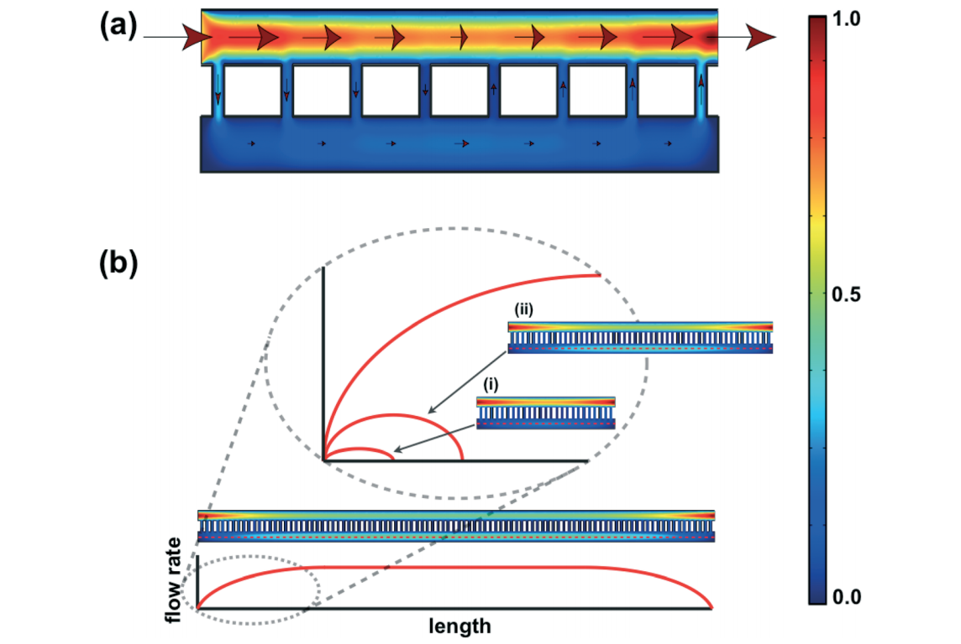
Si Nanomembrane Applications
Tangential Flow
Cells
10⁶ fold shear stress reduction
Chung et al. “Highly Permeable Silicon Membranes for Shear-free Chemotaxis and Cell Labeling” Lab Chip 2014
Notes:
Dr. Henry Chung published in Lab on a Chip where he used the properties of nanomembranes to effectively shield cells from fluid shear stress. This kind of protective effect would be really useful for other kinds of devices that are sensitive to flow or get gummed up by nonspecific binding. In other words the membrane could act as an upstream filter and still shield any device place underneath it.

Slide 6
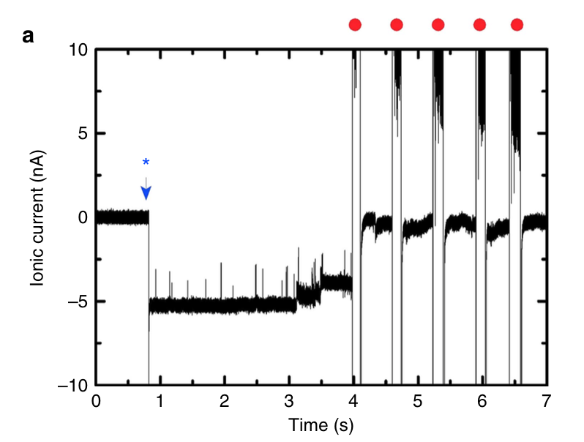
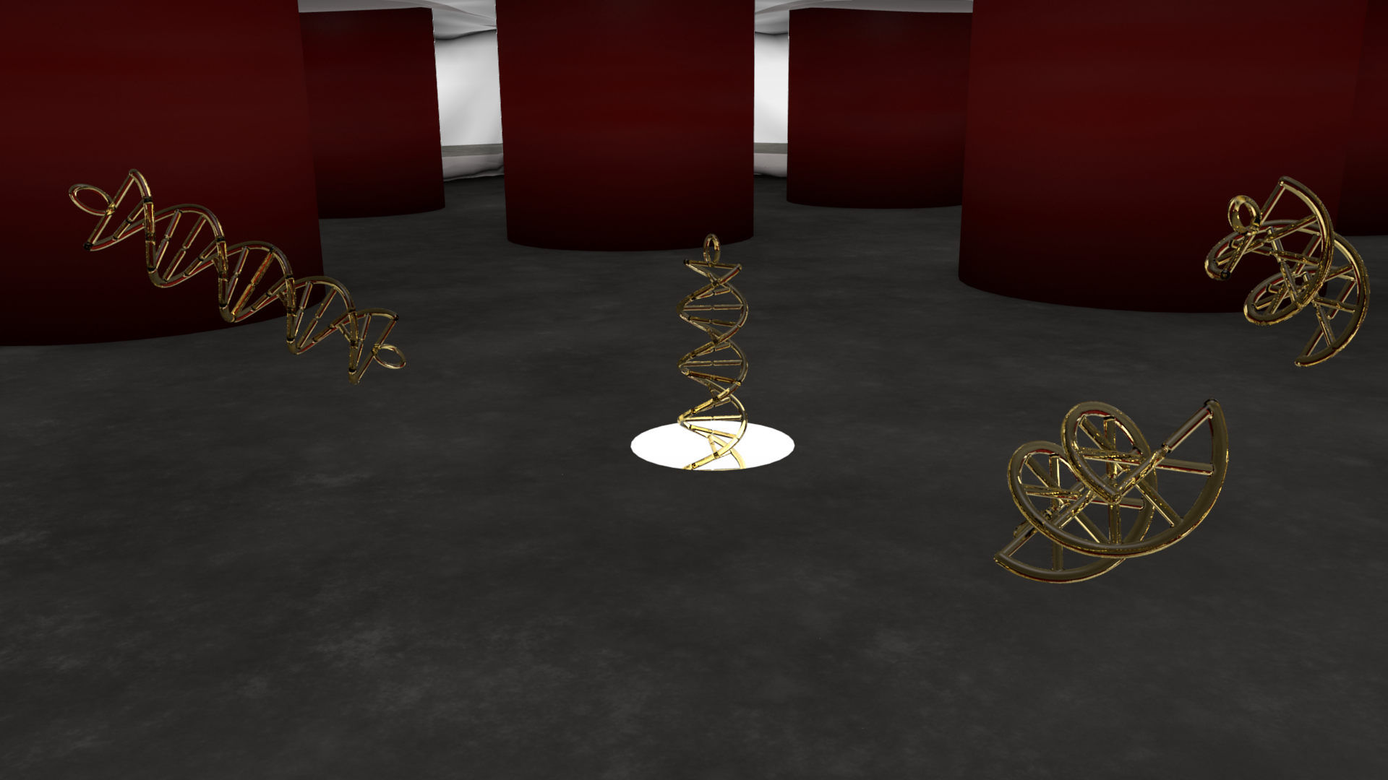
DNA Blockage
A filter could screen out ‘clogging’ DNA configurations
Schneider, G. F., et al. (2013). "Tailoring the hydrophobicity of graphene for its use as nanopores for DNA translocation." Nat Commun 4.
Notes:
Unfortunately, these devices have a major limitation; a single point of entry. This means that if DNA gets balled up, or garbage gets near the device, the DNA sensor would stop working.

Slide 7
Desires
Have a prefilter close to the nanopore, keeping DNA within the capture radius
Interesting engineering challenge to create a nanocavity where the filter is within ~50-100 nm of the surface, but not touching

Slide 8
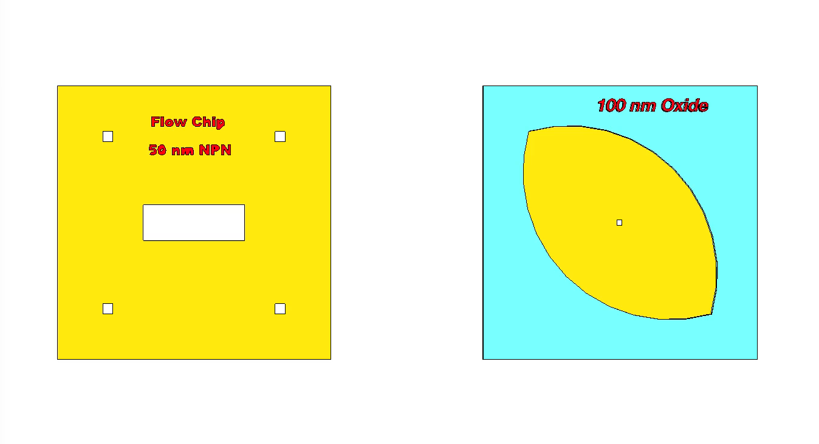
Anodically Bonded Nanofilter

Slide 9
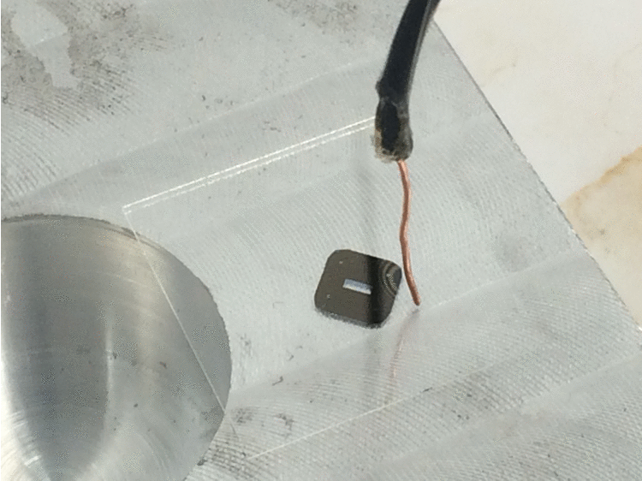
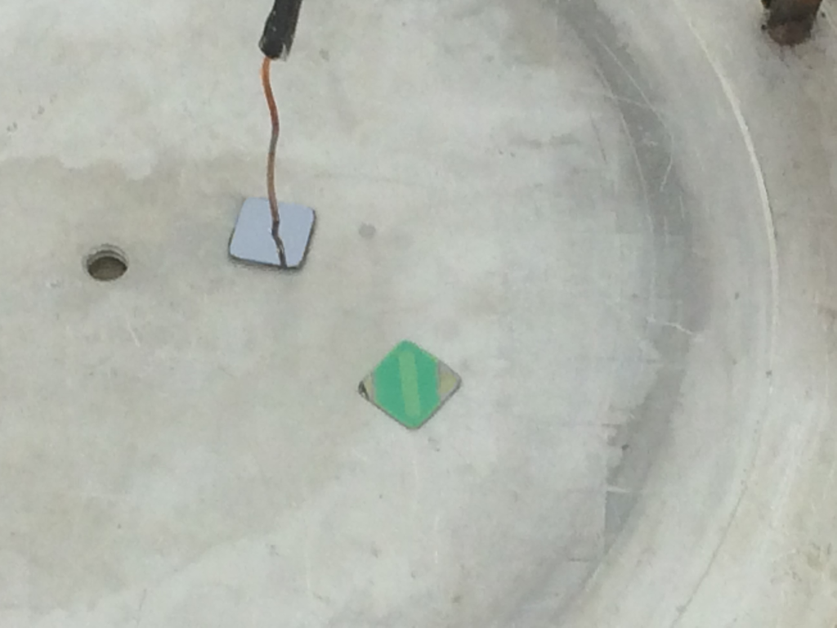
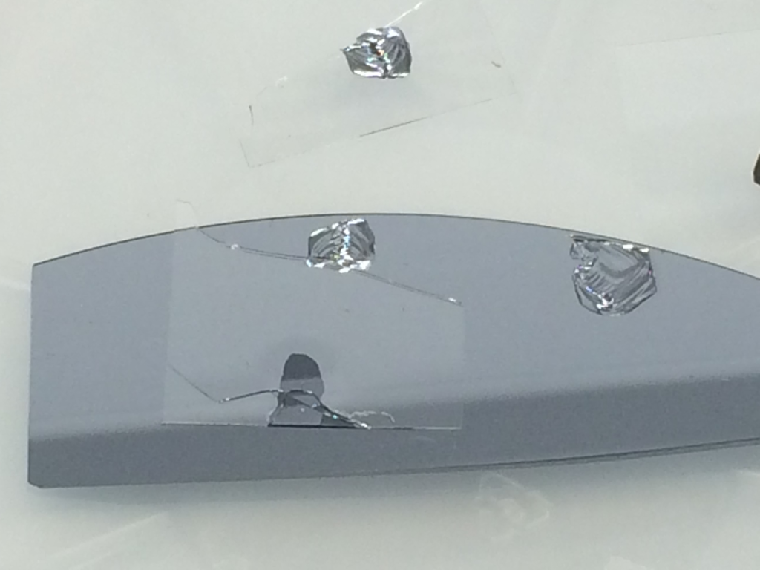
Anodic Bonding Microsystem
Notes:
To ffabricate the previous device, we would use Anodic bonding, literally welding the filter on top of the dna sensor. Unfortunately it didn’t work the first time, but the nanomembrane transferred over. It draped over some structures intended to keep the filter from sagging and impacting the device function.

Slide 10
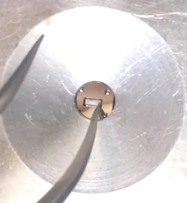
Nanomembrane-Vapor Transfer

Slide 11

Tenting
Notes:
Tenting video, dropping a thin sheet of nanoporous membrane on top of a structure to protect devices underneath it.

Slide 12
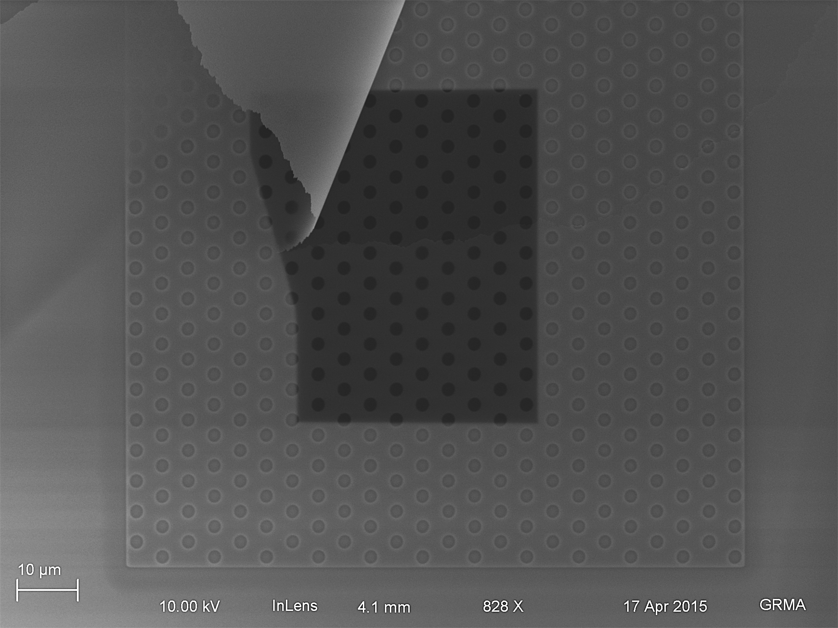
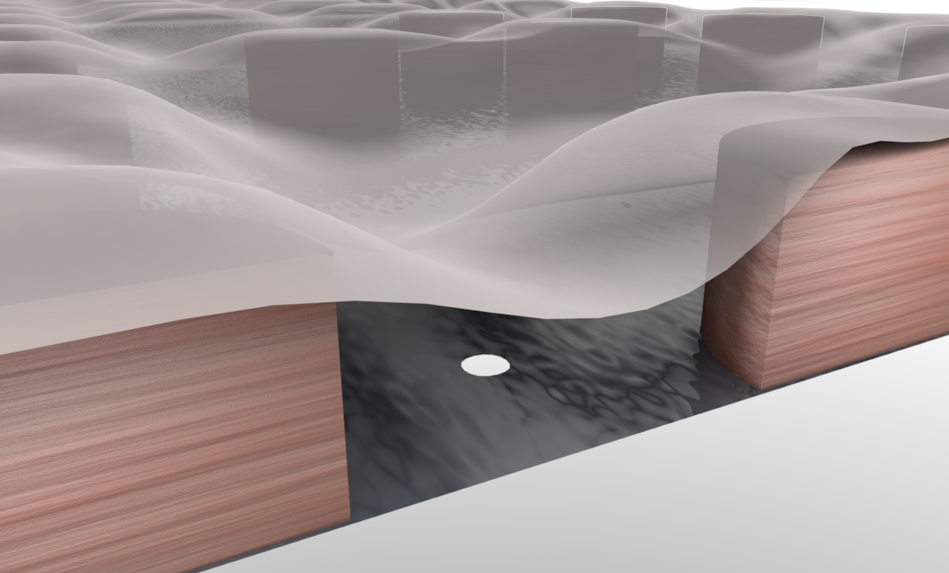
Tenting - SEM

Slide 13
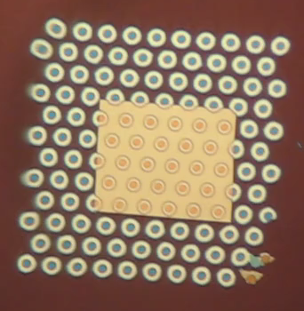
Tenting - Wetting
Notes:
Repeated applications of water vapor swell the nanomembrane, but ultimately is fixed in place. Water can diffuse into cavity spaces

Slide 14
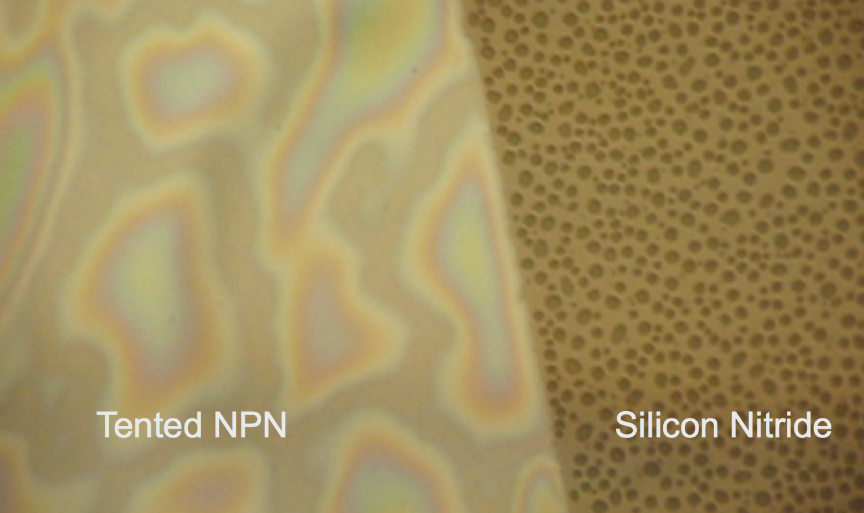
Tenting - Wetting
Notes:
The wetting behavior is unusual. The NPN and silicon nitride are the same material composition, but display different wetting behavior

Slide 15
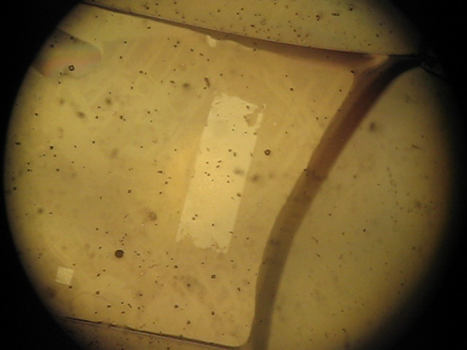
Tenting – Adhesion Model
Stable for a week, submerged in water
Water provides adhesion
Credit: Tucker Burgin
Notes:
We need to know more about this process in order to integrate it into other flows potentially.

Slide 16
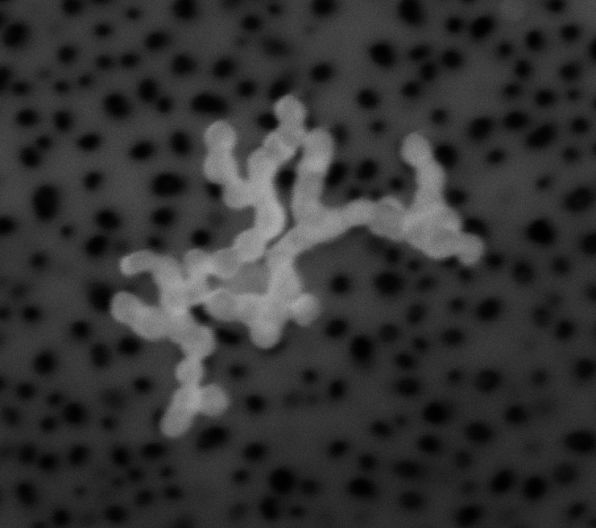
Tented Filtration
60 nm Au
aggregate
Notes:
Filtering out aggregates is important analagous to DNA coiling on itself

Slide 17
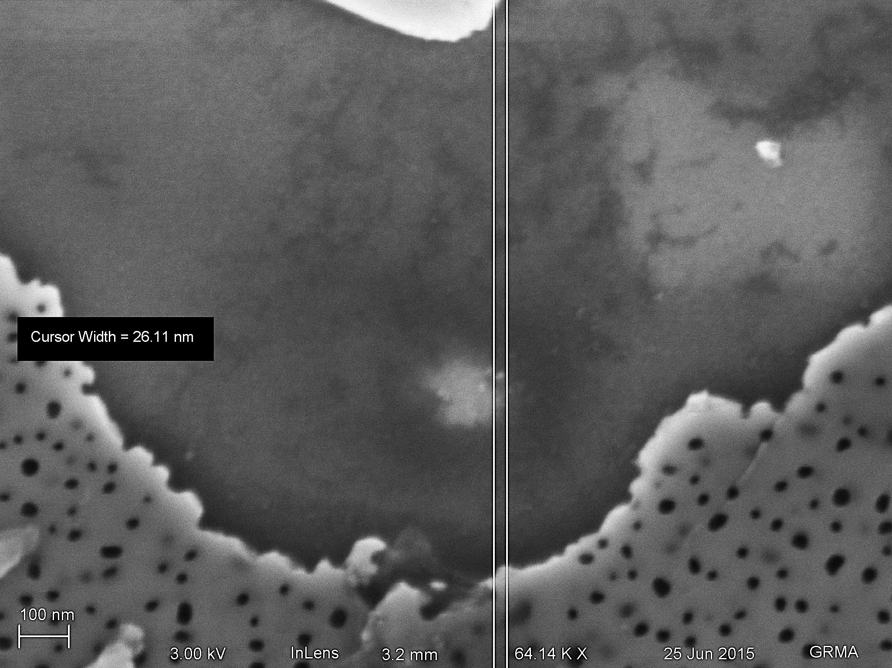
Tented Filtration
Notes:
Small pieces can still get through!

Slide 18
Tented Nanopore Improved
~30 Events in this Example
Extend the lifetime of silicon nanopore sequencers
Tent in Place

Slide 19
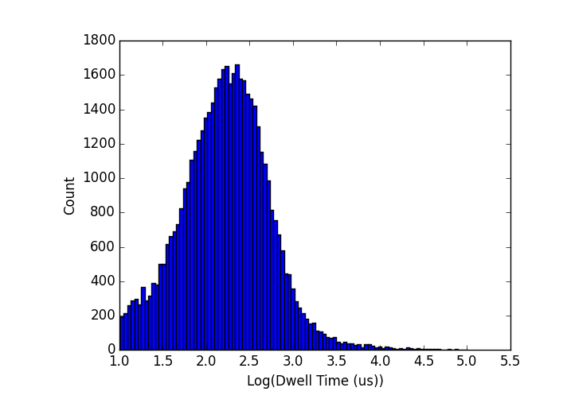
Experiment
50-nt ssDNA
50,000 - 100,000 events with tent in place
Hundreds or thousands of events is typical
Credit: Kyle Briggs

Slide 20
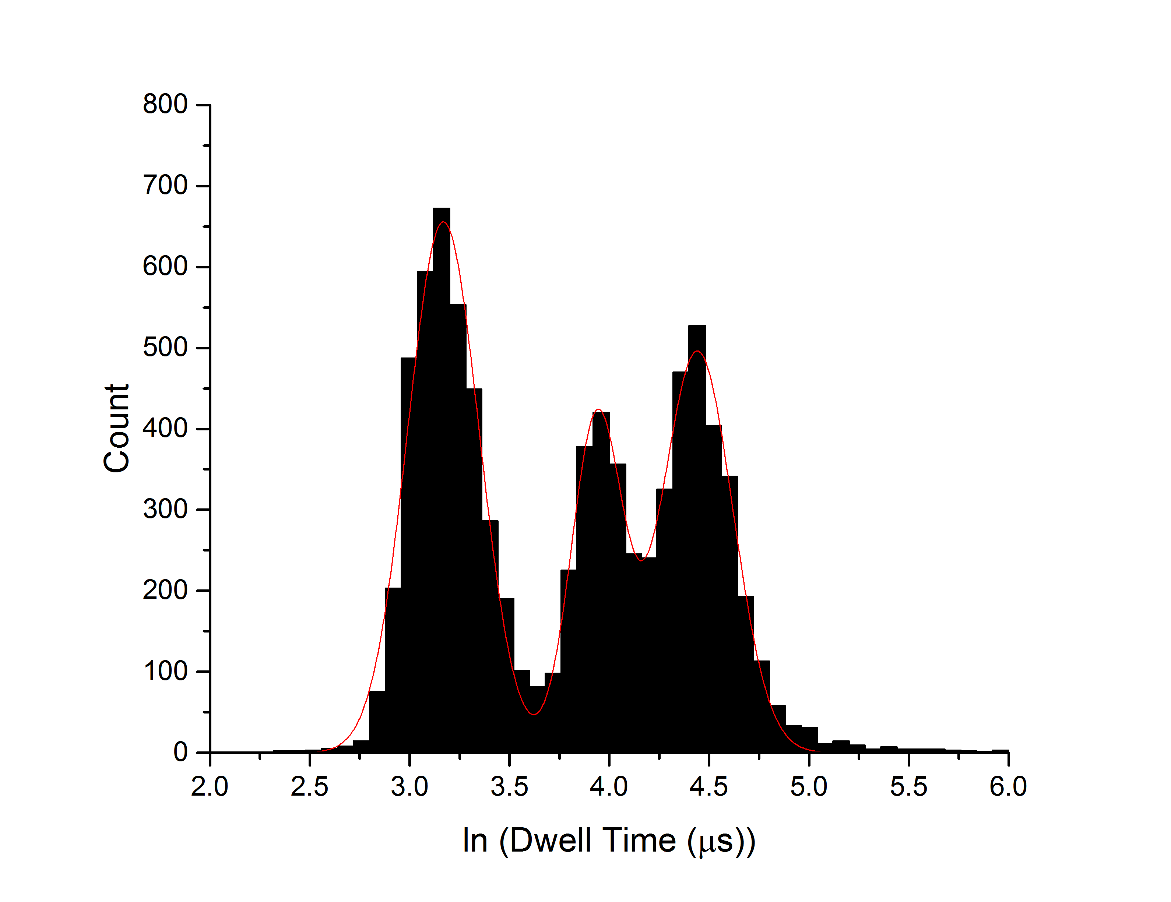
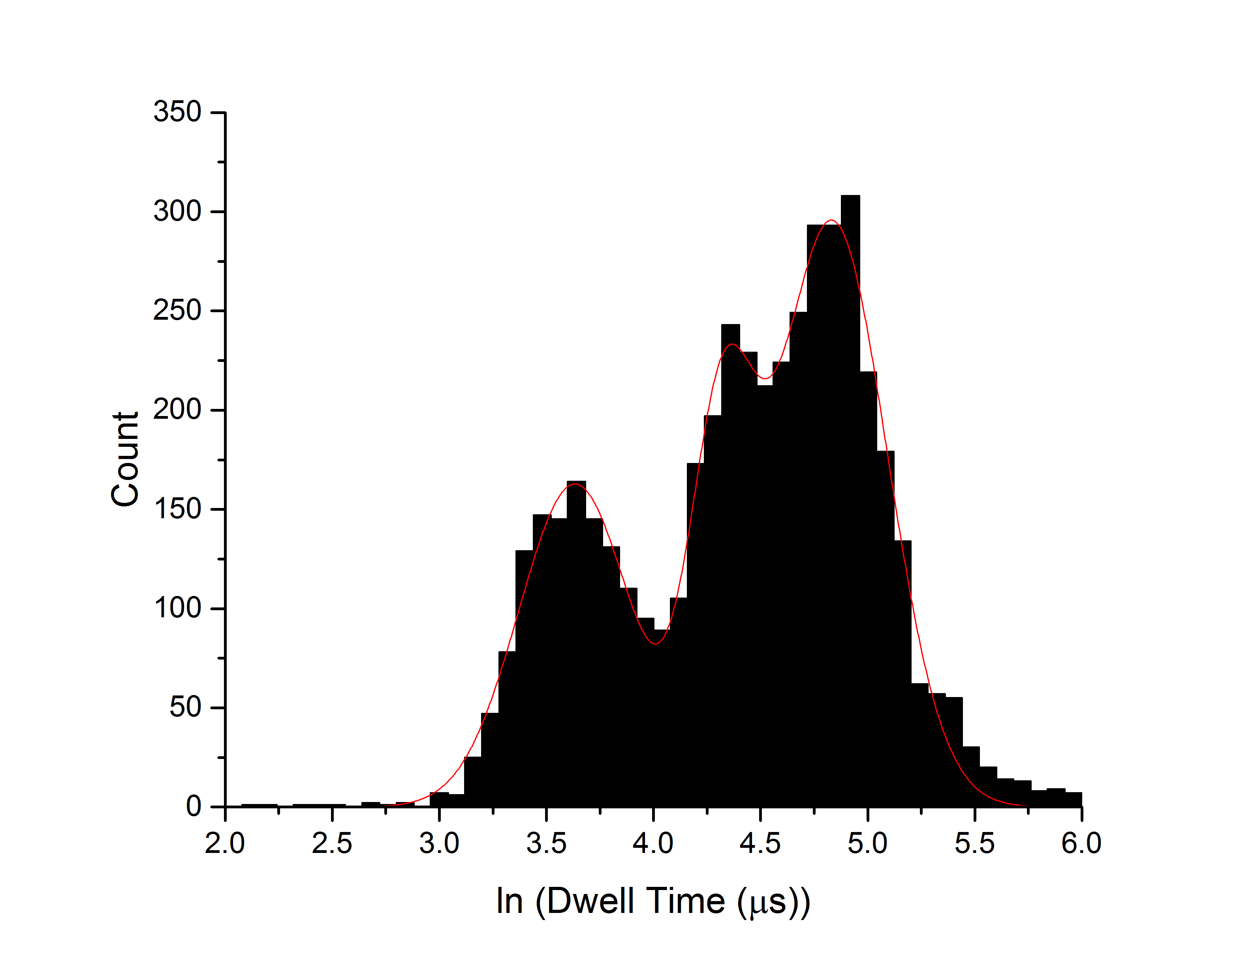
Tenting Separations
500, 1000, 1500 bp ds-DNA
Tent in Place
Tent not in Place
Sharper Resolution
Credit: Kyle Briggs
Notes:
Single-file, unfolded passages of DNA strands

Slide 21
Future – Monolithic Device
Rigid, uniform gap height
50 nm NPN
100 nm
SiO₂
vs
15 nm SiN
Si
Si
Wavy, variable gap height
Notes:
We’ve been running many experiments, figuring out how the tent works

Slide 22
Overall Summary
Integrate different nanomembranes to improve microsystem characteristics
  Protection Regions
  Sensing Regions
  Supporting Regions
Simple miniaturization – small components, not a lot of supporting equipment, low dead volume
Compatible with existing
technology, materials, procedures

Slide 23
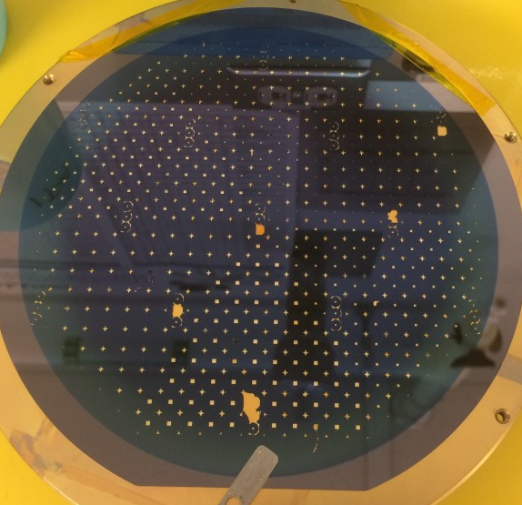
Integrated Nanomembrane Microsystem
10 mm
Flow Sensor
EO Pump
Cell Substrate
Filter A
Filter B
Filter C
Hundreds of microsystems fabricated at once
Notes:
All of these functions lead to my vision of a system where you can control these different functions and integrate them onto a single chip. Micrototal analysis systems, or ‘Lab on a chip’ type systems minaturize and combine all of these applications. Explain image

Slide 24
Funding
University of Rochester WUN Mobility Travel Grant
Whitaker Foundation 2013+2015
NSF:PFI-ATT IIP-1601850

Slide 25

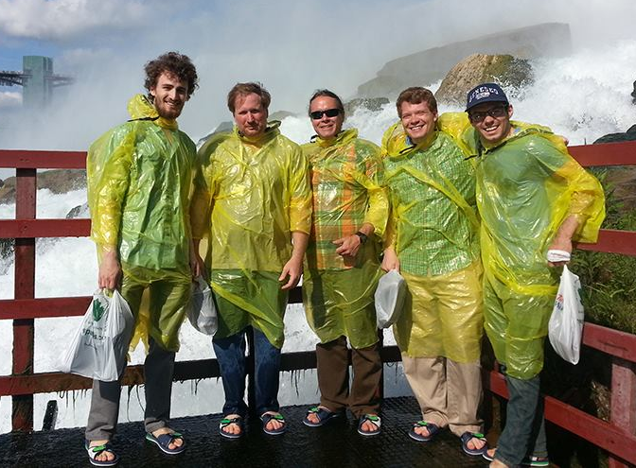

Acknowledgements
University of Rochester
Prof. James McGrath
Dean Johnson, PhD
Tejas Khire
Karl Smith
Tucker Burgin
J.P. DesOrmeaux
Josh Miller
Jamie Roussie, PhD
University of Nottingham
Prof. Kevin Webb
Flavius Pascut, PhD
Emilia Moradi, PhD
RIT
Prof. Tom Gaborski
Henry Chung, PhD
University of Ottawa
Prof. Vincent Tabard-Cossa
Kyle Briggs
URnano – Brian McIntyre

Slide 26
Questions?

