Slide 1
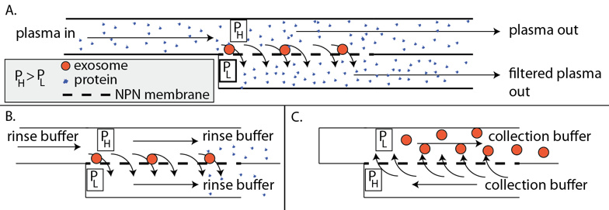
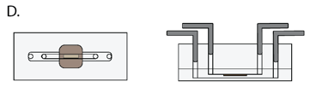
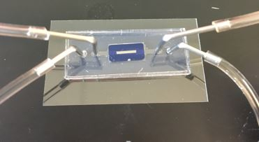
TFF Capture of Exosomes with Ultrathin Membranes
Isolation of exosomes on nanomembranes by diffusion-driven physical sieving in a modified tangential flow device:
(A) Capture stage
(B) Clean-up stage
(C) Collection stage
(D) Schematic of a chip based device with microfluidic access at the inlet and outlet of top and bottom chambers

Slide 2
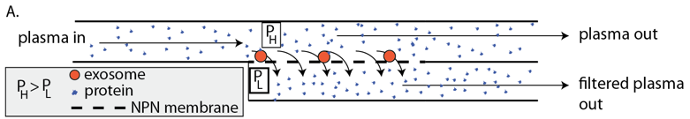
Optimization of TFF Device
30 microliter, 30 minutes
60 microliter, 60 minutes
90 microliter, 90 minutes
120 microliter, 120 minutes

Slide 3
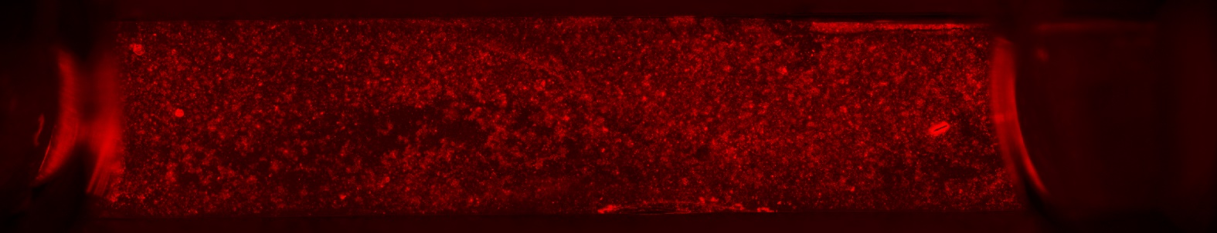
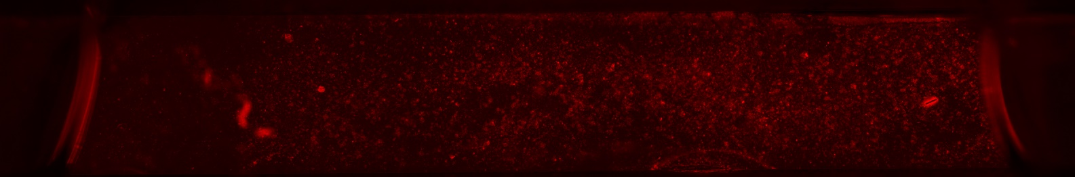
Optimization of TFF Device
Before Washing
Average Intensity: 7.780
After Washing
Average Intensity: 6.265

Slide 4
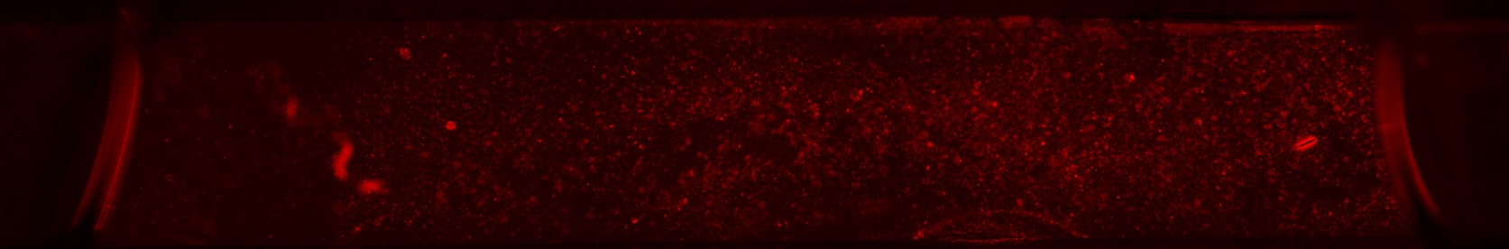
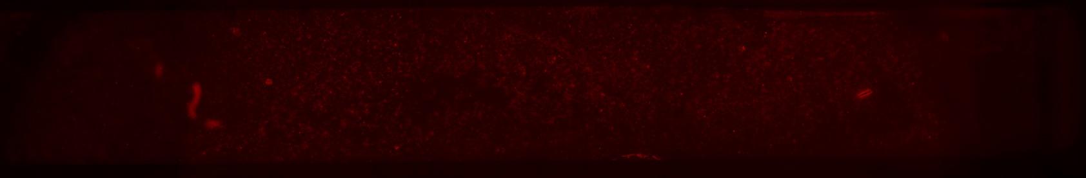
Optimization of TFF Device
Before Releasing
Average Intensity: 6.265
After Releasing
Average Intensity: 5.647

Slide 5
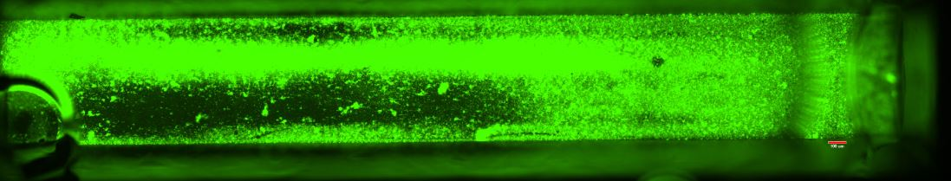
Optimization of TFF Device
Having an air bubble

Slide 6
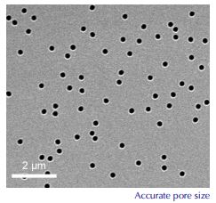
Track Etched Membranes
Verification of our approach: single step tangential flow concept.
Different pore sizes: 10, 50, 80, 100, and larger
Upside down, changing the design
Compare and show advantageous of our membranes over TE membranes
Clamped devices

Slide 7
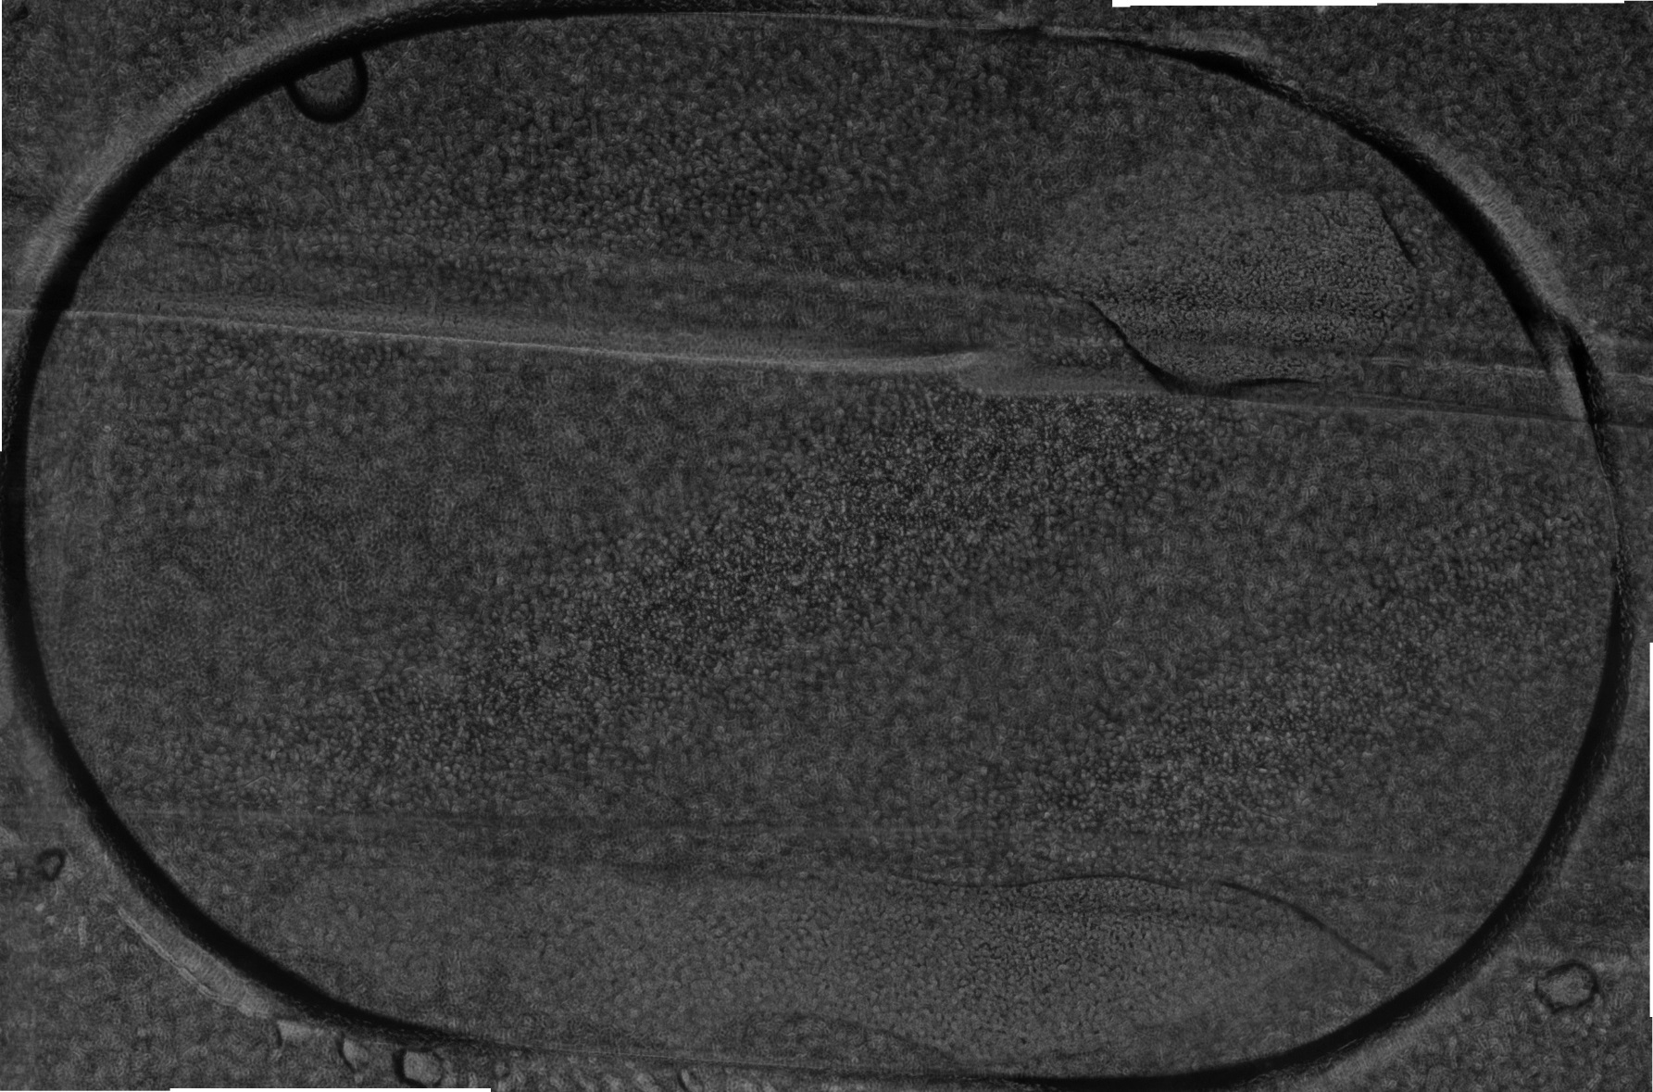
TE membrane

Slide 8
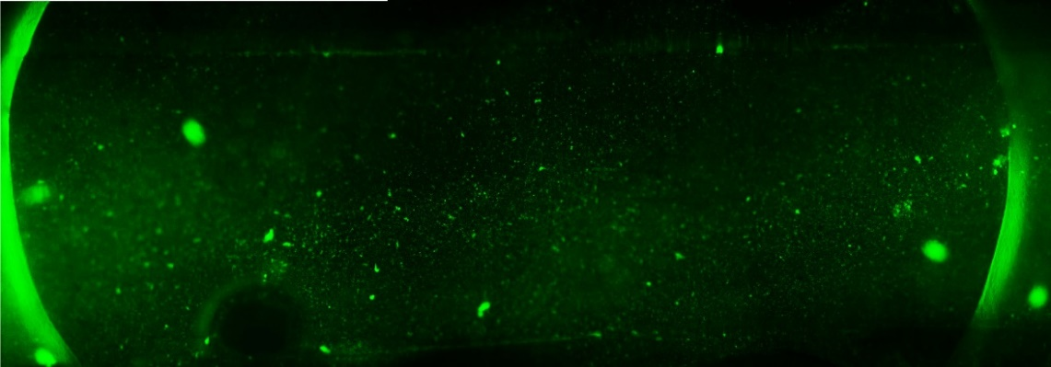
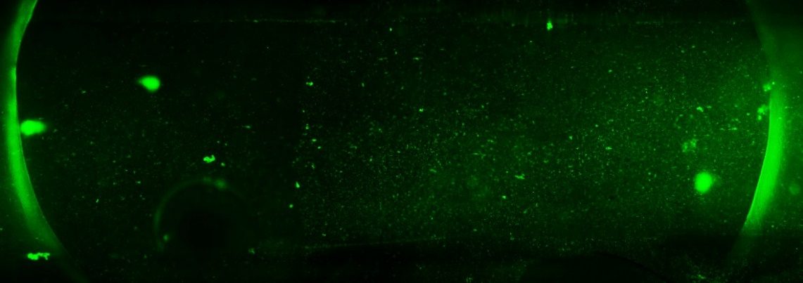
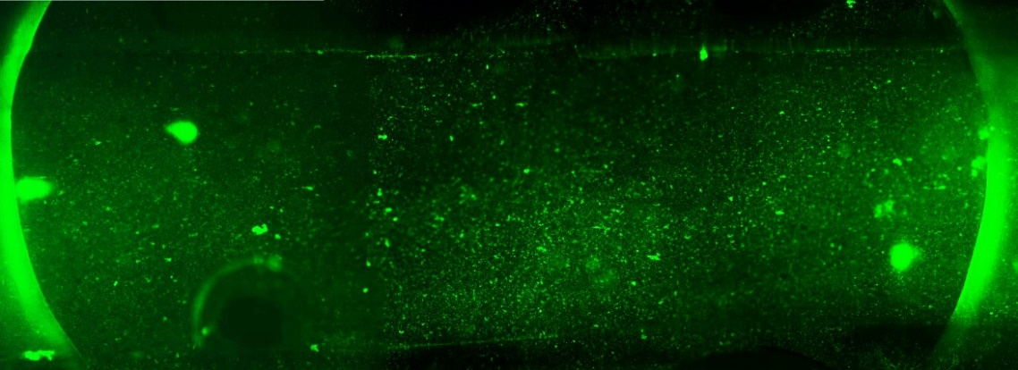
Trapping Step
40 Microliter
Average Intensity: 275.359
60 Microliter
Average Intensity: 291.365
80 Microliter
Average Intensity: 360.944

Slide 9

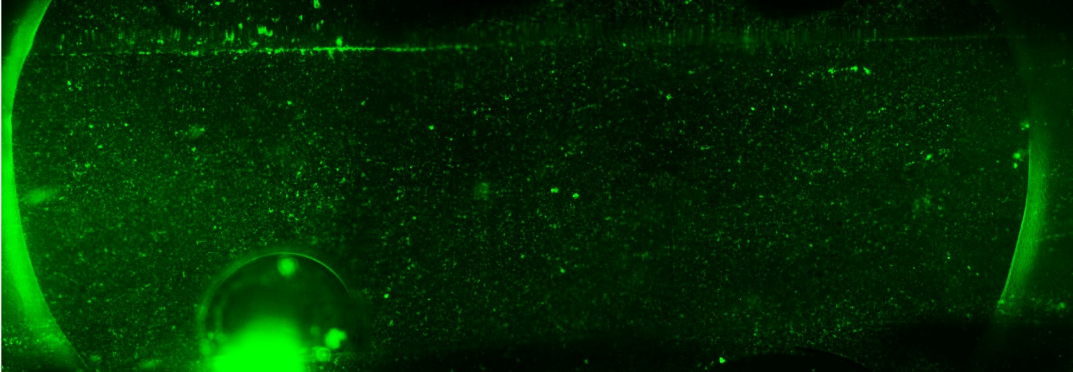
Washing Step
Before Washing
Average Intensity: 360.944
After Washing
Average Intensity: 340.723

Slide 10
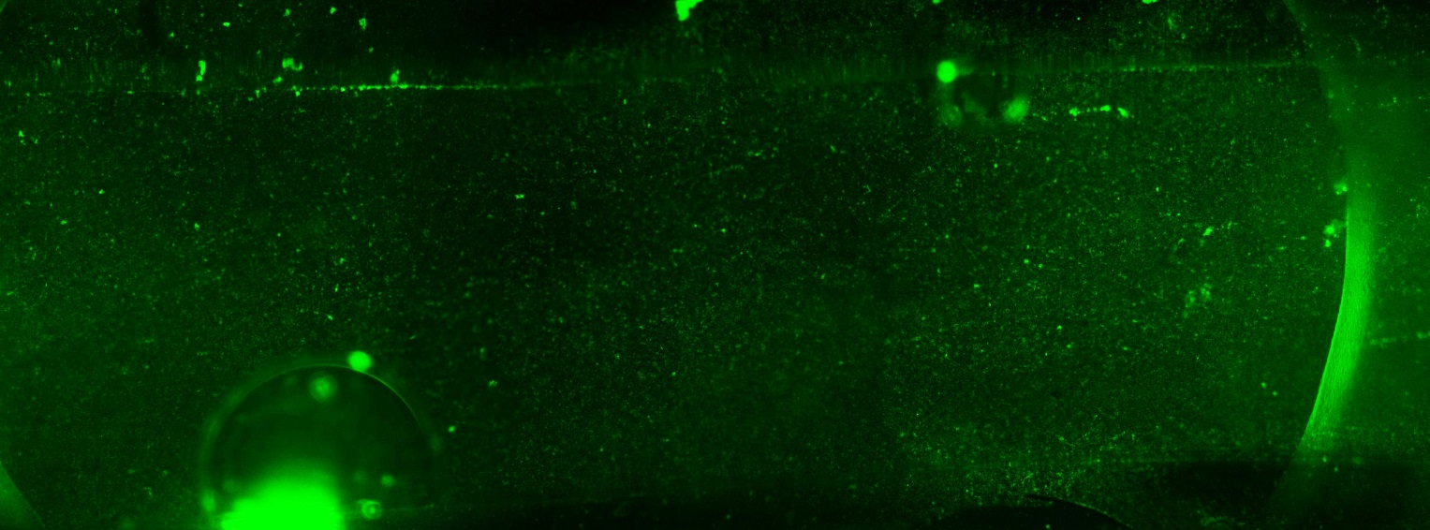
Releasing Step
Before Releasing
Average Intensity: 340.723
After Releasing
Average Intensity: 291.469

Slide 11

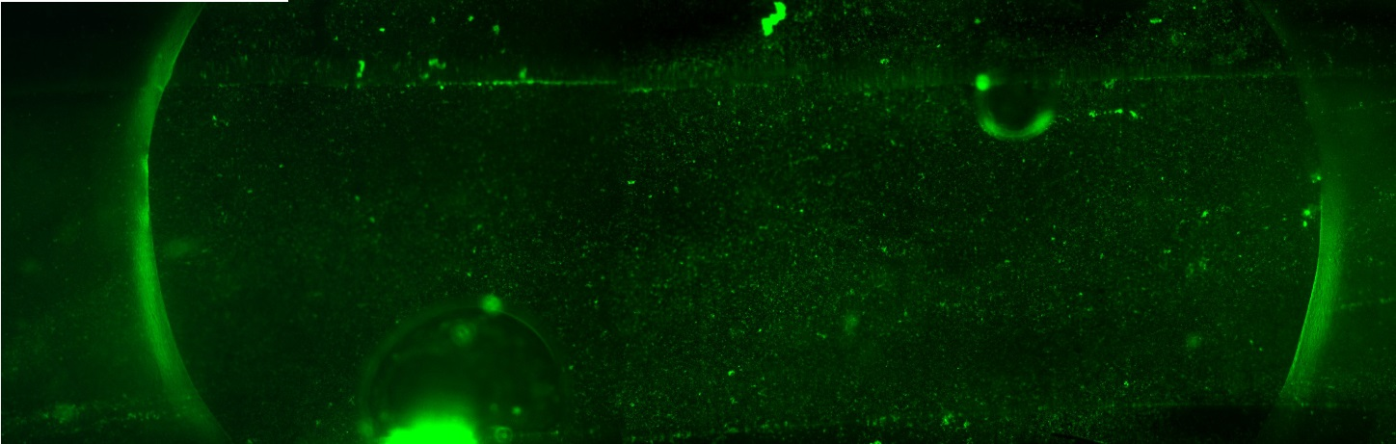
Washing after Releasing
Before Washing
Average Intensity: 291.469
After Washing
Average Intensity: 285.918

