Slide 1
Modelling the multi-step migration of human T cells across the human blood-brain barrier under physiological flow in vitro: Introduction of a novel nanomembrane based flow chamber system
Maria Rosito, Hung Li Chung, Tejas Khire, Adrien Mossu, Isabelle Gruber, Fabien Gosselet, James McGrath, Britta Engelhardt*
*the order of authors and the title is provisional – equal contributions and correspondence need to be discussed.
Paper draft

Slide 2
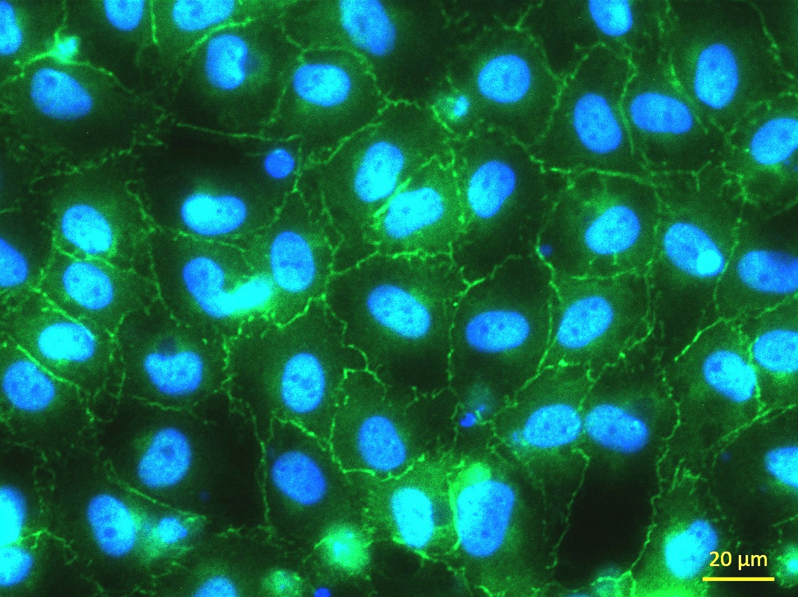
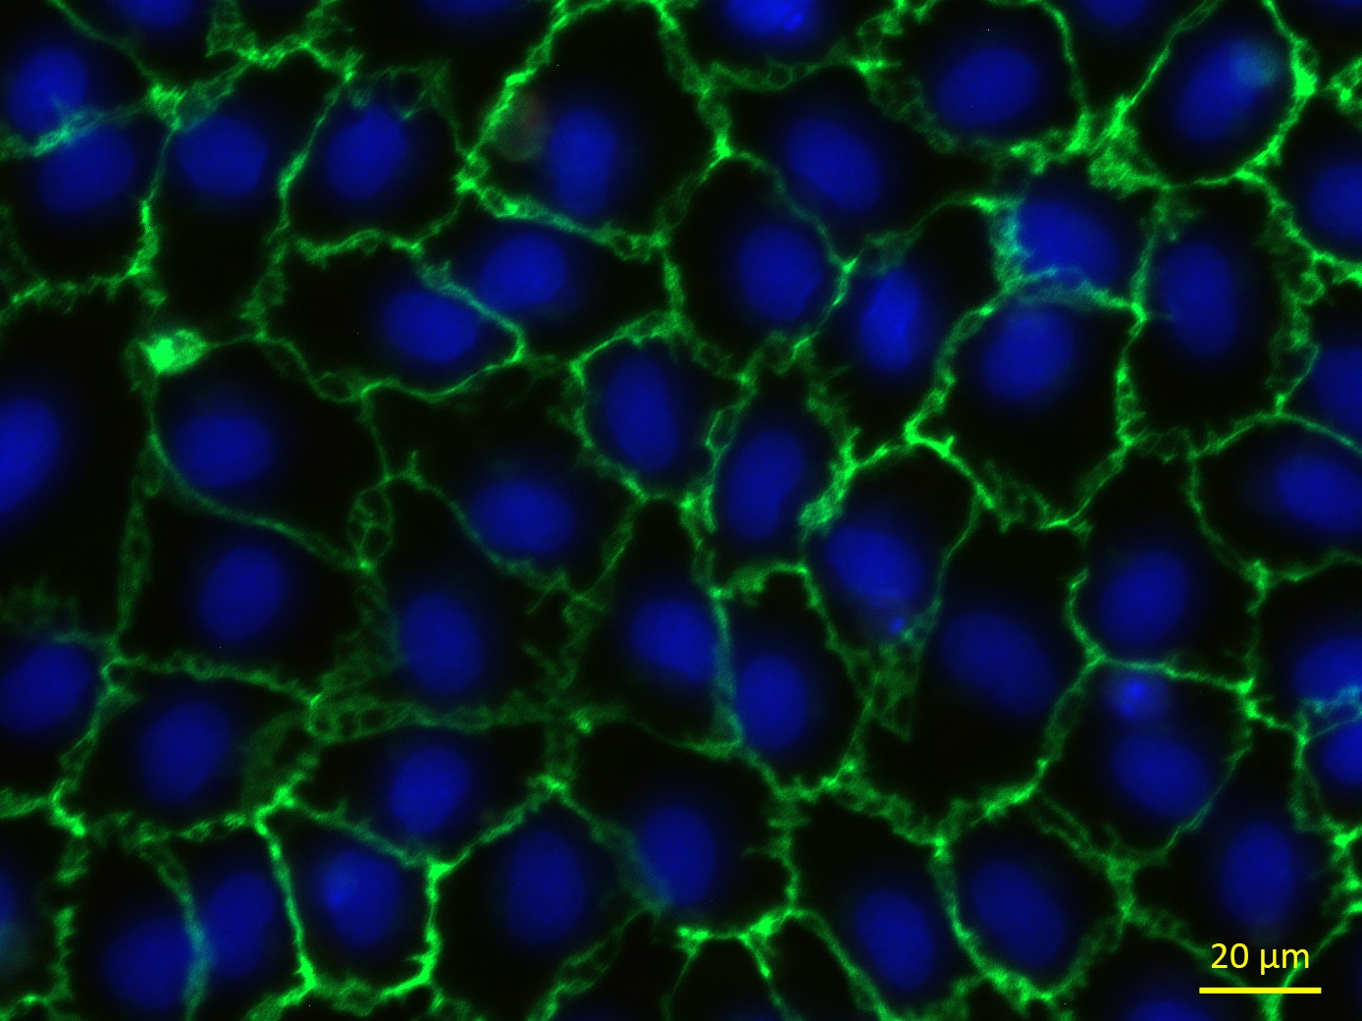
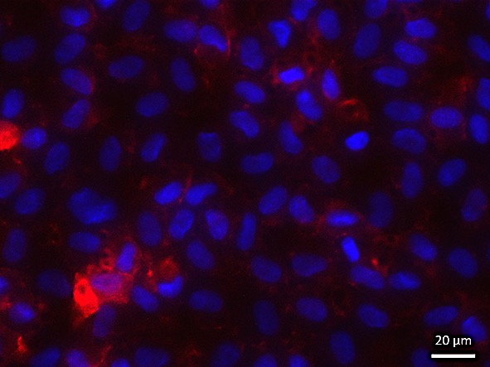
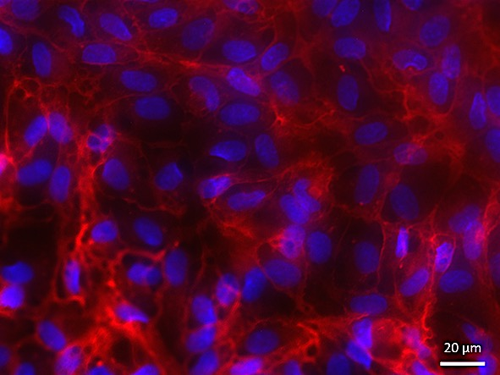
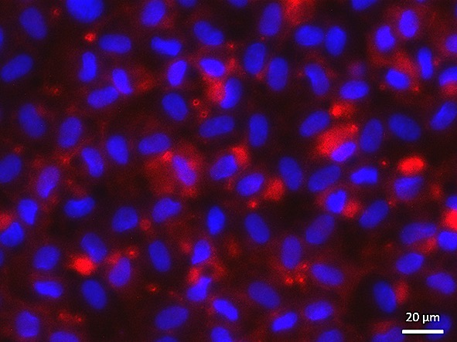
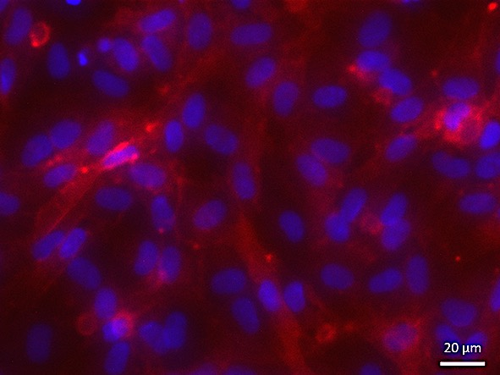
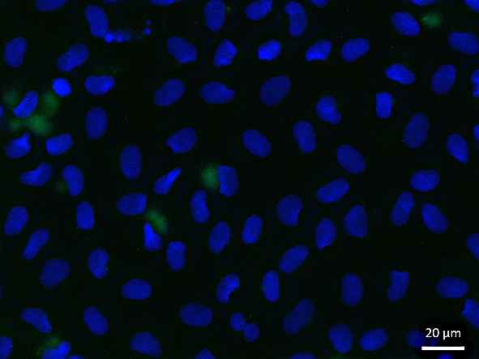
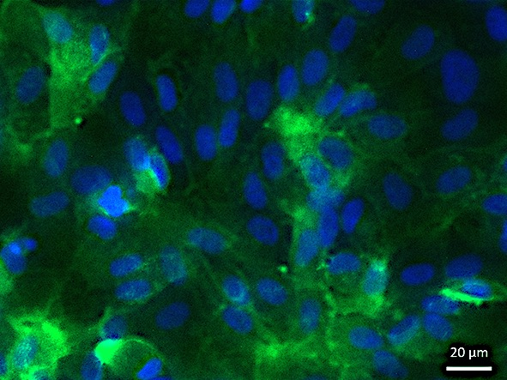
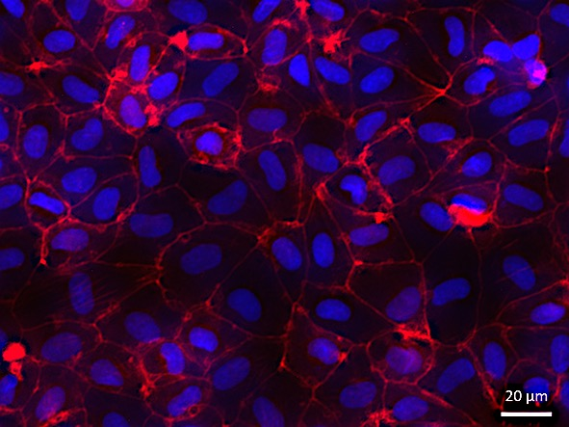
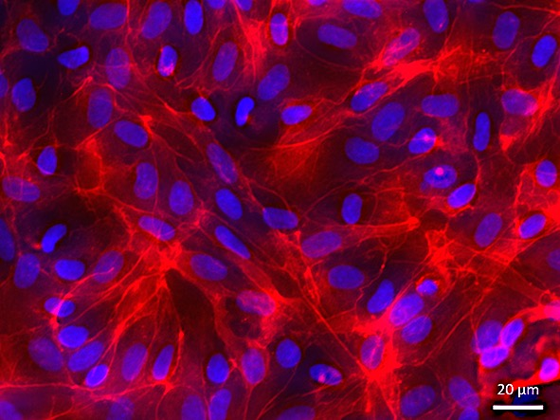
Immunofluorescence staining of the BLECs in the transwell mimetic
B
Unstimulated
TNFa
A
ZO-1
VE-Cadherin
ICAM-1
ICAM-2
VCAM-1
F-actin
Engelhardt lab to describe

Slide 3
Outlet tubing
Inlet tubing
300 µm
Flow turbulence
flow
Flow rate calculation ?
300 µm
?
300 µm
Is there a flow turbulence on top of the cells with this configuration ?
Is the flow rate calculation right considering that the height of the chamber is changing from 300 µm to 900 µm?

Slide 4
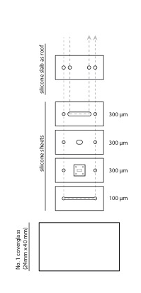
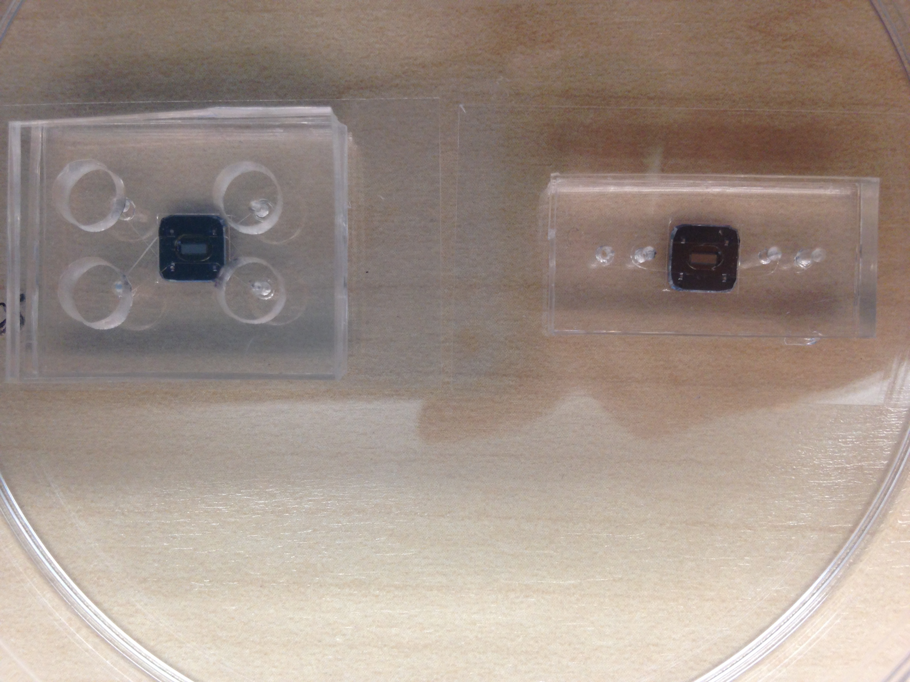
Parcel n° 1
Width =2mm
Height = 300 um suggested
Movie n°1_151209_ 10x: accumulation phase 0,028 ml/min
min 5: increased flow rate: 0,417ml/min
Movie n° 2_151209_20x: same chamber flow rate : 0,417ml/min
Parcel n° 5
Width =2mm
Height = 300 um suggested
Movie n° 3_ 160920_20x: movie staterd with 0,1 min/ml
min 3,5: 0,0216 min/ml (Accumulation phase 0,1 dyne/cm²)
min 8: 0,2 min/ml
min 8,75: 0,324 min/ml (supposed to be the 1,5 dyne/cm² with the hight at 300um)

Slide 5
Parcel n° 6
Width =2mm
Height = 900um suggested
Movie n°4_160908_ 20x: movie started with 0,194 min/ml
min 1,5: increased flow rate : 2,92 ml/min (Immediate vacuolization of the cells)
min 2 Reduction of the flow rate to 0,028 ml/min
min 11 increased flow rate to 0,417 ml/min (again vacuole formation)
Movie n°5_160920_ 20x: movie staterd with 0,1 min/ml
min 3,5: 0,0216 min/ml (Accumulation phase 0,1 dyne/cm²)
min 8,5: 0,2 min/ml
min 10,2: 0,324 min/ml (supposed to be the 1,5 dyne/cm² with the hight at 300um)

Slide 6
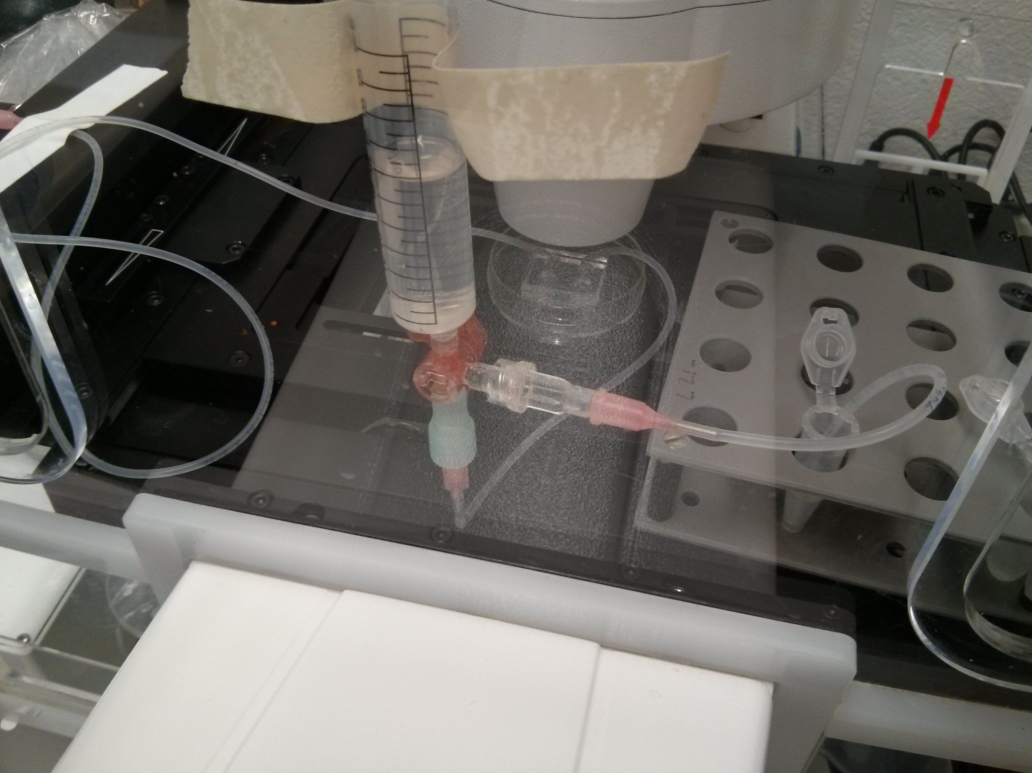
Flow chamber setup
medium reservoir
T cells reservoir
Three-way tap

Slide 7
Flow rate calculation (adapted from Coisne et al. Fluids and Barriers of the CNS 2013 )
The flow rate is calculated according to the formula (1):
μ (dynamic viscosity) = 0.083 dyne*sec/cm² (DMEM, 5% calf serum at 37°C (2));
Q (flow) = variable value to be controlled by the pump in cm³/sec;
(half height of chamber) = 0.015 cm;
(width of chamber) = 0,2 cm.
Aspiration of T cells from a reservoir via the inlet tubing is performed at 1.5 dyne/cm² until the T cells appear in the field of view. T cell interaction with the endothelial surface occurs during the accumulation phase, which is started by a reduction of flow to 0.1 dyne/cm². This allows settling of the T cells on the endothelial surface, which due to the size of the flow chamber only occurs under reduced shear conditions.
Lawrence MB, Smith CW, Eskin SG, McIntire LV: Effect of venous shear stress on CD18-mediated neutrophil adhesion to cultured endothelium. Blood 1990, 75:227–237.
Moreira JL, Santana PC, Feliciano AS, Cruz PE, Racher AJ, Griffiths JB, Carrondo MJ: Effect of viscosity upon hydrodynamically controlled natural aggregates of animal cells grown in stirred vessels. Biotechnol Prog 1995, 11:575–583.

