Slide 1
Overview...
TWO papers:
“Preliminary Diffusive Clearance of Silicon Nanopore Membranes in a Parallel Plate Configuration for Renal Replacement Therapy”
Extracorporeal pig study
Mechanical robustness
Flow profile
Hemocompatibility
Diffusive clearance
“First Implantation of Silicon Nanopore Membrane Hemofilters”
Implantation
Dog trial

Slide 2
Paper I - Introduction
Authors present their technology as an alternative to hollow fiber dialyzers, citing issues with flow distribution, biocompatibility, fluidic resistance, and size-based selectivity.
They cite Ahmadi and Johnson’s implementations of SiMPore membranes…
“
Recently, Ahmadi et al. and Johnson et al. used flat MEMS-based ultrathin porous nanocrystalline silicon membranes from SiMPore (West Henrietta, NY) to investigate in vitro clearance of small molecules and hemocompatibility using a single parallel plate configuration. These flat membranes had average circular pore sizes of 5 and 20 nm with a membrane thickness of 30 nm. They were able to show clearance of small solutes over a total membrane area of 3 mm². The main limitation was fragility of the membrane requiring testing at very low flow rates (82.5 μl/min) and static dialysate to avoid mechanical failure.

Slide 3
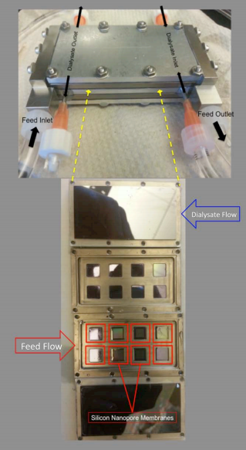
Paper I - Device
6 cm
3 cm
Non-porous silicon

Slide 4
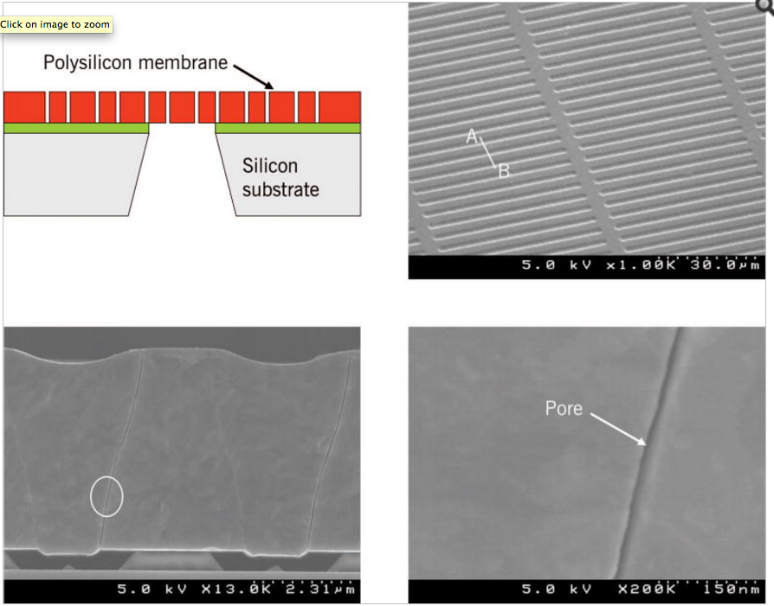
Paper I - Chips
300 nm in this paper
Surface modification
Piranha → Toluene → PEG → Rinse
“Coating thickness was sub-5 nm”
Chip dimensions
10 mm squares
Effective membrane area 0.216 cm²
Burst pressure
1448 mmHg (28 psi)
Pore dimensions
4.5 um x 10 nm

Slide 5
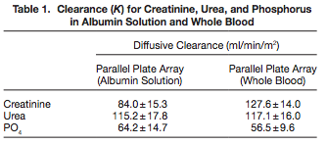
Paper I - Benchtop Experiment
Predicted surface area-, flow rate-, minor-axis pore size-, and channel height-matched SiMPore Dialyzer
803
857
829
Low PO₄ clearance indicative of native phosphate in dialysate
“
The change in concentration using single-pass measurements was below the level of detection because of the high flow rate indicating that diffusive clearance was no longer dependent on flow rate.

Slide 6
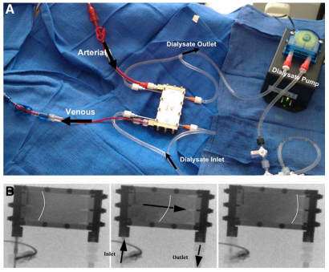
Paper I - Animal Experiment
Four-hour pig study
No data on clearance of toxins or the like reported
Absence of blood pump -- device ran entirely on animal’s AV pressure drop
Animal was heparinized prior to experiment; no clotting was observed afterwards

Slide 7
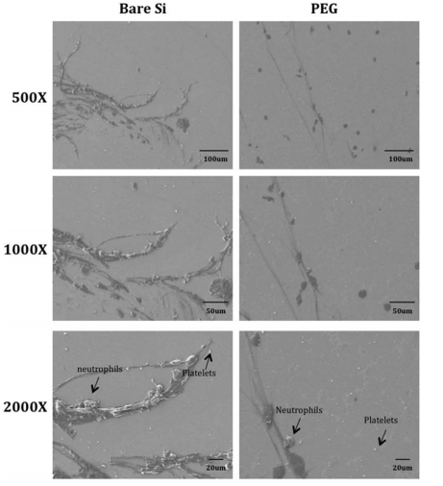
Paper I - Hemocompatibility
Following pig experiment
Fluorescence assay for adhesion of neutrophils and proteins
“
Bare silicon surfaces had a 4.1-fold increase in fluorescent intensity for [tissue plasminogen activator] and a 1.8-fold increase in fluorescent intensity for CD41 compared with PEG-coated surfaces.

Slide 8
Paper I - Discussion
“
What this says to me: “we have no advantage over traditional hemodialysis membranes”
The clearance values are comparable with current commercial polymer hollow-fiber membranes at low blood flow rates (200ml/min) when normalized to surface area
“
Fissell is only considering Kt/V and albumin retention in this paper
For comparison, we can do this with a single membrane (~10 cm²)
A potential wearable artificial kidney device that is used daily for 8 hours would require a minimum sp (single pool) Kt/V of 0.34 per treatment (V = 35 L) to achieve a weekly std (standard) Kt/V of 2.0. Based on the presented clearance values for the SNM, we would require a total of 0.21 m² surface area. This would result in a device about the size of a coffee cup with approximately 25–30 stacked parallel plates each with 10×8 cm membrane area.

Slide 9
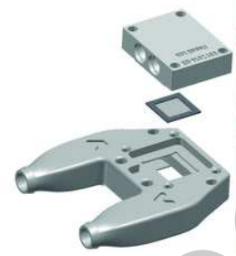
Paper II - Dog Experiment
“
Study of a dog trial at n = 6
Device is a hemofilter
Purpose of the study was to evaluate feasibility of device implantation
5- and 8-day implants (both n = 1) began leaking albumin
Other four animals’ devices behaved as expected
No thromboses
In an uncontrolled pilot study, silicon filters were implanted in six Class A dogs. Cartridges were connected to the cardiovascular system by anastamoses to the aorta and inferior vena cava and filtrate was drained to collection pouches positioned in the peritoneum.

