Slide 1
Non-fouling monomolecular coating on nanoporous membrane materials
Professor Alexander Shestopalov’s Group

Slide 2
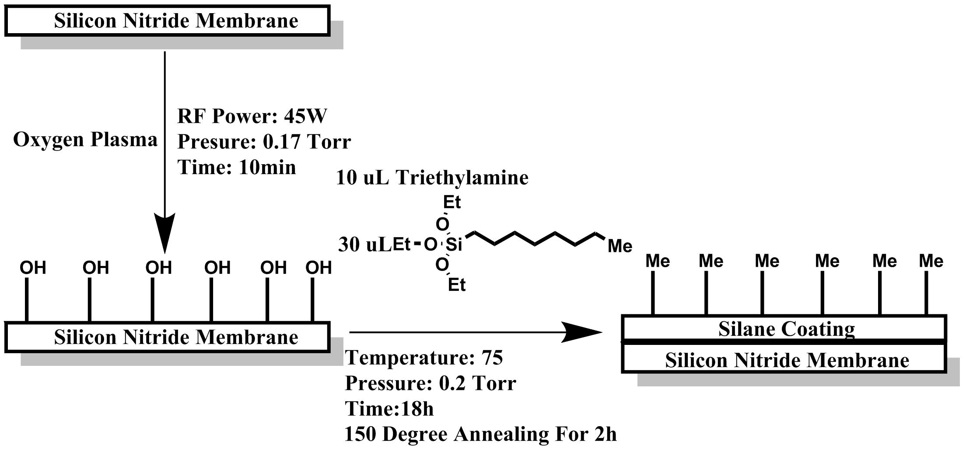
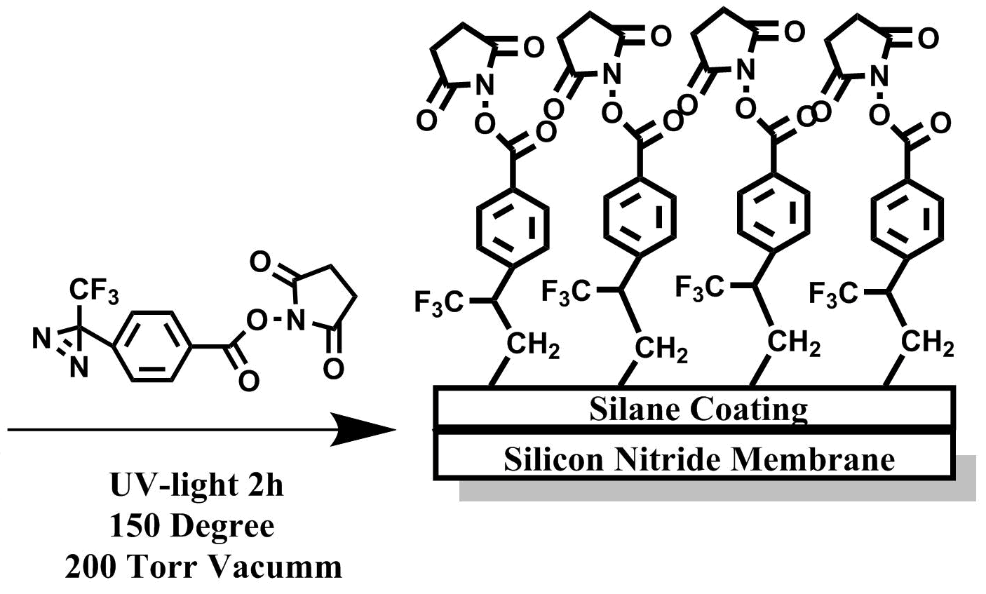
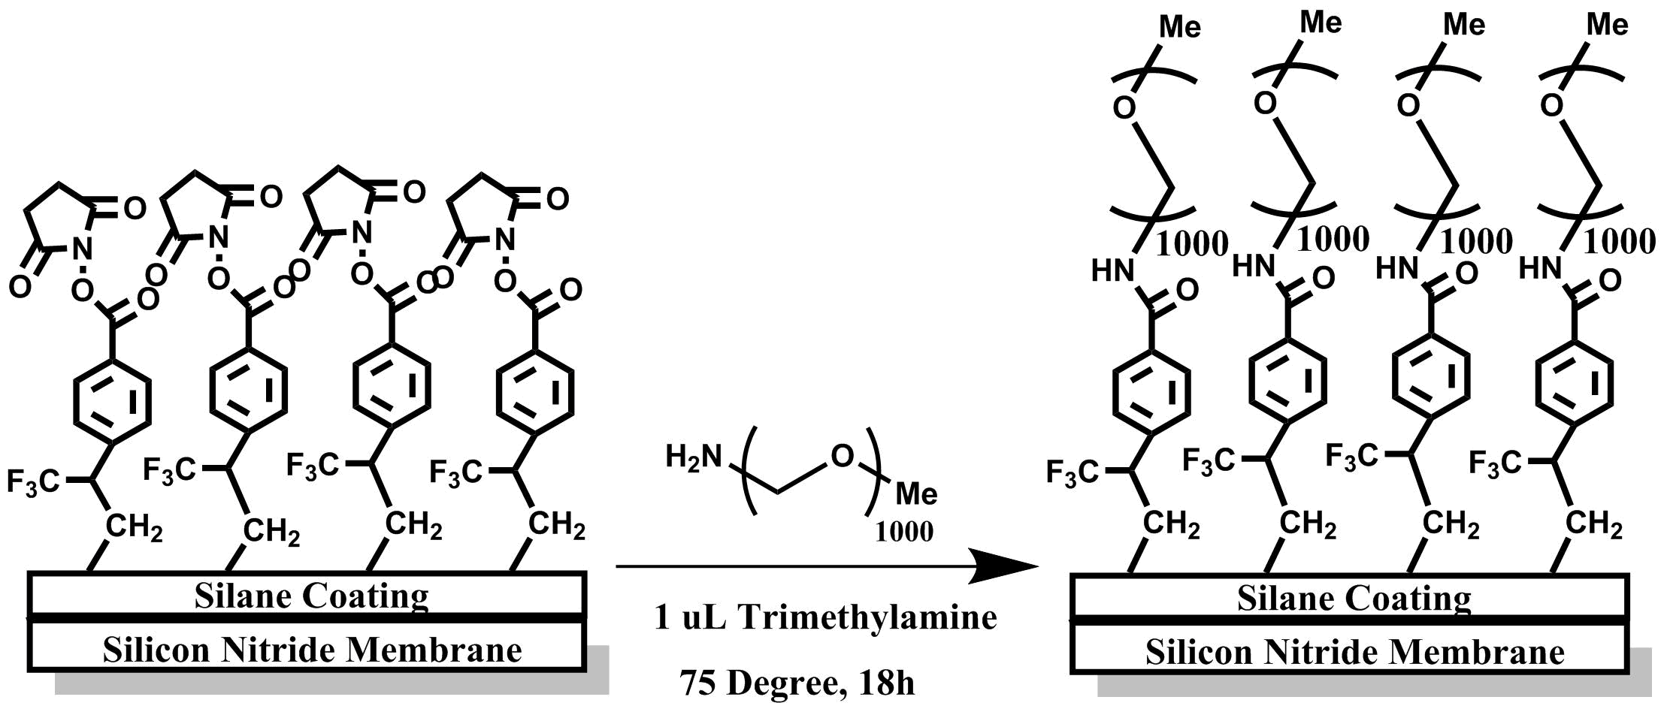

Slide 3
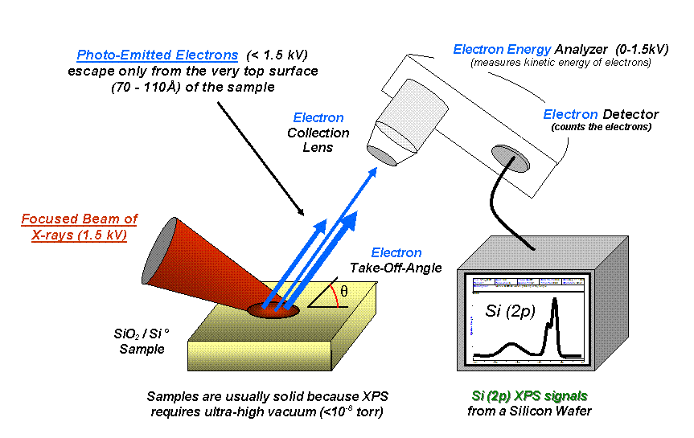
Introduction to XPS
X-ray photoelectron spectroscopy
Wikipedia

Slide 4
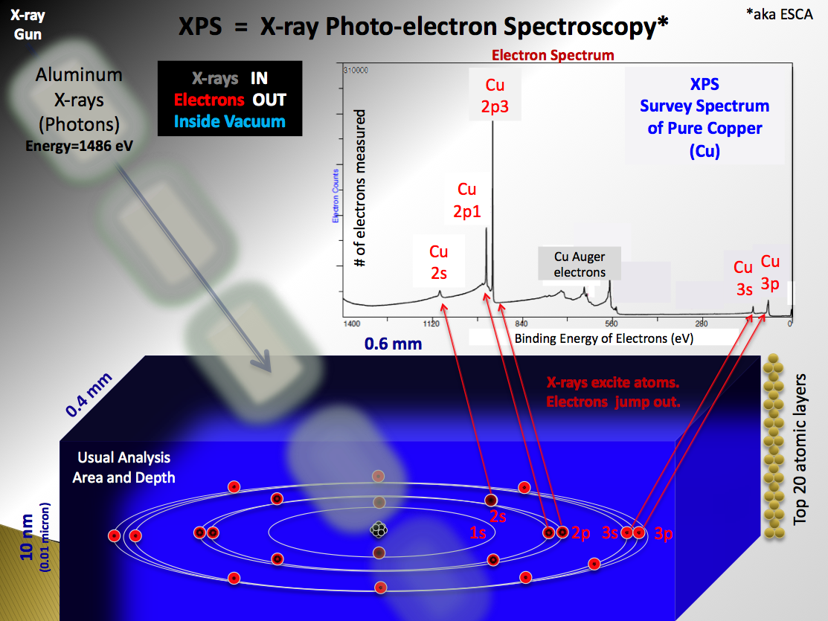
Wikipedia

Slide 5
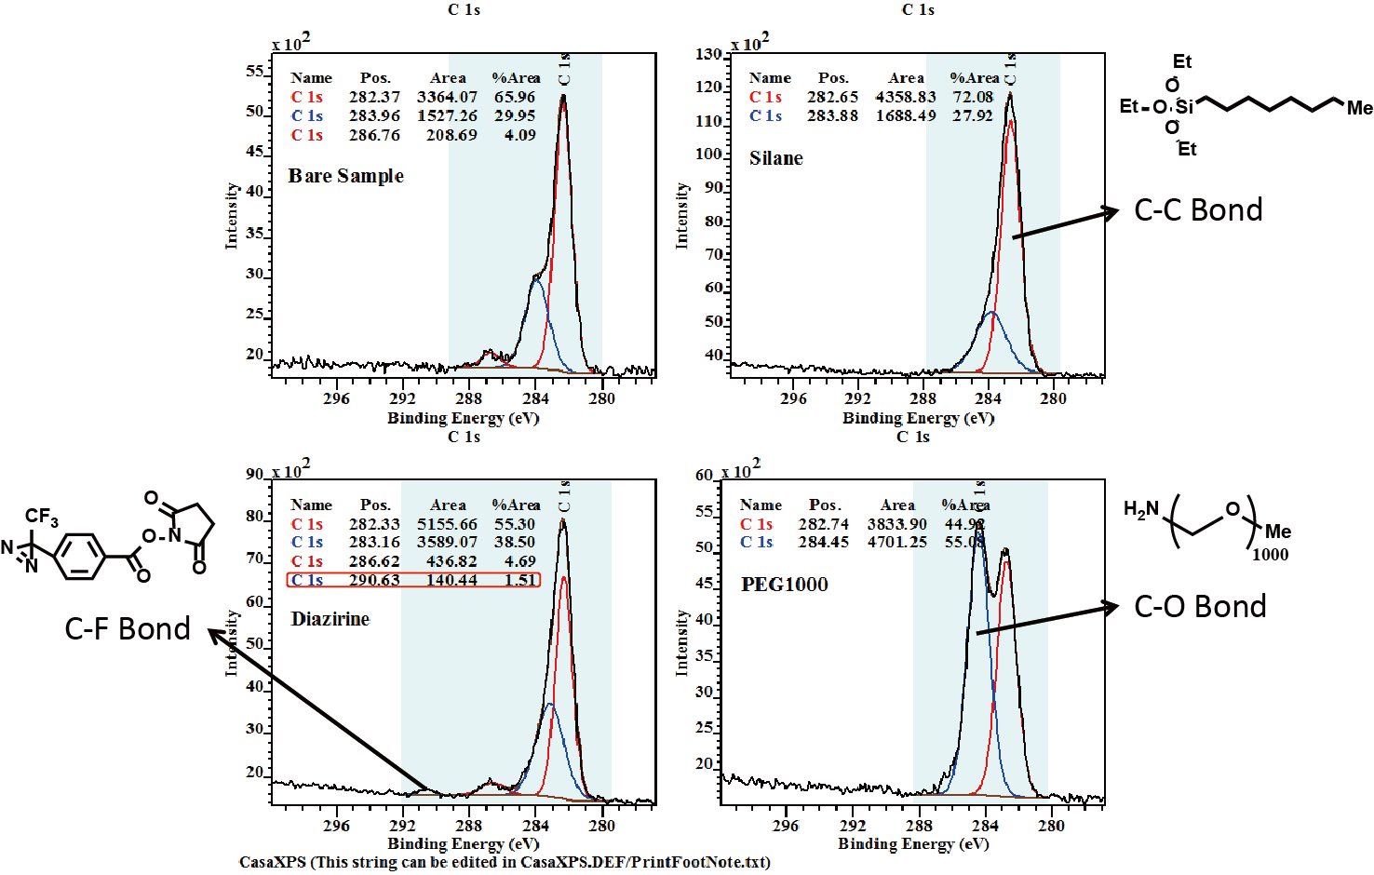

Slide 6
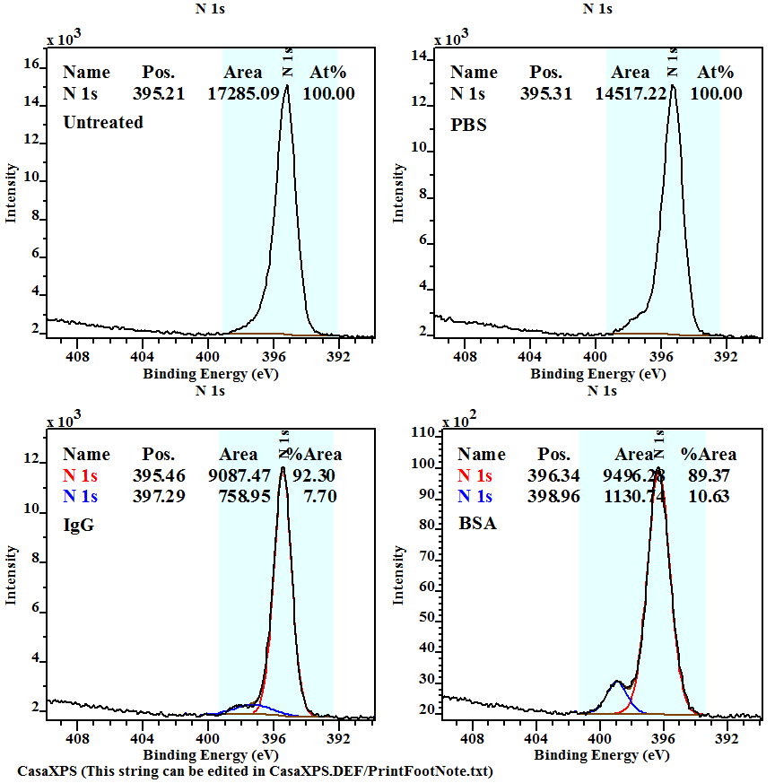
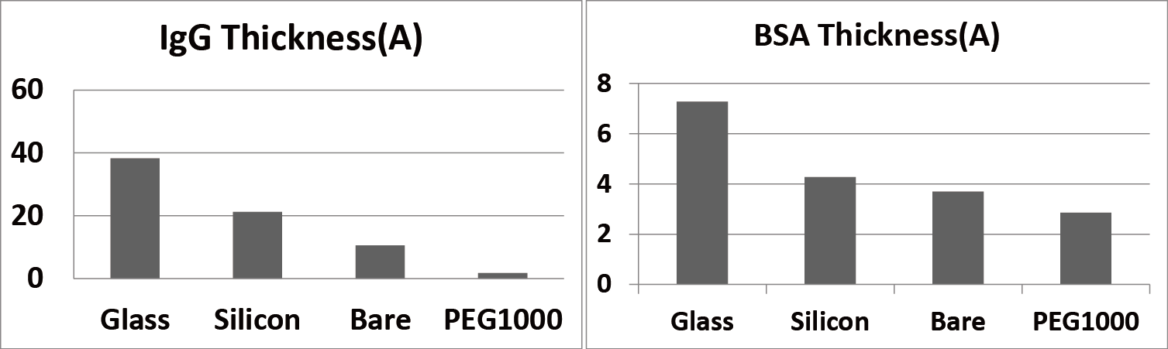
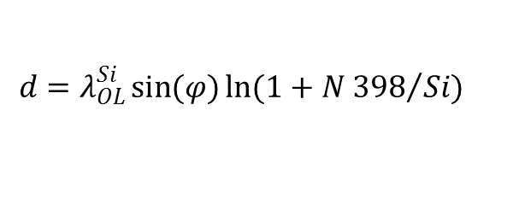
Protein Adsorption Test
$$d=λ_{OL}^{Si}\sin{(φ)}\ln{(1+{N 398}/{Si})}$$

