Slide 1
Journal Club
NRG
02/19/2015
Tejas Khire

Slide 2
Trans epithelial electrical resistance (TEER) is the net measured impedance offered by the cells.

Slide 3
Alternative representations
More complicated models available to include multiple parameters in the system
What TEER box (Volt-ohm meter actually measures!)
A low frequency AC implies
X_{c} = 0 and Z = R_{c}- R_{o}

Slide 4
Analytical model
Membrane Area = 0.1 cm²
Membrane only
Cell only

Slide 5
Results

Slide 6
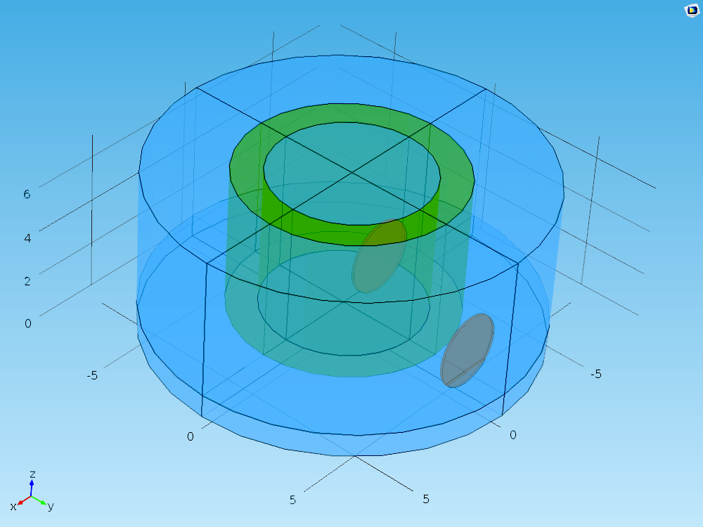
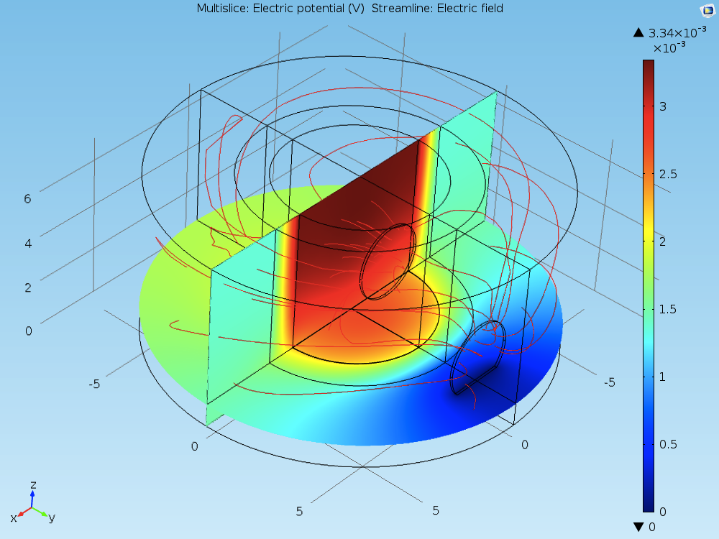
Multiple parameters influence the electric field distribution
What is the obsession with area multiplication ???

Slide 7
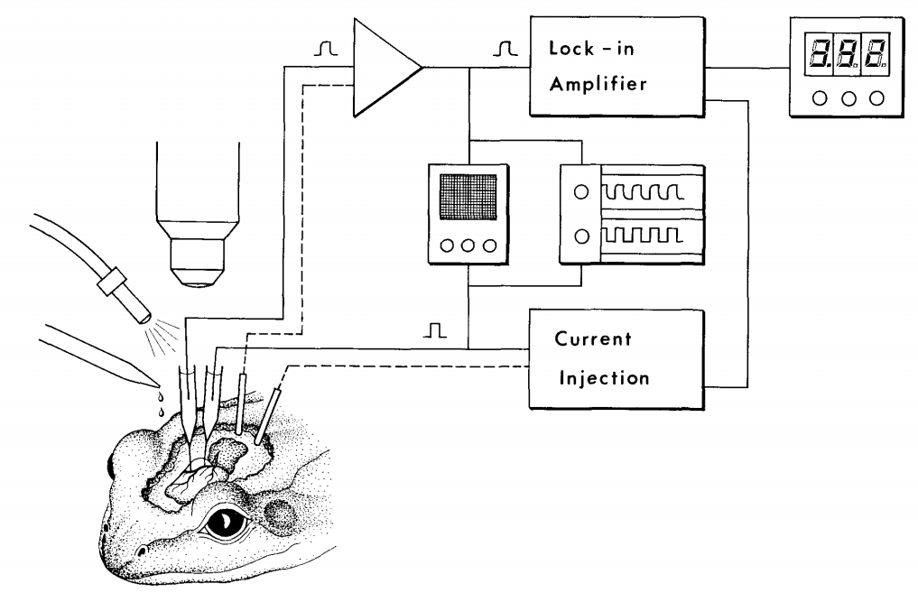
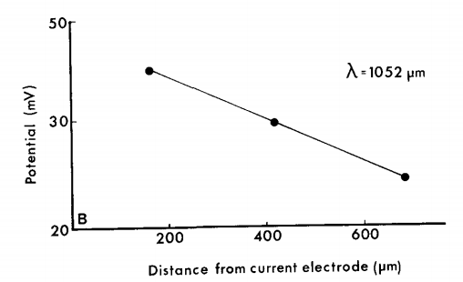
In vivo measurements

Slide 8
Proposed approach

