Slide 1
The Testing of Electro-Osmotic Pumping against Back Pressure
by
Jirachai Getpreecharsawas

Slide 2
Objective
To test the capability of nano-pore membrane in generating the electro-osmotic pumping against a range of back pressures under a limiting condition to avoid gas evolution in Ag/AgCl electrolytic cell

Slide 3
Overview
The electro-osmotic (EO) pumping is tested against a range of constant back pressures.
The EO testing device is based on an Ag/AgCl electrolytic system in which 100 mM of NaCl(aq) is used as electrolyte in this experiment.
Theoretically, the applied voltages need to be below 700 mV to avoid bubble formation at the concentration of 100 mM.
An adjustable voltage source is used to apply a constant voltage across the cell, while the current is being monitored throughout the experiment.

Slide 4
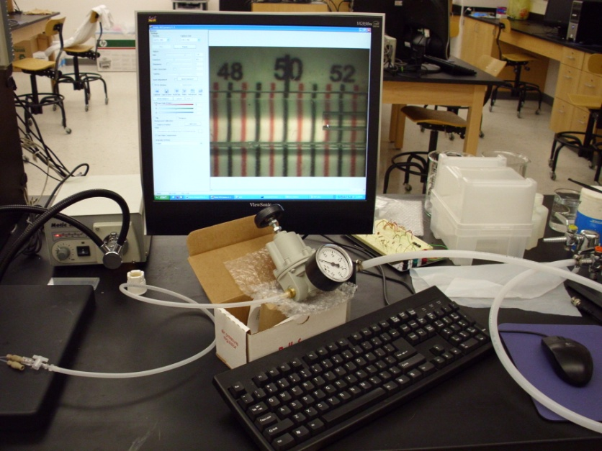
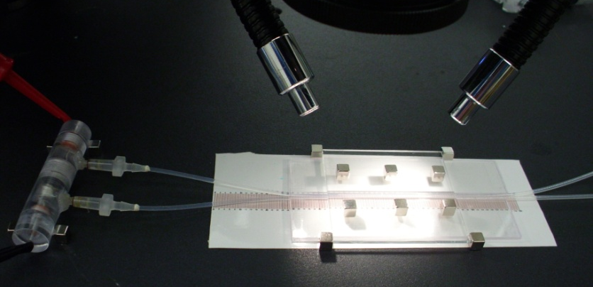
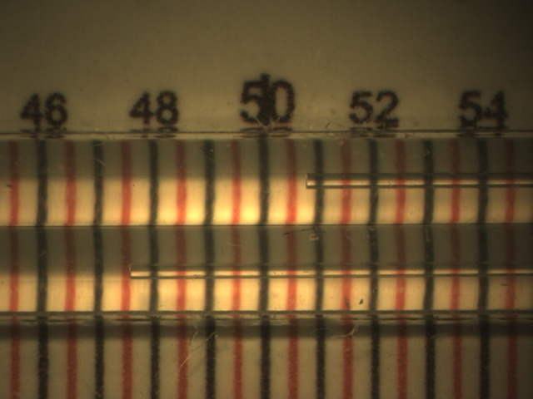
Experiment Setup
A precision air pressure regulator is used to supply a constant back pressure.
Tubing with 250 µm in diameter (49 nL/mm) allows low flow rates to be visually monitored comparing to that with 500 µm (196 nL/mm).
The flows in both tubes are monitored under a microscope.

Slide 5
Procedures
Turn on and adjust the air pressure regulator, and measure the rate of pressure-driven flow
Turn off the regulator, apply the voltage, and measure the EO flow rate
Then turn on the regulator to apply the back pressure and measure the flow rate
Finally, stop applying the voltage, and measure the pressure-driven flow again to compare with the previously measured
Repeat the steps for each value of the back pressure
Note: The omission of EO flow rate verification at the end of each experiment is due to a significant drop in the current during the test.

Slide 6
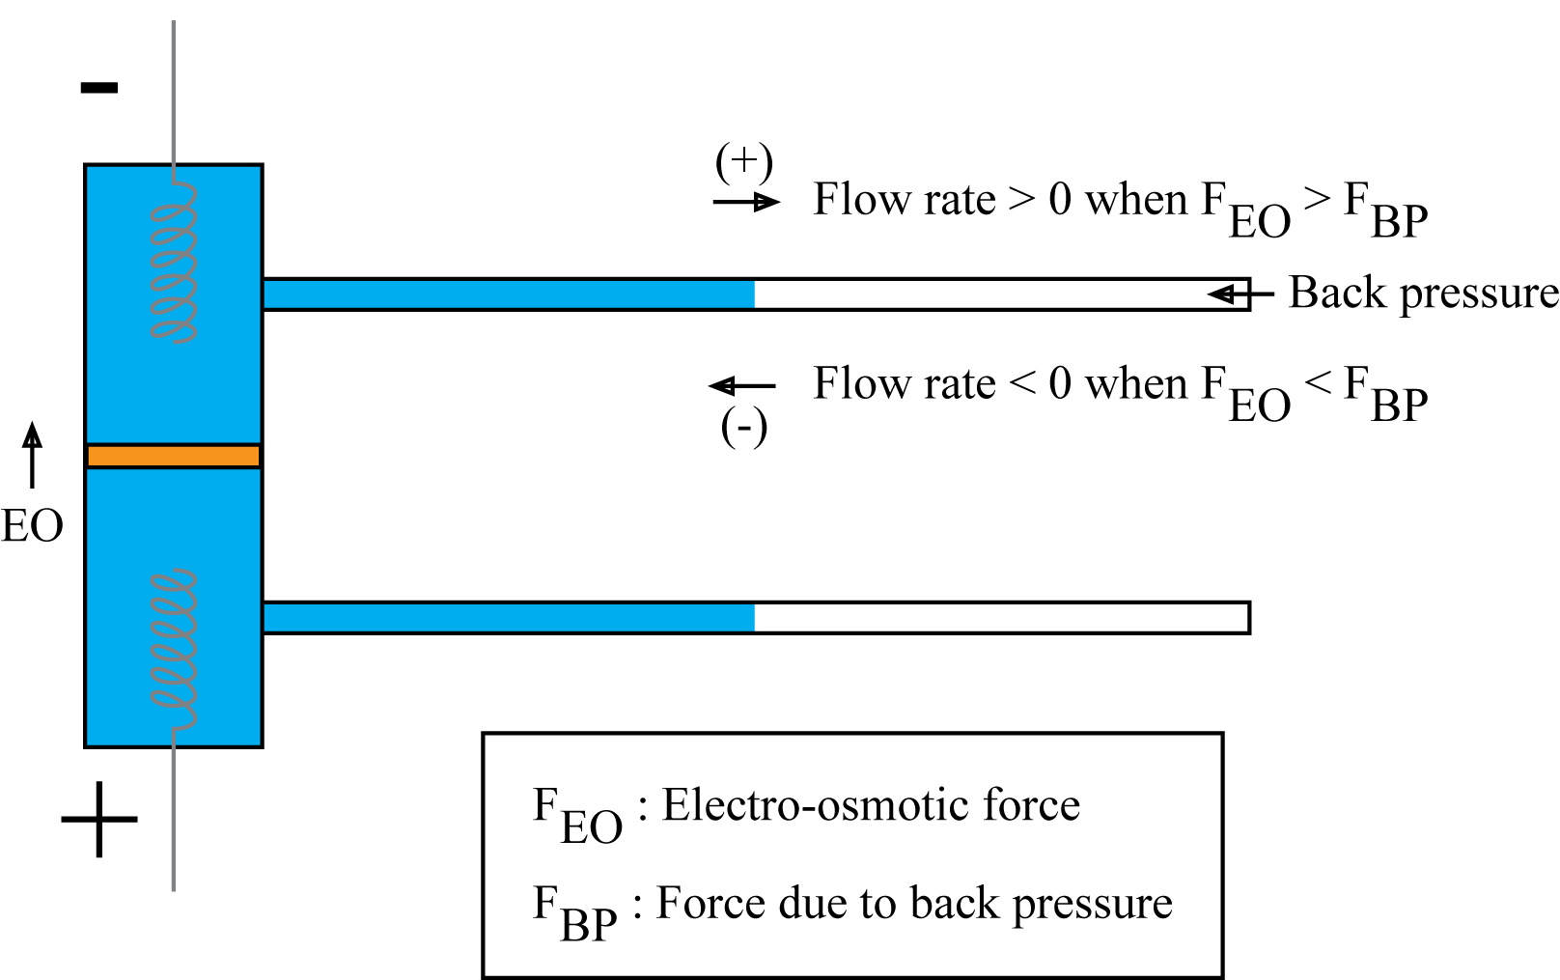
Table 1: Flow rates at various back pressures and applied voltages
Tube diameter = 500 µm
Flow rate (nL/min) |  | Pressure (psi)
 |  | 0 | 0.05 | 0.1 | 0.15 | 0.2 | 0.25 | 0.3
Voltage (mV) | 0 | 0 | -21.55 ± 7.22 | -186.24 ± 29.14 | -315.56 ± 90.92 | -399.26 ± 93.88 | -471.61 ± 116.41 | -539.51 ± 234.56
 | 500 | 391.98 ± 120.06 | 174.09 ± 24.30 | 55.07 ± 7.26 | 0 ± 0 | -3.59 ± 3.39 | -40.11 ± 10.22 | -111.94 ± 14.47
 | 600 | 499.76 ± 105.82 | 263.20 ± 37.72 | 122.67 ± 25.31 | 30.10 ± 3.62 | -0.60 ± 1.69 | -23.95 ± 7.68 | -71.28 ± 17.47

Slide 7
Figure 1: Flow rate vs back pressure
Figure 1 shows the rates of the electro-osmotic flow against various back pressures for different applied voltages.

Slide 8
Figure 2: Monitoring the currents
Figure 2 shows the statistic of the current during each experiment where their average values are plotted and their standard deviations are depicted by error bars.

Slide 9
Table 2: Flow rates at various back pressures and applied voltages
Tube diameter = 250 µm
Flow rate (nL/min) |  | Pressure (psi)
 |  | 0 | 0.05 | 0.1 | 0.15 | 0.2 | 0.25 | 0.3
Voltage (mV) | 0 | 0 | -1.27 ± 0.45 | -1.64 ± 0.61 | -56.80 ± 12.57 | -279.59 ± 53.59 | -487.67 ± 50.60 | -664.67 ± 36.64
 | 500 | 130.73 ± 57.00 | 4.03 ± 1.23 | 0.75 ± 0.26 | -0.03 ± 0.41 | -1.03 ± 0.51 | -1.73 ± 0.51 | -2.82 ± 0.79
 | 600 | 234.82 ± 43.38 | 54.23 ± 13.29 | 20.24 ± 17.55 | 8.73 ± 2.26 | 1.98 ± 2.20 | 0.01 ± 0.55 | -1.60 ± 1.16

Slide 10
Figure 3: Flow rate vs back pressure
Figure 3 shows the rates of the electro-osmotic flow against various back pressures for different applied voltages.

Slide 11
Figure 4: Monitoring the currents
Figure 4 shows the statistic of the current during each experiment where their average values are plotted and their standard deviations are depicted by error bars.

Slide 12
Discussions
Positive flow rates are achieved against the maximum back pressure of 0.15 psi for both tubes at 600 mV of the applied voltage.
Tube with a smaller diameter allows low flow rate to be visually monitored, but imposing higher fluidic friction that significantly reduces the flow rate particularly at the pressures below 0.25 psi.
It is found that by applying the voltage across the membrane, the fluid flow through the membrane is significantly resisted as compared to the corresponding flow rate when no voltage is applied.

